Slide 1
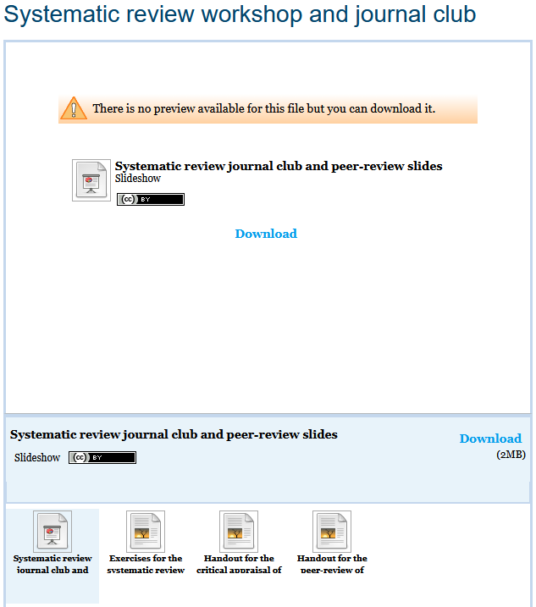
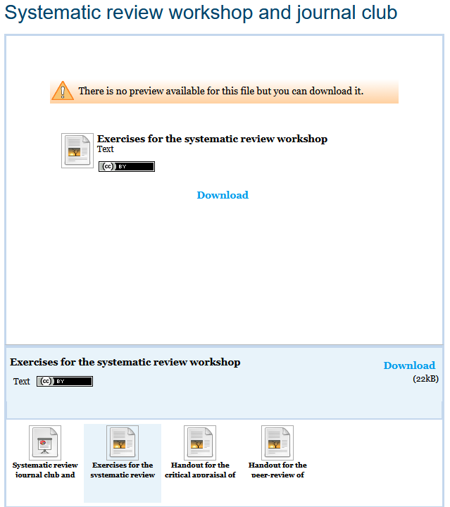
If you haven’t received the course materials via email or from Moodle, please download them from
https://edshare.gla.ac.uk/1048/

Slide 2
DClinPsy systematic review workshop
Paul Cannon
College Librarian Medical, Veterinary & Life Sciences
Tracey McKee
NHS Greater Glasgow & Clyde Library Services
paul.cannon@glasgow.ac.uk
tracey.mckee@ggc.scot.nhs.uk
Photo by rawpixel on Unsplash

Slide 3
Schedule for the day
09.30-11.00 Systematic review searching: Introduction to search concepts and guided walk-through of a PsycINFO search and Medline translation
11.00-11.15 Break
11.15-11.45 Systematic review searching: Self-paced replication of PsycINFO search with ‘drop-in’ Q&A
11.45-12.30 Systematic review searching: Self-paced development of your own search strategies
12.30-13.30 Lunch
13.30-15.00 Systematic review journal club: Introduction to appraising a systematic review, followed by small group discussion of Wallbridge Bourmistrova et al.’s systematic review
15.00-15.10 Break
15.10-15.40 Systematic review peer review session: Small group peer review of your draft search strategies
15.40-16.20 Systematic review escape room
16.20-16.30 Summary of the days learning

Slide 4
Learning outcomes
By the end of the workshop you will:
Be able to structure a search strategy using a question formulation framework
Understand the principles of Boolean logic and search syntax in relation to a systematic review search strategy
Be able to run a search using subject headings and free text terms in the PsycINFO database

Slide 5
Question formulation frameworks
PICO Used for: Evidence-based medicine https://dx.doi.org/10.7326/ACPJC-1995-123-3-A12 | SPICE Used for: Evaluating projects or interventions https://dx.doi.org/10.1108/07378830610692127 | SPIDER Used for: Qualitative or mixed methods https://dx.doi.org/10.1177/1049732312452938 | ECLIPSE Used for: Evaluating services https://dx.doi.org/10.1046/j.1471-1842.2002.00378.x
Population / patient | Setting | Sample | Expectation
Intervention / indicator | Perspective / population | Phenomenon of Interest | Client group
Comparator / control | Intervention | Design | Location
Outcome | Comparison | Evaluation | Impact
 | Evaluation | Research methodology / method | Professionals
 |  |  | SErvice
See Supplementary Material 1 of Booth A, Noyes J, Flemming K, et al. Formulating questions to explore complex interventions within qualitative evidence synthesis. BMJ Global Health 2019;4:e001107: https://dx.doi.org/10.1136/bmjgh-2018-001107 for an exhaustive list of question formulation frameworks.

Slide 6
Illustrating a PICO search strategy
Does physical activity improve mental health outcomes in adolescents?
(child* or adolescen* or youth or “young person*” or school* or teen*)
AND
(“physical activit*” or exercis* or sport* or fitness)
AND
(“mental health” or wellbeing or well being)

Slide 7
Exercise one: Frameworks and strategies
What factors improve or diminish access to, or experience of, psychological services for adults in contact with the criminal justice system?
ECLIPSE framework elements | Elements from the research question
Expectation | -
Client group | Adults [define age range]
Location | Criminal justice system
Impact | [List of factors]
Professionals | -
SErvice | Psychological services
Search strategy
(adult*)
AND
(criminal justice system)
AND
((“mental health” or psycholog*) n2 service*)

Slide 8
Exercise two: Guided search of PsycINFO
From http://www.knowledge.scot.nhs.uk
Click PsycINFO from the Databases menu

Slide 9
Contact details
https://www.gla.ac.uk/myglasgow/library
Paul Cannon
College Librarian Medical, Veterinary & Life Sciences
Tracey McKee
NHS Greater Glasgow & Clyde Library Services
paul.cannon@glasgow.ac.uk
tracey.mckee@ggc.scot.nhs.uk
Photo by rawpixel on Unsplash
This work is licensed under a Creative Commons Attribution 4.0 International License

