Slide 1
DClinPsy
systematic
review journal club and peer-review
Tracey McKee
NHS Greater Glasgow & Clyde Library Services
Paul Cannon
College Librarian Medical, Veterinary & Life Sciences
paul.cannon@glasgow.ac.uk
tracey.mckee@ggc.scot.nhs.uk
Photo by rawpixel on Unsplash

Slide 2
Schedule for the afternoon
13.30-15.00 Systematic review journal club: Introduction to appraising a systematic review, followed by small group discussion of Wallbridge Bourmistrova et al.’s systematic review
15.00-15.10 Break
15.10-15.40 Systematic review peer review session: Small group peer review of your draft search strategies
15.45-16.15 Systematic review escape room
16.20-16.30 Summary of the days learning

Slide 3
Structure of the journal club
Mix of polling, voting, and small group and whole group discussion
Introduction to PRISMA reporting guidelines
Guided appraisal of the reporting of a systematic review
Small group discussion of a systematic review
Whole group feedback
Session review and feedback
Please ask any questions you have as we go along – in person or in the chat

Slide 4
Learning outcomes
By the end of this journal club you will:
Know where to find and how to follow PRISMA reporting guidelines for systematic reviews
Be able to apply your knowledge of reporting guidelines and search strategy formulation to critically appraise a systematic review

Slide 5
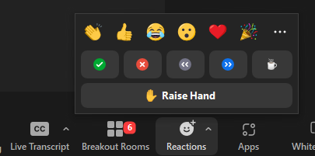
A few quick votes…
Use the green ‘Tick’ and red ‘Cross’ buttons on the Reactions link to vote.

Slide 6
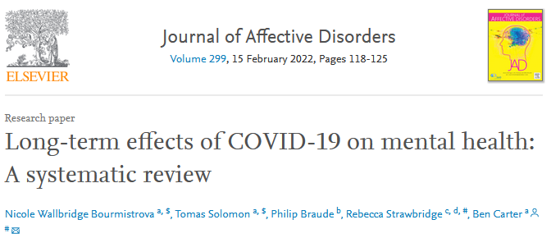
Critical appraisal vote
1. Do you think that this systematic review complies with PRISMA guideline standards?
2. Do you think that this systematic review search is appropriately constructed?

Slide 7
PRISMA reporting guidelines
From: Page MJ, McKenzie JE, Bossuyt PM, Boutron I, Hoffmann TC, Mulrow CD, et al. The PRISMA 2020 statement: an updated guideline for reporting systematic reviews. BMJ 2021;372:n71. doi: 10.1136/bmj.n71
For more information, visit: http://www.prisma-statement.org
Additional items from: Rethlefsen ML, Kirtley S, Waffenschmidt S, Ayala AP, Moher D, Page MJ, Koffel JB; PRISMA-S Group. PRISMA-S: an extension to the PRISMA Statement for Reporting Literature Searches in Systematic Reviews. Syst Rev. 2021 Jan 26;10(1):39. doi: 10.1186/s13643-020-01542-z. PMID: 33499930; PMCID: PMC7839230.

Slide 8
PRISMA reporting guidelines: points 4-6

Slide 9
PRISMA reporting guidelines: points 7 and 16a

Slide 10
PRISMA reporting guidelines: points 23c-25

Slide 11
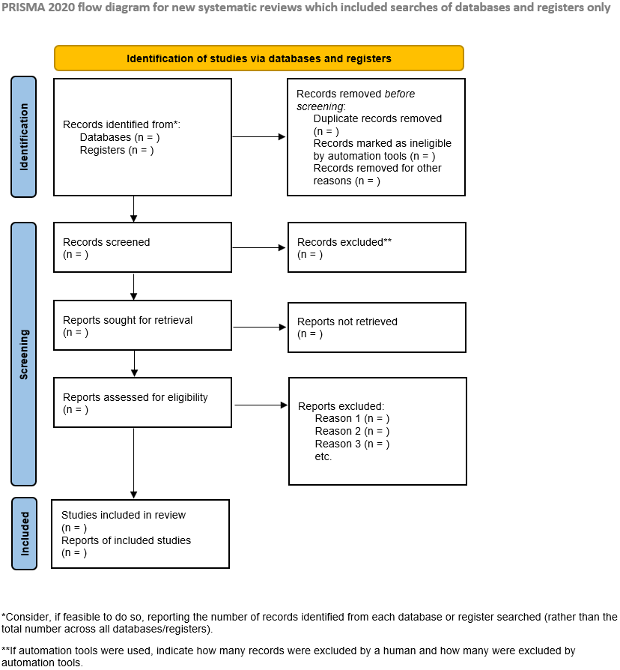
PRISMA flow diagram,
From: Page MJ, McKenzie JE, Bossuyt PM, Boutron I, Hoffmann TC, Mulrow CD, et al. The PRISMA 2020 statement: an updated guideline for reporting systematic reviews. BMJ 2021;372:n71. doi: 10.1136/bmj.n71

Slide 12
PRISMA Explanation and Exploration
Page MJ, Moher D, Bossuyt PM, Boutron I, Hoffmann TC, Mulrow CD, et al. PRISMA 2020 explanation and elaboration: updated guidance and exemplars for reporting systematic reviews. BMJ 2021;372:n160. doi: 10.1136/bmj.n160
“Poor reporting of systematic reviews diminishes their value to clinicians, policy makers, and other users.
“The checklist includes items deemed essential for transparent reporting of a systematic review. In this Explanation and Elaboration document, we explain the meaning and rationale for each checklist item.”

Slide 13
Guided discussion
Nuij, C. et al. (2021). Safety planning-type interventions for suicide prevention: Meta-analysis. The British Journal of Psychiatry, 219(2), 419-426. doi:10.1192/bjp.2021.50
Please refer to the ‘PRISMA – discussion points for journal club’ handout (Word document)

Slide 14
Small group discussion
Nominate a person to feedback to the whole group
Please refer to the ‘PRISMA – discussion points for journal club’ handout (Word document)

Slide 15
Session review and feedback

Slide 16
Critical appraisal vote 2
1. Do you think that this systematic review complies with PRISMA guideline standards?
2. Do you think that this systematic review search is appropriately constructed?

Slide 17
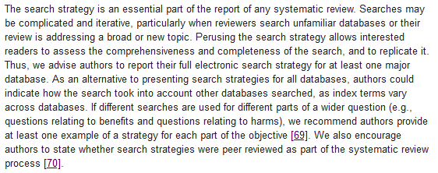
Peer-review of search strategies
Small group discussion of your draft search strategies
Please refer to the ‘Peer review PRESS’ handout (Word document)
Liberati A, Altman DG, Tetzlaff J, Mulrow C, Gøtzsche PC, et al. (2009) The PRISMA Statement for Reporting Systematic Reviews and Meta-Analyses of Studies That Evaluate Health Care Interventions: Explanation and Elaboration. PLOS Medicine 6(7): e1000100. https://doi.org/10.1371/journal.pmed.1000100

Slide 18
Second session review and feedback

Slide 19
Systematic review escape room
https://tinyurl.com/4m8sa2up

Slide 20
Closing slide
https://www.gla.ac.uk/myglasgow/library
Tracey McKee
NHS Greater Glasgow & Clyde Library Services
Paul Cannon
College Librarian Medical, Veterinary & Life Sciences
Photo by rawpixel on Unsplash
This work is licensed under a Creative Commons Attribution 4.0 International License

