Slide 1
Introduction to systematic reviews
Dr Paul Cannon
College Librarian Medical, Veterinary & Life Sciences
paul.cannon@glasgow.ac.uk
Photo by rawpixel on Unsplash
This work is licensed under a Creative Commons Attribution 4.0 International License

Slide 2
Learning outcomes
By the end of the lecture you will:
Know where to find methodological and reporting guides
Be able to define “systematic” in the context of a systematic review search strategy
Understand the principles of Boolean logic, search syntax, and subject headings in relation to a systematic review search

Slide 3
Key methodology documents
Cochrane Handbook for Systematic Reviews of Interventions
https://training.cochrane.org/handbook/current
CRD’s guidance for undertaking reviews in health care
https://www.york.ac.uk/crd/guidance/
JBI Manual for Evidence Synthesis
https://jbi-global-wiki.refined.site/space/MANUAL
Searching for studies: a guide to information retrieval for Campbell systematic reviews
https://doi.org/10.4073/cmg.2016.1

Slide 4
Key reporting documents and registration
PRISMA-P: https://doi.org/10.1186/2046-4053-4-1
PRISMA-P Explanation and Elaboration (E&E): https://doi.org/10.1136/bmj.g7647
PRISMA 2020 Statement: https://doi.org/10.1136/bmj.n160
PRISMA 2020 E&E: https://doi.org/10.1136/bmj.n160
PRISMA-S: https://doi.org/10.1186/s13643-020-01542-z
PRISMA website: https://prisma-statement.org
PROSPERO: https://www.crd.york.ac.uk/PROSPERO/

Slide 5
Any questions?
Feel free to unmute yourself or type into the chat box.

Slide 6
Contextualising “systematic” in a search strategy
The “where”
The “how”
The “…but hold on”
And the “how” again

Slide 7
The “where”

Slide 8
The “how”
Does physical activity improve mental health outcomes in adolescents?
(physical activity or exercise or fitness).tw | 467,927
(physical* adj5 (activ* or condition* or education or therap* or train* or fit*)).tw | 222,934
(exercis* or aerobic or anaerobic or endurance* or kinesiotherapy or resistance* or strength* or stamina or treadmill).tw. | 1,749,750
(ai chi or bad ragaz or baseball or basketball or bicycl* or boxing or chi kung or climbing* or cricket or cycling or football or golf or gym* or halliwick or hockey or jog* or martial or mind body or mountaineering or pilates or qigong or racquet or recreation* or rowing or rugby or run* or skating or skiing or soccer or sport* or squash or swim* or tai chi or tai ji or tennis or track or tiathlon or volleyball or walk* or (water adj1 sport*) or weight lifting or wrestling or yoga).tw | 712,774
[the above combined together with ‘OR’] | 2,457,488

Slide 9
The “…but hold on”
A full systematic review will take 67.3 weeks mean average¹
Does physical activity improve mental health outcomes in adolescents?
Does yoga improve anxiety symptoms in adolescents?
In RCTs, does physical activity improve mental health outcomes in adolescents?
Expect to sift ~1,000 results in 8 hours against your inclusion and exclusion criteria
1. Borah R, Brown AW, Capers PL, et al. Analysis of the time and workers needed to conduct systematic reviews of medical interventions using data from the PROSPERO registry. BMJ Open 2017;7:e012545. doi: 10.1136/bmjopen-2016-012545

Slide 10
An iterative process
Draft a research question
Check for originality
Draft a comprehensive search
Analyse the number of results
Analyse data within results
Not too many, not too few?
Can you synthesise the data?
Draft searches on other databases
Finalise searches
Run searches and record the process

Slide 11
Any questions?
Feel free to unmute yourself or type into the chat box.

Slide 12
And the “how” again
Question formulation frameworks
Boolean logic and search syntax
Subject headings

Slide 13
Question formulation frameworks
PICO Used for: Evidence-based medicine https://dx.doi.org/10.7326/ACPJC-1995-123-3-A12 | SPICE Used for: Evaluating projects or interventions https://dx.doi.org/10.1108/07378830610692127 | SPIDER Used for: Qualitative or mixed methods https://dx.doi.org/10.1177/1049732312452938 | ECLIPSE Used for: Evaluating services https://dx.doi.org/10.1046/j.1471-1842.2002.00378.x
Population / patient | Setting | Sample | Expectation
Intervention / indicator | Perspective / population | Phenomenon of Interest | Client group
Comparator / control | Intervention | Design | Location
Outcome | Comparison | Evaluation | Impact
 | Evaluation | Research methodology / method | Professionals
 |  |  | SErvice
See Supplementary Material 1 of Booth A, Noyes J, Flemming K, et al. Formulating questions to explore complex interventions within qualitative evidence synthesis. BMJ Global Health 2019;4:e001107: https://dx.doi.org/10.1136/bmjgh-2018-001107 for an exhaustive list of question formulation frameworks.

Slide 14
A worked PICO example
Does yoga reduce anxiety symptoms in adolescents?
Framework element | Question element
Population / patient | Adolescents
Intervention / indicator | Yoga
Comparator / control | N/A
Outcome | Reduction in anxiety symptoms

Slide 15
Illustrating a PICO search
Adolescents
Yoga
Anxiety

Slide 16
Any questions before a short break?
Feel free to unmute yourself or type into the chat box.

Slide 17
Don’t reinvent the wheel
Cochrane Library
https://www.cochranelibrary.com/advanced-search
Search for concept of interest > open results > methods > appendix
Epistemonikos
https://www.epistemonikos.org/
Search for concept of interest > filter to systematic reviews (left-hand menu)

Slide 18
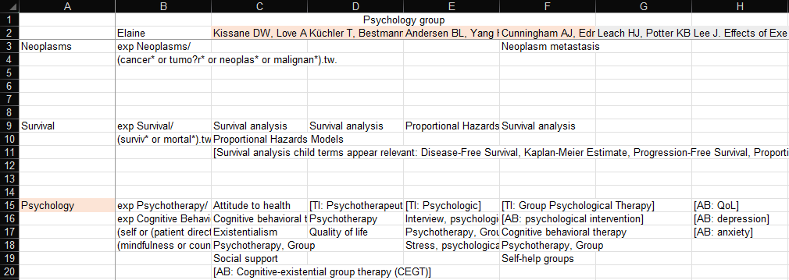
Starting from scratch
PubMed (or another database of choice)
Look for descriptions of concepts in Titles, Abstracts, and MeSH terms (or Subject headings if using another database)

Slide 19
Boolean logic
OR: increases sensitivity
use for different synonyms, spelling variants and acronyms i.e., child or children or adolescent or schoolchild
AND: increases specificity
use to group different concepts that must be mentioned with the search results i.e., adolescent and anxiety and yoga
NOT: exclude unwanted terms
in most circumstances, never use NOT; you may lose important references

Slide 20
Search syntax
Proximity: more sensitive than phrase searching
use to find words near each other i.e., cognitive adj3 therapy
Truncation: different word endings (or sometimes beginnings)
use for singular, plural and adjectives i.e., therap* will retrieve therapy, therapies, therapeutical, and therapeutically
Wildcards: spelling variations
use for British and American spelling amongst other uses i.e., behavio?r will retrieve behavior and behaviour

Slide 21
Any questions?
Feel free to unmute yourself or type into the chat box.

Slide 22
Photo by Valdemaras D. on Unsplash
Bos primigenius taurus

Slide 23
Subject headings
Treatment
Cognitive behavior therapy
Acceptance and commitment therapy
Cognitive processing therapy
Prolonged exposure therapy
PsycINFO
Behavior treatment
Cognitive behavioral therapy
Acceptance and commitment therapy
Cognitive restructuring
Mindfulness
Medline
Cognitive therapy
Cognitive behavioral therapy
Cognitive behavioral stress management
Cognitive processing therapy
Cognitive restructuring
Dialectical behavior therapy
Mindfulness-based stress reduction
Embase

Slide 24
Any questions?
Feel free to unmute yourself or type into the chat box.

Slide 25
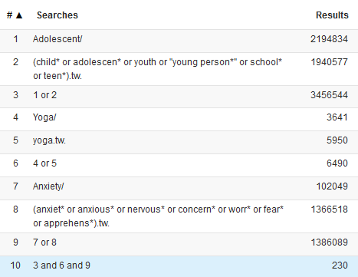
What might a(n abridged) search look like?

Slide 26
Self-help resources
Systematic review resources: https://edshare.gla.ac.uk/451/
Systematic review skills development for Doctorate in Clinical Psychology trainees: https://edshare.gla.ac.uk/1578/
Video guides to searching library databases: https://edshare.gla.ac.uk/278
Cochrane Interactive Learning: https://eleanor.lib.gla.ac.uk/search~S6?/yDatabases%20C/ydatabases+c/1%2C1%2C63%2CB/eresource&FF=ydatabases+c&42%2C%2C63
Book an appointment to see me: https://bit.ly/2O3fLZs
Contact me at paul.cannon@glasgow.ac.uk
Previous class recording available at: https://edshare.gla.ac.uk/135
Inter-library loans: https://www.gla.ac.uk/myglasgow/library/interlibraryloans/

