Slide 1

Google search tips and Google Scholar settings for UofG staff and students
Lynn Allardyce Irvine, College Librarian

Slide 2

Searching Google, and using Google Scholar
the Google index and how Google searching works
Using search operators for more focused searching – from the basic search screen and the advanced search screen
Site searches for targeted searches to find government, charities, organization or academic documents
File type searches to find policies, reports, journal articles, statistics and data
Filtering Google search results
Google Scholar settings – linking to full text
Citation settings for EndNote Desktop and EndNote online users
Saving items for export from Google Scholar to EndNote
The Google Scholar button
Photo by Kai Wenzel on Unsplash

Slide 3

How Google searching works
The Google index is created by crawlers, software that visits webpages and gathers information (keywords, images, videos, audio files etc.) Google indexes this content including information about the webpage e.g., language, location, type of information as well as the keywords that make up the page. When you search, your query is matched against the index
When Google returns search results, these are ranked, and the ranking is based on several things –
  The words in your search query – Google corrects spellings and uses synonyms for your term to establish the meaning of your search
  Relevance – returns sites with words in your query. Sites with words in the title or in headings are considered more relevant
  Google considers pages that are linked from prominent websites to have more authority and trustworthiness, so these are also ranked more highly in results
  Google also uses your previous search history, your country and location to deliver results (perhaps) more relevant to your search
To control your search results, you can use a few useful advanced search features – the next few slides highlight the most useful and how to use them
Photo by Brett Jordan on Unsplash

Slide 4
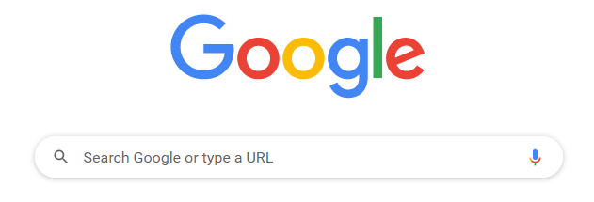
Google – using search operators (from the default search screen)
The default is the basic search screen – a single search box where you can use natural language searching
However, with just a few search operators you can use Google much more efficiently, and get to the information you need more quickly
Google uses Boolean and other search operators you may be familiar with – AND, OR, NOT and phrase searching
If you enter a few search terms, Google will assume all the words must appear in the results. This is like using AND between your search terms
To search for alternative terms, you can use OR between terms e.g.; youth OR teenagers OR “young people” OR “young persons” OR adolescents
Use quotation marks for phrases, e.g., “young persons”
Use a minus sign before words you want to exclude from a search e.g., fiction OR novels –”science fiction”

Slide 5
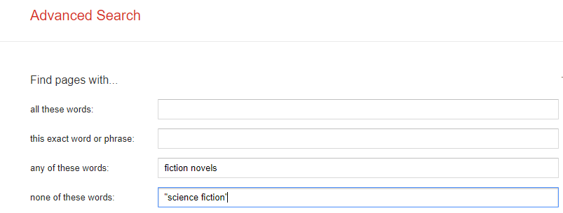
Google – using search operators (from the advanced search screen)
If you are using the advanced search screen, simply put your search terms into the appropriate boxes and Google will apply the search operators
e.g., this search is rendered as fiction OR novels -"science -fiction"
The boxes are equal to the following search operators:
‘all these words’ = AND
‘this exact word or phrase’ = “….”
‘any of these words’ = OR
‘none of these words’ = NOT
There is also an option on the advanced search screen to match words in specific parts of a webpage, e.g., in the title, in the URL etc. This can be another useful way to focus your search

Slide 6
Google – using advanced search options from the basic search screen – site searches
There are useful search features you can use on the basic search screen to help you find presentations, reports, statistics or information from specific sectors of society or specific organisations.
Site search
Use this to find information from a specific sector of society or specific organisations. You might be interested in government policies on social mobility for example. You can limit your search to UK government or Scottish government web sites. To do this, use these searches and your search results will be limited to only content from these pages:
“social mobility” site:gov.scot
“social mobility” site:gov.uk
You may want to see content from charity bodies. In that case, you could do a search using the org.uk domain or use the domain of a specific charity (Joseph Rowntree Foundation for example):
“social mobility” site:org.uk
“social mobility” site:jrf.org.uk
All you need to know is the domain name of the organisation you want to search, or the domain for the sector you are interested in. See the next slide for a list of useful domain names to use in a site search on Google

Slide 7
Google – useful domains for site searches
.org
can also add .uk if limiting to UK organisations
Can be useful for organisations, like charities or think tanks. This is helpful if you want to find policies.
.gov.uk
Can also use .gov.scot etc.
Use government domains to limit searches to government websites or documents. Use the appropriate domain for the country/government you are interested in
.ac.uk
For academic websites in the UK
Use when you want to search for information on UK academic websites. Use the appropriate domain for the country you are interested in e.g., .edu for US academic websites or .edu.au for Australian academic websites etc.
Specific domains
Use to search for content from specific organisations
e.g., site:suttontrust.com or site:jrf.org.uk

Slide 8
Google – file type search
For reports and policy documents, it can be helpful to use a filetype search for PDFs. For example, I want to find documents on social mobility:
"social mobility" filetype:pdf
Results might include government reports, policies, charity reports, journal articles and reports from the OECD or other international organisations.
Presentations can sometimes be useful if you are researching a recent event, like new legislation or new research. It is also useful to find open access teaching material (like lectures or seminars) from academic institutions.
“social mobility” filetype:ppt
Searching for Excel files is also a good way to find statistical data, including open access research data.
“social mobility” filetype:xls
N.B. You can combine filetype and site searches to be even more focused with your search. e.g., "social mobility" site:org "social mobility" filetype:PDF
Another useful search is a file type search. Use this if you want to find particular types of information, like reports, policy documents, presentations or statistics.

Slide 9
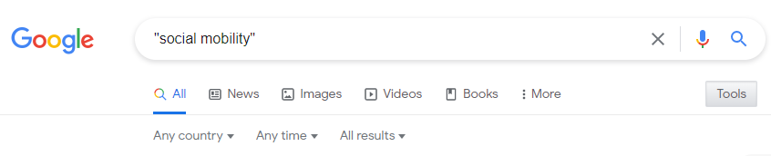
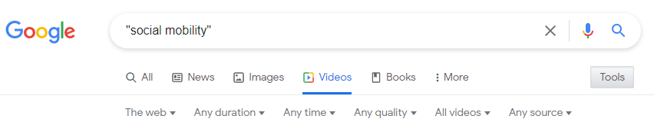
Google – filtering results
There are also some useful features to filter search results. When you run a search, choose the Tools button. This gives options to filter results by certain criteria. These criteria depend on whether you are looking across the whole index, or just for news, images, videos, books etc.
The screenshots on the right show refinements for searches across the whole index, and searches for videos.
When searching across all information types, you can refine your results:
By country – choose ‘Any’ or UK, You can also filter by a different country
By time, past hour/24 hours/week/month/year/custom range
By results – there is a ‘verbatim’’ option which means that the search results must match your search exactly.

Slide 10
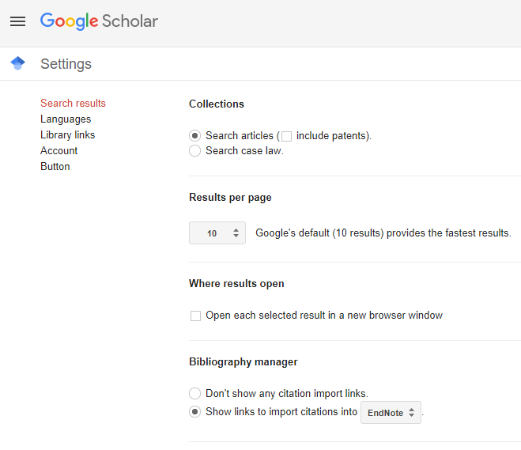
Google Scholar settings – including full-text links for journal articles
Go to Google Scholar https://scholar.google.com/
Click on the hamburger menu (three lines on the left of the Google Scholar logo) and choose Settings (or the cogwheel icon)
Choose Library Links from the options

Slide 11
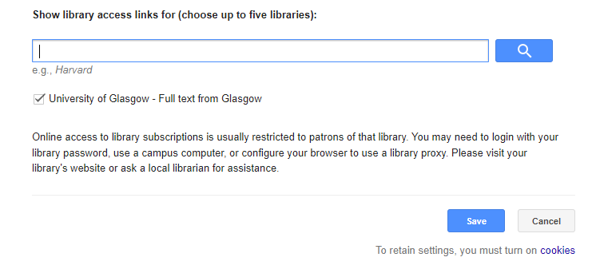
Set up links for libraries you have access rights to
Enter University of Glasgow in the search box
Choose University of Glasgow – Full text from Glasgow
Press Save
Results will now show a link to any journal articles that you can access as a registered student or member of staff at UofG
If you have access rights at another library, you can include it in your settings. You can include up to 5 libraries

Slide 12
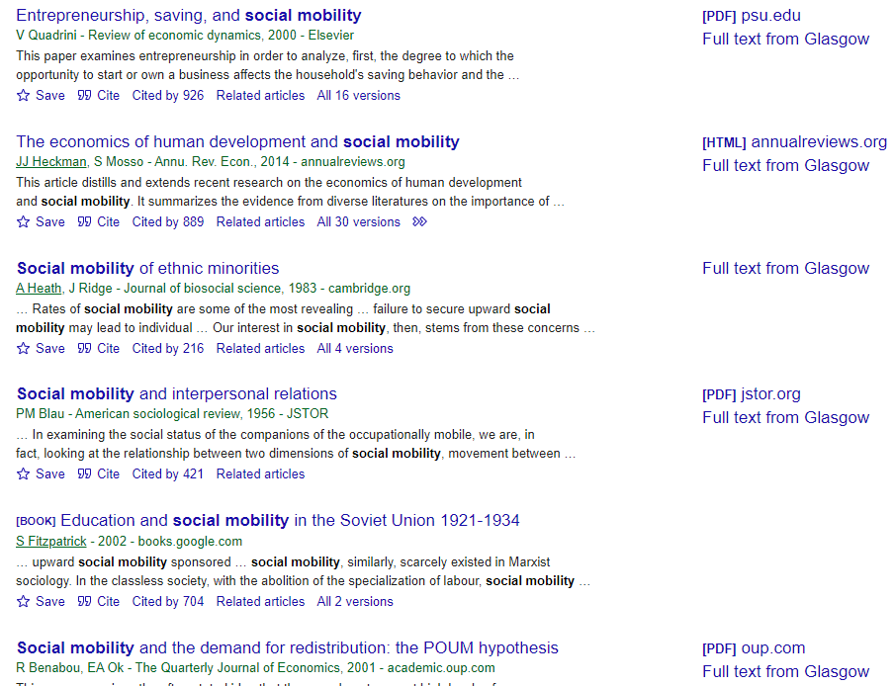
Google Scholar – results showing full text links

Slide 13
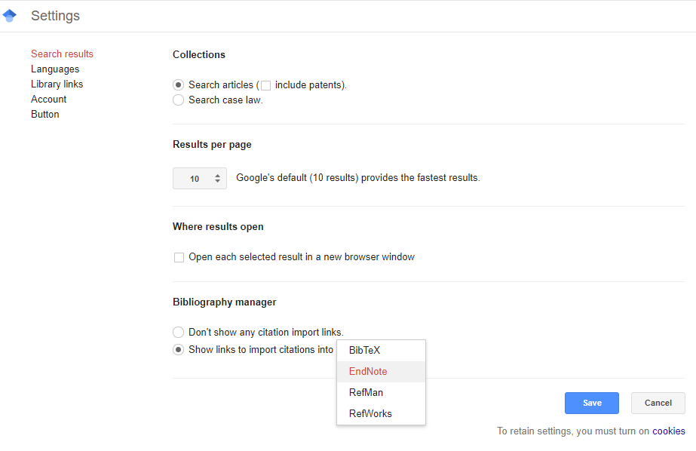
Importing references from Google Scholar
You can also set up Google Scholar to show citation import links, so that you can export references into reference management software.
From the Settings menu, choose an option from the Bibliography manager to Show links to import citations into…
For EndNote Desktop users, choose EndNote and results will show a link to ‘Import into EndNote’
For EndNote online users, choose RefMan and results will show ‘Import into RefMan’

Slide 14
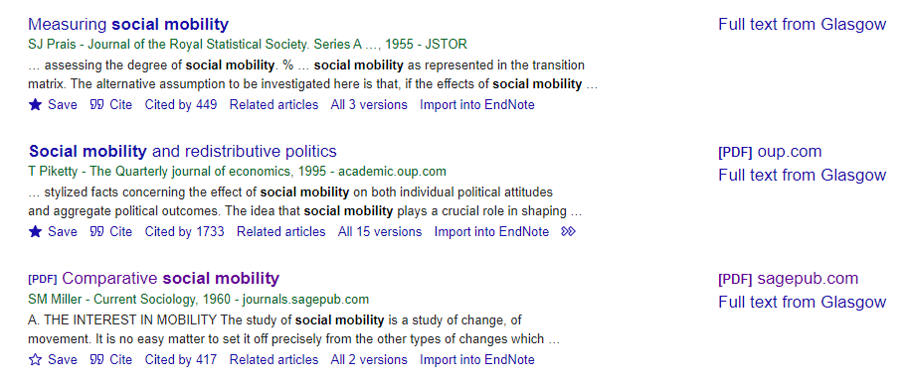
Google Scholar – results showing citation import links

Slide 15
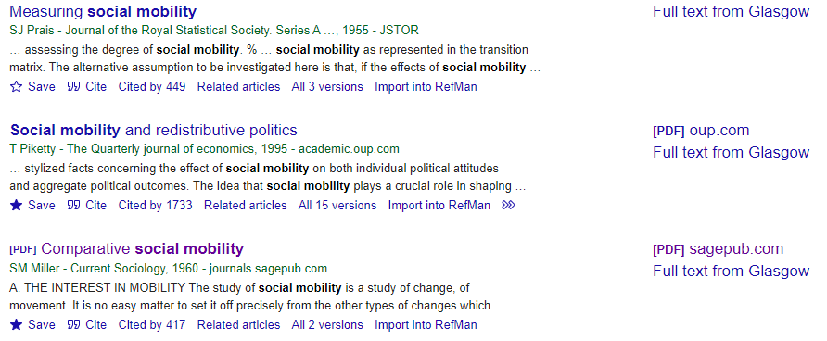
selecting multiple references from Google Scholar to export
If you have a Google account, you can import up to 20 references at once. The default number of results shown is 10. You can change that to 20 in the Settings menu.
When you run a search, you can select items that you want to save to your Google ‘My library’ by clicking on the star icon or Save link under each result
Click on My library at the top left of the screen to see your saved results

Slide 16
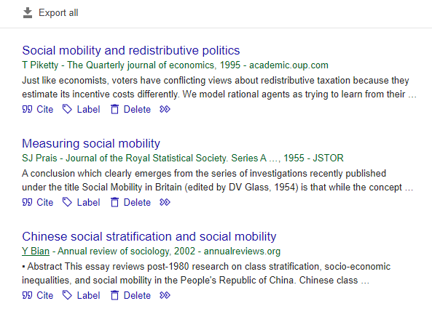
Importing multiple references from Google Scholar to EndNote
From within your library, you can see all the articles you have saved
You can label them to organise them in groups. This will allow you to export only those articles you want to your EndNote account
Select the group(label) that you want to export
Choose the Export all option at the top of the screen and the file format you want to export the articles in.
EndNote desktop users, choose EndNote.
EndNote online users, choose RefMan

Slide 17
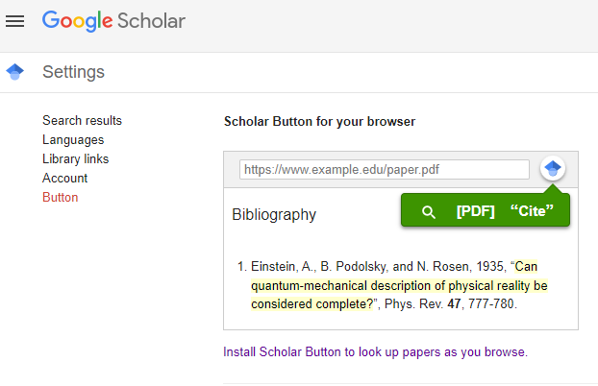
Google Scholar Button
You may want to install the Google Scholar Button on your browser. This lets you search for publications from bibliographies, reference lists or web pages as you browse

Slide 18



This presentation is created by Lynn Allardyce Irvine under licence -
CC BY-NC-SA 4.0 Attribution-NonCommercial-ShareAlike 4.0 International
#UofGWorldChangers
@UofGlasgow

