Slide 1
Generative AI: a problematic illustration of the intersections of racialized gender, race and ethnicity
Workshop design: Nayiri Keshishi (University of Surrey)
Workshop content: repurposed, with full author permission, from this blog by Dustin Hosseini (University of Glasgow)
Notes:
https://www.dustinhosseini.com/blog/2023/08/08/generative-ai-a-problematic-illustration-of-the-intersections-of-racialized-gender-race-ethnicity
We highly recommend you read the blog before delivering this workshop. We also recommend you share it with students to read before their participation e.g. as part of the ‘pre-workshop’ materials.

Slide 2
Workshop feedback & licensing
This work is licensed under the Creative Commons Attribution-NonCommercial 4.0 International License.
To view a copy of this license, visit http://creativecommons.org/licenses/by-nc/4.0/ or send a letter to Creative Commons, PO Box 1866, Mountain View, CA 94042, USA.
We’d like to gather your views on this workshop, via this online survey, from both student participants and educators.
This should take no longer than 5-10 minutes to complete. You can scan the QR code or use the link below. This survey has received full ethical clearance from the University of Surrey.
Thank you for taking the time to participate in this research!
https://forms.gle/9wbx1ye1P3deLRrB7

Slide 3
Learning outcomes
Recognise and understand biases in generative AI, particularly regarding race and gender.
Develop critical and analytical thinking to make ethical choices and address biases in practical AI applications.
Communicate the ethical complexities of AI's impact on race and gender, promoting awareness towards ethical considerations and solutions.

Slide 4
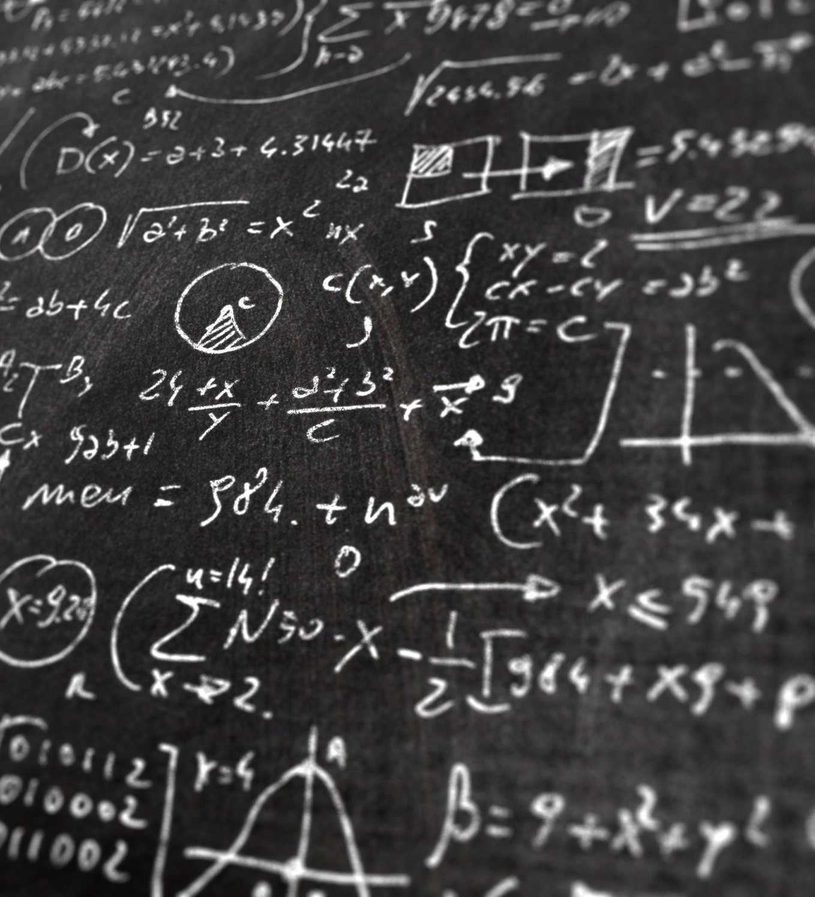
Intro
Machine learning allows AI to become more intelligent by drawing on datasets 🡪 develop expertise over time
Rely on raw data created by humans 🡪 reflect biases e.g. racial, economic of those who have gathered the evidence (Benjamin, 2019)
Research is looking into the reasons that enable AI to skew results and create representations that overlook and erase others, whilst focusing on specific, dominant groups (Noble, 2018; Benjamin, 2019; Mohamed et al., 2020; Zembylas, 2023)
The way human-created algorithms inform AI to portray racialized, gendered people is especially problematic.
To understand this, it is worth looking at the ideas of intersectionality (Crenshaw, 1991; hooks, 2015; Hill Collins, 2019).
Notes:
Benjamin, R. (2019). Race After Technology: Abolitionist Tools for the New Jim Code. Polity Press.
Crenshaw, K. (1991). Mapping the Margins: Intersectionality, Identity Politics, and Violence against Women of Color. Stanford Law Review, 43, No. 6, 1241-1299. https://doi.org/10.2307/1229039
Hill Collins, P. (2019). Intersectionality as Critical Social Theory. Duke University Press.
hooks, b. (2015). Ain’t I a Woman: Black Women and Feminism. Routledge.
Noble, S. U. (2018). Algorithms of Oppression: How Search Engines Reinforce Racism. New York University Press.
Mohamed, S., Png, M.-T., & Isaac, W. (2020). Decolonial AI: Decolonial Theory as Sociotechnical Foresight in Artificial Intelligence. Philosophy & Technology, 33(4), 659-684. https://doi.org/10.1007/s13347-020-00405-8
Zembylas, M. (2023). A decolonial approach to AI in higher education teaching and learning: strategies for undoing the ethics of digital neocolonialism. Learning, Media and Technology, 48(1), 25-37. https://doi.org/10.1080/17439884.2021.2010094

Slide 5
What is intersectionality?
The concept of intersectionality describes the ways in which systems of inequality based on gender, race, ethnicity, sexual orientation, gender identity, disability, class and other forms of discrimination “intersect” to create unique dynamics and effects (Center for Intersectional Justice, 2023)
Will use this concept to analyze AI-generated avatars, looking at how they represent socially constructed identities in terms of racialized gender, race, ethnicity and nationality.
What is represented and why the representations might appear this way?
Notes:
Center for Intersectional Justice (2023) What is Intersectionality. Available at https://www.intersectionaljustice.org/what-is-intersectionality (Accessed: 28 Sept 2023).

Slide 6
Common generative AI tools
For now, three or four major types:
text to text (e.g. ChatGPT, Google Bard)
text to image (e.g. DALL-E)
text to media, such as audio or video
text-to-code, for coding and programming purposes
Notes:
Explain that this session will focus on text-to-image generative AI through example prompts that were created

Slide 7
To note…
We will use definitions of race and ethnicity offered by Fitzgerald (2020, p. 12)
Race = ‘group of people that share some socially defined characteristics, for instance, skin colour, hair texture, or facial features’
Ethnicity = the ‘culture, nationality, ancestry and/or language’ shared by a group of people irrespective of their physical appearance
Notes:
Fitzgerald, K. J. (2020). Recognizing Race and Ethnicity: Power, Privilege and Inequality (Third ed.). Routledge.

Slide 8
Another definition of race informed by decolonial thinking:
‘A dividing line that cuts across multiple power relations such as class, sexual and gender at a global scale (Grosfoguel, 2016, p. 11)
The above implies race and subsequent racism are institutional and structural in nature 🡪 the concept of race creates hierarchies of power and domination which are compounded by gender, sex, class and other factors.
While the concepts of race and ethnicity are social constructs and neither are mutually exclusive, we will use these definitions to frame our analysis.
NB: You may find the results upsetting and potentially angering.
Notes:
Highlight that the images may be upsetting and potentially angering
Grosfoguel, R. (2016). What is Racism. Journal of World-Systems Research, 22(1), 9-15. https://doi.org/10.5195/jwsr.2016.609

Slide 9
Sweet old grannies making pancakes – why?
Wide discussions on the issues of generative AI and how to prepare students and educators
I like pancakes!
Grandmothers play a significant role in several cultures
E.g. in Russia, they are a major cultural symbol and source of unpaid family work (Utrata, 2008) and symbol of stoicism that represents an intersection of age, gender and class (Shadrina, 2022).
Notes:
This slide can be edited, especially the ‘I like pancakes!’ point, to personalise the session and make more relevant to deliverer.
Shadrina, A. (2022). Enacting the babushka: older Russian women ‘doing’ age, gender and class by accepting the role of a stoic carer. Ageing and Society, 1-18. https://doi.org/10.1017/s0144686x2200037x
Utrata, J. (2008). Babushki as Surrogate Wives: How Single Mothers and Grandmothers Negotiate the Division of Labor in Russia. UC Berkeley: Berkeley Program in Soviet and Post-Soviet Studies. https://escholarship.org/uc/item/3b18d2p8

Slide 10
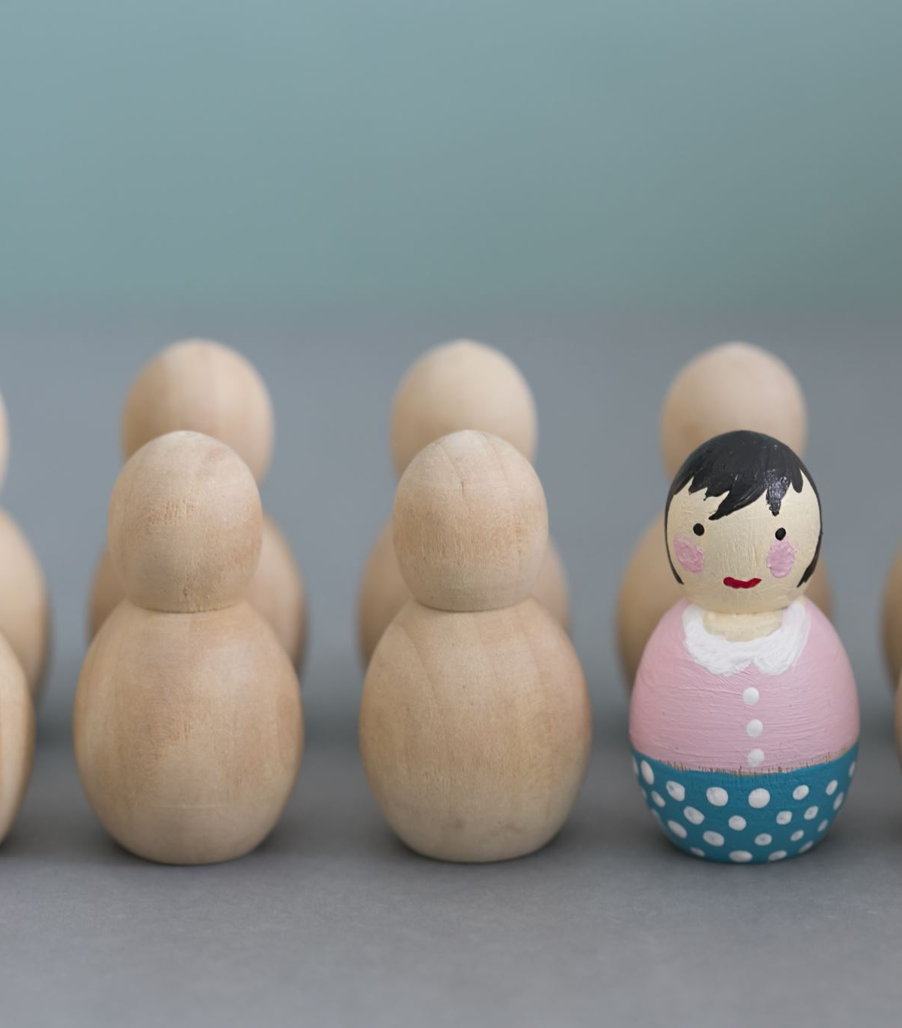
Acknowledgments
Using gendered, ageist and even stereotypical language, especially in terms of describing 'a sweet, old X grandmother’.
Focused on a particular type of social/familial role
Not all old(er) women are grandmothers and not all grandmothers are old
Adjectives used to describe 'opinion, size, age, shape, colour, origin, material, purpose' often translate to gender, race, racism and racialization, and the humanity of individuals and groups of individuals (Benjamin, 2019, p.102; Dowling, 2016; Wynter, 2003).
Notes:
These are important acknowledgments to highlight before sharing the prompts/ images
Being aware of language used can help to become more critically conscious of concepts and effects of using specific language
Benjamin, R. (2019). Race After Technology: Abolitionist Tools for the New Jim Code. Polity Press.
Dowling, T. (2016, Tuesday, 13 September). Order force: the old grammar rule we all obey without realising – The Guardian. Retrieved 2023-07-24 from https://www.theguardian.com/commentisfree/2016/sep/13/sentence-order-adjectives-rule-elements-of-eloquence-dictionary
Wynter, S. (2003). Unsettling the Coloniality of Being/Power/Truth/Freedom: Towards the Human, After Man, Its Overrepresentation—An Argument. CR: The New Centennial Review, 3(3), 257-337. https://doi.org/10.2307/41949874

Slide 11
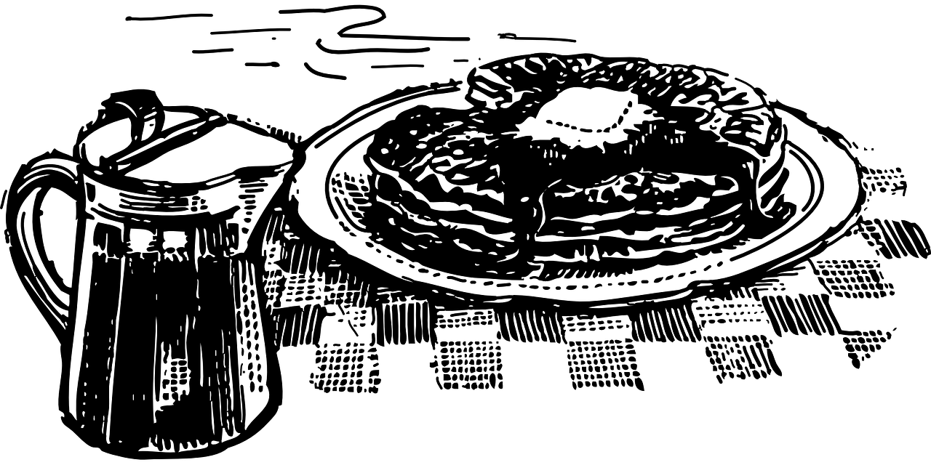
Initial prompts
"Create an image of a sweet, old Polish grandmother making pancakes"
"Create an image of a sweet, old Russian grandmother making pancakes"
"Create an image of a sweet, old American grandmother making pancakes"
"Create an image of a sweet, old Black American grandmother making pancakes"
Notes:
Explain that these were the prompts used on DALL-E to create four (4) individual representations of each character or avatar. In total, there are 16 images which you will see (caveat = generative AI does not currently do well with the finer details of humans such as facial expressions, eyes, and hands. While we won't focus on hands and eyes specifically, facial expressions and ethnicity will be important later).
Highlight that only the adjectival qualifier describing the national origin of the imaginary character or avatar was changed: "Create an image of a sweet, old X grandmother making pancakes". These prompts were explored over a period of two weeks in July 2023.
It is worth noting that, at the time you deliver this session, the results may be different and the session should be adjusted accordingly.
It might be worth asking students if they spot anything odd from the prompts (hint: the last two prompts are problematic for a different reason, that two prompts were required to generate avatars of different/diverse phenotypes)

Slide 12
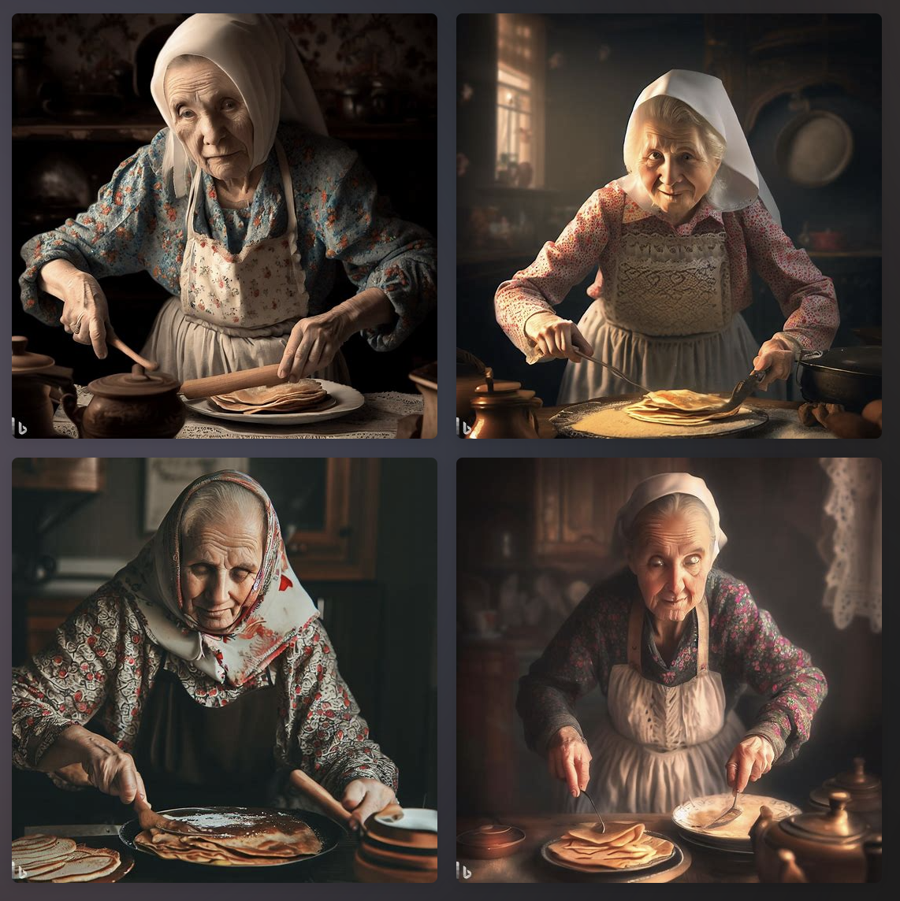
Representations of Polish grandmothers

Slide 13
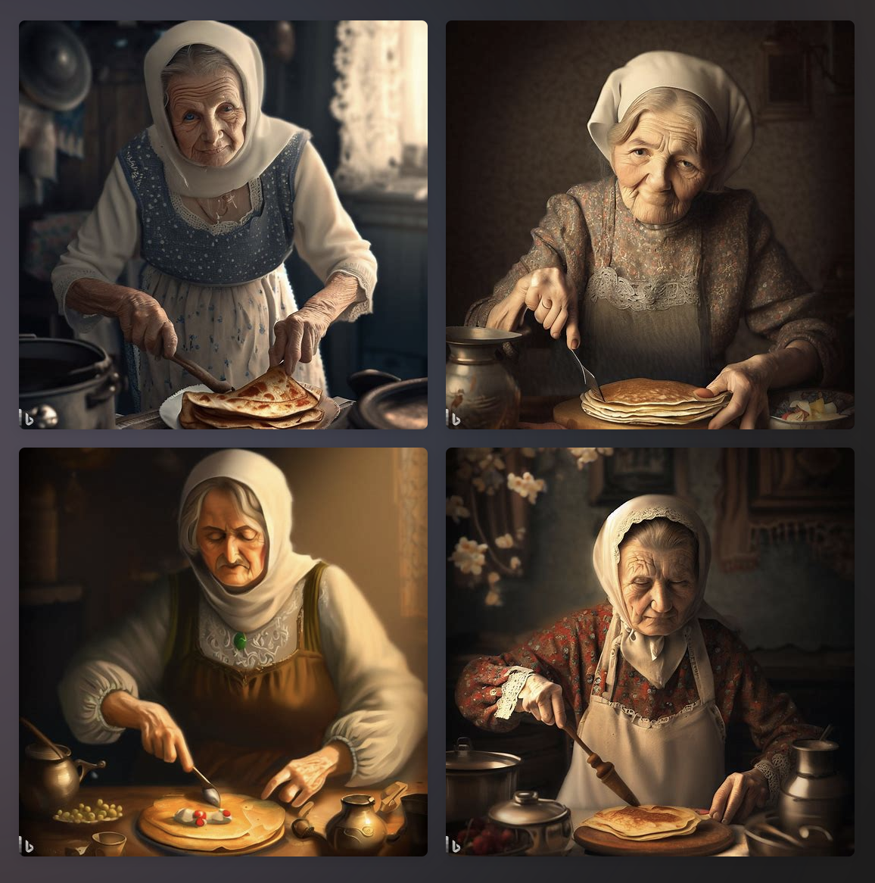
Representations of Russian grandmothers

Slide 14
Representations of American grandmothers
Notes:
Important to acknowledge that using ‘American’ can be problematic. It can refer to people of the United States or, if you live in Latin America, American can refer to anyone from the Americas, not just people who live in the United States of America.

Slide 15
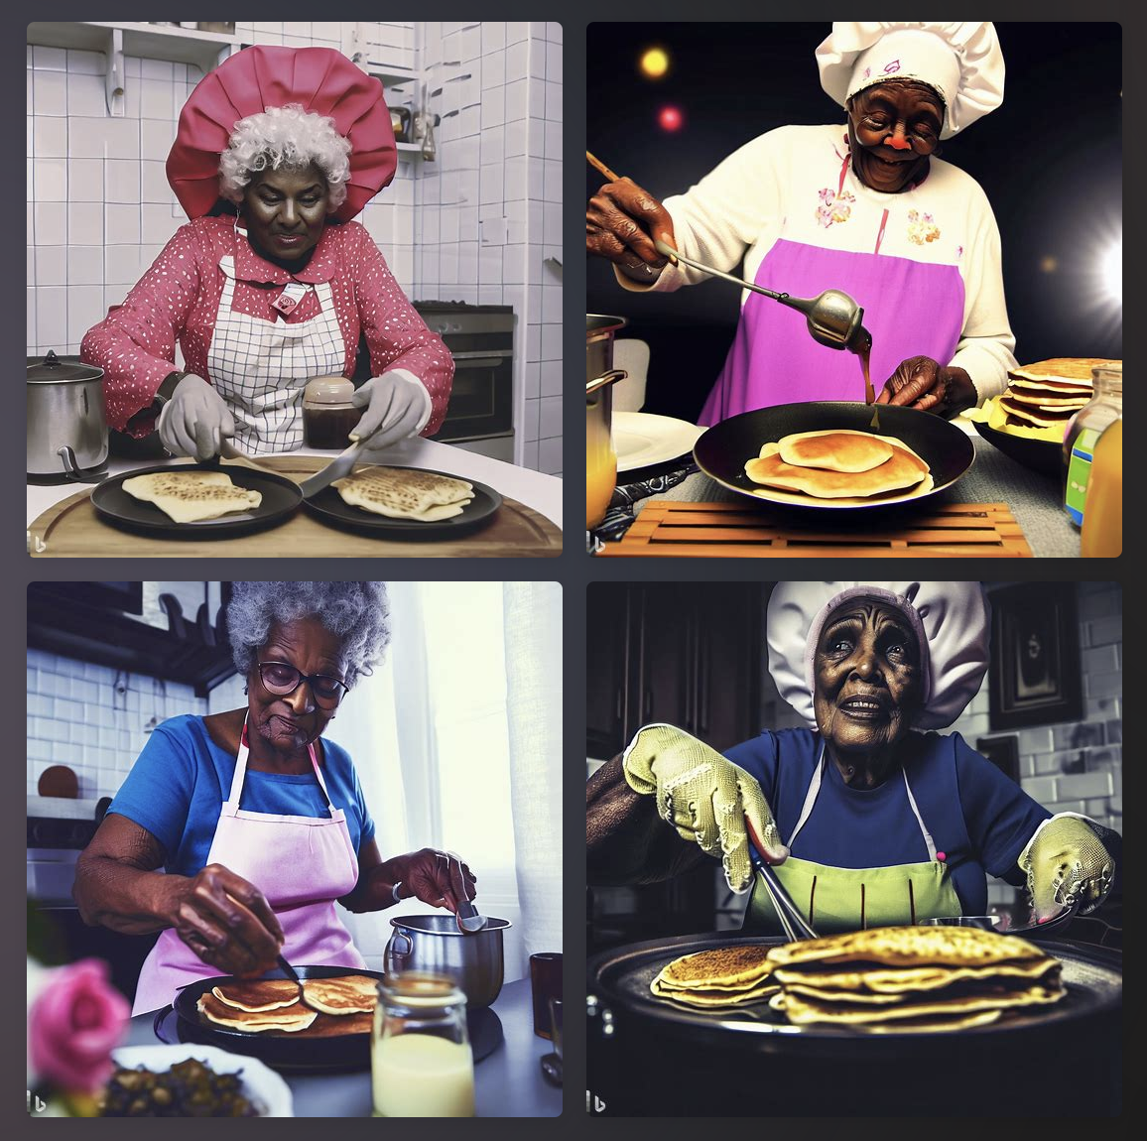
Representations of grandmothers from the US racialized as Black

Slide 16
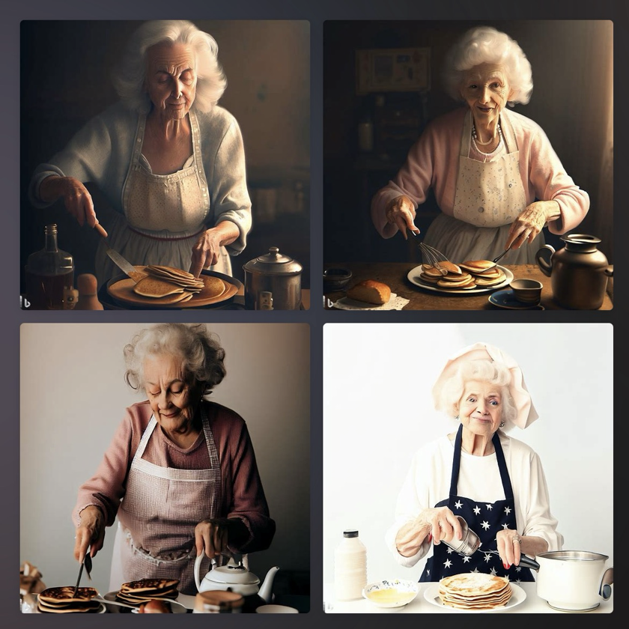
Representations of Polish grandmothers
Representations of Russian grandmothers
Representations of American grandmothers
Representations of grandmothers from the US racialized as Black
Notes:
Summary of all the images. You may wish to print and circulate and/or share this digitally with students as they participate in the upcoming activity.

Slide 17
Description
What?
When?
Who?
Where?
Describes/outlines/summarises/defines a theory, a viewpoint or a situation
Provides context (background) to a subject
= Tells or restates
Analysis & Evaluation
Why?
How?
So what?
What next?
Compares/explores/assesses strengths and weaknesses (to understand complexity and depth)
Provides reasons and draws informed conclusions
= Comments, makes links and shows implications
How do you know?
Scholarly support
Notes:
Use this visual to explain the main elements of critical analysis. Emphasize that this type of analysis can be done with any material, including written sources.
This slide is from the session by Alicja Syska, Using visual sources to develop analytical thinking: a 3-stage method with an image (https://aldinhe.ac.uk/product/learnhigher-resources/excelling-at-critical-analysis-a-3-stage-method-with-an-image/#:~:text=The%203%2Dstage%20method%20breaks,about%20paying%20attention%20to%20detail.)

Slide 18
 | Atmosphere, decor, clothing |  |  | Expressions and ethnicity
 | Description | Analysis (what might it mean?) | Evaluation (what do you know?) | Description | Analysis (what might it mean?) | Evaluation (what do you know?)
Representations of Polish and Russian grandmothers
Representations of grandmothers from the US
Representations of grandmothers from the US racialized as Black
Notes:
Invite students to use this worksheet to critically analyse the images. They should focus on atmosphere, décor, clothing and expressions and ethnicity. The worksheet with suggested answers can be used for class discussion and shared with students after the session.

Slide 19
Questions
Why do the avatars represent these groups in the way that they do?
What informs how the avatars construct the representations?
What, if anything, do the representations get right?
What, if anything, do the illustrations get wrong?
How are the representations problematic?
Where representations are problematic...
What message does this send to someone without knowledge of the context?
What message does this create about the people/cultures/objects portrayed in the images?
What can you do to ensure generative AI creates, if it is possible, more accurate and equitable representations of peoples/cultures/objects?
Notes:
These questions can be used, alongside the worksheet, to discuss/ critically analyse the images.

Slide 20
Discussion
Each image represents ‘deeply ingrained cultural prejudices’ and ‘biases’ (Benjamin, 2019, p.59) drawn from data that the generative AI tools use to create representations
‘Algorithmic coloniality’? (Mohamed et al., 2020; Zembylas, 2023).
Coloniality = state of knowing and being that encompasses knowledge and power relations that sees those formerly colonized and/or enslaved as encountering inherent disadvantages whilst former colonizers keep many advantages (Quijano and Ennis, 2000; Wynter, 2003; Ndlovu-Gatsheni, 2015).
In simple terms 🡪 accepted knowledges and ways of being represent those of the dominant members of society
Notes:
Use these as discussion points/ start to summarise the session

Slide 21
Discussion ctd…
Those who follow the dominant modes of cultural, and technological production, take part in the creation and preservation of algorithms which overvalue some humans (those racialized as White) whilst undervaluing the humanity of other humans (those racialized as Black, Asian and others).
Considering the daily injustices that people racialized as Black, Asian and others experience, it is problematic that human-authored algorithms reflect dominant systems of knowing and being
Influence the datasets that inform algorithms 🡪 allow for some change? Not easy…
Collaboration and awareness of everyone on the issues will be key
Might include understanding and identifying such sites (where and how algorithms are made/ function), who is involved in beta-testing and testing generally, and what local/ national policies can be developed. Also includes developing algorithmic literacy as part of digital literacy initiatives (Zembylas, 2023; Mohamed et al., 2020, p. 8).
Notes:
Use these as discussion points/ start to summarise the session

Slide 22
Conclusion
We must experiment with generative AI tools to understand and critique the tools and what they produce
Begin to understand how and why such tools create the content that they do
No concrete solution 🡪 collective and concentrated effort that includes a range of groups focused on creating a more equitable and inclusive world
Decolonial thinking can offer some thoughts to counter the coloniality of AI

Slide 23
References
Benjamin, R. (2019). Race After Technology: Abolitionist Tools for the New Jim Code. Polity Press.
Bowdre, K. M. (2006). Racial mythologies: African American female images and *representation from minstrelsy to the studio era. [Doctoral dissertation/thesis, University of Southern California].
Center for Intersectional Justice (2023) What is Intersectionality. Available at https://www.intersectionaljustice.org/what-is-intersectionality (Accessed: 28 Sept 2023).
Crenshaw, K. (1991). Mapping the Margins: Intersectionality, Identity Politics, and Violence against Women of Color. Stanford Law Review, 43, No. 6, 1241-1299. https://doi.org/10.2307/1229039
Dowling, T. (2016) Order force: the old grammar rule we all obey without realising. Available at: https://www.theguardian.com/commentisfree/2016/sep/13/sentence-order-adjectives-rule-elements-of-eloquence-dictionary (Accessed: 24 July 2023).
Downing, C. (2007). “Interlocking oppressions of sisterhood: (re) presenting the black woman in nineteenth century blackface minstrelsy”. Senior Scholar Papers, Paper 539. https://digitalcommons.colby.edu/seniorscholars/539
Fitzgerald, K. J. (2020). Recognizing Race and Ethnicity: Power, Privilege and Inequality (Third ed.). Routledge.
Grosfoguel, R. (2016). What is Racism. Journal of World-Systems Research, 22(1), 9-15. https://doi.org/10.5195/jwsr.2016.609
Hill Collins, P. (2019). Intersectionality as Critical Social Theory. Duke University Press.
hooks, b.. (2015). Ain’t I a Woman: Black Women and Feminism. Routledge.
Hosseini, D. (2023). ‘Generative AI: a problematic illustration of the intersections of racialized gender, race, ethnicity’. Dustin Hosseini blog, 8 August. https://www.dustinhosseini.com/blog/2023/08/08/generative-ai-a-problematic-illustration-of-the-intersections-of-racialized-gender-race-ethnicity
King, J. E. (2019). Staying Human: Forty Years of Black Studies Practical-Critical Activity in the Spirit of (Aunt) Jemima. International Journal of African Renaissance Studies - Multi-, Inter- and Transdisciplinarity, 14(2), 9-31. https://doi.org/10.1080/18186874.2019.1690399
Mohamed, S., Png, M.-T., & Isaac, W. (2020). Decolonial AI: Decolonial Theory as Sociotechnical Foresight in Artificial Intelligence. Philosophy & Technology, 33(4), 659-684. https://doi.org/10.1007/s13347-020-00405-8
Ndlovu-Gatsheni, S. J. (2015). Decoloniality as the Future of Africa. History Compass, 13(10), 485-496. https://doi.org/10.1111/hic3.12264
Noble, S. U. (2018). Algorithms of Oppression: How Search Engines Reinforce Racism. New York University Press.
Quijano, A., & Ennis, M. (2000). Coloniality of Power, Eurocentrism, and Latin America. Nepantla: Views from South, 1(3), 533-580.
Shadrina, A. (2022). Enacting the babushka: older Russian women ‘doing’ age, gender and class by accepting the role of a stoic carer. Ageing and Society, 1-18. https://doi.org/10.1017/s0144686x2200037x
Thompson Moore, K. (2021). The Wench: Black Women in the Antebellum Minstrel Show and Popular Culture. The Journal of American Culture, 44(4), 318-335. https://doi.org/10.1111/jacc.13299
Utrata, J. (2008). Babushki as Surrogate Wives: How Single Mothers and Grandmothers Negotiate the Division of Labor in Russia. UC Berkeley: Berkeley Program in Soviet and Post-Soviet Studies. https://escholarship.org/uc/item/3b18d2p8
Wallace-Sanders, K. (2008). Mammy: A century of race, gender, and southern memory. University of Michigan Press.
Wynter, S. (2003). Unsettling the Coloniality of Being/Power/Truth/Freedom: Towards the Human, After Man, Its Overrepresentation—An Argument. CR: The New Centennial Review, 3(3), 257-337. https://doi.org/10.2307/41949874
Zembylas, M. (2023). A decolonial approach to AI in higher education teaching and learning: strategies for undoing the ethics of digital neocolonialism. Learning, Media and Technology, 48(1), 25-37. https://doi.org/10.1080/17439884.2021.2010094

Slide 24
Feedback
We now wish to gather feedback, via this online survey, from both student participants and educators delivering the workshop.
This should take no longer than 5-10 minutes to complete. Thank you for taking the time to participate in this research!
https://forms.gle/9wbx1ye1P3deLRrB7
Notes:
The link to the survey is here - https://forms.gle/9wbx1ye1P3deLRrB7

Slide 25
This work is licensed under the Creative Commons Attribution-NonCommercial 4.0 International License. To view a copy of this license, visit http://creativecommons.org/licenses/by-nc/4.0/ or send a letter to Creative Commons, PO Box 1866, Mountain View, CA 94042, USA.

