Slide 1
Library
Knowledge Base
TEAP – finding & using ebooks

Slide 2
The Library offers a number of search services to find, and access eBooks.
This resource highlights two of these search options, so you can use the one that suits you best.
Finding eBooks

Slide 3
The first method of searching is to use
Specific Search: Books
www.glasgow.ac.uk/library
Specific search: Books

Slide 4
From the Library homepage click on the link: Specific Search: Books
Specific search: Books

Slide 5
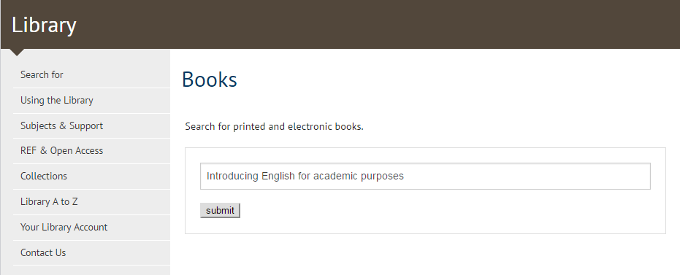
Enter your search terms in the search box – In this example, we are looking for a book from your Reading List – “Introducing English for Academic Purposes”
Click submit
Specific search: Books

Slide 6
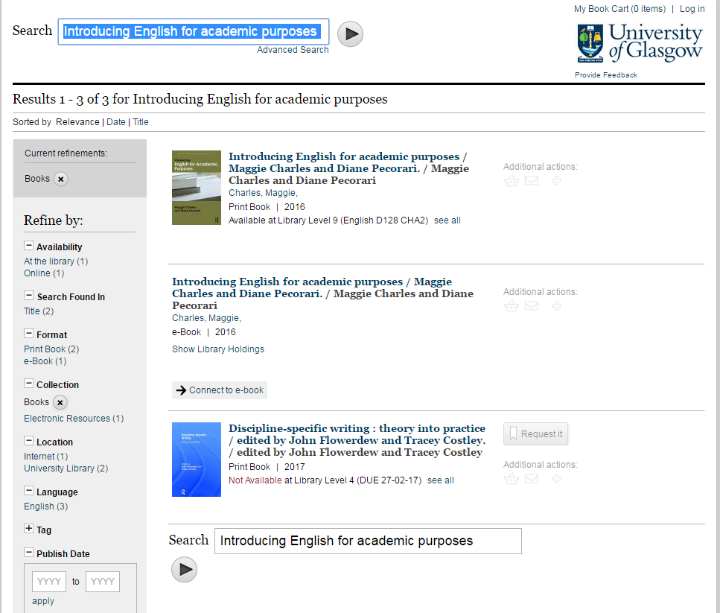
To limit your results to eBooks – that you can access online:
Select e-Book Format in the Refine By menu on the left
Specific search: Books

Slide 7
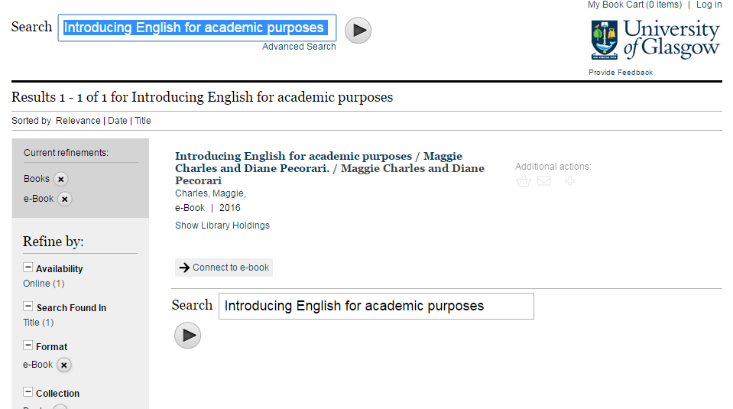
Click on the Connect to e-book link to access the text
Specific search: Books

Slide 8
The second method of searching is to refine the results from a search using:
Library Search
www.glasgow.ac.uk/library
Refining your results

Slide 9
On the Library homepage enter your search terms in the search box, and select Search
In this example I’m looking for books on teaching english for academic purposes – so I’ve entered “teaching english” AND “academic purposes” – the double quotes means that Library search will search for material with the phrase “teaching english” AND the phrase “academic purposes” and not treat all the parts as individual words!
Refining your results

Slide 10
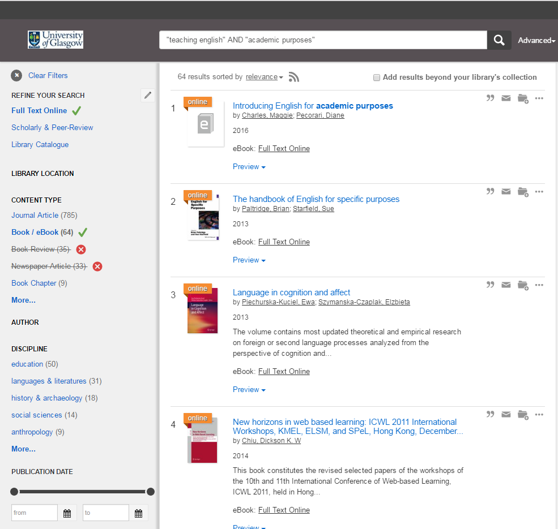
From the initial results list which provides a mix of books, articles, journals, conference reports, book chapters… you can get to just the ebooks by clicking on Full Text Online & Book/ebook limits from the Refine menu on the left!
Then click on the Full Text Online link on each individual title to access!
Refining your results

Slide 11
You may also want to try using the other refine your search tools to improve your results – for example by discipline or date
Refining your results

Slide 12
So, that’s two ways to search for, and access eBooks:
Use
Specific Search: Books
Refine the results of
Library Search
Finding eBooks

Slide 13
Library
Knowledge Base
Thank you, this presentation is complete.
Please close this presentation.

