Slide 1
Developing Rigour and Validity in Literature Searches
Please download the course exercise worksheet from https://edshare.gla.ac.uk/id/document/8024

Slide 2
Developing Rigour and Validity in Literature Searches at Doctoral Level
Dr Paul Cannon
College Librarian Medical, Veterinary & Life Sciences
paul.cannon@glasgow.ac.uk
Photo by rawpixel on Unsplash
This work is licensed under a Creative Commons Attribution 4.0 International License

Slide 3
Learning outcomes
By the end of the workshop, you should…
Understand the various literature review methods available and their limitations
Be able to structure a search strategy for effective literature searching
Utilise advanced search techniques to find relevant information in your research field
Use basic text mining techniques to improve the specificity or sensitivity of searches
Use data to identify prominent journals, papers and authors within your field

Slide 4
Getting started and familiarisation
Enlighten Publications: the University’s research repository
Enlighten Theses: research degree repository
Enlighten Research Data: research data repository
EthOS: UK doctoral theses
Proquest Dissertations and Theses: Global theses
University of Glasgow Library: your collections and archives
Library Hub Discover: Search the collections of most UK and Irish libraries

Slide 5
Where to find data

Slide 6
What type of literature review am I doing?
https://doi.org/10.1111/hir.12276

Slide 7
A typology of reviews
Type of review | Strengths | Weaknesses
Narrative/literature review | Consolidation of existing research | Significant bias in search methods and synthesis
Critical review | Critical evaluation Used to justify subsequent research | Open to bias in search methods and synthesis of results
Rapid review | Quick, but methodological | Open to bias, with limitations, but transparently so
Systemised review | Provides insight into a topic without resource implications of full SR | Likelihood of bias versus full SR method
Systematic review | Systematic method of searching and appraisal | Application of study designs reduces insight into research topic Time and resource heavy
Meta-analysis | Statistical assimilation of evidence base Useful for getting knowledge into practice | Needs to systematically identify all literature Quality of available studies
Adapted from Sutton, A., Clowes, M., Preston, L. and Booth, A. (2019), Meeting the review family: exploring review types and associated information retrieval requirements. Health Info Libr J, 36: 202-222. doi:10.1111/hir.12276

Slide 8
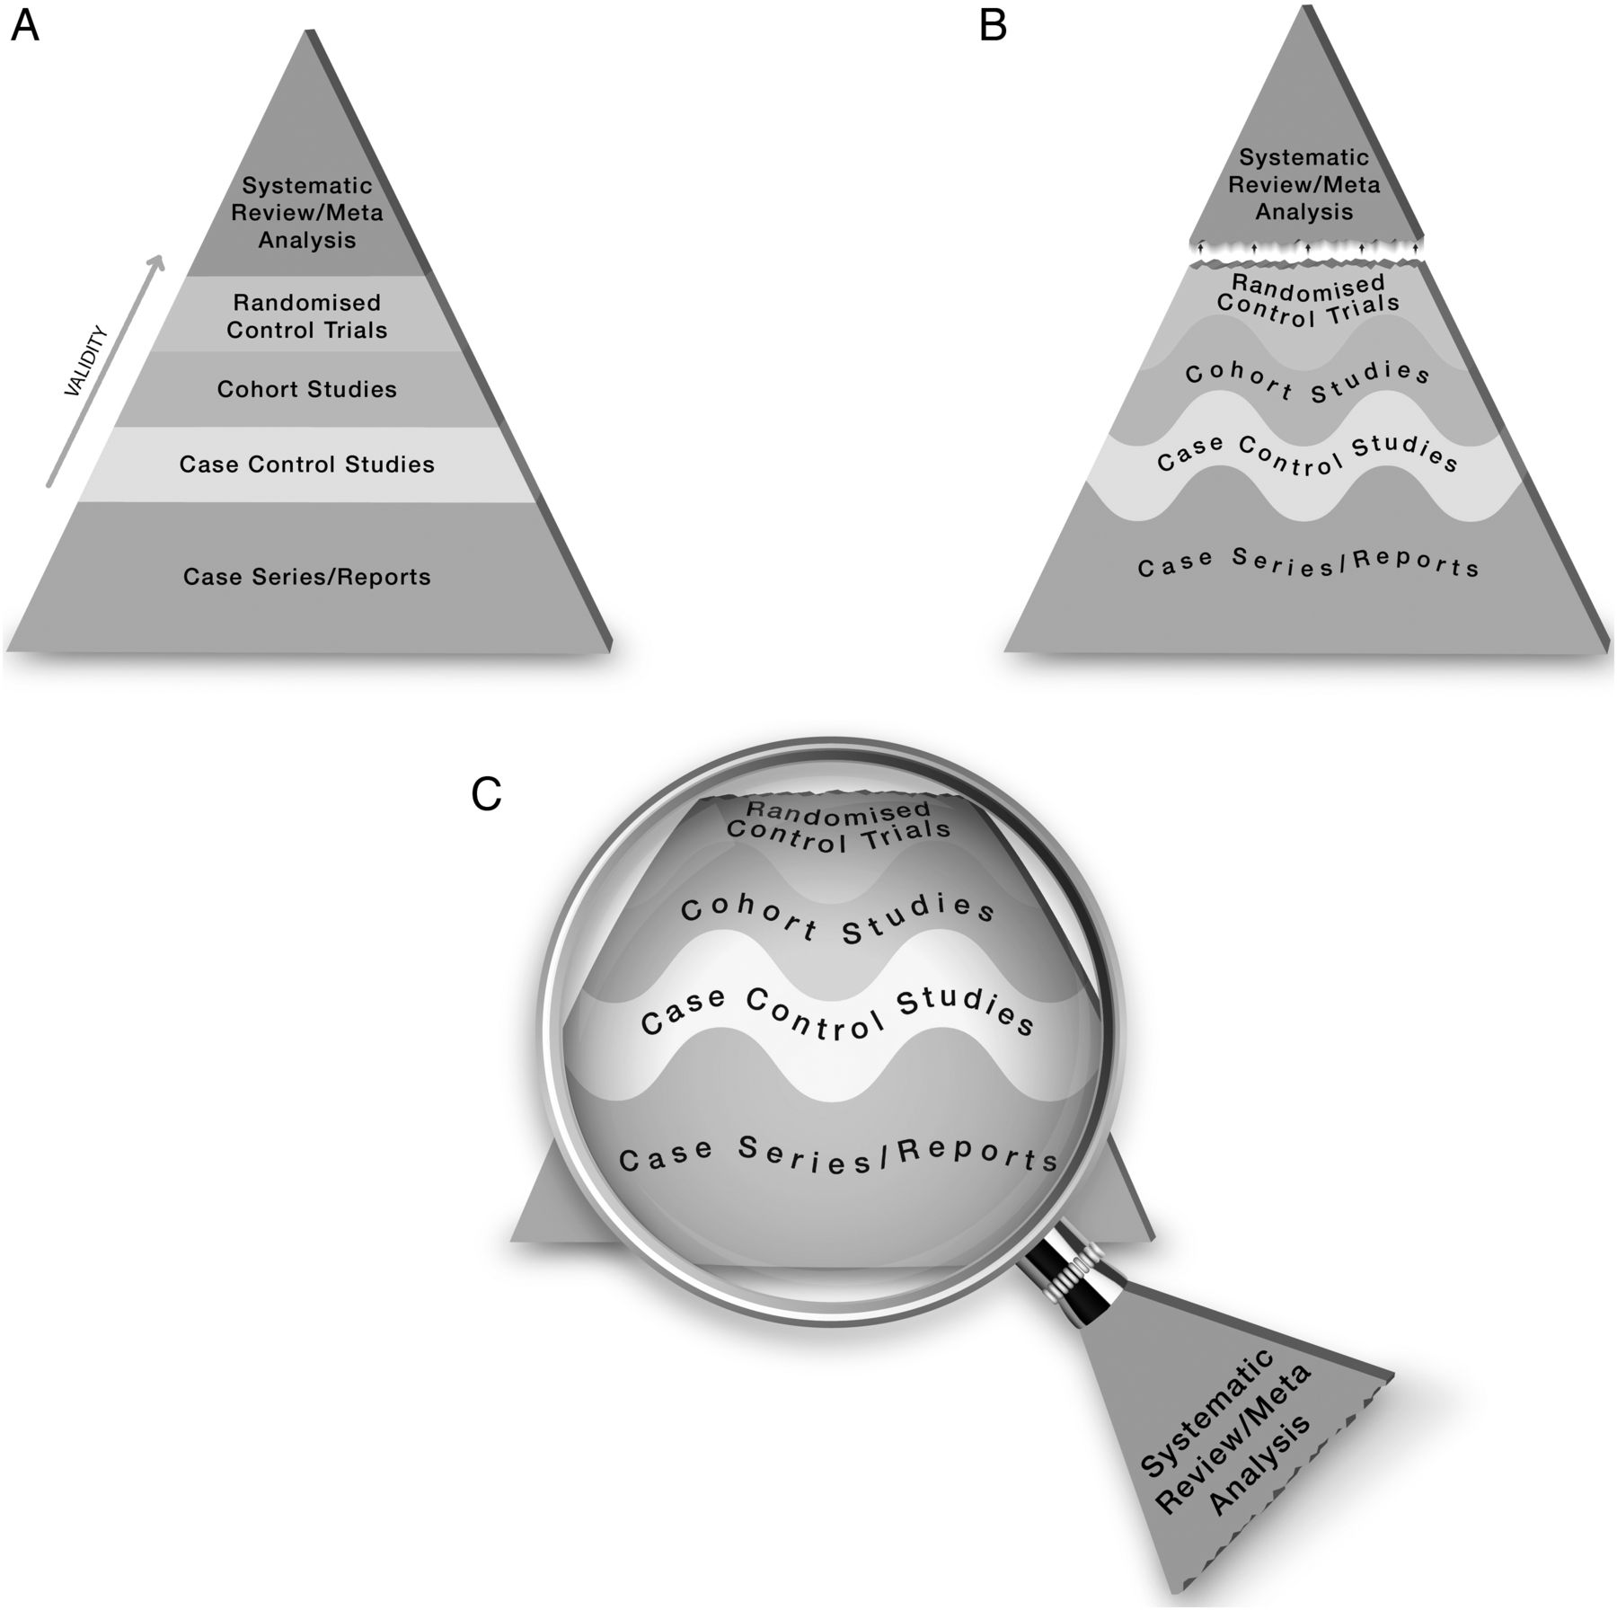
Algorithms and Artificial Intelligence
Murad MH, Asi N, Alsawas M, et al. New evidence pyramid. BMJ Evidence-Based Medicine 2016;21:125-127.

Slide 9
Any questions?

Slide 10
Question formulation frameworks
PICO Used for: Evidence-based medicine https://dx.doi.org/10.7326/ACPJC-1995-123-3-A12 | SPICE Used for: Evaluating projects or interventions https://dx.doi.org/10.1108/07378830610692127 | SPIDER Used for: Qualitative or mixed methods https://dx.doi.org/10.1177/1049732312452938 | ECLIPSE Used for: Evaluating services https://dx.doi.org/10.1046/j.1471-1842.2002.00378.x
Population / patient | Setting | Sample | Expectation
Intervention / indicator | Perspective / population | Phenomenon of Interest | Client group
Comparator / control | Intervention | Design | Location
Outcome | Comparison | Evaluation | Impact
 | Evaluation | Research methodology / method | Professionals
 |  |  | SErvice
See Supplementary Material 1 of Booth A, Noyes J, Flemming K, et al. Formulating questions to explore complex interventions within qualitative evidence synthesis. BMJ Global Health 2019;4:e001107: https://dx.doi.org/10.1136/bmjgh-2018-001107 for an exhaustive list of question formulation frameworks.

Slide 11
What are the most effective chemical repellents to deter arthropod vectors?
PICO Used for: Evidence-based medicine https://dx.doi.org/10.7326/ACPJC-1995-123-3-A12 | SPICE Used for: Evaluating projects or interventions https://dx.doi.org/10.1108/07378830610692127 | SPIDER Used for: Qualitative or mixed methods https://dx.doi.org/10.1177/1049732312452938 | ECLIPSE Used for: Evaluating services https://dx.doi.org/10.1046/j.1471-1842.2002.00378.x
Population / patient | Setting | Sample | Expectation
Intervention / indicator | Perspective / population | Phenomenon of Interest | Client group
Comparator / control | Intervention | Design | Location
Outcome | Comparison | Evaluation | Impact
 | Evaluation | Research methodology / method | Professionals
 |  |  | SErvice

Slide 12
Exercise one: PICO
Worksheet at https://edshare.gla.ac.uk/id/document/8024
Framework element | Concept
Population / patient | adult cat
Population / patient | chronic kidney disease
Intervention / indicator | Wet maintenance diet
Comparator / control | dry maintenance diet
Outcome | lower disease risk
Search strategy
(cat OR cats OR feline*)
AND
(chronic renal failure OR chronic renal disease OR chronic renal insufficiency OR chronic kidney insufficiency OR chronic kidney failure OR chronic kidney disease OR CKD)
AND
(diet* OR food* OR feed)

Slide 13
Any questions?

Slide 14
Don't reinvent the wheel
"Given the difficulty defining upstream interventions, a multistranded search method²⁸ will be employed, with each strand representing an intervention of interest. [...] The dental and oral health elements of the search will be adapted from the strategies employed by Waldron et al²⁹ and Arora et al.³⁰ The sugar tax strand of the search will use the strategies of Pfinder et al³¹ and the equity-focused strand will use the strategies of Prady et al.³²"
Dawson ER, Stennett M, Daly B, et al. Upstream interventions to promote oral health and reduce socioeconomic oral health inequalities: a scoping review protocol
BMJ Open 2022;12:e059441. doi: 10.1136/bmjopen-2021-059441

Slide 15
Advanced search techniques
OR: increases sensitivity
use for different synonyms, spelling variants and acronyms i.e., diet or eat or feed
AND: increases specificity
use to group different concepts that must be mentioned with the search results i.e., Population AND Intervention AND Comparator
NOT: exclude unwanted terms
in most circumstances, never use NOT; you may lose important references

Slide 16
Advanced search techniques
Proximity: more sensitive than phrase searching
use to find words near each other, i.e., “mental health” adj3 (personnel or professionals or staff)
NOTE: the proximity syntax varies in each database, and is not supported in others
Truncation: different word endings (or sometime beginnings)
use for different word formulation i.e., toxic* will retrieve toxic, toxicity, toxicology…
Wildcards: spelling variations
use for British and American spelling amongst other uses i.e., colo?r will retrieve color and colour
NOTE: the wildcard syntax varies in each database, and is not supported in others

Slide 17
Comprehensiveness of vocabulary
Cognitive behaviour therapy--clinical applications.
Contemporary Cognitive Behavior Therapy: A Review of Theory, History, and Evidence.
Historical perspective and future directions in Cognitive Behavioral Therapy for insomnia and behavioral sleep medicine.
Cognitive-behavioral treatment of the paraphilias.
Cognitive behavioral control of arthritis pain.
Behavioral and cognitive-behavioral approaches to chronic pain: recent advances and future directions.
Cognitive therapy for anxiety disorders.
Cognitive Training in the Elderly: Bottlenecks and New Avenues.
Influence of adjuvant mindfulness-based cognitive therapy (MBCT) on symptoms of post-traumatic stress disorder (PTSD) in veterans - results from a randomized control study.
Effects of an Internet-based cognitive behavioral therapy (iCBT) program in Manga format on improving subthreshold depressive symptoms among healthy workers: a randomized controlled trial.

Slide 18
Text for an example of utilising search syntax
Cognitive behavio?r* therapy
OR
Cognitive Behavioral Therapy
OR
Cognitive-behavioral treatment
OR
Cognitive behavioral control
OR
cognitive-behavioral
OR
Cognitive therapy
OR
Cognitive Training
OR
mindfulness-based cognitive therapy
OR
cognitive behavioral therapy
OR
ICBT
OR
MBCT

Slide 19
Final version of text when search syntax is used
(Cognitive adj2 (therap* or treatment* or control or approach* or training)) or iCBT or MBCT

Slide 20
Search sensitivity
74% increase!

Slide 21
Discussion slide on indexing
Photo by Valdemaras D. on Unsplash
Bos primigenius taurus

Slide 22
Subject headings
Treatment
Cognitive behavior therapy
Acceptance and commitment therapy
Cognitive processing therapy
Prolonged exposure therapy
PsycINFO
Behavior treatment
Cognitive behavioral therapy
Acceptance and commitment therapy
Cognitive restructuring
Mindfulness
Medline
Cognitive therapy
Cognitive behavioral therapy
Cognitive behavioral stress management
Cognitive processing therapy
Cognitive restructuring
Dialectical behavior therapy
Mindfulness-based stress reduction
Embase

Slide 23
Search sensitivity
35% increase!

Slide 24
Any questions?

Slide 25
Exercise two: text mining to develop a search strategy
Worksheet at https://edshare.gla.ac.uk/id/document/8024
What insights can we learn from the number of articles published per year?
Frequency of articles published per year variable, but relatively stable. This is a small field of research and that will affect the approach to my search
Where might you chose to read, or publish in, on this topic?
Antimicrobial Agents and Chemotherapy
What authors might you follow or seek out their work?
Be careful with author names – these may not be unique persons and may simply share a surname and initial(s)
Are there any particular keywords or MeSH headings you would incorporate into a search strategy as a result of this search?
Look out for F0XDI6ZL63; this is the Unique Ingredient Identifier. Always search for the drug name, trade name, registry number and UNII

Slide 26
Text mining
PubMed PubReMiner: text mines PubMed
MeSH on Demand: identifies MeSH headings and articles from PubMed
The National Centre for Text Mining
Previously identified literature

Slide 27
Exercises
Worksheet at https://edshare.gla.ac.uk/id/document/8024
Exercise three and four: hands-on searching
Embase: key database for all MVLS subjects
BIOSIS Previous: useful for biomedical life sciences
Exercise five: citation searching
The BIOSIS platform, Web of Science, is useful for citation searching and analysis (Scopus is another alternative, and is a larger database)

Slide 28
Decorative image
Photo by Mishal Ibrahim on Unsplash

Slide 29
Support for your reviews
Workshop slides: https://edshare.gla.ac.uk/352
Inter-library loans: https://www.gla.ac.uk/myglasgow/library/interlibraryloans/
Literature search and review in MVLS: https://edshare.gla.ac.uk/78/
Systematic and scoping review resources: https://sway.cloud.microsoft/w8GFGP6RUhf8CjW1?ref=Link
Cochrane Interactive Learning: https://eleanor.lib.gla.ac.uk/search~S6?/yDatabases%20C/ydatabases+c/1%2C1%2C61%2CB/eresource&FF=ydatabases+c&40%2C%2C61
Video guides to searching library databases: https://edshare.gla.ac.uk/278
Book an appointment to see me: https://www.gla.ac.uk/myglasgow/library/bookanappointment/cl/mvls/ or email paul.cannon@glasgow.ac.uk
only after reviewing the self-help material, please!

