Slide 1

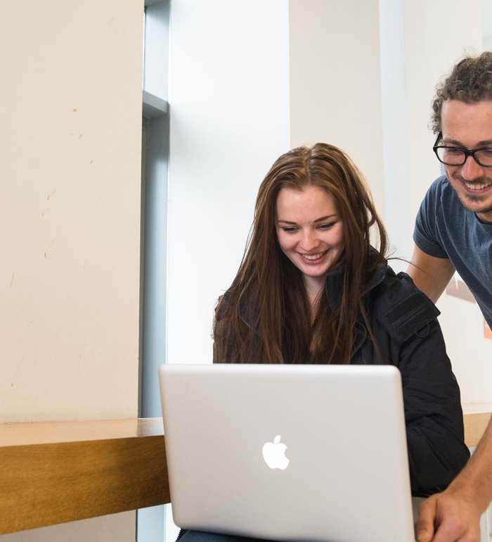



Archives and Special Collections Training
Archive Skills Guide: Planning your visit to use archives
Archives and Special Collections (ASC)
This work is made available under a Creative Commons Attribution-Non Commercial 4.0 International License (CC BY-NC 4.0)

Slide 2
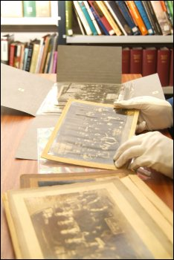
Planning ahead is always advisable
to ensure you make the most of a visit
to any archive repository.
Most archives have rules and
regulations which seem strange to
start with. For example most only
allow the use of pencils rather than
pens for making notes as there is less
danger of causing damage to unique
and irreplaceable documents.

Slide 3
University of Glasgow Archive
The University of Glasgow’s rules and regulations on using archives are fairly typical but you should check if there is anything else before you visit a new repository.
Over the next few slides, we’ll suggest some things you should consider checking before your visit to an archive.

Slide 4
Questions to consider before your visit:
Are there any special conditions of access for that particular archive repository? Some places require a formal letter of introduction from your University before they will allow access.
What identification do you need to take with you?
Do you need to make an appointment?

Slide 5
Questions to consider before your visit (continued)
Will the records you want be available at the time you want to visit? For example sometimes records need to be brought from off-site stores, or they may be too fragile to consult without prior conservation treatment or some 20th and 21st century records may have restrictions to protect the confidentiality of the subjects.
If you are planning a whole day visit, is there somewhere you can buy food locally or should you take something with you?

Slide 6
Questions to consider before your visit (continued)
Can you take a laptop computer?
What size of bag will you be permitted to take into the reading room? Are there lockers to leave larger bags?
Do they allow pre-ordering of documents so you don’t have to wait for them to come from the stores?
Do they allow digital cameras or do they have a photocopying service?

Slide 7
Planning to use archive held in private hands
There is no legal obligation for archives held by private individuals or organisations to let you see their archives. You should write outlining your research topic and why it is important that you see their archive and then hope that they will grant you access. There is little that you can do if they say no.

Slide 8
More in the Archive Skills Guide collection
Finding an archive for your research
What to expect when you get there
Reading old handwriting (Palaeography)
Latin skills
Legal issues when consulting and using archives
Historical currency, weights, measures and dates

Slide 9
Contact us
To learn more about ASC, our services and how we can support you, please visit our website: https://www.gla.ac.uk/myglasgow/archivespecialcollections/

Slide 10

Archives and Special Collections
To learn more about ASC, our services and how we can support you, please visit our website: https://www.gla.ac.uk/myglasgow/archivespecialcollections/
@UofGlasgowASC

