Slide 1

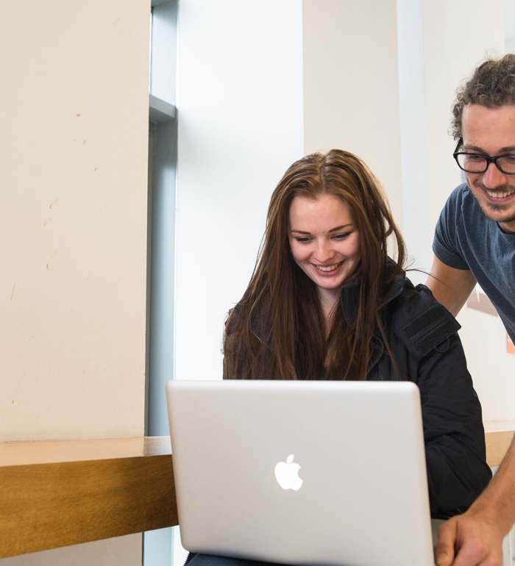



Archives and Special Collections Training
Archive Skills Guide: Legal issues when consulting and using archives
Archives and Special Collections (ASC)
This work is made available under a Creative Commons Attribution-Non Commercial 4.0 International License (CC BY-NC 4.0)

Slide 2
Copyright
Copyright is part of a wider set of intellectual property rights which offer protection and certain exclusive rights to the owner(s) of the rights in a work. For example copyright laws usually grant the creator of a work the exclusive right to reproduce that work or prepare derivative works.
When making copies of unpublished archive material, the Copyright Laws are likely to be drawn to your attention so it is useful to have an overview of what this means to your research. You are likely to be supplied with copies for private research and study only so you cannot supply a copy to anyone else.

Slide 3
Copyright in unpublished material
Copyright in unpublished archives and manuscripts is complex and the rights vary depending upon when the work in question was made. Therefore ask for advice if you wish to use the copies for anything other than private study or research.
These UK government pages are useful for finding out more
Permitted uses of copyright works
Locating and obtaining a licence from a copyright owner

Slide 4
Data Protection
The most common legal reason that archivists deny access to records is because of the Data Protection Act 1998. This protects an individual’s right to privacy so some records that are 100 years old or less can be subject to restriction.
Access is sometimes possible for research by postgraduates and academics so contact the individual repository for more information on whether this will be permitted for the records you are interested in.
For more information on Data Protection:
The University of Glasgow’s Data Protection Office
The National Archives

Slide 5
More in the Archive Skills Guide collection
Finding an archive for your research
What to expect when you get there
Reading old handwriting (Palaeography)
Latin skills
Planning your visit to an archive
Historical currency, weights, measures and dates

Slide 6
Contact us
To learn more about ASC, our services and how we can support you, please visit our website: https://www.gla.ac.uk/myglasgow/archivespecialcollections/

Slide 7

Archives and Special Collections
To learn more about ASC, our services and how we can support you, please visit our website: https://www.gla.ac.uk/myglasgow/archivespecialcollections/
@UofGlasgowASC

