Slide 1

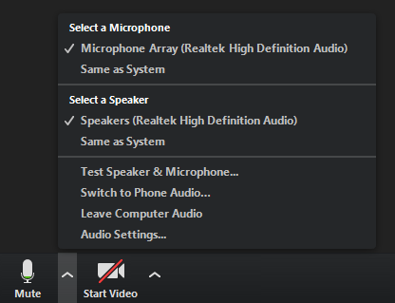


Supervising systematic reviews
Paul Cannon
College Librarian Medical, Veterinary & Life Sciences
Tracey McKee
NHS Greater Glasgow & Clyde Library Services
I recommend testing your speakers before the webinar starts
Use the chat icon to ask questions to all participants or to the host only

Slide 2
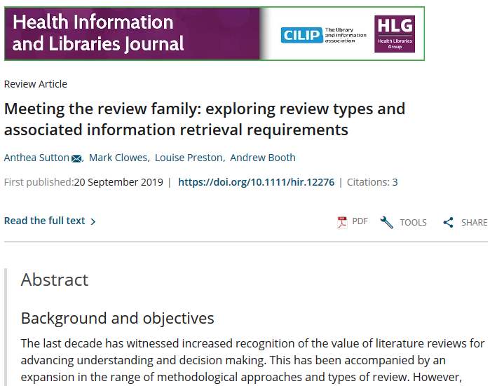



Systematic reviews compared to other types of review
https://doi.org/10.1111/hir.12276
What are systematic reviews?

Slide 3
Type of review | Strengths | Weaknesses
Narrative/literature review | Consolidation of existing research | Significant bias in search methods and synthesis
Critical review | Critical Used to justify subsequent research | Open to bias in search methods and synthesis of results
Rapid review | Quick, but methodological | Open to bias, but in a transparent way
Systemised review | Provides insight into a topic without resource implications of full SR | High likelihood of bias with limited methodology
Systematic review | Systematic, reproducible, method of searching and appraisal | Application of study design reduces insight into research topic Time and resource heavy
Meta-analysis | Assimilation of evidence base Useful for getting knowledge into practice | Needs to systematically identify all literature Quality of available studies
Adapted from Grant, M. J. and Booth, A. (2009), A typology of reviews: an analysis of 14 review types and associated methodologies. Health Information & Libraries Journal, 26: 91-108. doi:10.1111/j.1471-1842.2009.00848.x
A typology of reviews
Notes:
Comparing SRs to other reviews > important for TPG student projects – not likely to be doing a full SR, more likely Rapid or Systemised reviews.
Real-world implication of publishing a review purporting to be systematic > used for clinical practice and evidence reviews.
RESEARCH INTEGRITY.

Slide 4
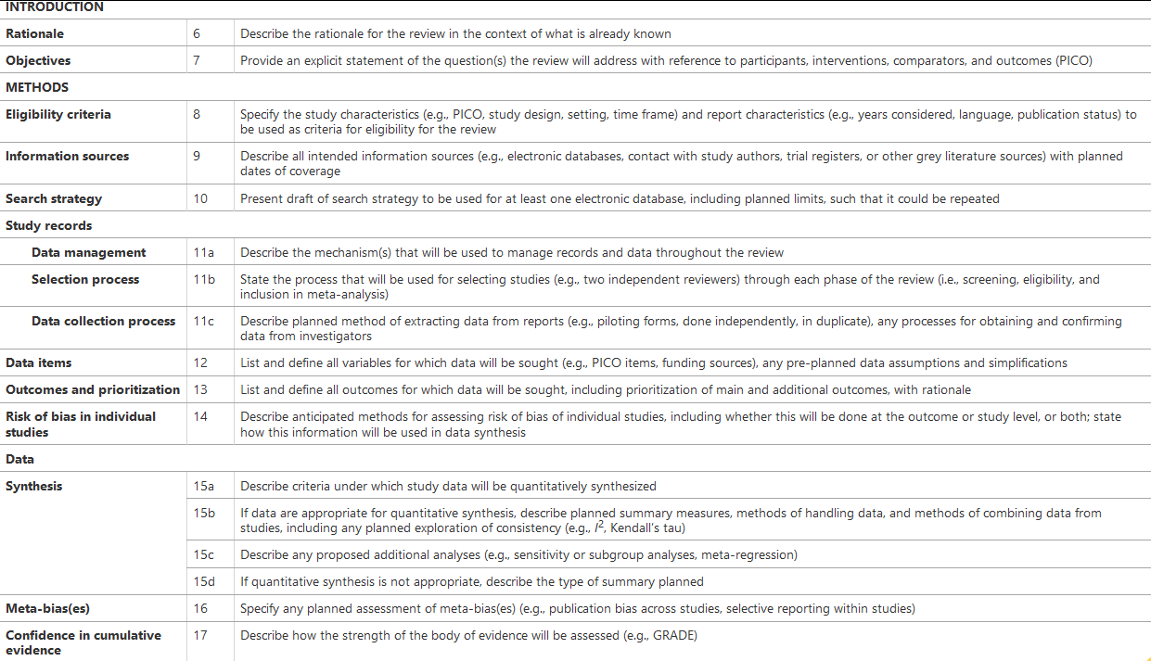
Moher, D., Shamseer, L., Clarke, M. et al. Preferred reporting items for systematic review nd meta-analysis protocols (PRISMA-P) 2015 statement. Syst Rev 4, 1 (2015). https://doi.org/10.1186/2046-4053-4-1
Notes:
PRISMA-P: Importance of protocol for review > foundations for entire review. Sets context and enables students to get a grasp on the scale of the literature > is the review topic feasible? Also focuses the mind > why is the review important, what is the review question, how do you set out to answer the question, etc.?
See also PRISMA Exploration and elaboration: https://doi.org/10.1371/journal.pmed.1000100
See PROSPERO for examples.
Is review feasible > scoping searches > also helps find existing reviews and protocols

Slide 5
Any questions?
Type ‘Yes’ in the chat box if you do – then take time to write you question.

Slide 6
Creating a search strategy
PICO Used for: Evidence-based medicine http://dx.doi.org/10.7326/ACPJC-1995-123-3-A12 | SPICE Used for: Evaluating projects or interventions http://dx.doi.org/10.1108/07378830610692127 | SPIDER Used for: Qualitative or mixed methods http://dx.doi.org/10.1177/1049732312452938 | ECLIPSE Used for: Evaluating services http://dx.doi.org/10.1046/j.1471-1842.2002.00378.x
Population / patient | Setting | Sample | Expectation
Intervention / indicator | Perspective / population | Phenomenon of Interest | Client group
Comparator / control | Intervention | Design | Location
Outcome | Comparison | Evaluation | Impact
 | Evaluation | Research methodology / method | Professionals
 |  |  | SErvice
See Supplementary Material 1 of Booth A, Noyes J, Flemming K, et al. Formulating questions to explore complex interventions within qualitative evidence synthesis. BMJ Global Health 2019;4:e001107: http://dx.doi.org/10.1136/bmjgh-2018-001107 for an exhaustive list of question formulation frameworks.
If a template doesn’t fit your research question, don’t worry. The main aim is to identify the key components of your search and the various synonyms and acronyms used to describe them.
Search formulation frameworks

Slide 7
Illustrating a PICOS search strategy
INTERVENTION
CONDITION
STUDY TYPE
POPULATION
INTERVENTION
Retrieved literature
Intervention
A
B
F
OR
C
POPULATION
Ped-iatric
CONDITION
Hyper-kinetic
E
D
Adole-scent
OR
Child
AND
Attention deficit disorder
OR
ADHD
Meta-analysis
STUDY TYPE
OR
SRs
PICOS search formulation framework
Notes:
Sensitivity vs specificity > Not all elements of a question will necessarily be in the search
some elements are more appropriate for inclusion/exclusion criteria.
Some elements are not appropriate for a search, outcomes, for example (rarely described in titles/abstracts).

Slide 8
Advanced search techniques
Boolean searching
OR: increases sensitivity
  use for different synonyms, spelling variants and acronyms, i.e. diet or eat or feed…
AND: increases specificity
  use to group different concepts that must be mentioned with the search results, i.e. GP and CEA and abdominal pain
NOT: exclude unwanted terms
  in most circumstances, never use NOT; you may lose important references
Boolean logic and search syntax

Slide 9
Advanced search techniques
Search syntax
Proximity: more sensitive than phrase searching
  use to find words near each other, i.e. “mental health” adj3 (personnel or professional or staff)
    NOTE: the proximity syntax varies in each database, and is not supported in others
Truncation: different word endings (or sometimes beginnings)
  use for singular, plural and adjectives, i.e. toxic* will retrieve toxic, toxicity, toxicology…
Wildcards: spelling variations
  use for British and American spelling amongst other uses, i.e. colo?r will retrieve color and colour
    NOTE: the wildcard syntax varies in each database, and is not supported in others
Boolean logic and search syntax

Slide 10
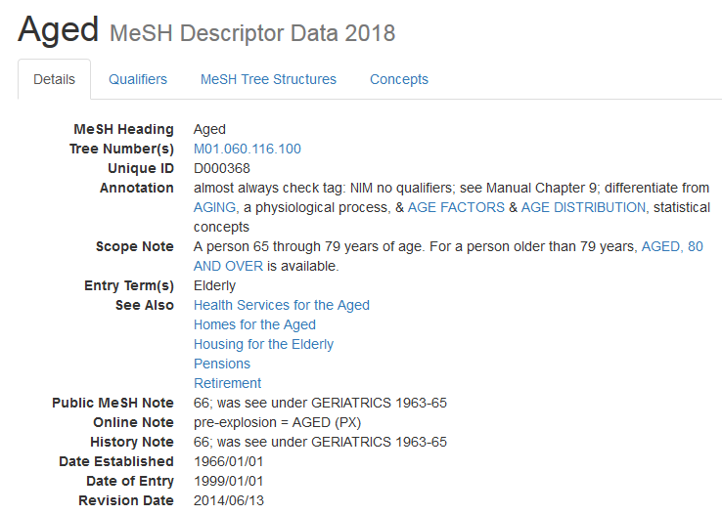
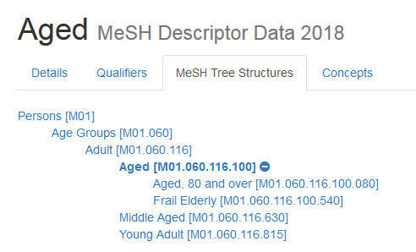
https://meshb.nlm.nih.gov/record/ui?ui=D000368
Subject headings

Slide 11
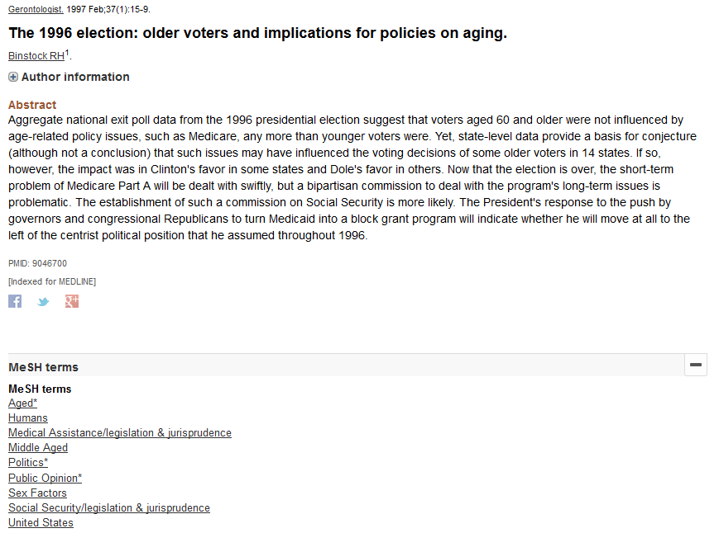
https://www.ncbi.nlm.nih.gov/pubmed/9046700
Subject headings

Slide 12
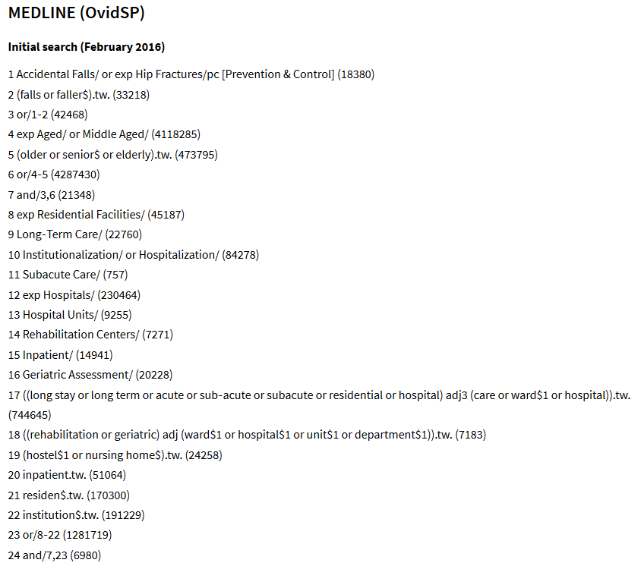

Cameron, ID, Dyer, SM, Panagoda, CE, et al. (2018) Interventions for preventing falls in older people in care facilities and hospitals. Cochrane Database of Systematic Reviews: https://www.cochranelibrary.com/cdsr/doi/10.1002/14651858.CD005465.pub4
Illustrating a search strategy
Notes:
Cochrane Handbook > 1000 results = 8 hours of sifting
Search has to be sensitive by definition. What is the expectation of PGTs (and UGs)? Not earlier reference to review types (likely not doing a SR).

Slide 13
Information sources
Subject specific databases (highly dependent on the research question)
  Clinical medical questions should use a minimum of Medline, Embase, CENTRAL
  Other databases might be CINAHL, PsycINFO, or ASSIA.
Multidisciplinary databases
  Scopus or Web of Science Core Collection
Hand and citation searching
  Prominent journals or subject repositories
  Scopus or Web of Science for citations (backward and forward)
See https://www.gla.ac.uk/myglasgow/library/specificsearch/databasesbysubject/
Information sources

Slide 14
Trials and grey literature
Trial repositories
  WHO International Clinical Trials Registry Platform
  ClinicalTrials.gov
Conference proceedings and abstracts
  Covered in Scopus, Web of Science and PapersFirst and ProceedingsFirst
Official publications
  Government, NGOs, charities, professional bodies, etc.
Sources
  Open Grey (EU), National Technical Information Service (US), and NICE Evidence Search
Information sources

Slide 15
Any questions?
Type ‘Yes’ in the chat box if you do – then take time to write you question.

Slide 16
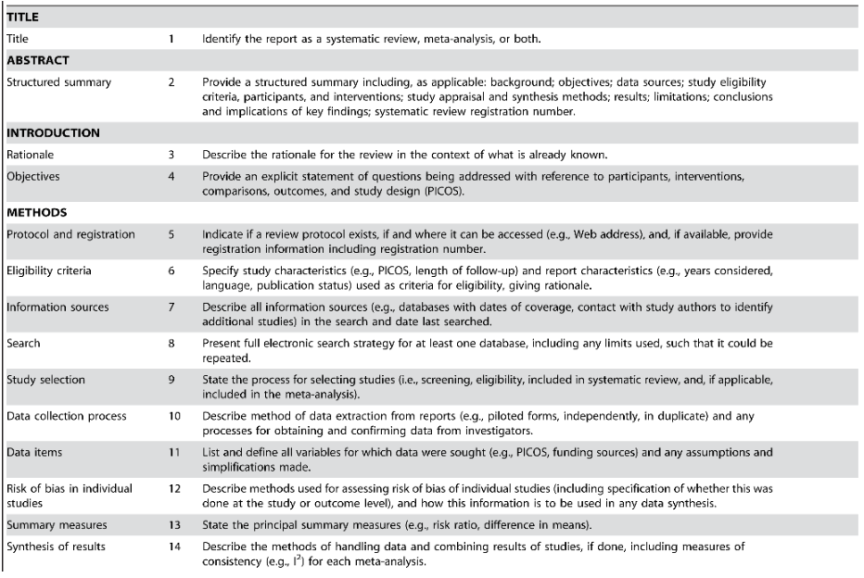
Reporting of systematic reviews
Moher D, Liberati A, Tetzlaff J, Altman DG, The PRISMA Group (2009) Preferred Reporting Items for Systematic Reviews and Meta-Analyses: The PRISMA Statement. PLOS Medicine 6(7): e1000097. https://doi.org/10.1371/journal.pmed.1000097
See also http://prisma-statement.org
Notes:
PRISMA = Possible marking rubric?

Slide 17
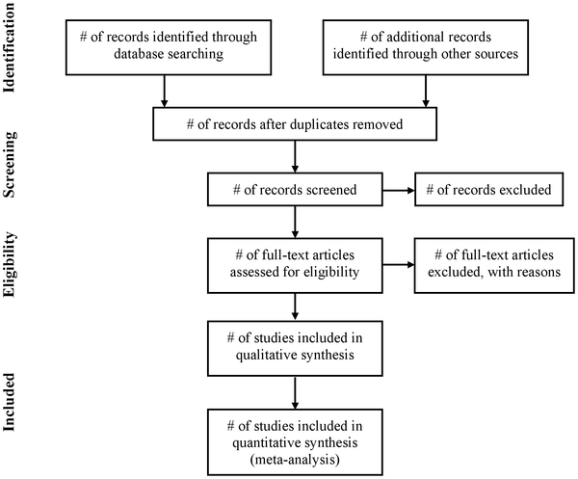
Reporting of systematic reviews
Moher D, Liberati A, Tetzlaff J, Altman DG, The PRISMA Group (2009) Preferred Reporting Items for Systematic Reviews and Meta-Analyses: The PRISMA Statement. PLOS Medicine 6(7): e1000097. https://doi.org/10.1371/journal.pmed.1000097
See also http://prisma-statement.org
Systematic review reporting
Notes:
Good record keeping important > cannot revisit searches to get the same number of results as previously run search.
On databases > save searches, set-up alerts, save Word versions of searches as run on day of search – for each database.

Slide 18
Resources and further guidance
Plenty of print and electronic books on SRs in the Library
Methodology guides:
  Cochrane Handbook for Systematic Reviews of Interventions
  Systematic Reviews: CRD’s guidance for undertaking reviews in health care
  Joanna Briggs Institute Reviewer’s Manual
  Searching for Studies: a Guide to Information Retrieval for Campbell systematic reviews
Preferred Reporting Items for Systematic Reviews and Meta-Analyses (PRISMA)
Defining the Role of Authors and Contributors
CRediT – Contributor Roles Taxonomy
Further reading and resources

Slide 19
Finding full-text pdfs guide: https://edshare.gla.ac.uk/252/
MVLS systematic review project support: https://moodle.gla.ac.uk/course/view.php?id=19213
  Enrolment key: MVLS srps
Systematic review resources: https://edshare.gla.ac.uk/451/
  The University of Glasgow guide to search strategies for systematic reviews in medical, veterinary and life sciences: https://edshare.gla.ac.uk/444/
  Video guides to searching library databases: https://edshare.gla.ac.uk/278
  Systematic review lecture: https://edshare.gla.ac.uk/135
  Systematic review workshop: https://edshare.gla.ac.uk/410
Appointments:
  For UG and TPG students, first line support is via the College Library Support Team: https://www.gla.ac.uk/myglasgow/library/help/collegesupport/
  For PGRs and staff, see me at Gilmorehill: https://bit.ly/2O3fLZs, or Garscube: https://bit.ly/2mLxZBh, or email paul.cannon@glasgow.ac.uk.
Self-help and further assistance

Slide 20



https://www.gla.ac.uk/myglasgow/library
Paul Cannon
College Librarian Medical, Veterinary & Life Sciences
paul.cannon@glasgow.ac.uk
@pcann_LIS
http://orcid.org/0000-0001-8721-1481
Photo by rawpixel on Unsplash
This work is licensed under a Creative Commons Attribution 4.0 International License

Slide 21
Any final questions?
Type ‘Yes’ in the chat box if you do – then take time to write you question.

