Slide 1

Online session: Best practice for adhering to UK Copyright Law when developing Online and blended learning
Delivered by Greg Walters, Information Services Learning Technologist on 19/06/2020
Notes:
Slide 1: Copyright section
Hi there, my name is Greg Walters and I’m Information Services Learning Technologist. Many thanks for attending this section of todays Zoom session focusing on UK Copyright and how it can be applied when developing online learning materials.
Since December 2015, part of my role has been to provide non legal guidance and advice in relation to UK Copyright, specifically relating the development of online learning, i.e. Moodle courses, MOOCs, Micro Credentials. This support is also available in a range of online resources I’ve developed, which can be accessed via a webpage we’ll examine later on.

Slide 2
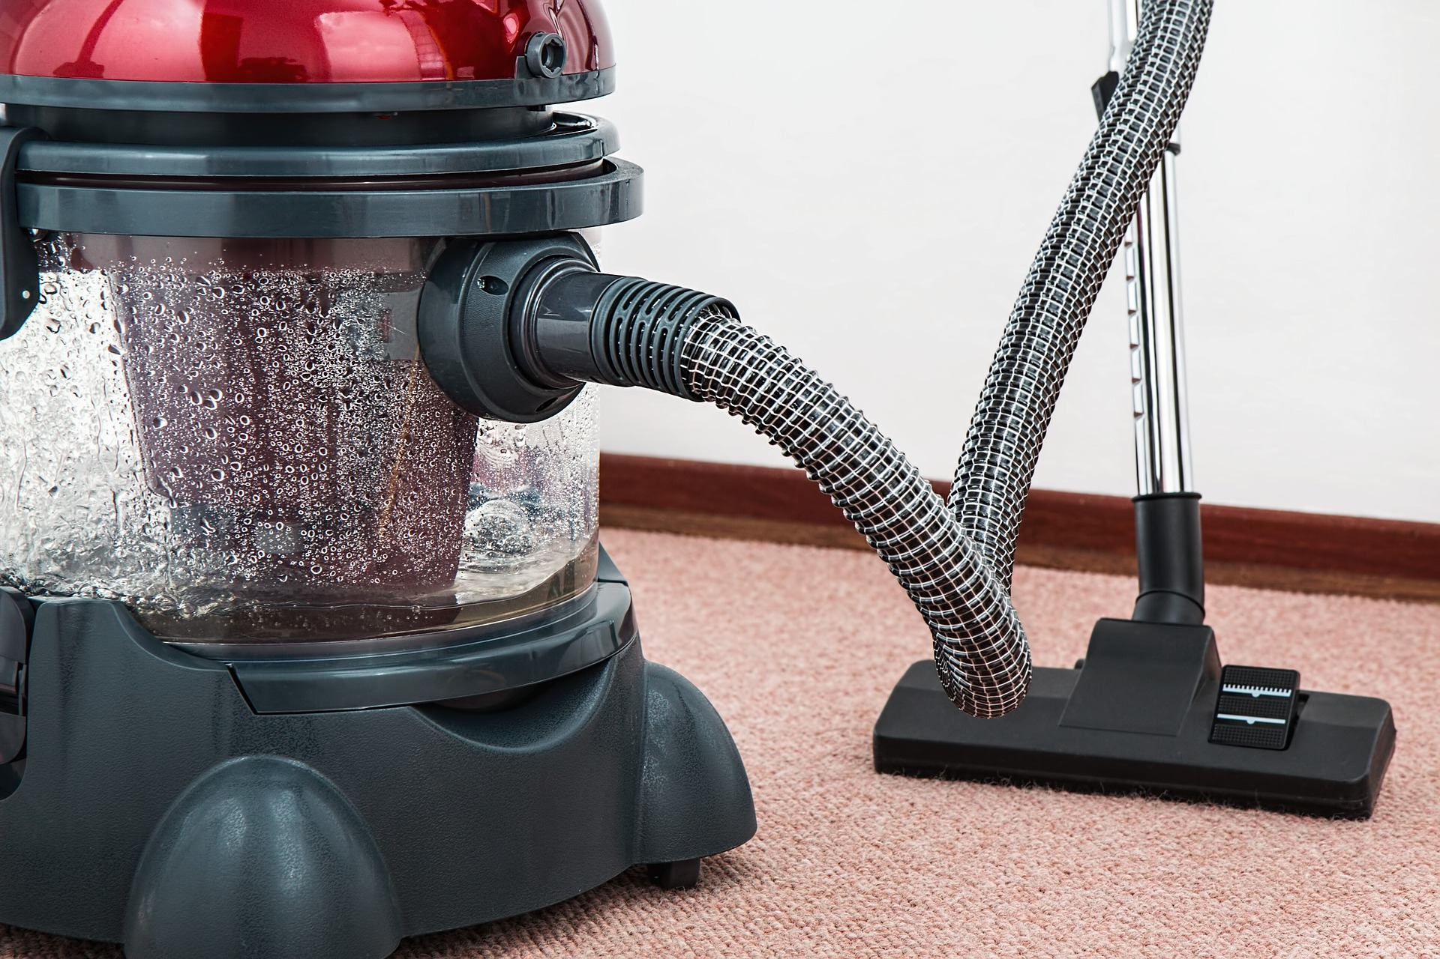
House keeping
Please post questions you have during my presentation to the chat box – I’ll do my best to answer them at the end
If I can’t answer your question during my section, I’ll take note of your details and email you the answer
Both the audio and visual content of this presentation (including Q&A), should not be considered legal advice
Notes:
Slide 2: Housekeeping
Before we go any further, we’ll go over some housekeeping.

Slide 3

What will be covered during this presentation?
What is Copyright and how is created (UK Law)?
How to search for media, i.e. images effectively online
Are there reliable online sources for Copyright free images, video etc..?
Does University of Glasgow provide any services that we can use?
Creative Commons licences and attribution
UK Copyright Exceptions and how they can be used
Notes:
Slide 3: What will be covered during this presentation
During this part of the Zoom session, we’ll focus on the areas highlighted on screen. Due to the volume of information we’re trying to cover during this session, in some cases I’ll direct you to applicable resources I've developed for further reading, as these will provide more detailed information.
Regarding the links that I display during my presentation, these will be displayed at the end of my presentation and disseminated through Social Media and email.

Slide 4

What is Copyright (UK Law)?
Copyright is generated automatically when a person creates something original in a fixed format
Copyright protects the creators works for a specific period of time
Current copyright legislation is the UK Copyright and Patents Act 1988
Notes:
Slide 4: What is Copyright
I’d like to very quickly go over what copyright is, how its created and where to find further guidance for it.
From a UK perspective, copyright is a legal protection, automatically generated when a person creates something original in a fixed format, (i.e. written or recorded.). Copyright protects the works of authors and performers for a specific period of time. The current copyright legislation in the United Kingdom is the Copyright and Patents Act 1988.

Slide 5
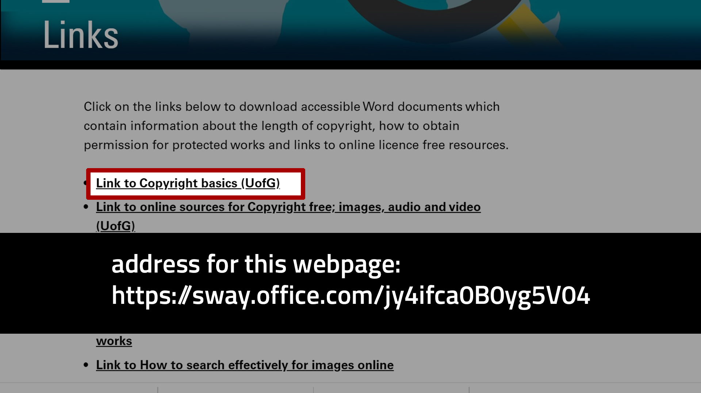
Notes:
Slide 5: Document focusing on Copyright basics (UK) and intellectual property right from a UofG perspective
For further information relating to UK Copyright basics and Intellectual property, please examine the document found in the webpage I developed. This document provides an overview of who owns what. For example, if an academic members of staff creates teaching and learning materials for classroom or online use do they own it?

Slide 6
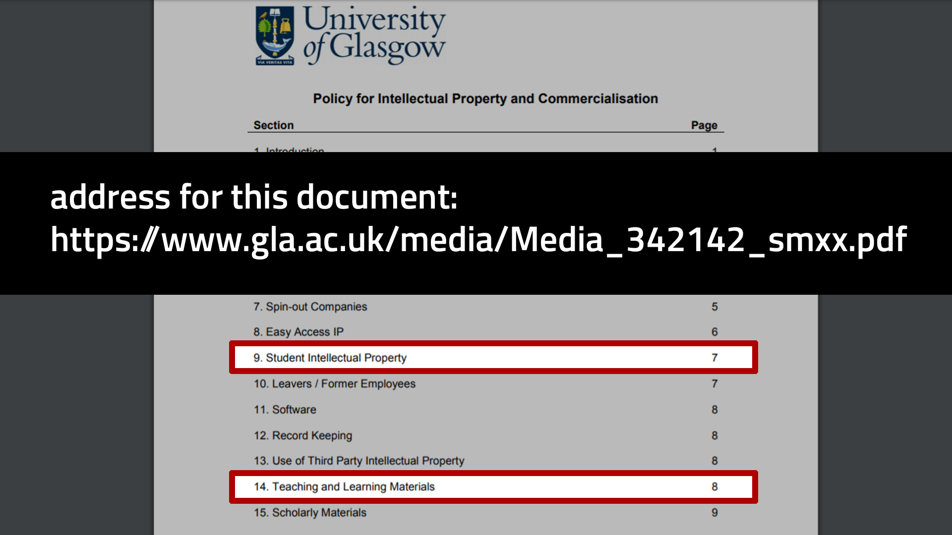
Notes:
Slide 6: University of Glasgow, Policy for Intellectual Property and Commercialisation
In relation to ‘Who owns IP’, I would strongly recommend you examine the University’s Policy for Intellectual Property and Commercialisation, specifically section 14 for Teaching and Learning Materials, and you may want to examine section 9, which relates to students IP rights for work they’ve created.

Slide 7

Notes:
Slide 7: How to search for images effectively online
We’ll now examine how to search for images effectively online, using Google Advanced Image search

Slide 8
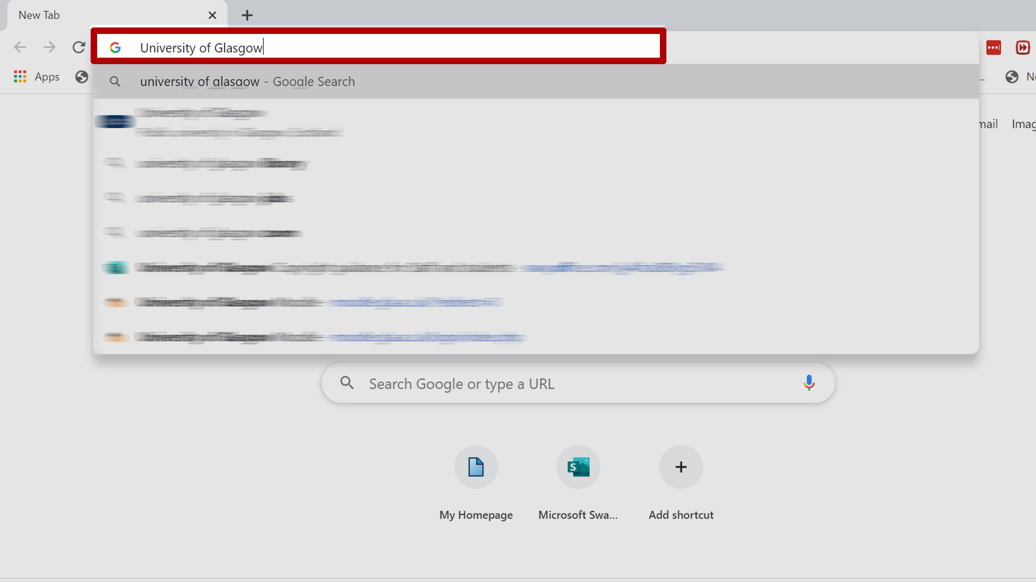
Step 1 of 5
Notes:
Slide 8: Step 1 of 5
When I used to search for images online using Google, I would simply open up the browser, type in what I was looking for and then press enter on my keyboard.

Slide 9
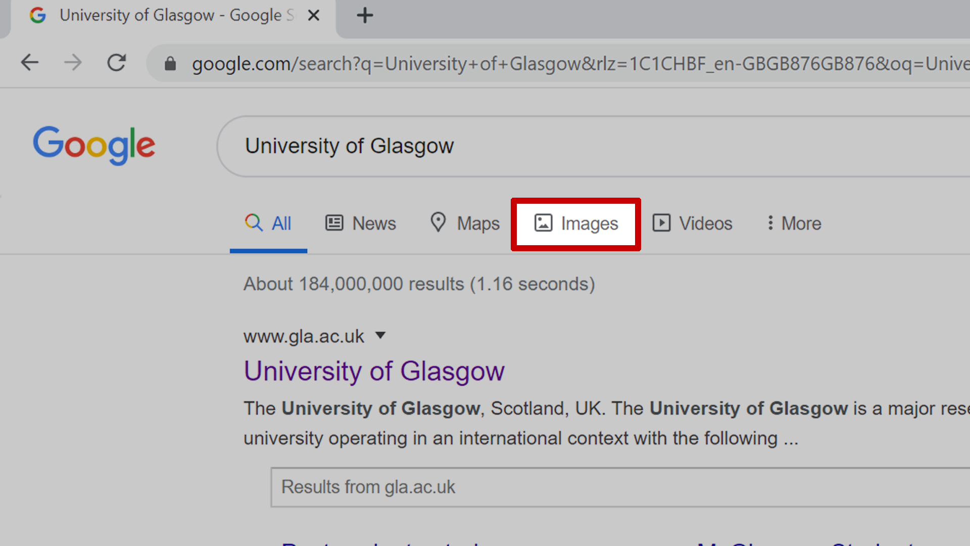
Step 2 of 5
Notes:
Slide 9: Step 2 of 5
Then I would click on ‘images’ to show me the results of my search.

Slide 10
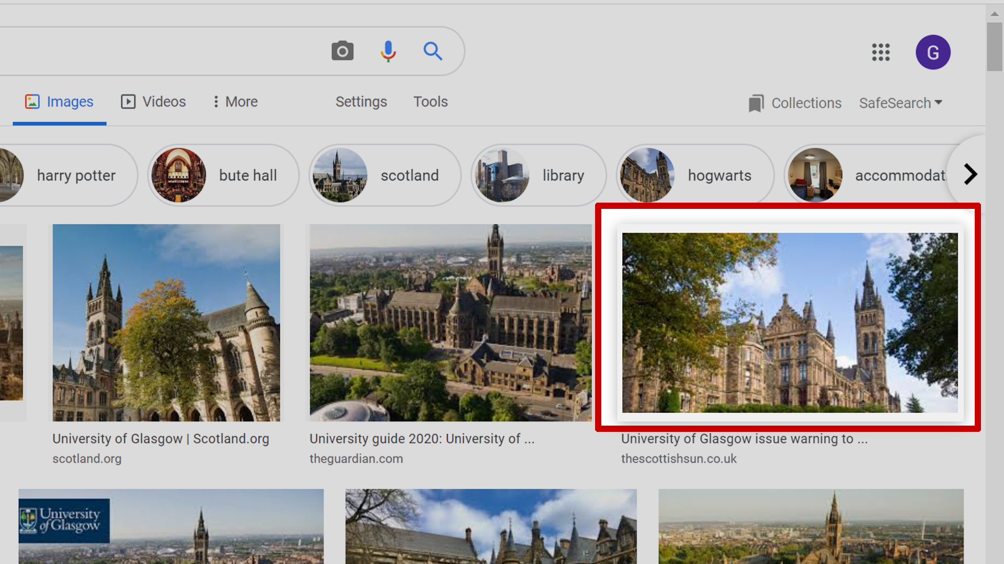
Step 3 of 5
Notes:
Slide 10: Step 3 of 5
Click on my chosen image.

Slide 11
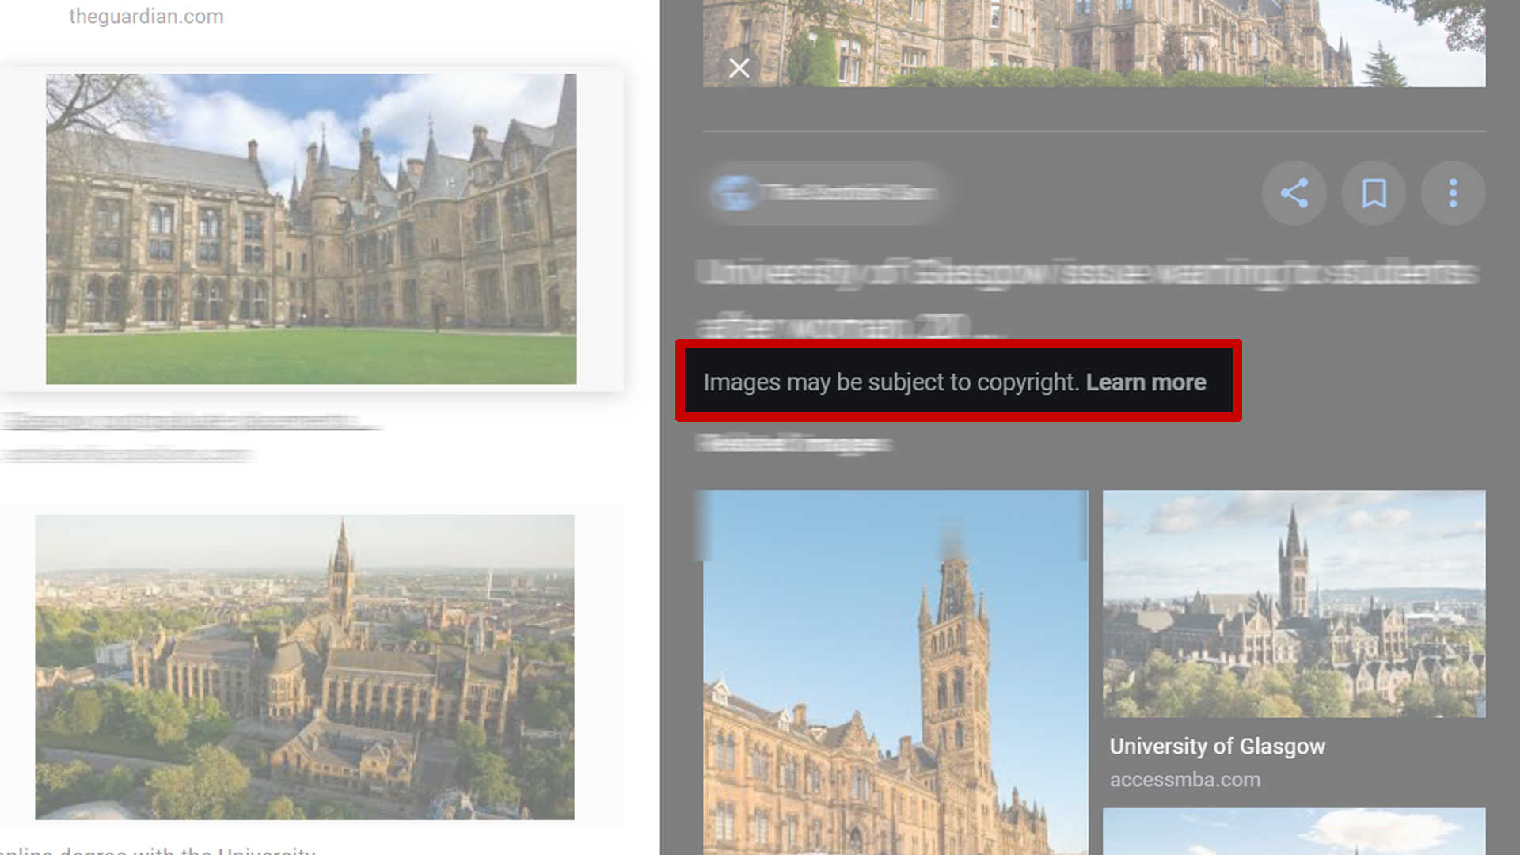
Step 4 of 5
Notes:
Slide 11: Step 4 of 5
Its at this point, I would encounter a problem as my image search had return unfiltered results. Meaning some of the images, could be subject to copyright protection.
At this point I could examine the possibility of using one of the UK Copyright Exceptions to use this, which we’ll look at closely later on. However, the point of this demonstration is to encourage good practice for when searching for images online, which will save you time.
So, instead of employing the search method we’ve used so far, I would encourage you to do the following, in order to return image results that you know can be used in your professional practice.

Slide 12
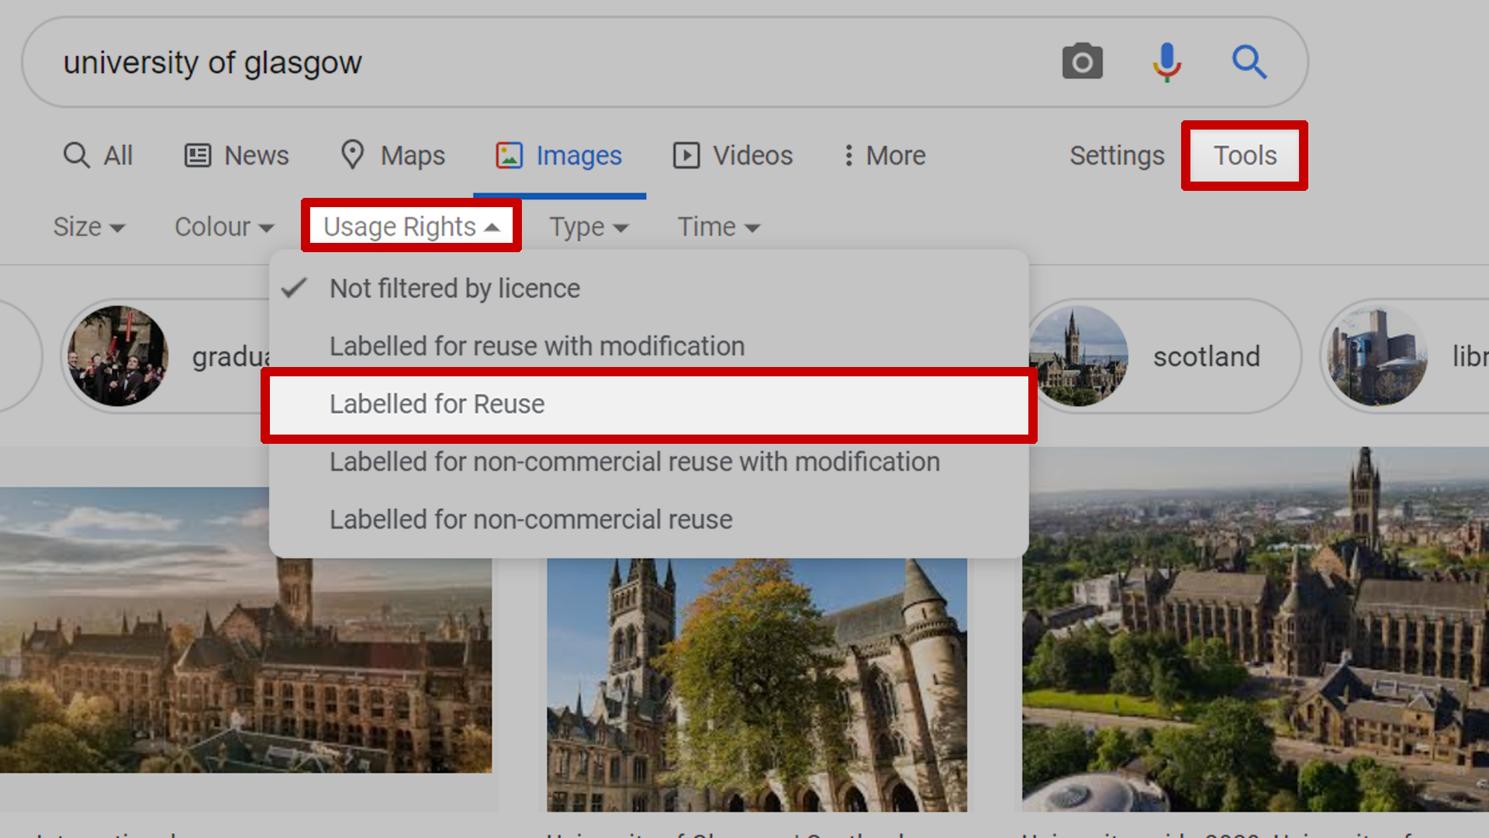
Step 5 of 5
Notes:
Slide 12: Step 5 of 5
One easy and quick way of filtering your image searches, is to click on the ‘tools’ button when you’ve done an image search.
When you’ve clicked on the tools button a drop down menu will appear, click on ‘Usage Rights’ and then select how you would like your images to be filtered by selecting an option from the final drop down menu. The options available, let you filter results to be for; either commercial or non-commercial use, if you can reuse or modify them

Slide 13
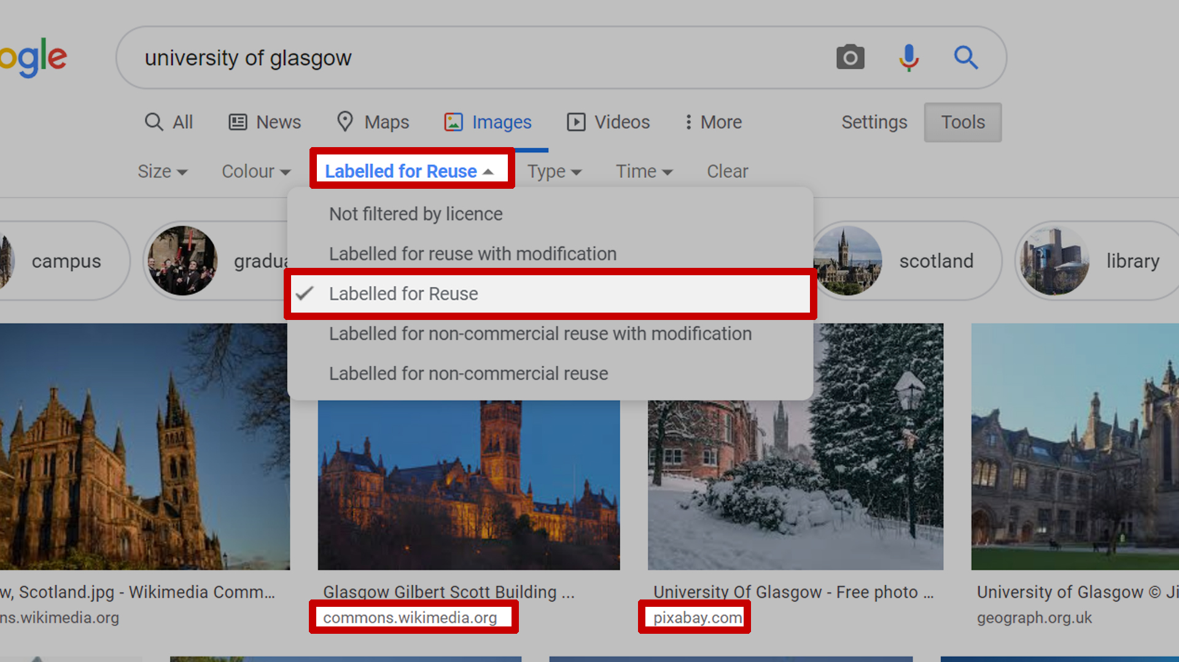
Notes:
Slide 13: Step 5 of 5
Once you’ve chosen how to filter your image search, the browser will refresh and then you’ll notice the image results on screen have changed. If you return to the usage rights (found under tools) and click on it, you’ll notice how you chose to filter your image now has a tick next to it, signifying that the images results adhere to this.
You’ll notice as well, the sources for the images have changed as well. These are copyright free sources, which we’ll examine in more detail later on.

Slide 14
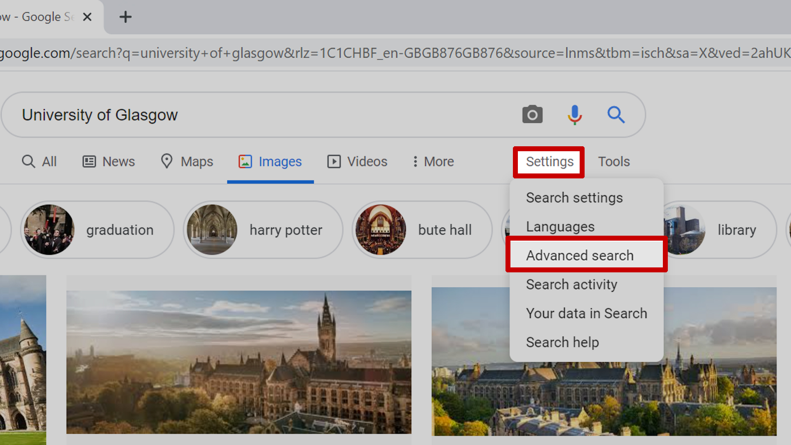
Notes:
Slide 14: another method of accessing Google Advanced image search
I’d like to quickly make you aware of an alternative method of accessing Google Advanced Image Search. If you’re looking to refine your advanced image search to a granular level, then you can access advanced search, by clicking on settings and selecting ‘Advanced search’ from the drop down menu.

Slide 15
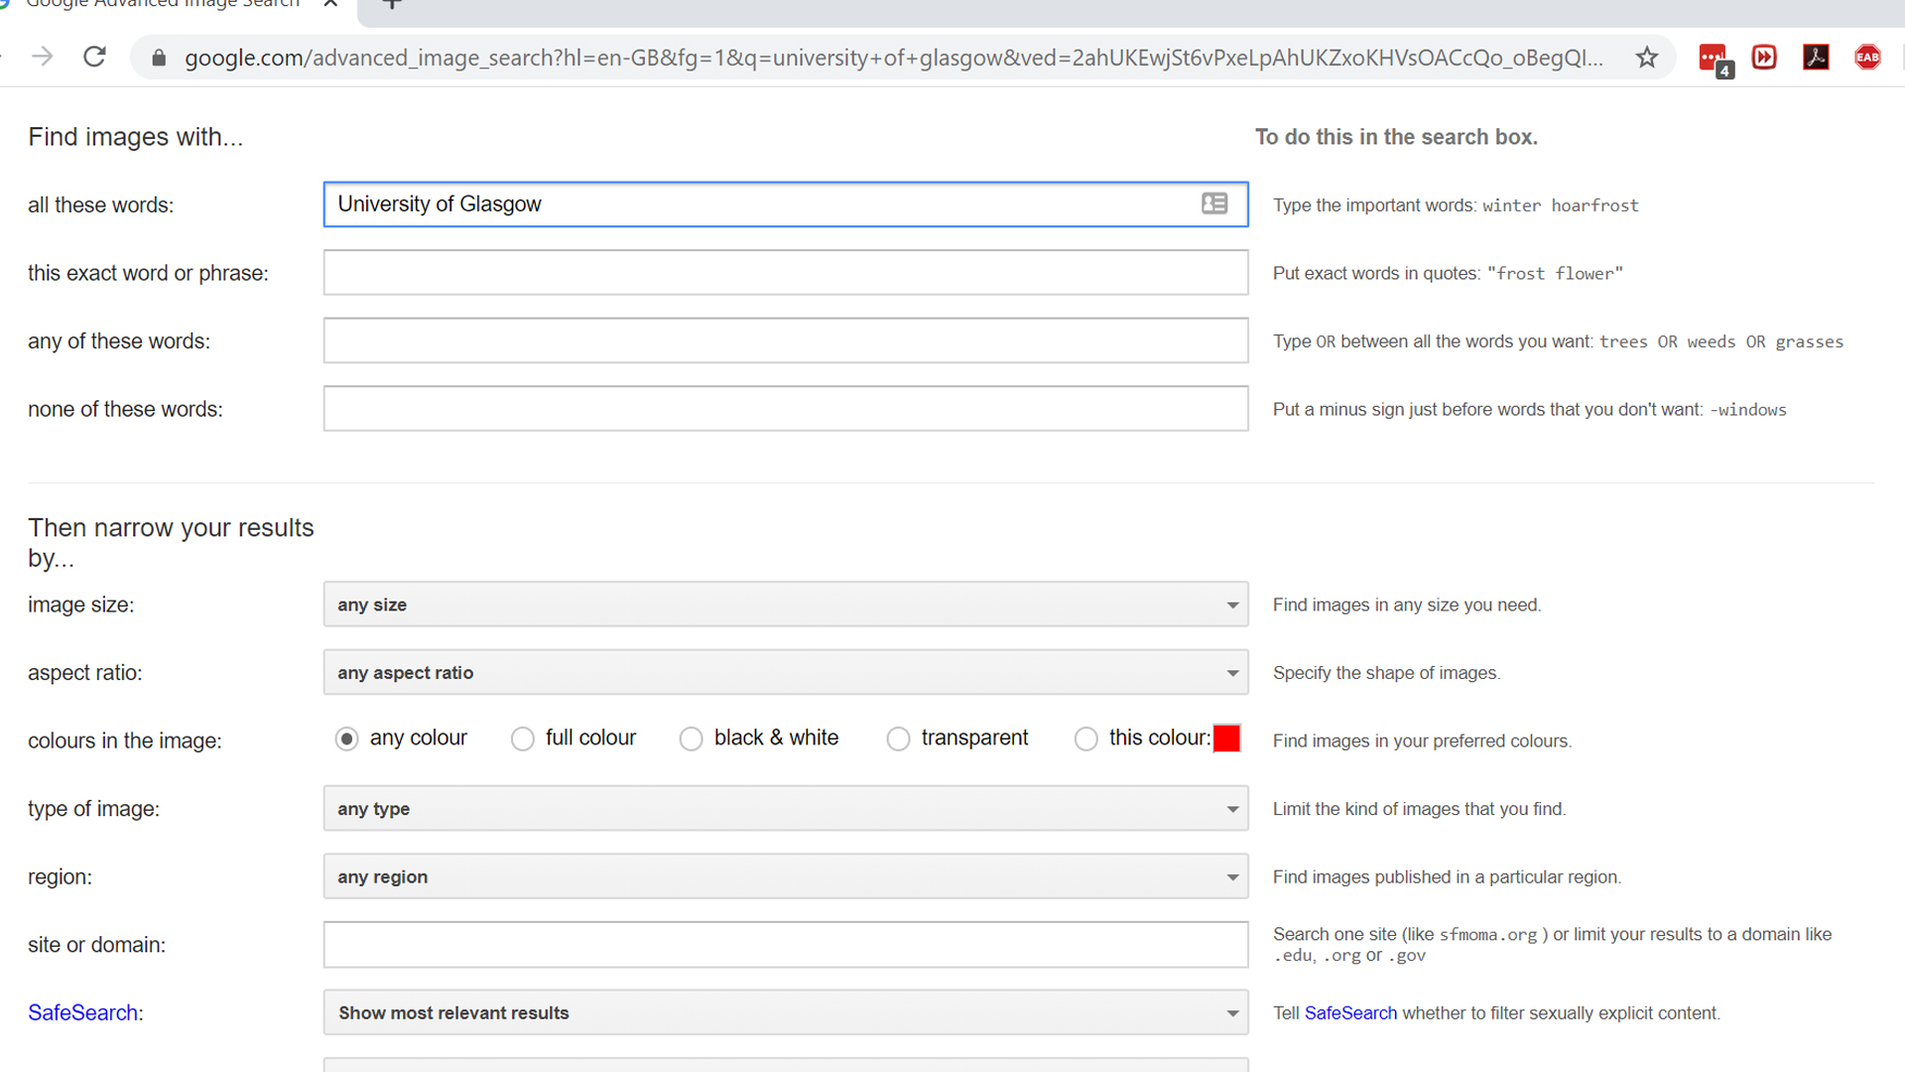
Notes:
Slide 15: another method of accessing Google Advanced image search
You’ll notice in the advanced search screen, you can refine your search, by using or excluding certain words or phrases, the type of image, its size, the region its from, colours used in the image etc.. You can still apply the filters for usage type as well in this screen.

Slide 16
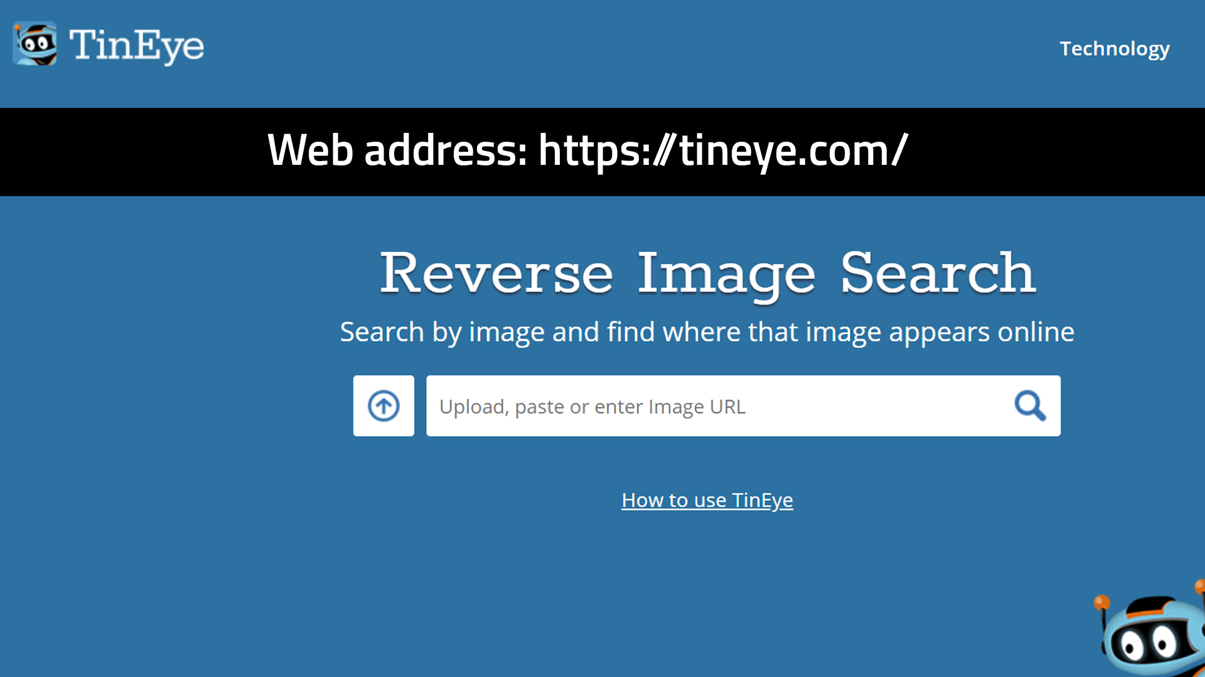
Notes:
Slide 16: TinEye Reverse Image Search engine
I’d now like to draw your attention to Tineye, which is a useful reverse search engine. This is a useful tool, when you have an image, but know what the online source is. I’ve found this useful, if for example, I’ve inherited teaching materials (PowerPoint slides), and I don’t know where the images used in the slides came from. To remedy this, I can upload my images individually to TinEye, which will return search results showing which online websites the image is used in, if at all. This helps determine if the image is copyright free or if its copyright protected.
We’ll go over the quick process of uploading an image and viewing the results

Slide 17
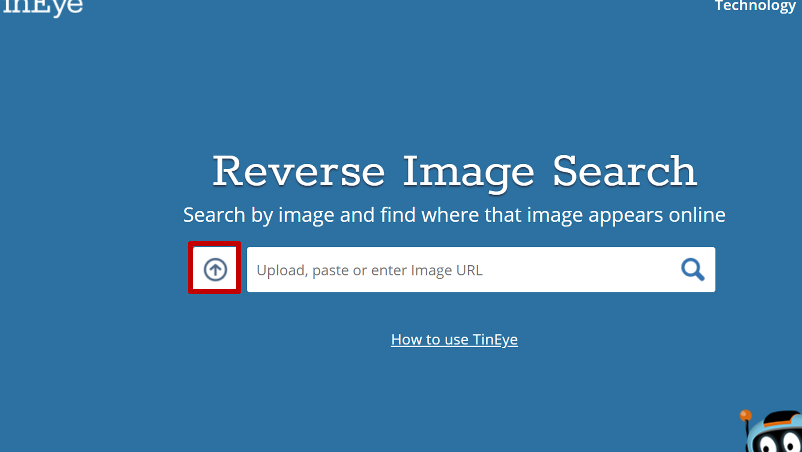
Step 1 of 3
Notes:
Slide 17: Using TinEye, step 1 of 3
To begin uploading an image to TinEye, click on the arrow button near the centre of the screen

Slide 18
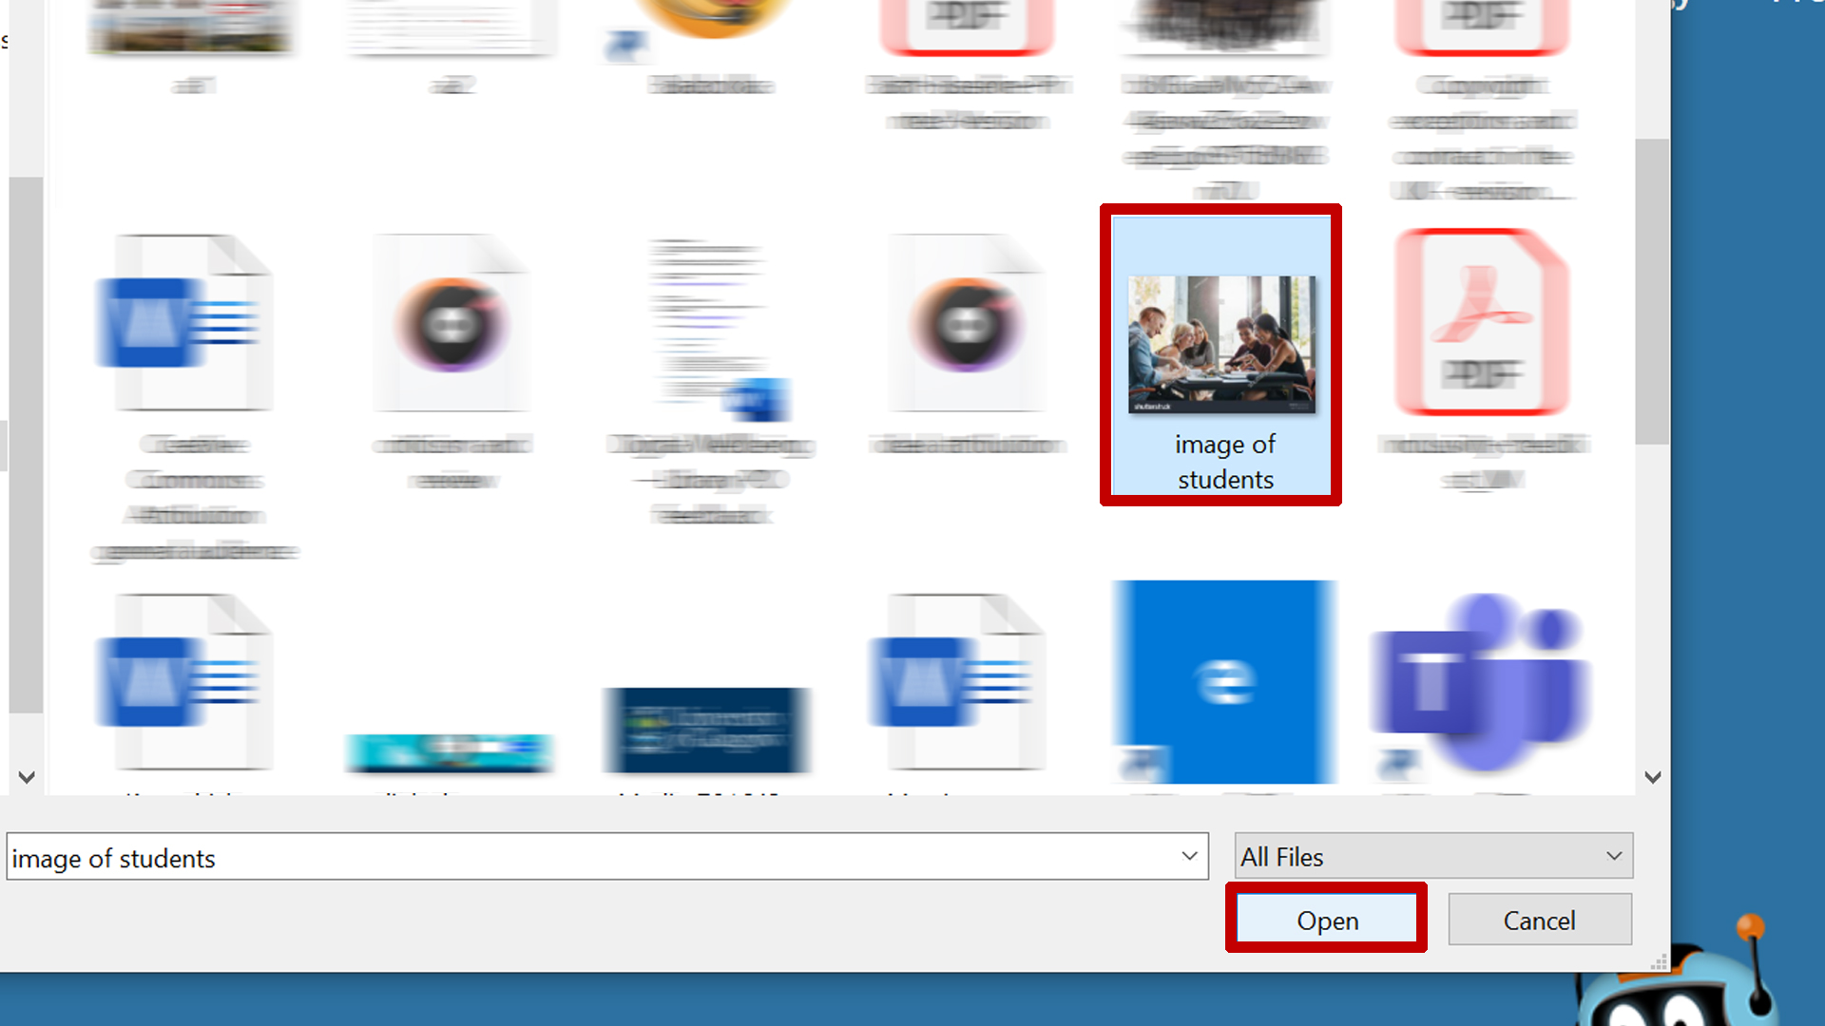
Step 2 of 3
Notes:
Slide 17: Using TinEye, step 2 of 3
A file chooser will pop up on screen, navigate to the image you want to upload, select it, and then click on the ‘Open’ button

Slide 19
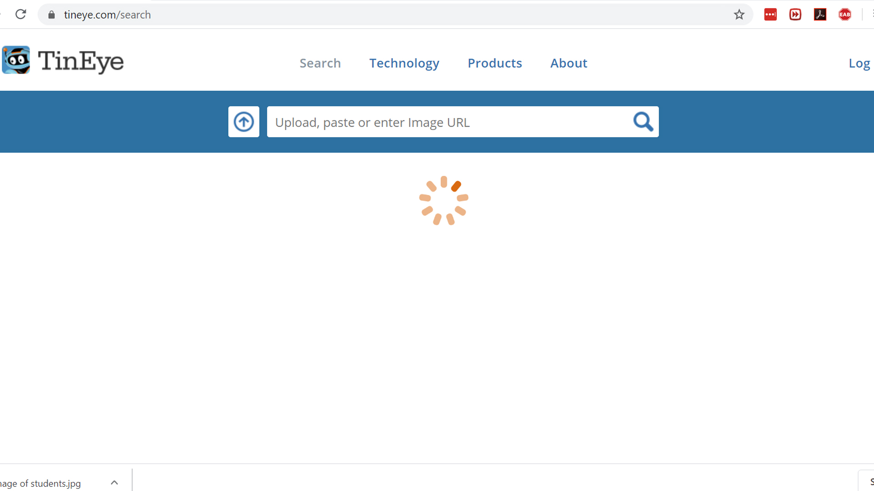
Notes:
Slide 17: Using TinEye, side note
Please note, you may see what's on screen, when your image is being processed by TinEye

Slide 20
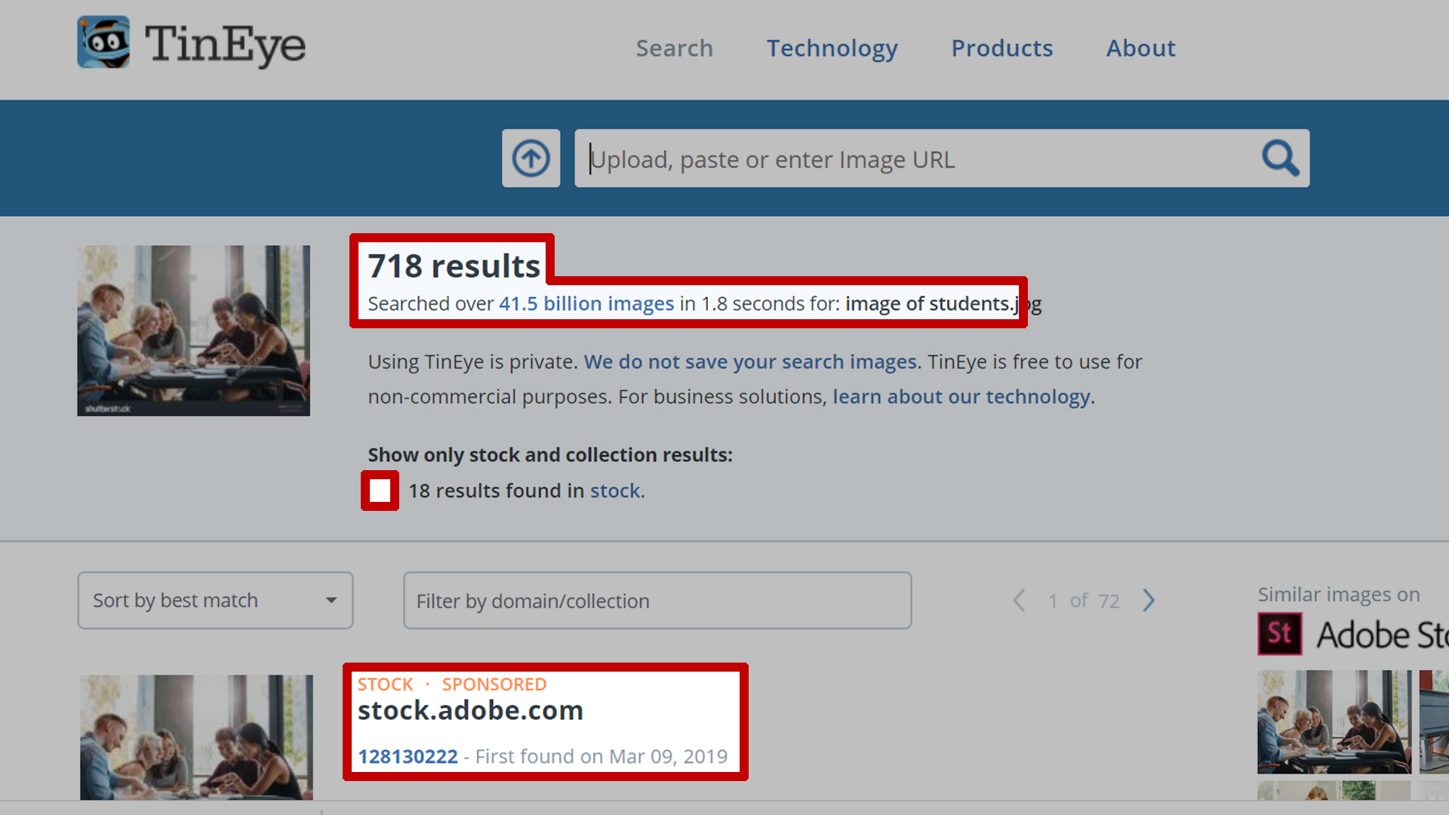
Step 3 of 3
Notes:
Slide 18: Using TinEye, step 3 of 3
Once your image has been processed, the results will be displayed on screen. Near the top, you’ll see the total number of results and the number of images TinEye searched through.
You can see images that are used in commercial online image collections are highlighted within the results.
Image results can be further refined by clicking on the box next to ‘show only stock and collection results.

Slide 21
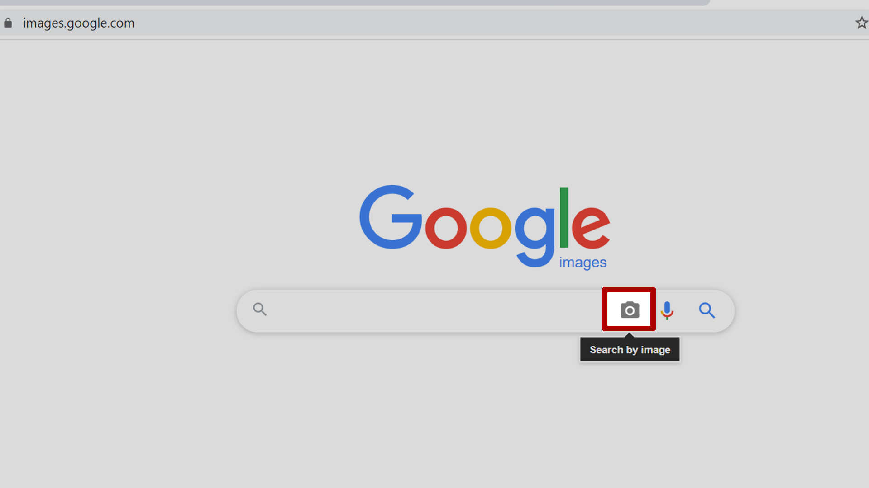
Google Reverse image search
Notes:
Slide 19: Alternative to using TinEye
Please note, an alternative to TinEye is Google Reverse Image search engine. To access this, click on the camera icon located to next to the text entry field

Slide 22
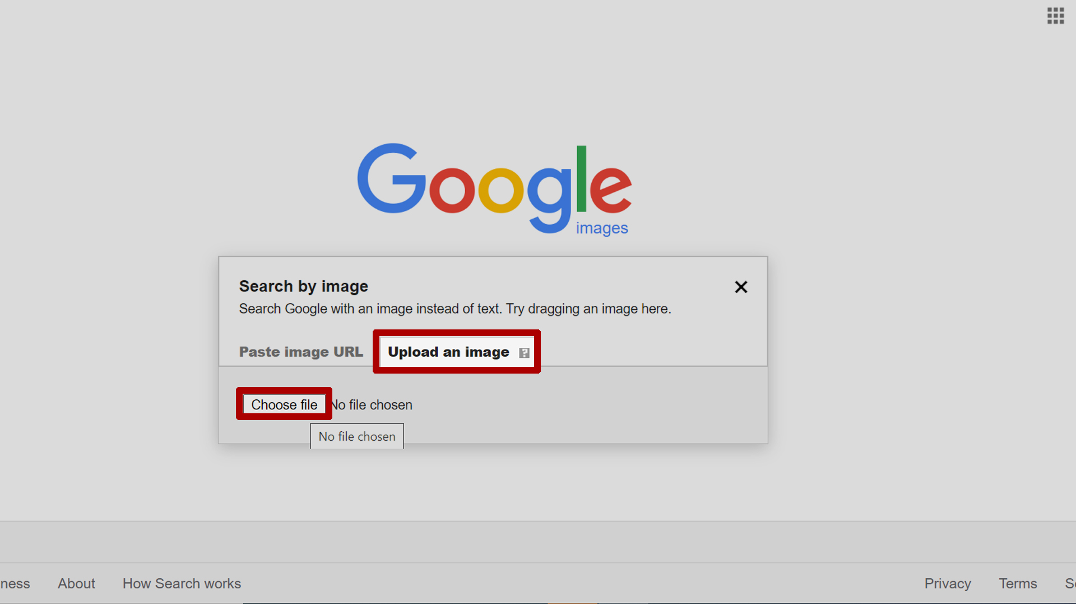
Google Reverse image search
Notes:
Slide 20: Alternative to using TinEye continued
Images can be uploaded in the same manor as found in TinEye.

Slide 23
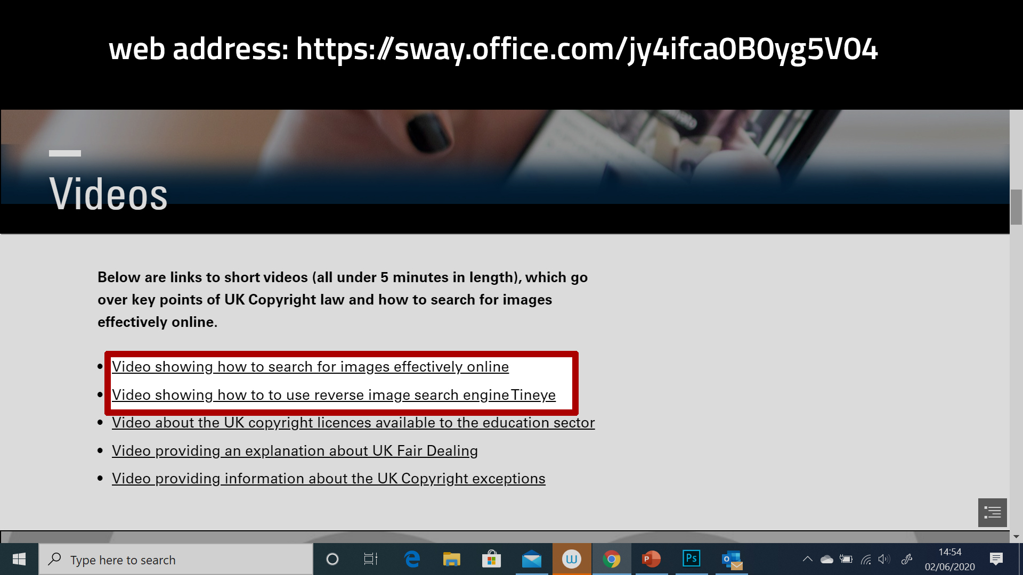
Notes:
Slide 21: Where to find guidance and tutorials for Google Advanced images search, TinEye and Google reverse image search
You can refer to the document and video guides found on this page for tutorials on what we’ve covered so far; how to search for images effectively using Google advanced image search and reverse search engine TinEye.

Slide 24
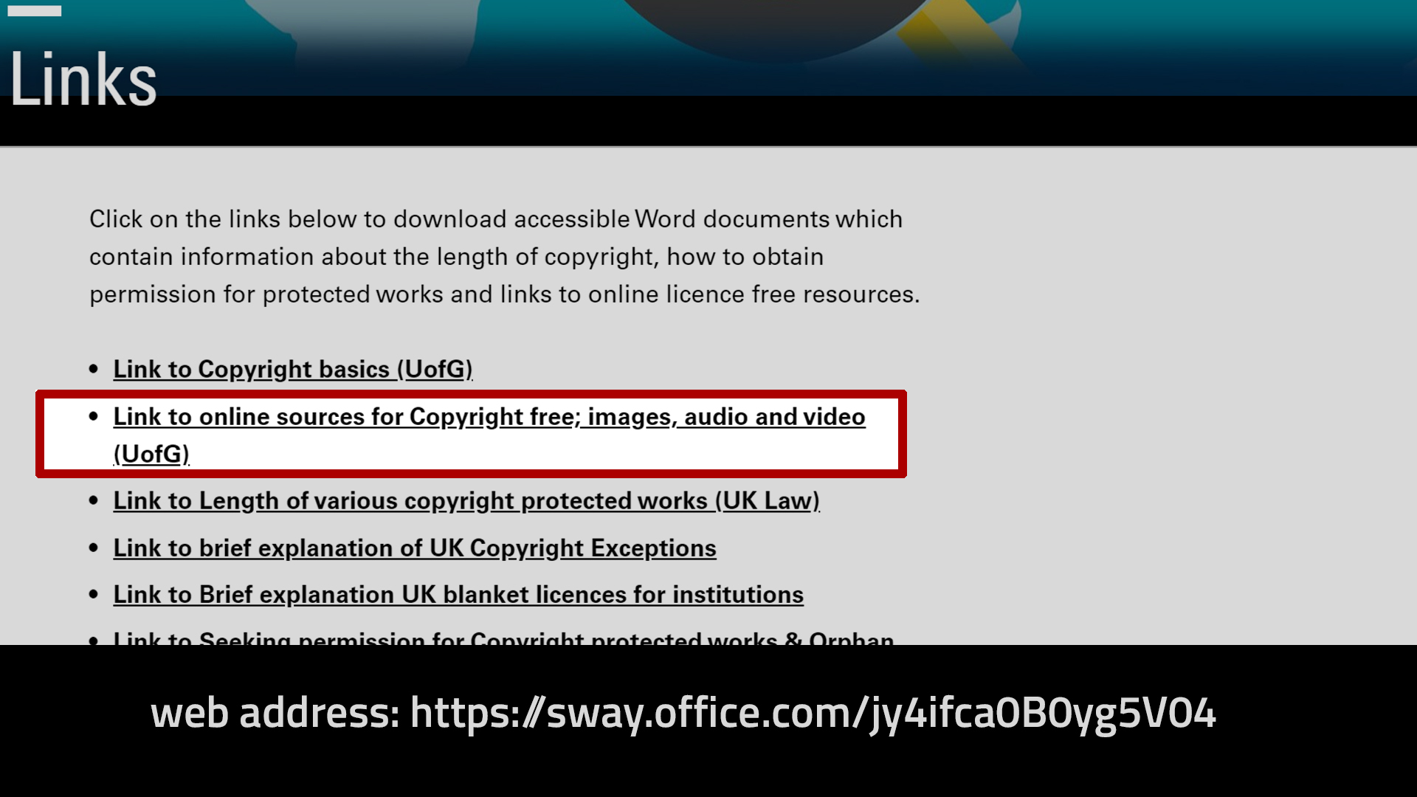
Notes:
Slide 22: Where to find online copyright free sources
In this next section, we’re going to cover where to find reliable, copyright free online sources for images, video and audio.
To save both staff and students valuable time, I would suggest downloading the list highlighted on screen, as it’s aimed at University of Glasgow staff and students.

Slide 25
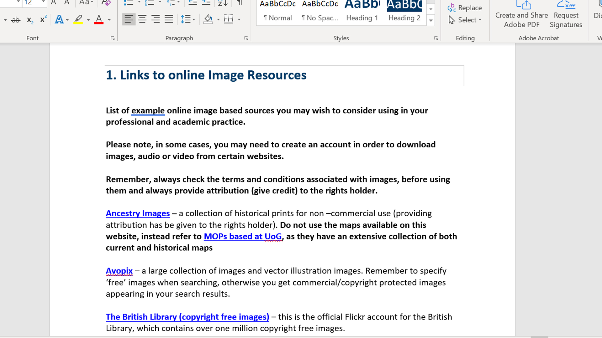
Notes:
Slide 23: Further information about online Copyright free sources list
This list is a Word document format, and contains a wide range of online sources for images, audio and video. A brief synopsis is next to each collection and you can directly access them, by clicking on the blue link text.

Slide 26
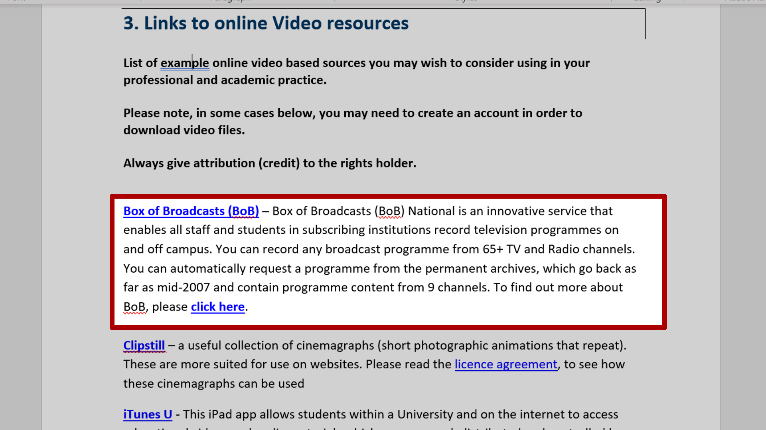
Notes:
Slide 24: Further information about online Copyright free sources list continued
This list also contains links to subscription based services like Box of Broadcasts that are exclusive to University of Glasgow staff and students

Slide 27
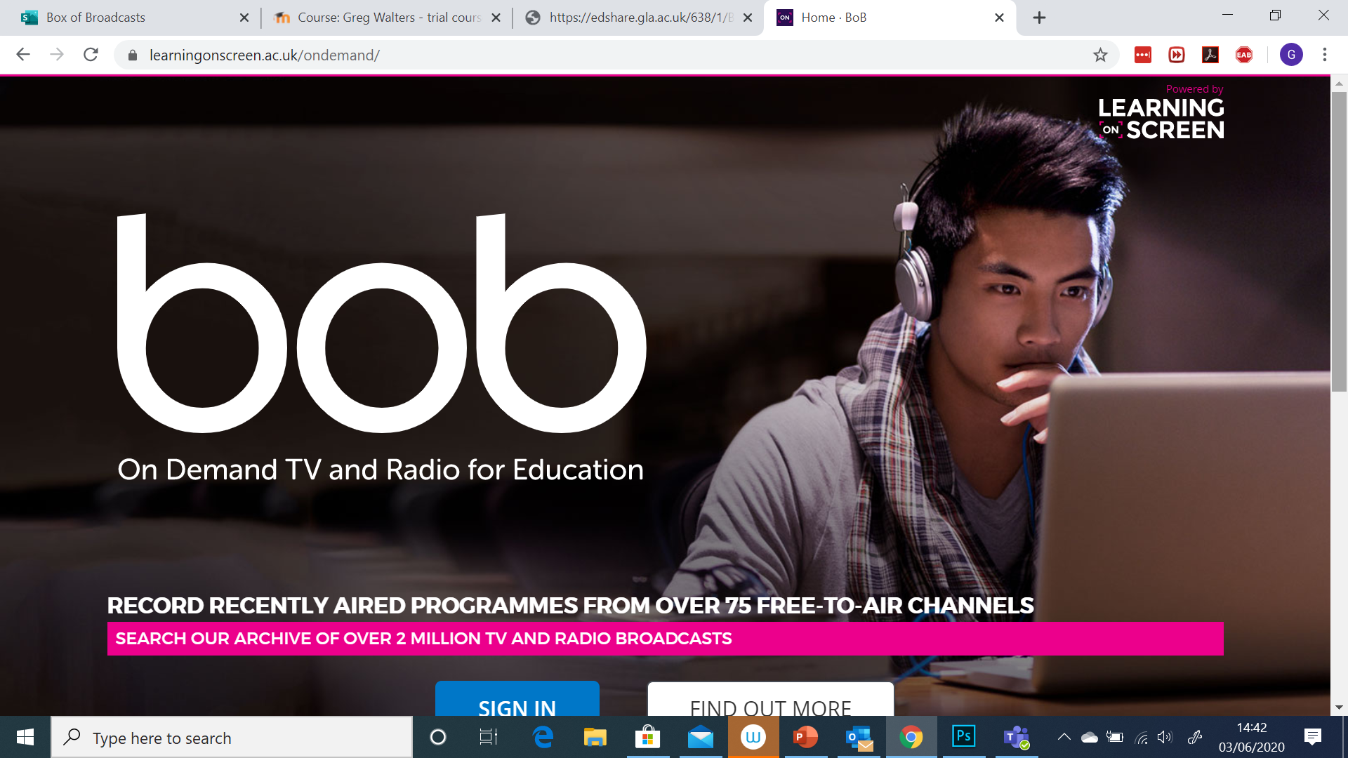
Notes:
Slide 26: Box of Broadcasts
I’m going to focus on Box of Broadcasts (BoB), as Reding Lists @ Glasgow is being presented by the team in another portion of this zoom session.
BoB, is a service that the University subscribes and it enables the on and off campus recording of television programmes on and off campus.

Slide 28
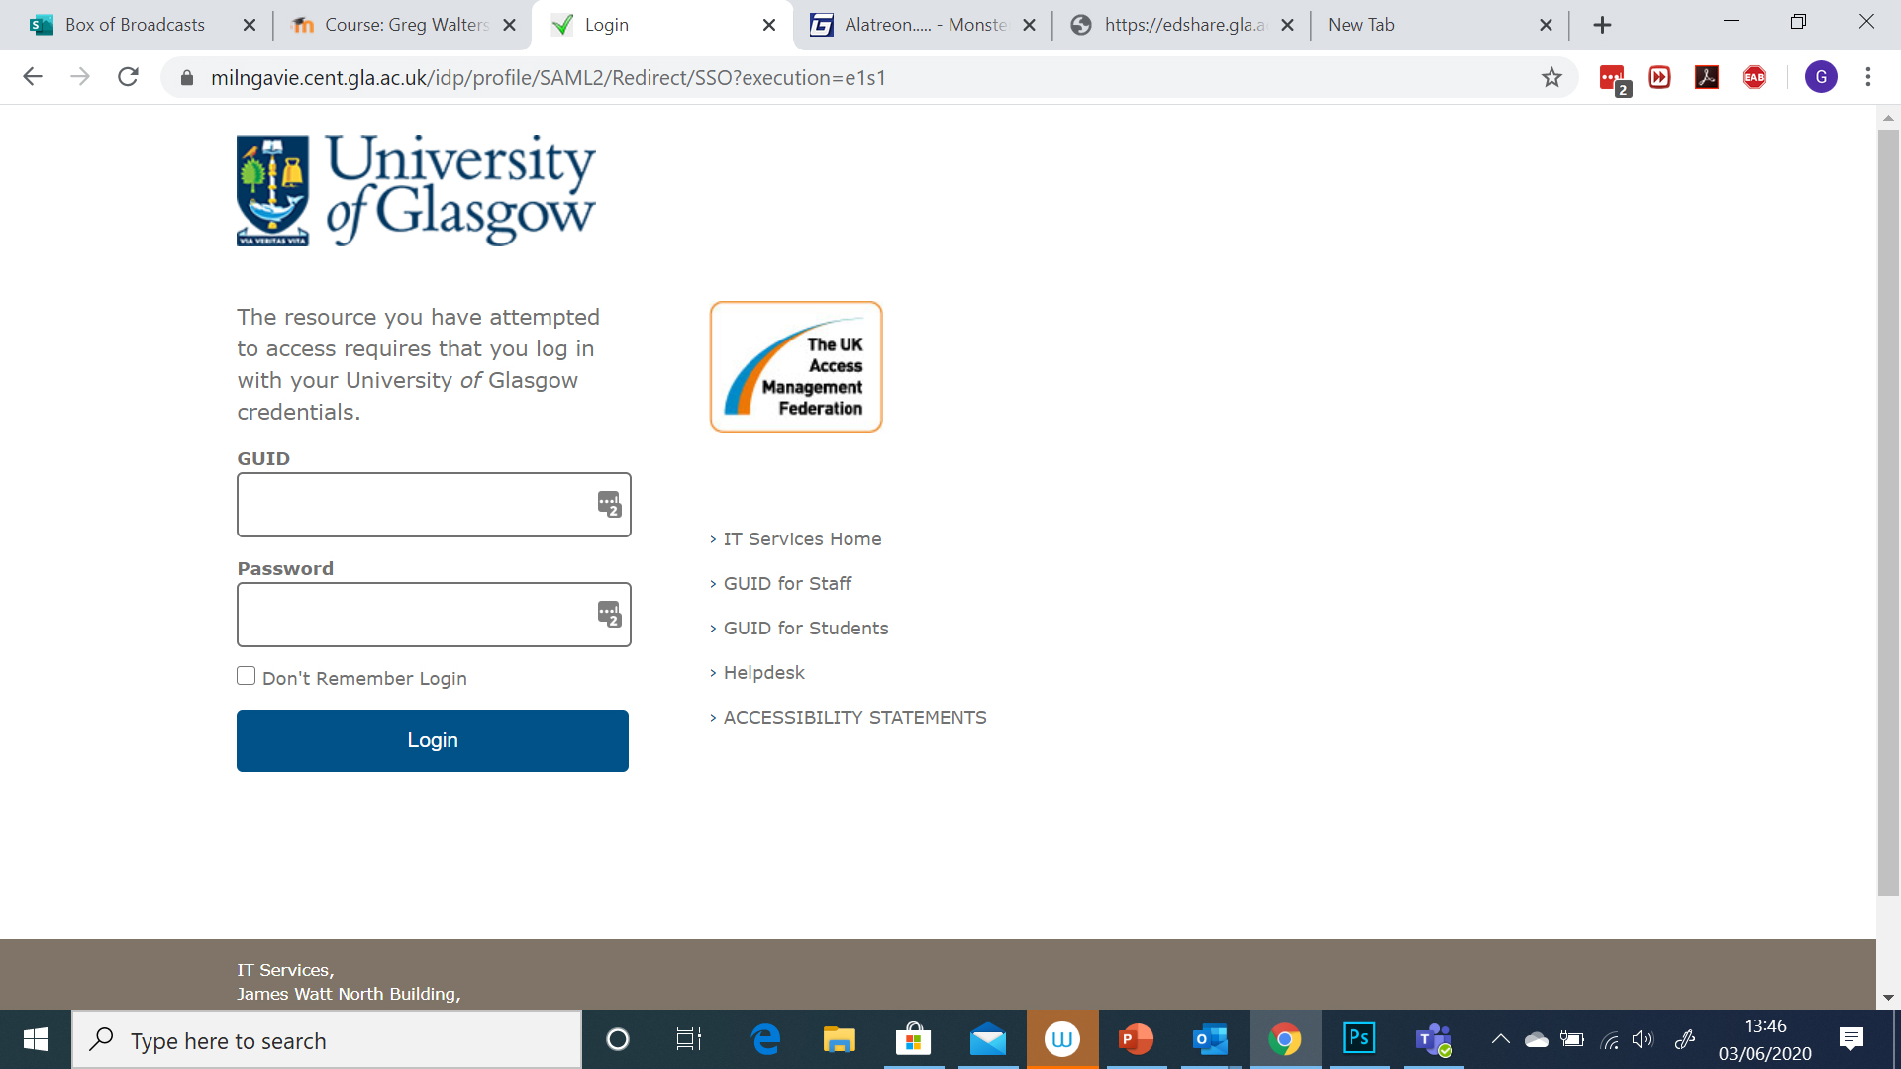
Notes:
Slide 27: Box of Broadcasts continued
To access BoB you can login with your GUID.

Slide 29
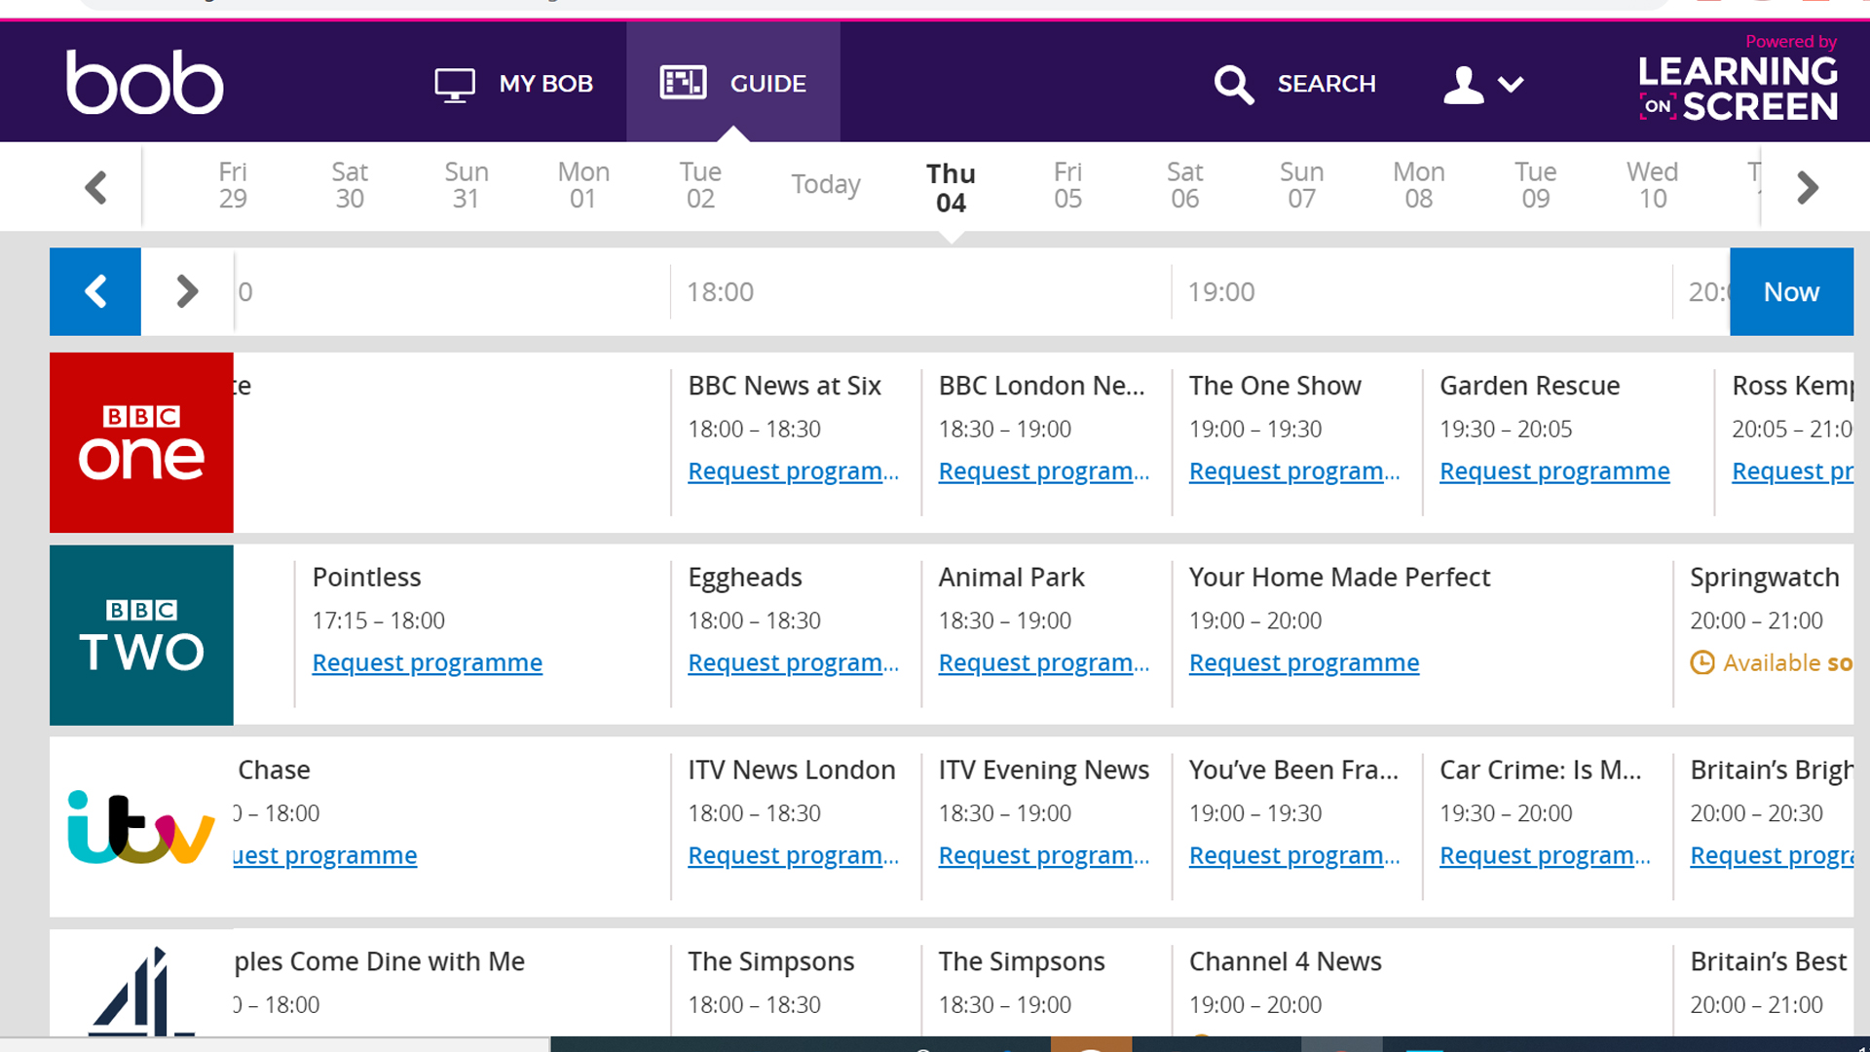
Notes:
Slide 28: Box of Broadcasts continued
You can record any broadcast programme from 65+ TV and Radio channels and automatically request programme(s) from the permanent archives, which go back as far as the 1950’s and contain programme content from 9 channels:
BBC 1 London/BBC 2, London/BBC 4/ITV, London/Channel 4
More 4/ Channel 5/BBC Radio 4/BBC Radio 4 Extra
Your recorded programmes are stored indefinitely (no expiry date) and added to a growing media repository (currently over 2 million broadcast programmes), which is content shared by other users from subscribing institutions. The programmes you record can only be used and accessed within the UK.
You cannot download content from BoB as it’s a streaming service.
I’d also like to make everyone available that, International students enrolled at UK universities but currently continuing their studies overseas due to the Covid-19 crisis can temporarily access the BBC News Channel via BoB, the UK streaming service for education, for the very first time. This lasts until the end of July 2020.

Slide 30
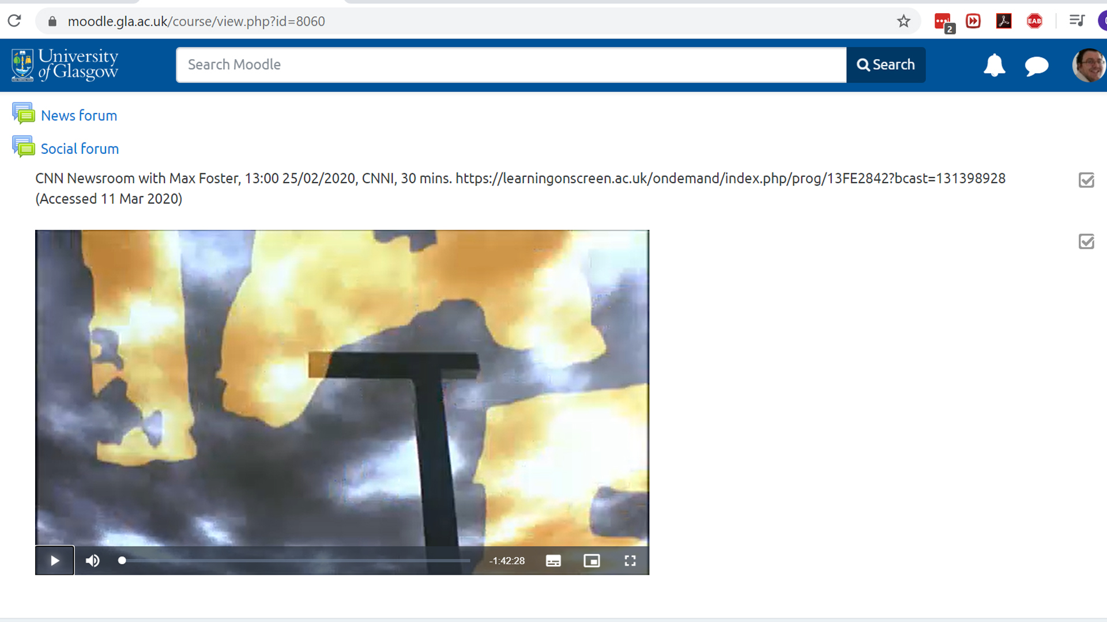
Notes:
Slide 29: Box of Broadcasts continued
Clips form BoB can be embedded into password protected environments like Moodle and made available to enrolled UK based UofG students.

Slide 31
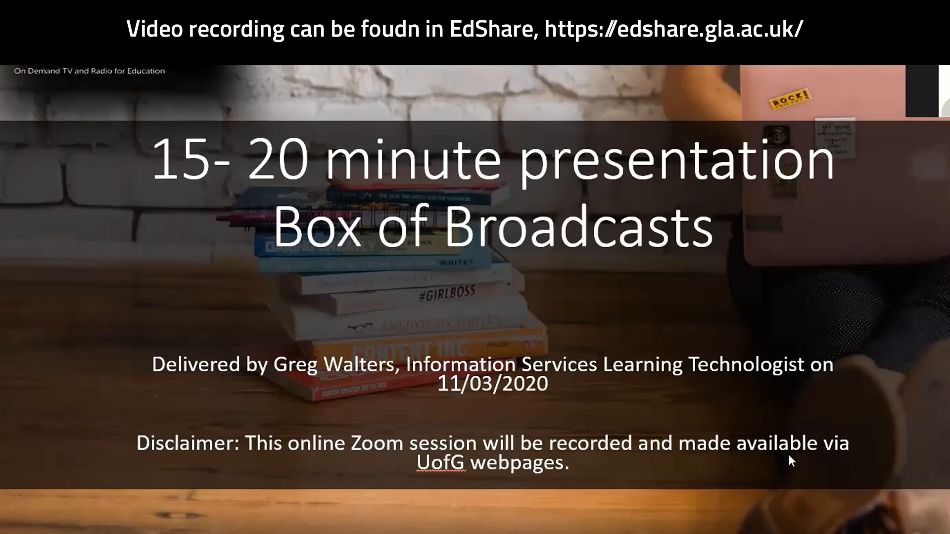
Video recording can be found here: https://sway.office.com/jy4ifca0B0yg5V04
Notes:
Slide 31: Box of Broadcasts continued
For an in-depth examination of what BoB is and how to use it, please refer to the video recording of a Zoom session I delivered. This examines what BoB is, the platforms functionality and how clips can be used and shared.

Slide 32
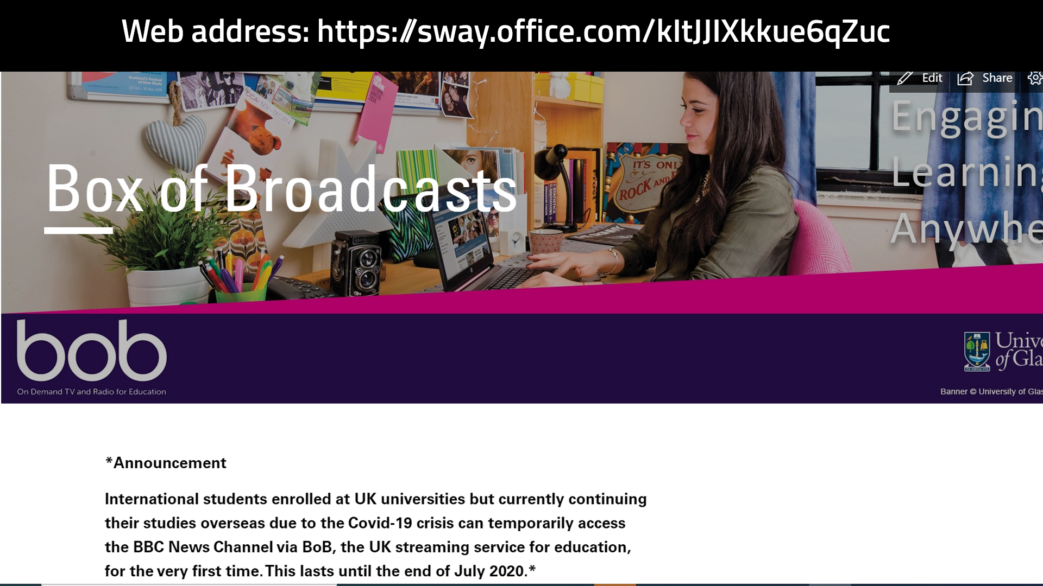
Notes:
Slide 32: Box of Broadcasts continued
There’s also a BoB information page, which provides a direct link to BoB’s log in page

Slide 33

Notes:
Slide 34: Creative Commons
We’ll now briefly examine what Creative Commons is and where you can find out more information about the licences and attribution associated with it.

Slide 34
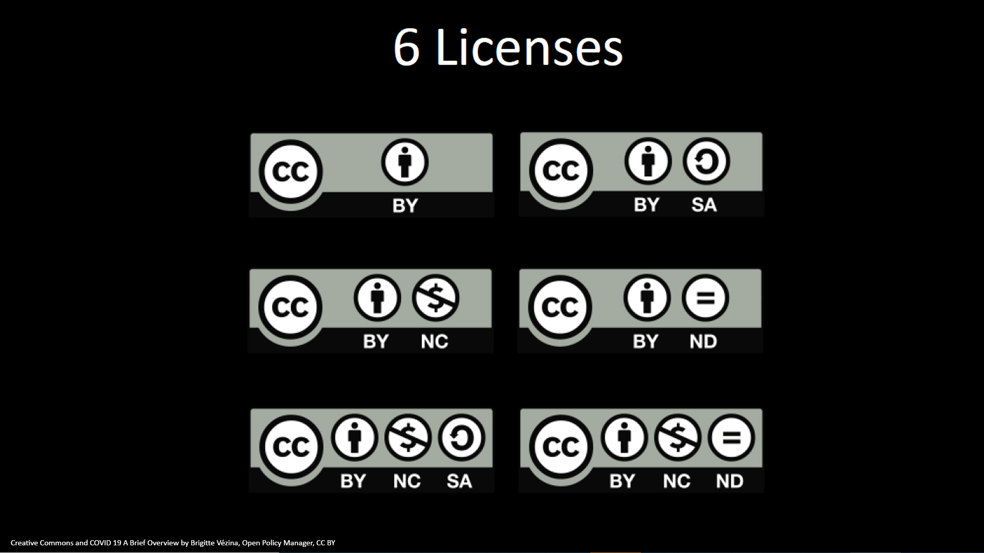
Notes:
Slide 31: Creative Commons Licences
Creative Commons is a suite of licences that enable creators to assign a simple, standardized way to give people permission to share and use your creative work— on conditions of your choice.

Slide 35
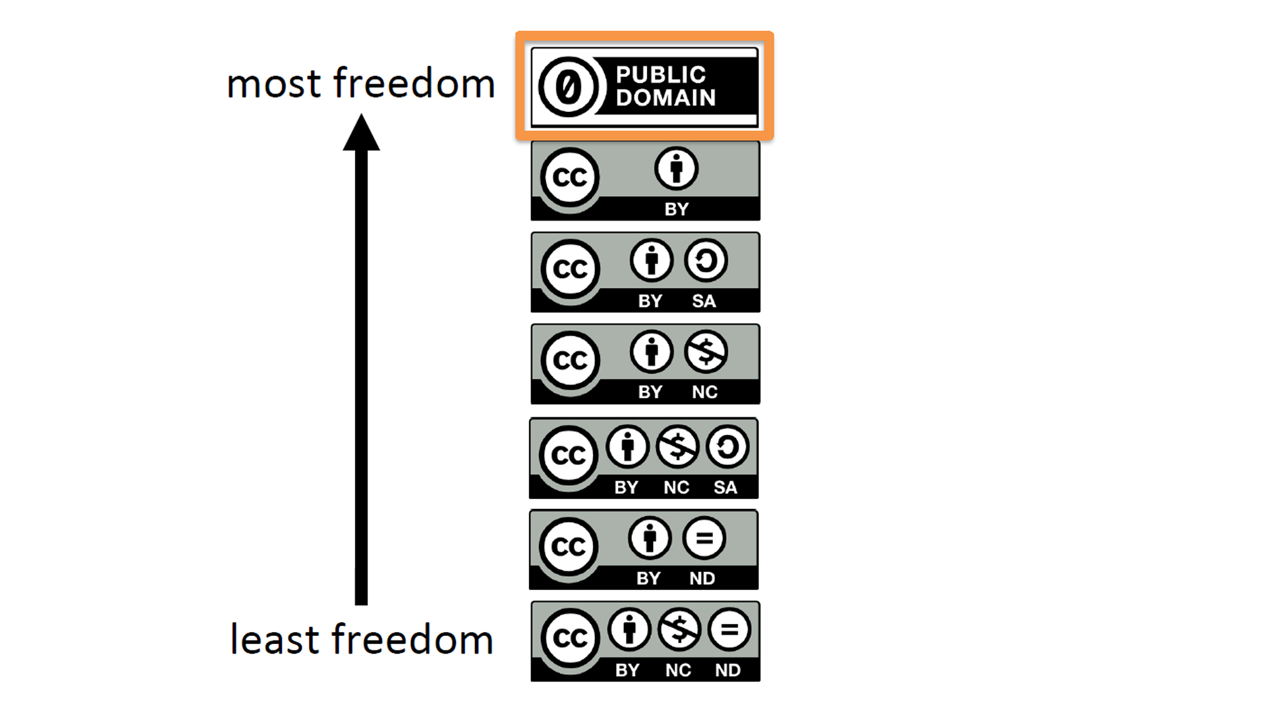
Creative Commons and COVID 19 a brief overview by Brigitte Vézina, Open’s Policy Manager, CC-BY
Notes:
Slide 32: Creative Commons Licences levels of ‘use’
There are various levels of ‘use’ associated with each type of licence, at one end of the scale we have what we call CC0, which is very open licence type, that allows materials to be reused, repurposed and distributed both commercially and non-commercially. Whilst at the other end of the scale we have the licence that doesn’t allow commercial reuse and no derivatives, i.e. the original materials can’t be modified or edited.

Slide 36
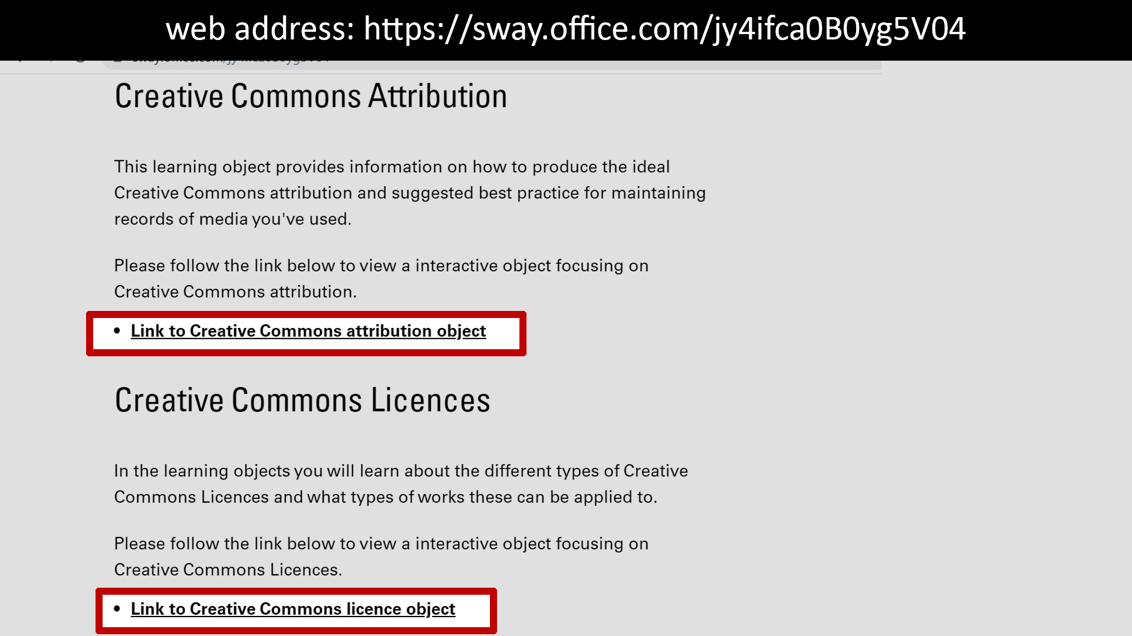
Notes:
Slide 33: Creative Commons, online learning resources
To learn more about Creative Commons licences and how to provide attribution (credit) to the rights holder, please examine the two learning objects highlighted on screen as these examine these areas in detail.
We don’t have time to fully explore Creative commons in this session, however, it would be useful to gauge the demand for such a session, so if you’d like a focused session on this, please let me know via the chat section or email (I’ll post my address at the end of my section)

Slide 37
Notes:
Slide 34: UK Copyright Exceptions
We won’t have the opportunity to fully explore both Fair Dealing and the UK Copyright exceptions. In this section I’m going to broadly go over what both Fair Dealing and the Copyright Exceptions are and allow. I will direct you to resources which go over both of these areas in more detail and as before, if anyone would like for me to do a focussed session around Fair Dealing or any of the UK Copyright Exceptions then please let me know via the chat or email.

Slide 38
Fair Dealing
Fair dealing is tied to a number of the UK Copyright Exceptions
It’s a framework that’s allows the lawful use of copyright protected work without having to seek permission from the author
Notes:
Slide 35: Fair Dealing
Licences aren’t the only method that enable the legal use of copyright protected works for teaching. During 2014 the UK Government introduced a number of reforms to the Copyright Design and Patent Act (CDPA), that make it easier to use material without having to obtain permission from the Rights Holder, but with attribution (credit) for the author. This results in the UK Copyright Exceptions being updated as well, these are tied to specific uses (usually educational and for non-commercial purposes). One concept that is connected to a number of the UK Copyright Exceptions is Fair Dealing.
Fair Dealing is a framework designed to allow the lawful use of copyright protected work without having to seek permission from the author. Sufficient acknowledgement must be provided to the author when their work is used, unless it is impossible to do so.
We’ve examined what Fair Dealing is and how its tied to a number of the UK Copyright Exceptions which allow different types of protected work to be used for the purpose of teaching.
We’ll now analyse a few relevant copyright exceptions in relation to teaching.

Slide 39
Section 30 Criticism, Review, Quotation and News Reporting
Allows the use of any work that has been made available to the public to be used for the purposes of review, criticism and quotation
The use of works must align with this exception and cannot be for illustrative purposes
There is no requirement that the use should be for non-commercial
Notes:
Slide 36: section 30 Criticism, Review, Quotation and News Reporting
The first exception we’re going to examine is section 30:
This exception (30 CDPA) allows the use of any work (that has been made available to the public) for the purpose of criticism, review, quotation, providing there is sufficient acknowledgement. There is no clear guidance on what represents criticism and review. In order for the exception to apply the copying must truly be for the purposes of review and criticism and not purely for illustrative purposes. You have to use your judgement and make sure you do not impinge the copyright owner’s right of exploitation. Quotes should be used as is necessary for the purpose.
Key points relating to this exception are:
Please note there is no Fair Dealing exception when quoting from unpublished material.
In contrast to s.32 Illustration for Instruction, there is no requirement that the use should be non-commercial.
Before we continue to examine the next exception, I’d like to quickly go over ‘Sufficient attribution’. This means giving credit to the author of the work you want to use, not the copyright holder. A good example of this would be to cite the author of a book as opposed to the publisher. In terms of what should be included in your attribution, the key components are to identify the work your intending to use, i.e. name of image and as previously discussed the name of the author. There's no need for a Harvard style (or length) type of attribution.

Slide 40
Section 32. Illustration for Instruction
Allows all types of Copyright protected works to be used
Uses must be for non commercial teaching purposes, not decorative
Attribution must be provided for the author of the work you’re going to use
Good practice, only use the amount of work necessary, in order to illustrate your teaching point
Notes:
Slide 37: section 32 illustration for Instruction
Providing it is for the sole purpose of 'illustration for instruction', individuals can utilise extracts from all types of copyright works i.e. film, music, sound recordings and text, to demonstrate a teaching point. Copying is not limited to digital distribution; it can also be done by hand and is not restricted just to educational establishments. However, the use must be for educational, non-commercial purposes, and accompanied by sufficient acknowledgement (credit) for the author of the work you intend to utilise.
The online usage of this exception can be challenging to determine, what constitutes ‘fair use’? If, for example access to content is restricted to enrolled students via a password protected environment like Moodle, then this will increase the likelihood of the use being considered “fair”. However, this doesn’t mean that materials which use 3rd party content and are made openly available on the web are automatically unfair. Consideration should be given to, whether the use is relevant to teaching, is the amount of work used reasonable and would it impact the market of the original work (i.e. undermine sales)?

Slide 41

Scenarios of when these exceptions could be used
Notes:
Slide 38: examples of how section 30 and 32 can be used
Could I use Zoom to record sections of Box of Broadcasts videos for the purposes of delivering remote learning to enrolled students? - It would depend on the specific circumstances, but in principle you could utilise the quotation part of Section 30 or section 32 Illustration for Instruction may be used. You would need to adhere to the conditions of these exception, i.e. providing sufficient attribution and only using the amount(s) required to fulfil your purpose.
Can I use an image from a commercial website or journal, in teaching materials I intended to make available online to UofG students, for non-commercial teaching purposes? – yes you can, both section 30 and section 32, would allow this image to be used in your teaching materials. Remember of these exceptions, allow types of work to be used, images, text, movies, audio, charts, diagrams,

Slide 42
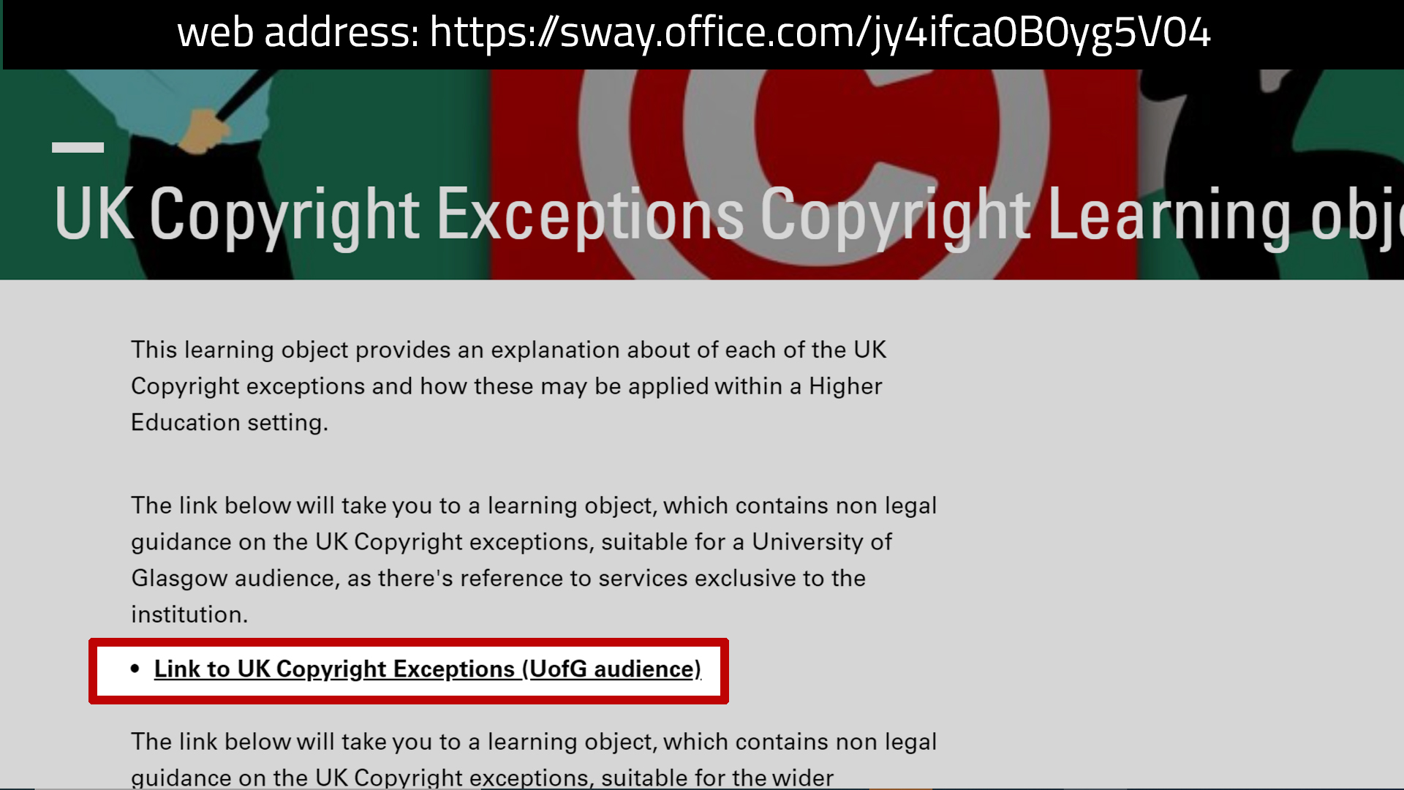
Notes:
Slide 39: where to find detailed information about Fair Dealing and UK Copyright Exceptions
I realise, Fair Dealing and the UK Copyright exceptions are extensive areas to cover, so with this in mind, please refer to the learning object highlighted on screen which will provide detailed information about Fair Dealing and provides explanations about all 17 UK Copyright Exceptions and how they can be applied.

Slide 43
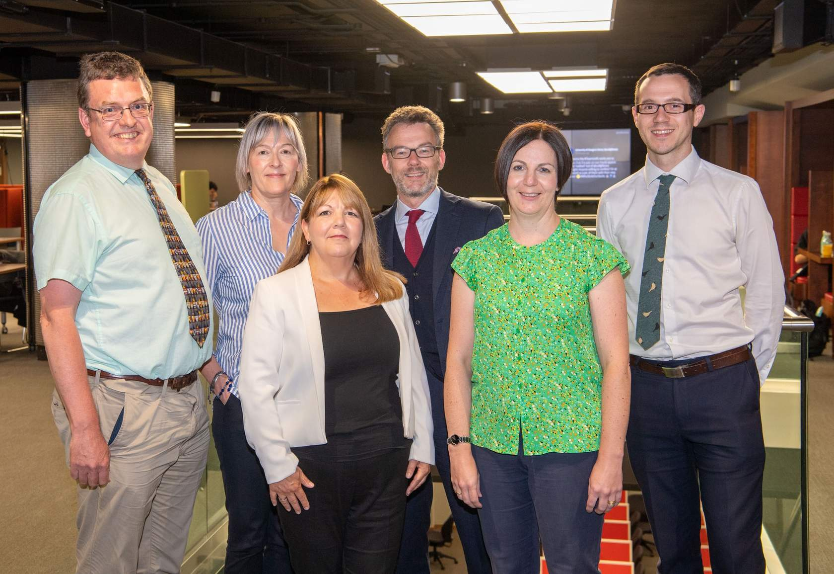
College Librarians
L-R: Richard Bapty (Arts), Lynn Irvine (Social Sciences), Roma Thompson (Science & Engineering), William Nixon (Assistant Director Academic Engagement & Digital Library), Morag Greig (Arts), Paul Cannon (Medical, Veterinary & Life Sciences).
Notes:
Slide 40: College Librarians
This brings me to the end of my talk, however before we proceed onto my contact details and Q & A session (time permitting), I’d like to highlight another excellent service, which is the College Librarians. Please speak to your College Librarian when planning a reading list; not all information is online and openly available. They can also advise on structuring a reading list to encourage your students to go beyond their lecture notes and become more independent learners.

Slide 44
Contact Details
Please send copyright queries to: copyright-queries@glasgow.ac.uk
Links to online resources shown during this presentation – you’ll find everything at: https://sway.office.com/jy4ifca0B0yg5V04
Link to Box of Broadcasts Information page: https://sway.office.com/kItJJIXkkue6qZuc
Link to University Policy for Intellectual Property & Commercialisation: https://www.gla.ac.uk/media/Media_185772_smxx.pdf
Reading Lists @ Glasgow, email address: library-readinglists@glasgow.ac.uk
Notes:
Slide 42: Contact details and links

