Slide 1

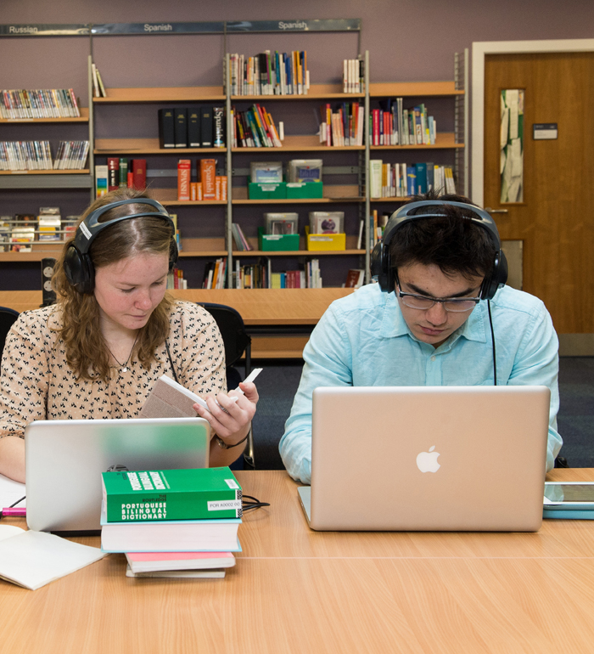


Library
Books in high demand

Slide 2
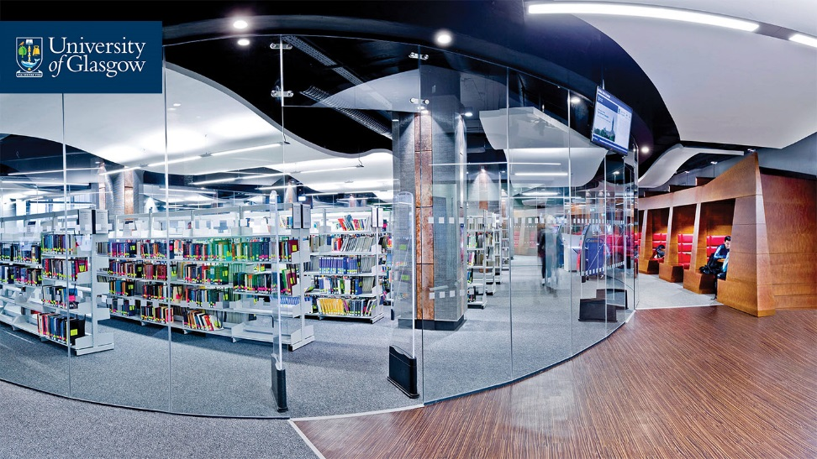


Welcome to the University Library
The Library is here to provide you with resources, spaces and services to support your learning while you are at university.
We buy multiple copies of textbooks and where possible we buy eversions to maximise access. Occasionally there are books which the Library only has a single copy of; for example the book might be out of print or is too expensive for the Library to acquire more than one copy. There are also times when specific books are in very high demand.
The Library has a dedicated high demand space and service to accommodate this.
Welcome to the Library

Slide 3
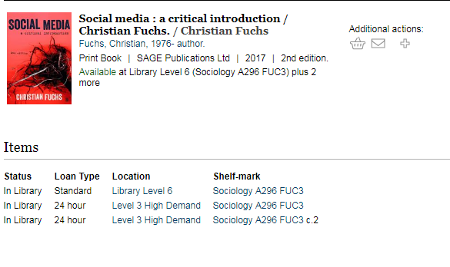
How do I know if a books is in the High Demand collection?
Books in high demand are on the catalogue. Often there is a mix of loan periods for multiple copies of books in high demand.
Books in high demand will be on 24 hour loan or 4 hour loan, depending on the number of copies we have. This will be shown on the catalogue in the Loan Type and Location column in the book’s catalogue record.
If the high demand copies are out on loan, there may be other copies available in the main collection. Remember to check.
Books in high demand

Slide 4

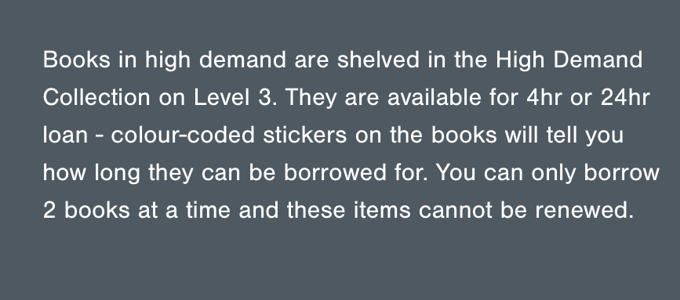
Library High Demand Area
The High Demand area on Level 3 of the Library is secure and you cannot take books out without issuing them first. There are printing, scanning and photocopying facilities in the area so you can, if you prefer, uwse the books in the area without taking them out. Here is a Library video on how to issue books in the High Demand Area.
When you issue the books you will get a receipt telling you when the books are due back.
Since books in this area are highly sought after, there are fines for late return. See our web page for details.
Welcome to the Library

Slide 5
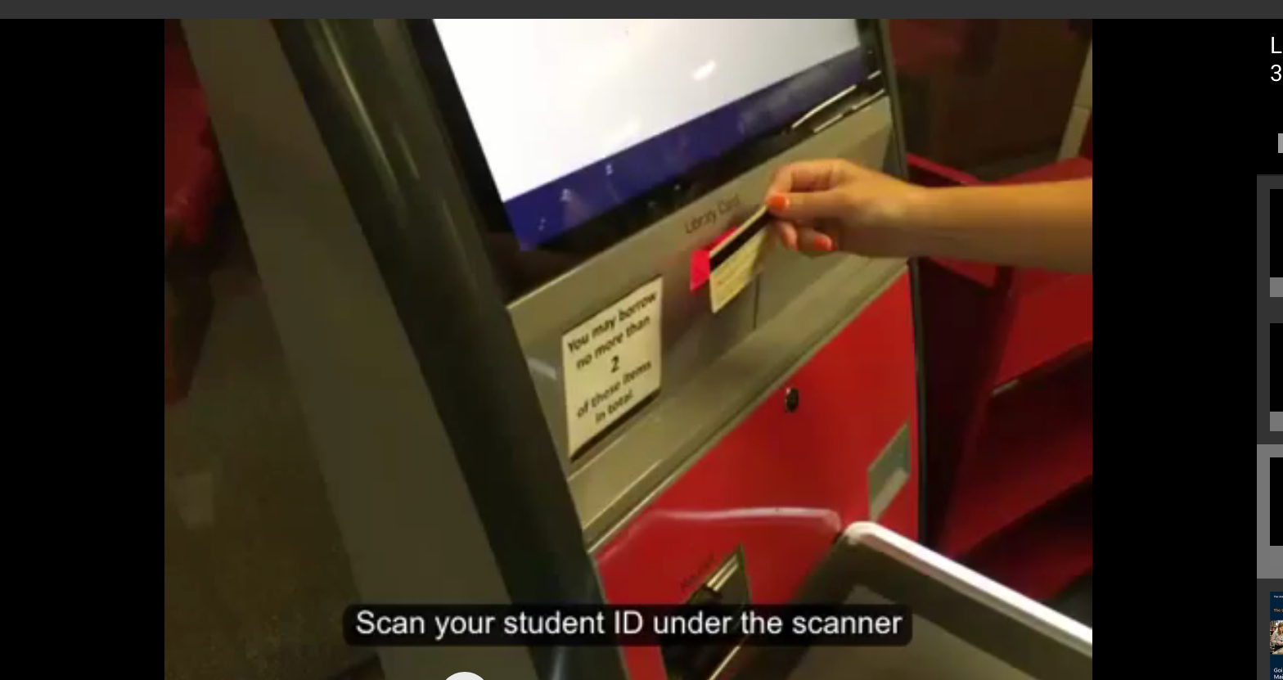
Returning books to the High Demand Area
To ensure that books are available quickly, please return high demand books to the High Demand Area using the red self issue machine there. The screen will advise you to either place the book on the shelving trolley or in the white book bin next to the machines.
You cannot renew high demand books but you can take them out again if no one else has placed a hold.
High Demand Area – returning books

Slide 6
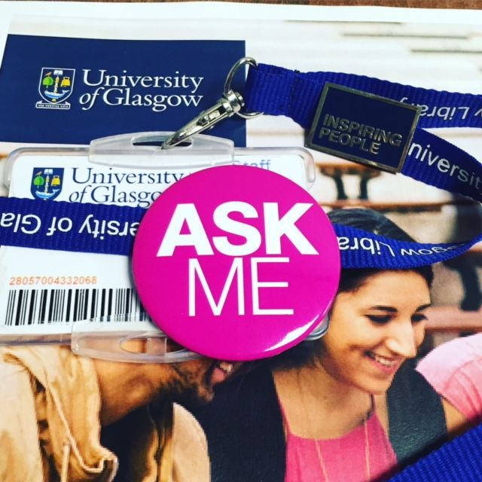
Further Help
See our Library Basics page with an introductory Library video, help guides and our Moodle Course for full help with Library services.
If you would like to speak to someone, please get in touch with your College Librarians – Kay Munro and Lynn Irvine:
Kay.Munro@glasgow.ac.uk
Library Room 810
0141 330 6741
Lynn.Irvine@glasgow.ac.uk
Library Room 810
0141 330 7094
We are very happy to meet with you if you want to find out more about using library resources and using them effectively in relation to your research.
Further help

Slide 7
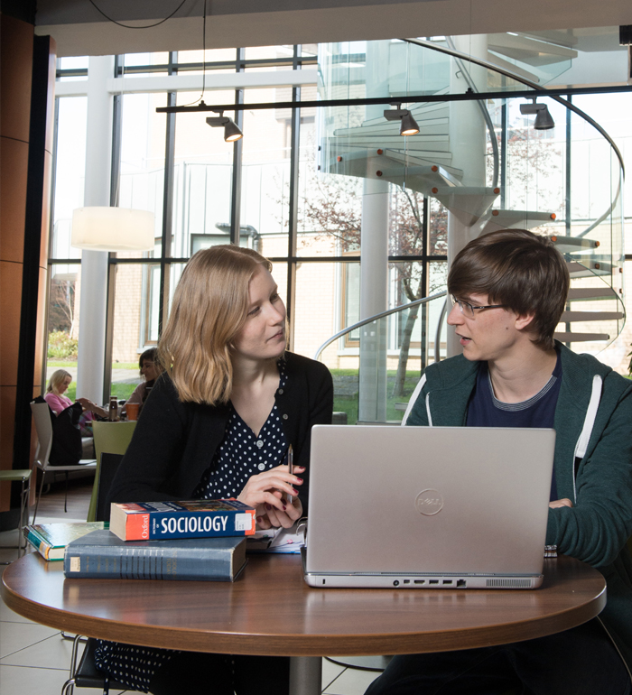
Library
Knowledge Base
Thank you, this presentation is complete.
Please close this presentation.

