Slide 1

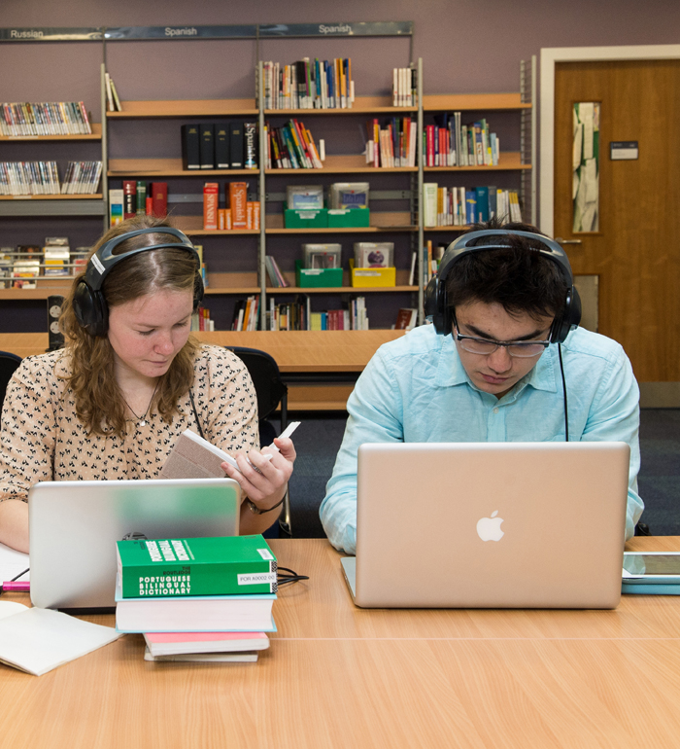


Library
Computers, printers and other equipment in the Library

Slide 2
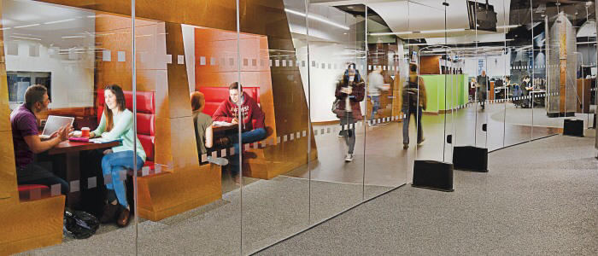


Welcome to the University Library
The Library is here to provide you with resources, spaces and services to support your learning while you are at university.
There are lots of staff and resources to help you use the Library effectively. You will find information on our web pages and there are always people willing to help.
Here are some useful guides to the equipment you will find in the Library including:
Computers
Printers, scanners and photocopiers and print top up machine
Self issue machines
Microfilm readers
Welcome to the Library

Slide 3
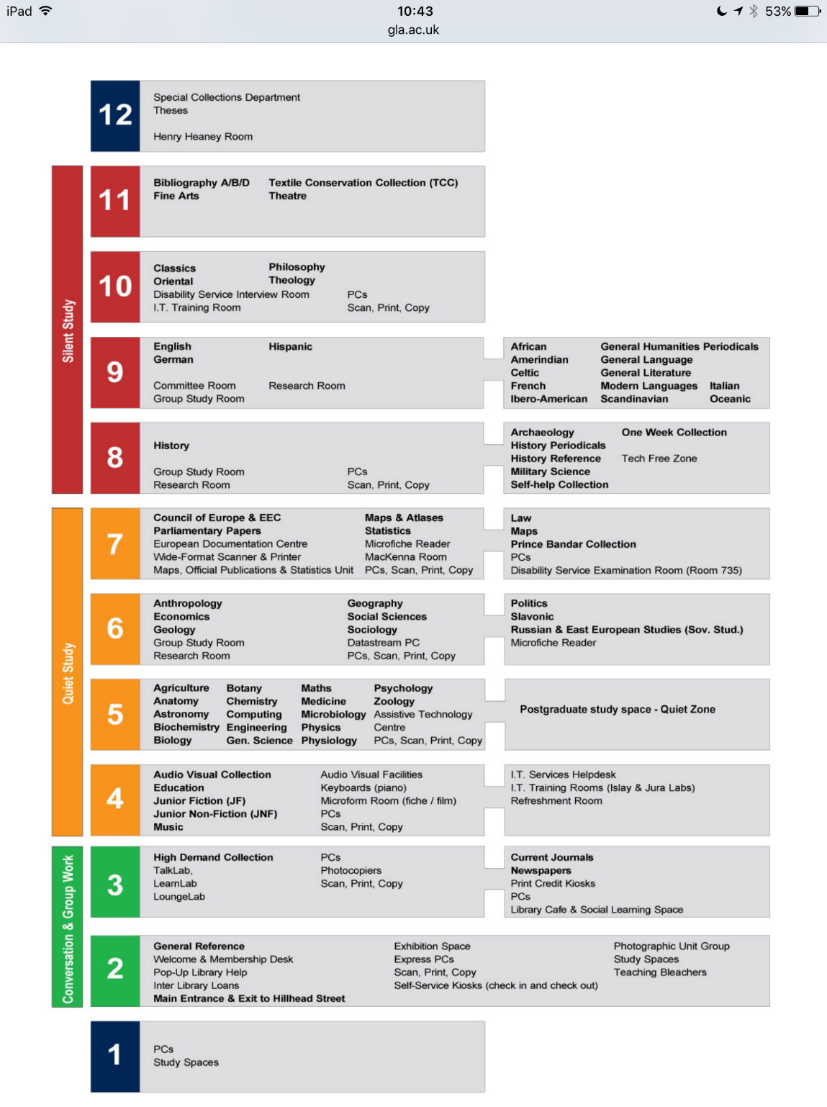

Floorplans – equipment on each floor
Each floor in the Library is slightly different but generally all have study space, subject-specific material and equipment.
The detailed floor plan includes information on equipment in the Library. Most floors have printing, scanning and photocopying facilities and power sockets for charging equipment. This varies by floor.
The Library building – Floorplans and guides

Slide 4
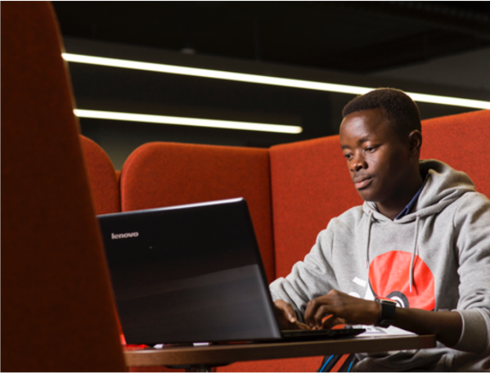
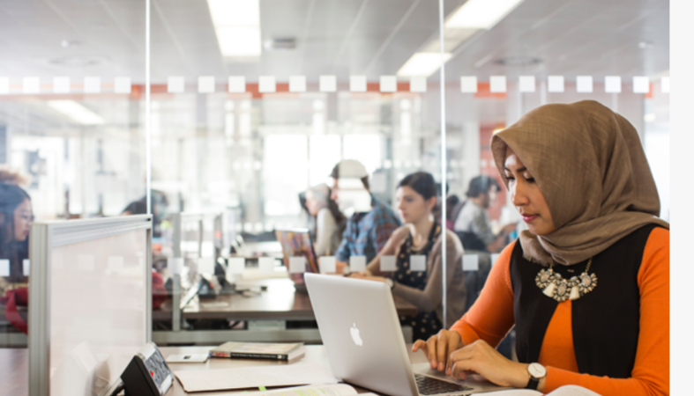
Computers in the Library
Computers
Most floors have PCs. There are over 800 in the Library which are set up and maintained by IT Services. They are checked and updated with software for the start of each academic year. For help see the IT help pages and link to help desk to log a call.
There is a web page and app for checking the availability of PCs across Campus, including in the Library.
As well as desktop PCs in the Library, there are power points in the desks, in the booths and at various points in the building to allow you to charge your mobile devices. You can connect your mobile devices to the Wi-Fi service Eduroam. The Library continuously reviews equipment and access to power in the Library as the use of mobile devices rises.
Computers, printing, photocopying and scanning

Slide 5
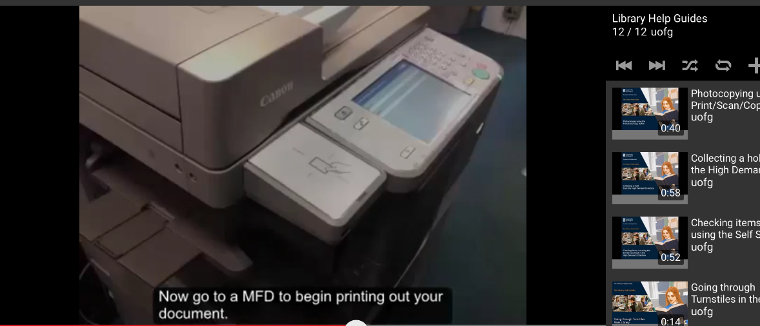
Printing, scanning and photocopying
Printing, scanning and photocopying
There are multi-function devices (MFDs) in the Library which allow you to print, scan and photocopy. The university’s pull print service means you can copy, scan and print from any MFD on campus. See the Library’s video guide for printing and photocopying .
As well as these (which are on most floors of the Library), there is a wide format scanner and printer on level 7 in the Maps, Official Publications and Statistics unit.
You need print credit to make prints and scans – see the IT web pages for details and note that there is a print credit top-up machine on level 3 of the Library.
Computers, printing, photocopying and scanning

Slide 6
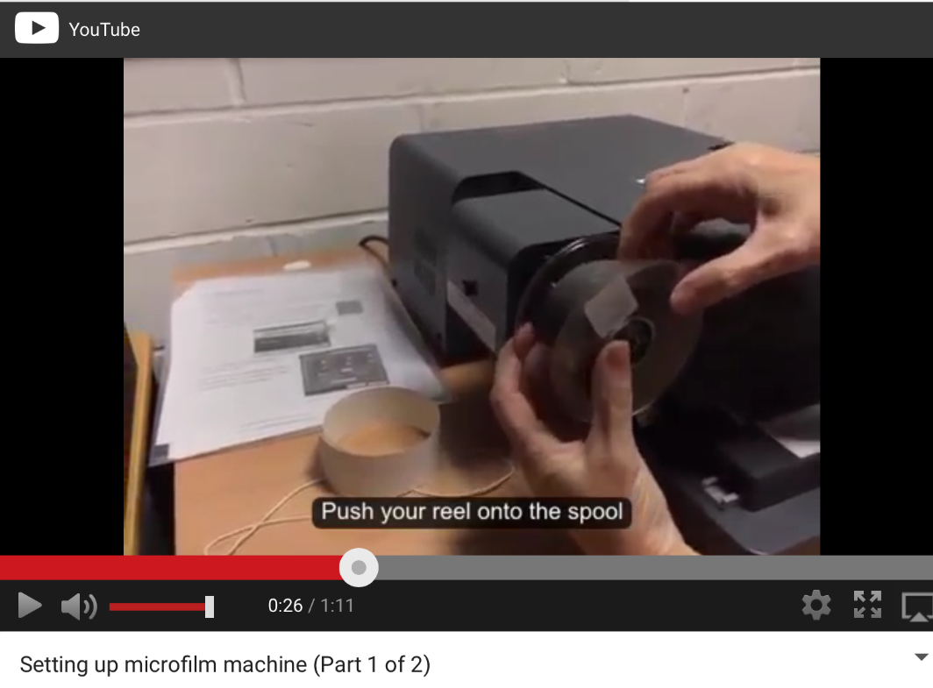
Microfilm and microfilm readers
The Library has some material on microfilm. This is usually historic material like old newspapers or specialist historical records such as political documents or social documents. All of this is catalogued so you can identify what we have and how to access it.
There are modern microfilm readers in the Library which are straightforward to use. Staff can help if you need some support using it. The Library has created videos on how to use the readers. This is a two-step process:
Setting up the microfilm reader
Using the microfilm machine and computer
Using the microfilm readers

Slide 7
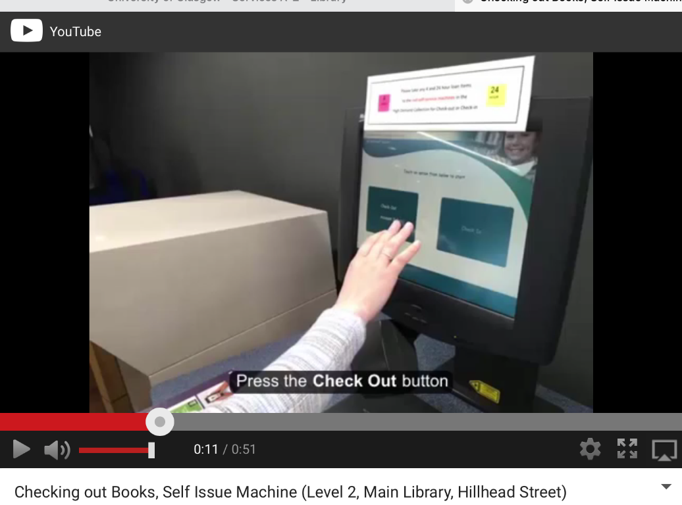
Using the self issue machines and the book drop
Self issue machines allow you to borrow and return material quickly and when the Library is not staffed.
See our videos on issuing and returning material
When the Library is closed you can return books through the book drop and staff will process your return for you. See our short video.
Using the self-issue machines

Slide 8

Further Help
See our Library Basics page with an introductory Library video, help guides and our Moodle Course for full help with Library services.
If you would like to speak to someone, please get in touch with your College Librarians – Kay Munro and Lynn Irvine:
Kay.Munro@glasgow.ac.uk
Library Room 810
0141 330 6741
Lynn.Irvine@glasgow.ac.uk
Library Room 810
0141 330 7094
We are very happy to meet with you if you want to find out more about using library resources and using them effectively in relation to your research.
Further help

Slide 9
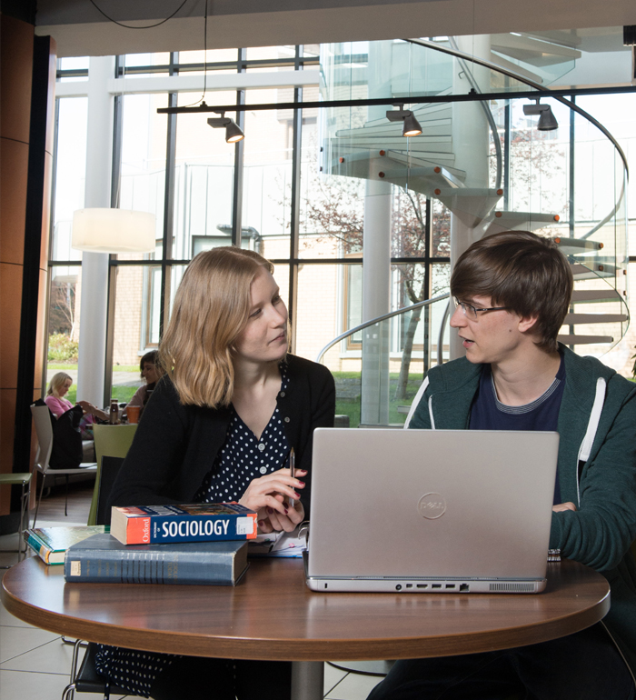
Library
Knowledge Base
Thank you, this presentation is complete.
Please close this presentation.

