Slide 1

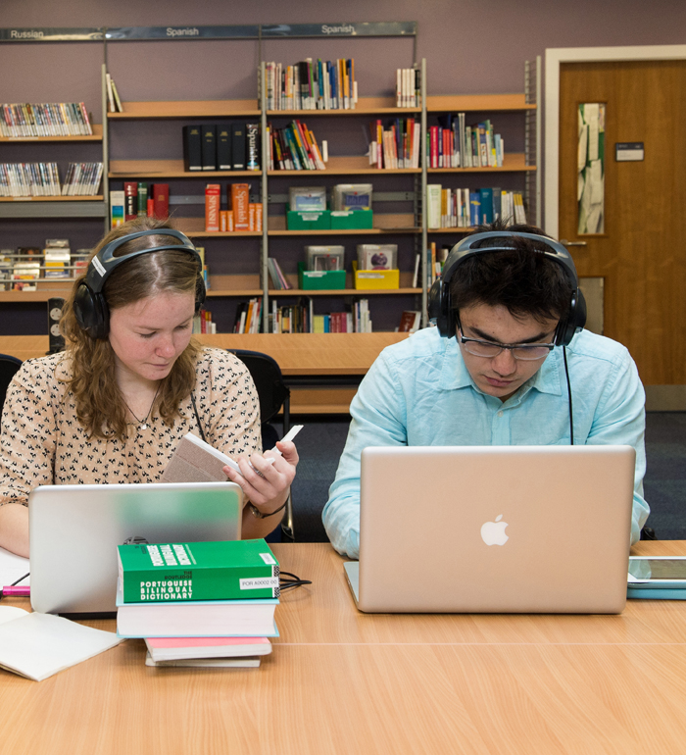


Library
Finding your way around the Library

Slide 2
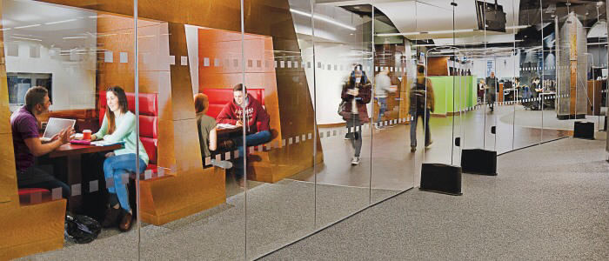



Welcome to the University Library
The Library is here to provide you with resources, spaces and services to support your learning while you are at university.
The Library has 12 floors which are zoned for noise. This means you can find a space to suit your needs – a quiet space for individual study or a more bustling atmosphere where you can work alongside friends or in a group.
There are lots of staff and resources to help you use the Library effectively. You will find lots of information on our web pages and there are always people willing to help. Here are a few of the key things you need to help you find out about the building and how to use it.
Welcome to the Library

Slide 3
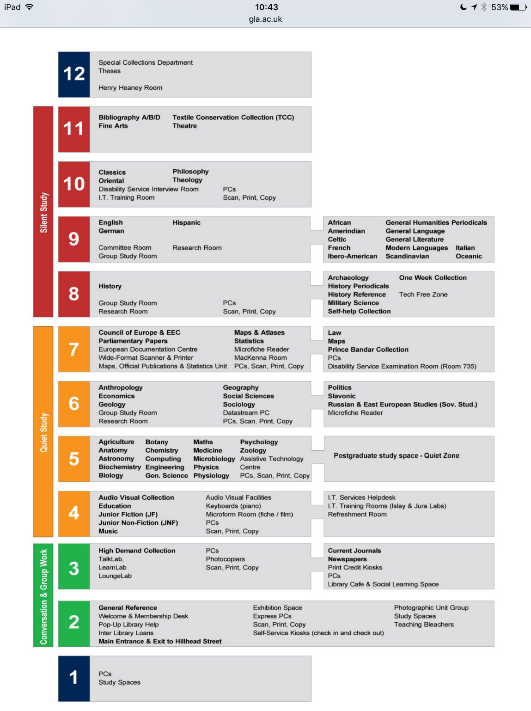

The Library building – what’s on each floor?
Each floor in the Library is slightly different but generally all have some study space, subject-specific material (including books, journals and reference materials. Some of this can be quite specialist including things like case law, government and EU documents, music scores, picture books and maps) and equipment.
Here is a link to the Library floorplans which show what is on each floor including broad subject areas, equipment, rooms, AV materials, specific collections and designated spaces.
The Library building – Floorplans and guides

Slide 4
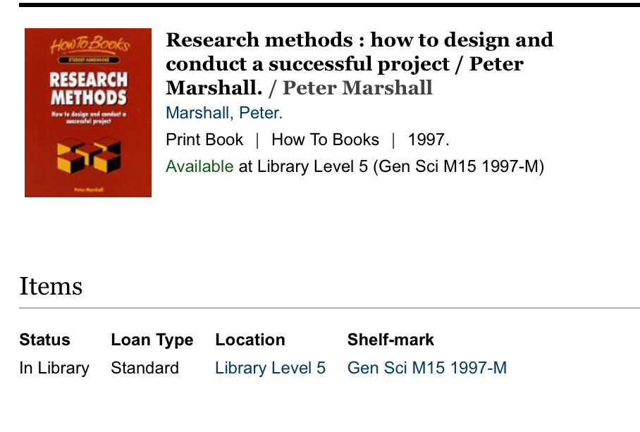
On which floor will I find books and other material for my subjects?
Material on specific subjects is housed together. Each item has a catalogue record which describes the material and also how to locate it in the Library.
Each item has a shelf mark and a location telling you which floor the item is shelved on and where on the shelves you will find it. It will also tell you how many copies there are, how many copies are available to borrow and for how long. See here for more details.
Not all books and materials are available to borrow; some are for reference use in the Library
If you need help searching for books and other material, see our guide to Library Search
Finding subject-specific material in the Library

Slide 5
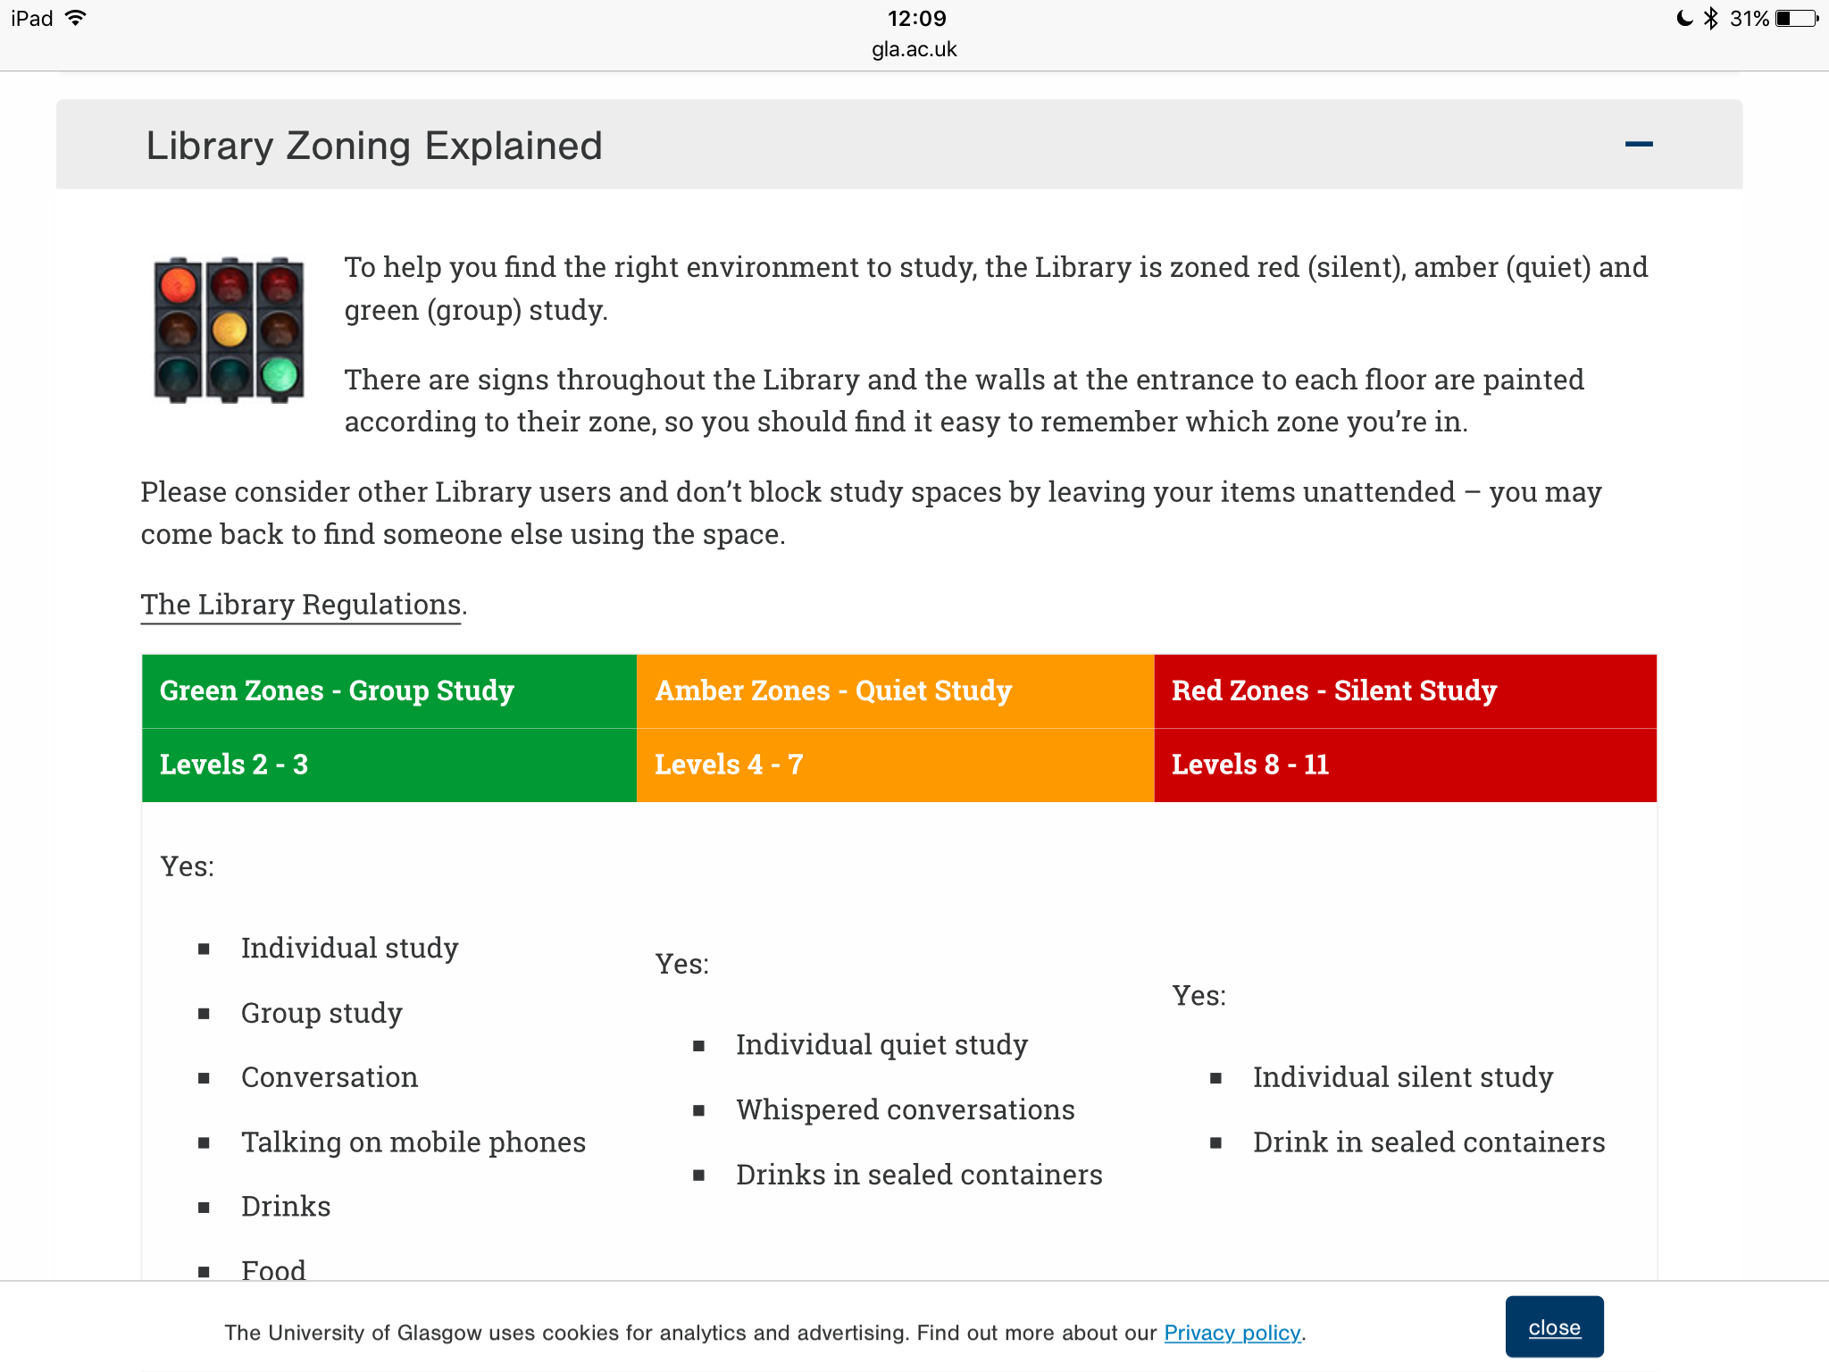
Noise zoning and spaces in the Library
The Library provides a mix of spaces and furniture for studying. Floors are zoned for noise. Each zoned space has a mix of tables with chairs for focussed study and soft seating when you want to be more relaxed. As a general rule, the higher up the Library you go, the quieter the study environment.
Lower floors are more relaxed in atmosphere with more ambient noise. There is a lounge space on level 3 with a variety of soft seating which is great if you want to relax with friends (or read if it is quiet). There is also a café on level 3 serving hot and cold food and drinks with plenty of seating.
Zoning in the Library
Notes:
Main body: Arial, 16 – 20 pt
Slide title: Arial, Bold, 24 pt

Slide 6
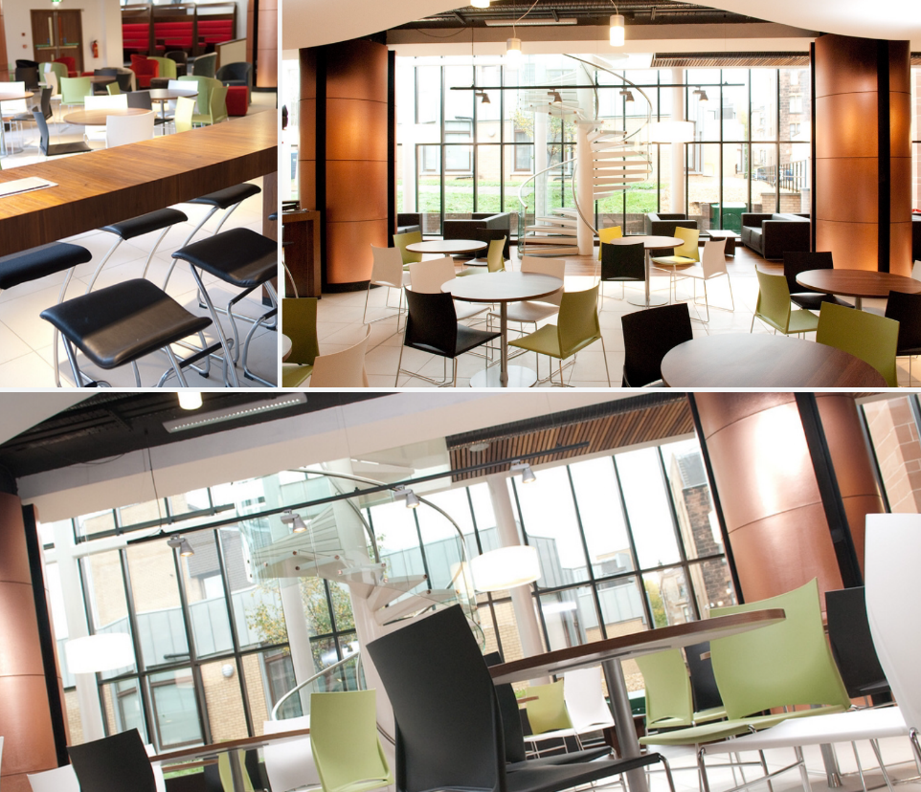
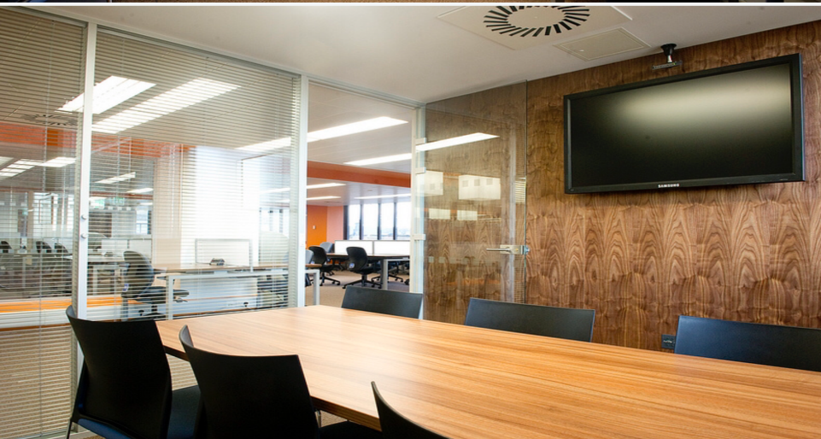
Study spaces and booking study rooms
There are approximately 2800 study spaces in the Library. Most spaces are open and are a mix of individual and group spaces.
There are designated group study spaces on levels 2 and 3. These are a mixture of booths, tables and pods.
You can also book study rooms. Each room holds up to 6 people. Undergraduate study rooms are 6A, 8A and 9A. Postgraduate bookable rooms are 5A, 5B, 5C, 5D and 5E.
There are 2 auditoria on level 2 (Kelvin and Clyde) which are also bookable for groups practicing presentations. Full details are on our web page.
Study spaces and booking study rooms

Slide 7

Further Help
See our Library Basics page with an introductory Library video, help guides and our Moodle Course for full help with Library services.
If you would like to speak to someone, please get in touch with your College Librarians – Kay Munro and Lynn Irvine:
Kay.Munro@glasgow.ac.uk
Library Room 810
0141 330 6741
Lynn.Irvine@glasgow.ac.uk
Library Room 810
0141 330 7094
We are very happy to meet with you if you want to find out more about using library resources and using them effectively in relation to your research.
Further help

Slide 8

Library
Knowledge Base
Thank you, this presentation is complete.
Please close this presentation.

