Slide 1




Library
Knowledge Base
From Research Question to Search Strategy

Slide 2
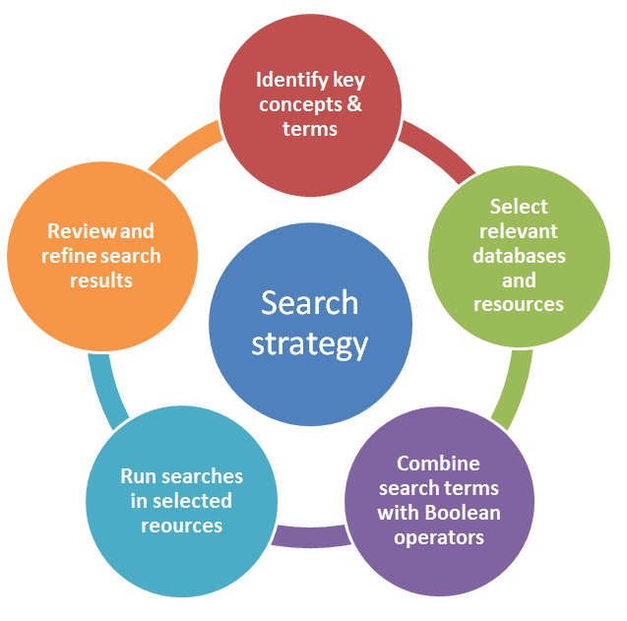


Search strategy
A search strategy is an organised structure of key terms used to search a database. The search strategy combines the key concepts of your search question in order to retrieve accurate results.
What is a search strategy?

Slide 3
Start with a clear research question
Ensure you have a well-constructed research question this will be a question that has a clear objective and is neither too specific nor too broad in scope to address
e.g.
What is the impact of performance management on employee engagement?
Start with a clear research question

Slide 4
1. Identify the key concepts in the question
The key concepts in our example are highlighted in red
What is the impact of performance management on employee engagement in China?
1. Identify the key concepts in the question

Slide 5
2. Think about how to describe each of these three concepts
Impact
Performance management
Employee engagement
China
try to think of other terms which may have been used by authors discussing the topic for example – China might also be referred to as Chinese
by including these key words in your search you are making your search as
broad as possible and capturing as many articles / papers as you can on the topics you're researching – so ….
Performance management OR Systems management OR Change management
Employee engagement OR
Worker engagement
China OR Chinese
2. Think about how to describe

Slide 6

3. Putting all this together to create a search strategy
You can now enter your search terms into a search box on Google Scholar , Library Search or one of the specific subject databases that index academic literature in Business & Management, Accounting & Finance or Economics (see Subject Specialist Databases section of this moodle course for more information).
You need to group keywords together and combine them in a logical way. Most databases do that by using Boolean operators to do this.
Boolean operators (AND, OR and NOT) allow you to try different combinations of search terms. When incorporated into your search strategy these words are always written in capital letters
3. Putting this all together to create a search strategy

Slide 7
Combining terms with AND means that
Both terms must appear in the same
record – it reduces the number of
references & increases the specificity
of the search
  e.g. impact AND effectiveness
Searching with AND

Slide 8
Combining terms with the OR operator increases the number of records retrieved as at least one of the terms must appear somewhere in each record
e.g. performance management OR systems management
Searching with OR

Slide 9

NOT excludes a search term or phase present
Warning - this should be used with caution –
as you may inadvertently exclude relevant references.
  e.g manager NOT boss
Searching with NOT

Slide 10

Other useful search tips – phrase searching
Putting quotation marks “” around exact
phases allows you to search for a phrase or
concept rather than two (or more)
separate terms. Gives more specificity and
can lead to more focused search.
For example:
“performance management”
Phrase health warning!! - try not to use long
descriptive phrases which would only find
articles with that exact phrase in the title or
abstract.
Searching with PHRASES

Slide 11
Other useful search tips – truncation & wildcards
Using a truncation symbol - if you add a star or asterik * symbol to the end of the stem of a word, the database will find and return all words with that stem – saves you having to type all those possible variations separately!
Using a wildcard symbol – if you add question mark symbol ? Into a word which may or may not have a certain letter in them. Wildcards are also useful for finding British and American spellings!
Data* Scot*
Database Scots
Databases Scottish
Scotland
Scottishness
wom?n organi?ation
Woman Organization
Women Organisation
Truncation & wildcards

Slide 12
4. Finally ….. The Search strategy
Performance management
Employee engagement
Impact
China
Impact AND “performance management” AND “employee engagement” AND China
Here is the search strategy for our first step - where we created four key concepts from our research question. Here we are combining keyword and phrases together using the connector AND.
4. Finally

Slide 13
4. Finally ….. The Search strategy
When we add all the possible alternatives to the search strategy it gets more complicated – so this time we use another trick of using parentheses ( ) to group similar concepts together so that the search is carried out in the order we want.
Performance management OR Systems management OR Change management
Employee engagement OR
Worker engagement
China OR Chinese
Impact
Impact AND (“performance management” OR “systems management” OR “change management”) AND (“employee engagement” OR “worker engagement”) AND (china OR Chinese)
Here is the search strategy for our second step - where we added possible alternatives to our four key concepts from our research question. Here we are combining keywords and groups of phrases together using parentheses () and the connector AND.
4. Finally …..

Slide 14


Getting help
College Librarians for the Adam Smith
Business School are
Dr Kay Munro & Lynn Irvine
Kay.Munro@glasgow.ac.uk
Lynn.Irvine@glasgow.ac.uk
We are very happy to meet with you if you need help with creating a search strategy from your research question , or if you want to find out more about using subject specific databases and other Library resources
Getting help with all this

Slide 15

Library
Knowledge Base
Thank you, this presentation is complete.
Please close this presentation.

