Slide 1
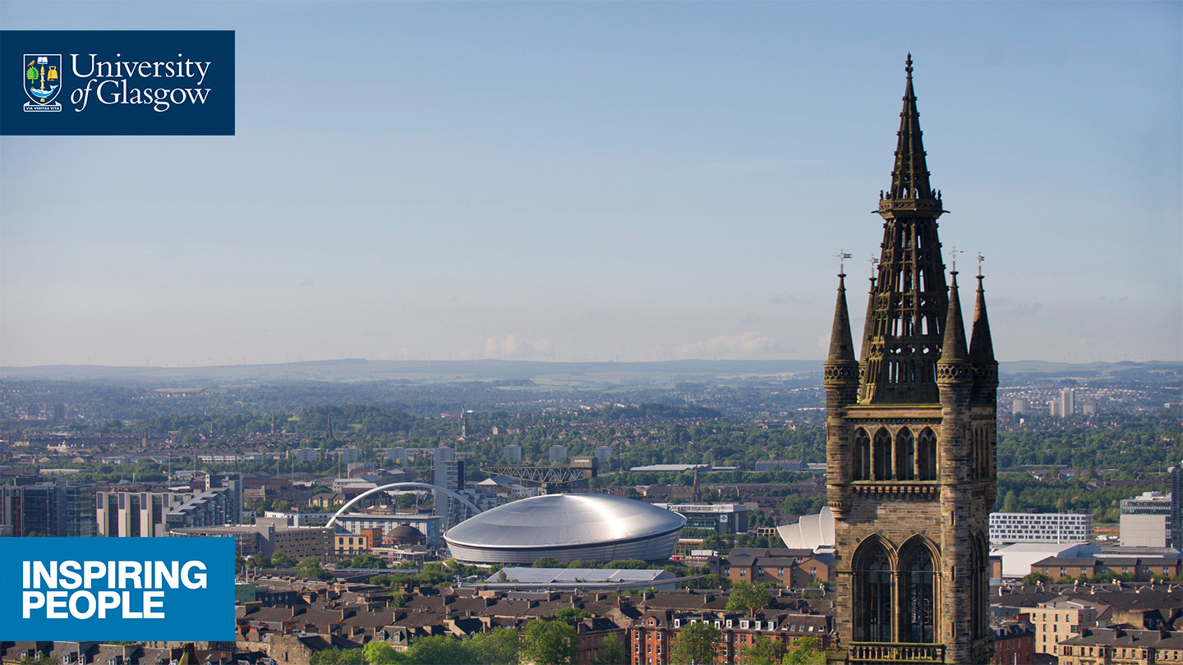
Welcome to the Library at the University of Glasgow

Slide 2
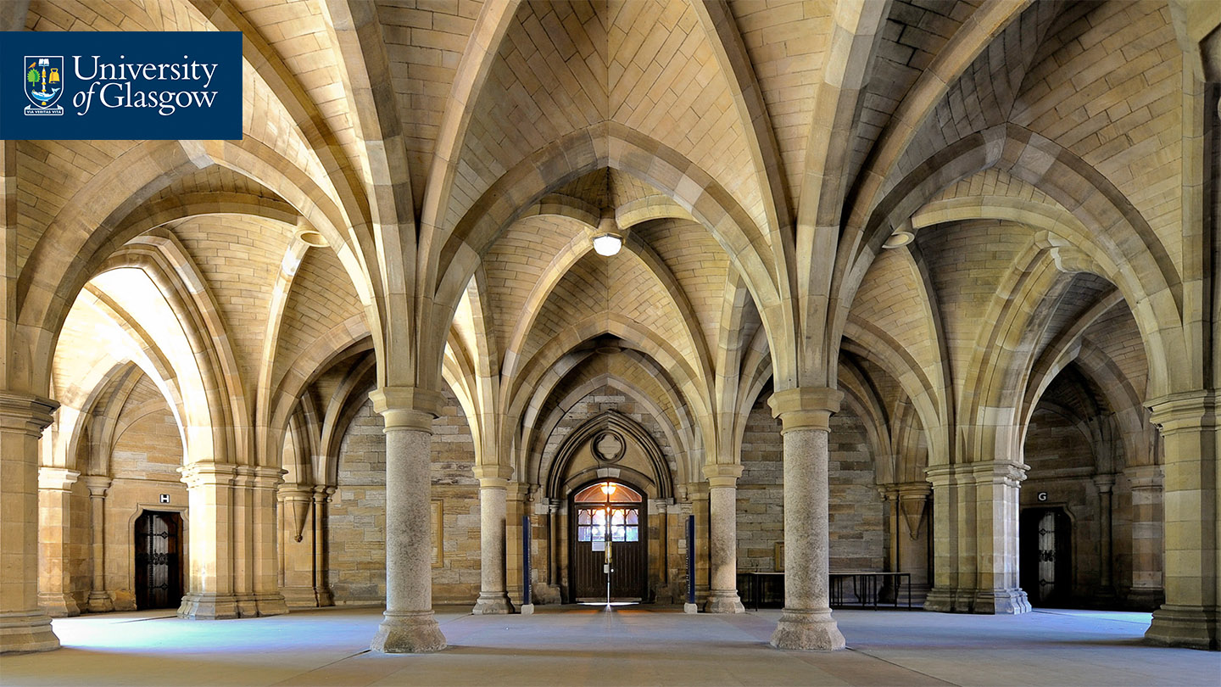

The Library is over 500 years old, and is one of the largest in the country.
We are proud to support the students and staff of the University of Glasgow.

Slide 3
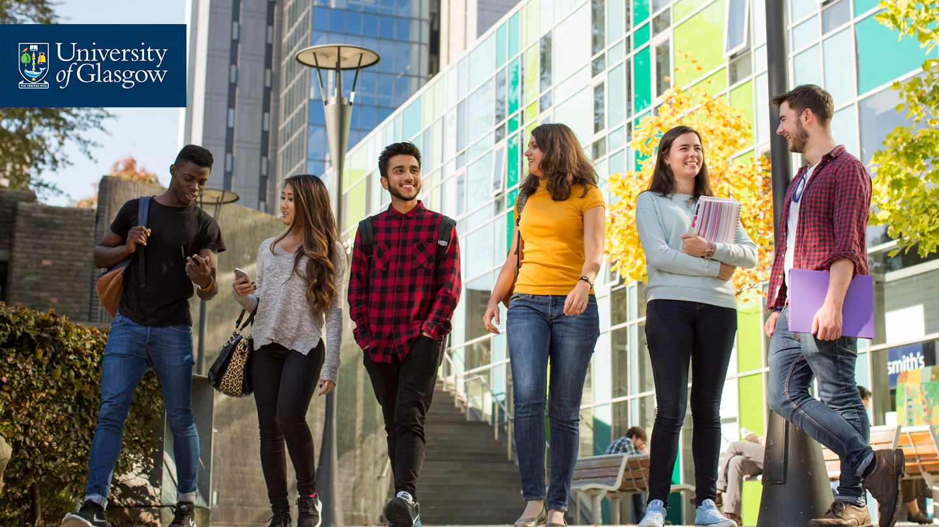
Where is the Library?
The Library is on Hillhead St – directly opposite the Fraser Building
You access and exit the Library by swiping your student card at the turnstiles
The Library is open from 07.15 am – 02.00 am most days of the year (except for Christmas and New Year)

Slide 4
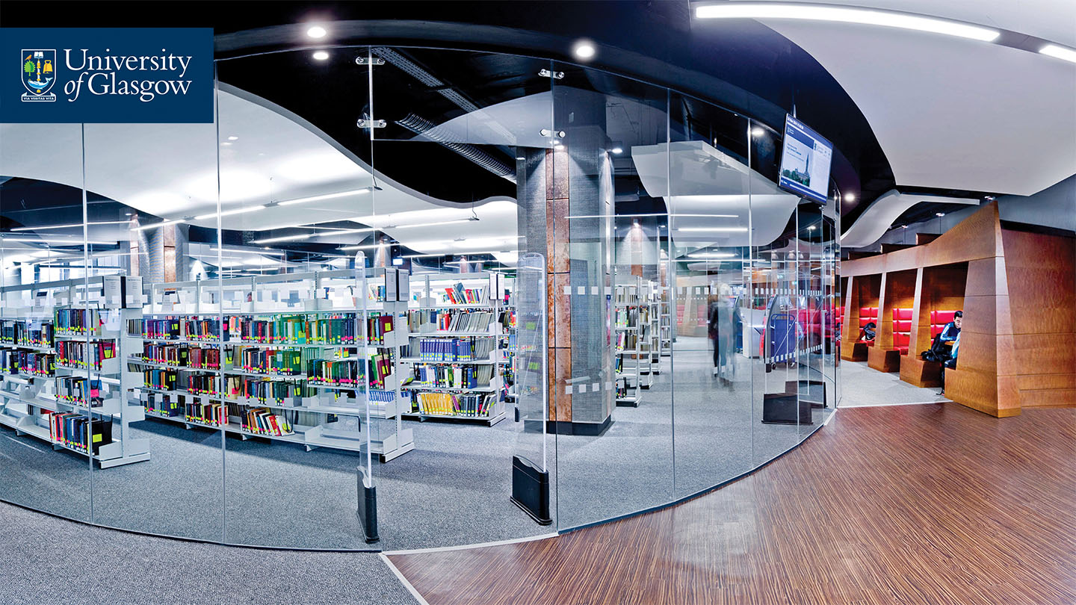
Your Library Collections
We provide all the resources and support you’ll need throughout your course for assignments, essays and your dissertation.

Slide 5
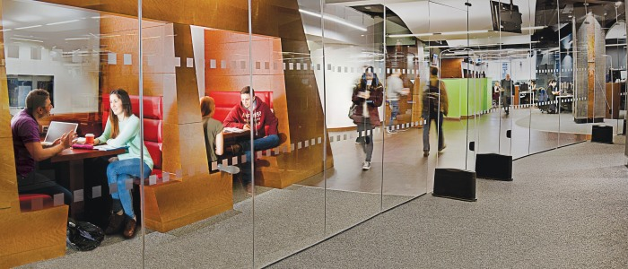
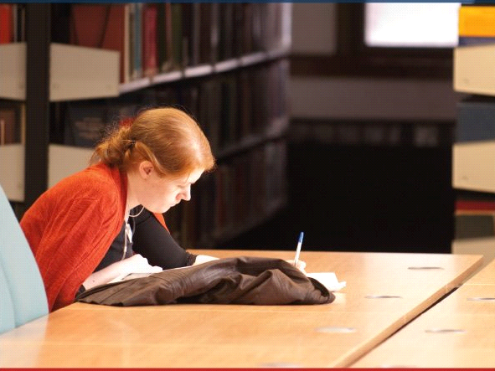
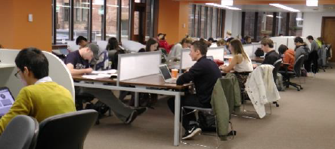
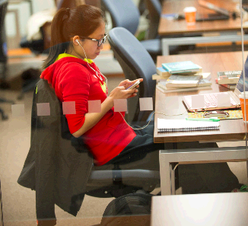
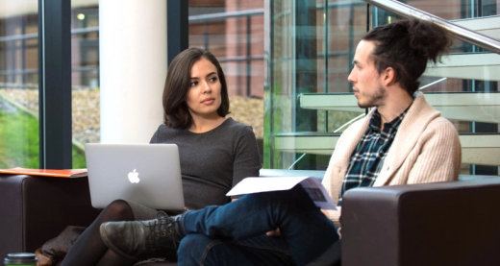
Library Study Spaces
The Library has lots of different types of study spaces – Spaces where you can work with or beside friends; Silent study spaces; Group study rooms and a PG only space on Level 5 of the Library building

Slide 6
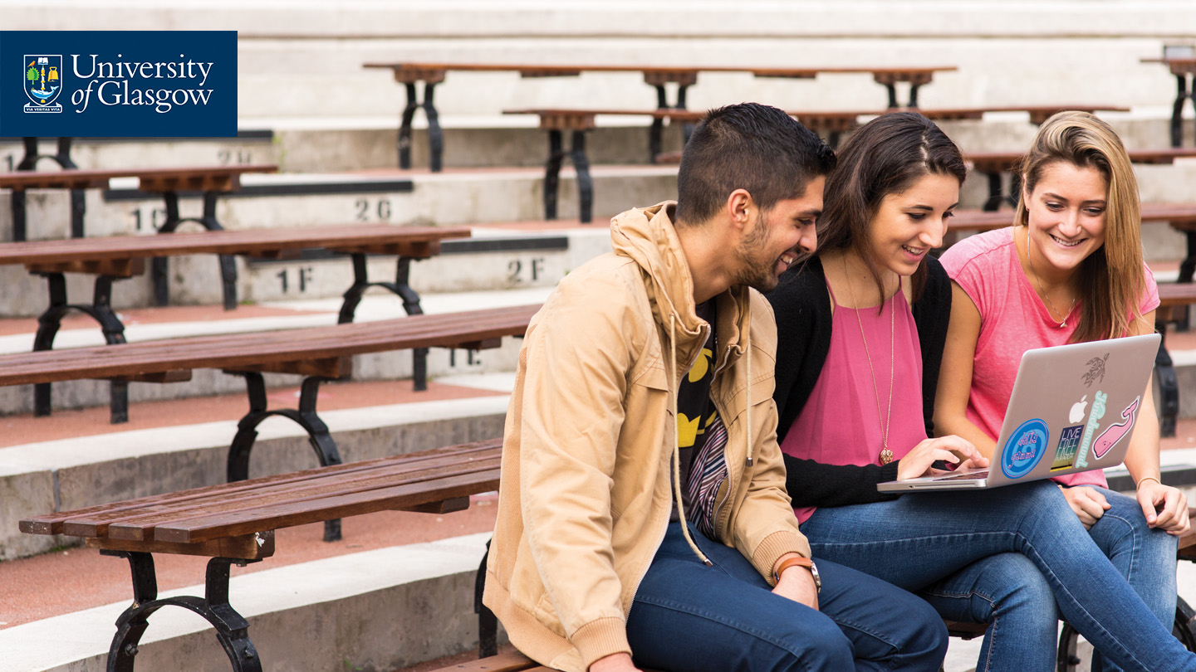
Always connected
You can access all our e-resources from the Library website:
www.glasgow.ac.uk/library
Use your GUID to access the resources you need.

Slide 7
Information skills
Throughout this course your Librarians can provide help and advice on how to find, access and use the information you need just at the time you are going to need it!

Slide 8
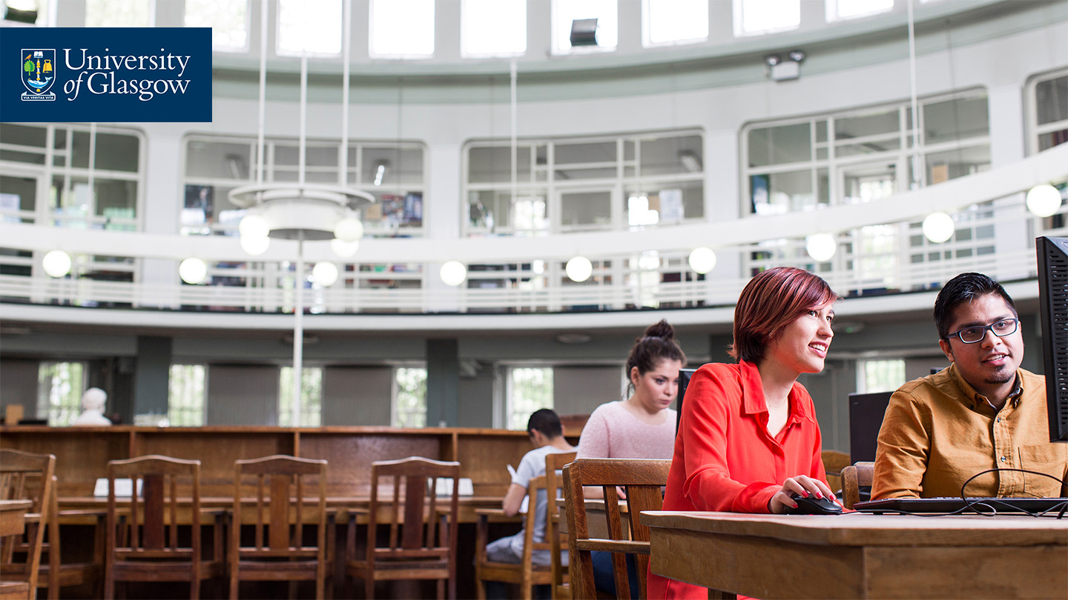
Support
Your College Librarians are Dr Kay Munro & Lynn Irvine, who are your contacts for any help you might need about Library or information matters.
You can email Kay or Lynn at any time, whenever you need help or advice.
kay.munro@glasgow.ac.uk
lynn.irvine@glasgow.ac.uk

Slide 9
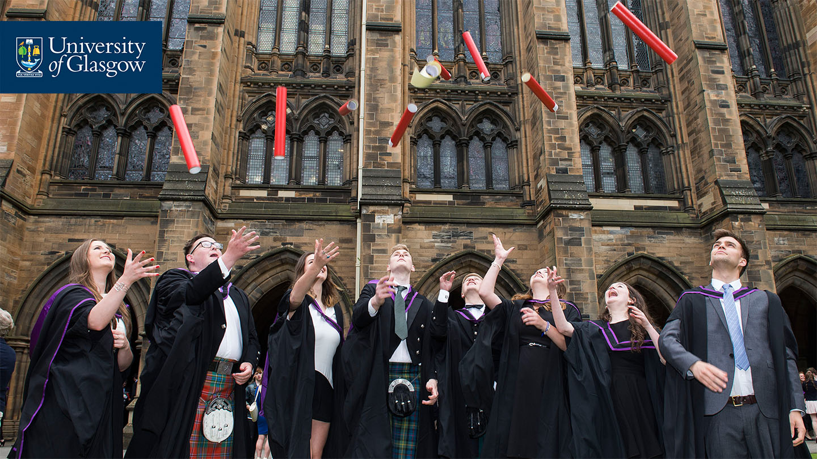
Remember
You always have support from your College Librarians!
You are always connected through the online Library.
We will help you develop your skills as you need them.

Slide 10
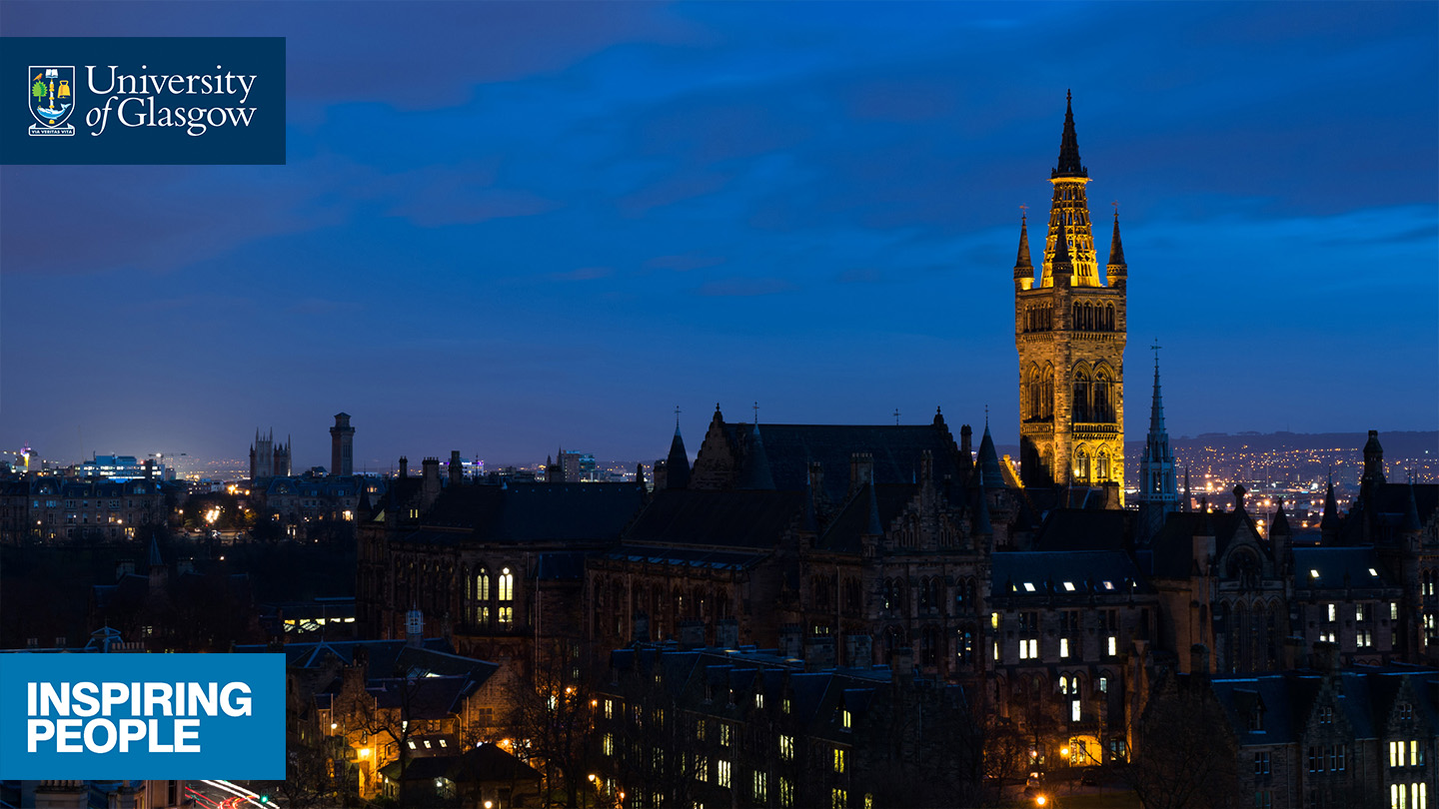







Welcome to the Library
kay.munro@glasgow.ac.uk
www.glasgow.ac.uk/library
/glasgowuniversity
@UofGlasgow
@UofGlasgow
UofGlasgow
Search: University of Glasgow

