Slide 1




Library
Knowledge Base
TEAP – finding eJournal articles

Slide 2


The Library offers a number of search services to find, and access electronic journal articles.
This resource highlights two of these search options, so you can use the one that suits you best.
Finding eJournal articles

Slide 3

The first method of searching is to use
Specific Search: Articles
www.glasgow.ac.uk/library
Specific search: Articles

Slide 4
From the Library homepage click on the link: Specific Search: Articles
Specific search: Articles

Slide 5
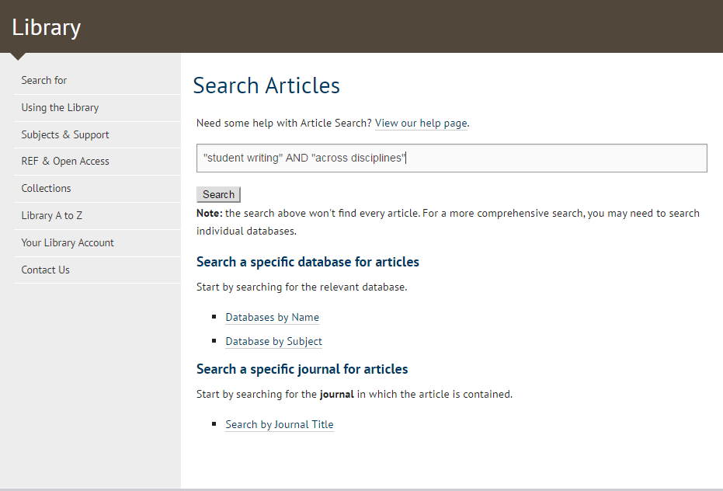
In this example I want to find articles on student writing across disciplines – so I’m entering two phrases “student writing” AND “across disciplines”
Putting phrases or concepts inside double quotes means that the database will search for them as phrases and not as individual words – adding AND means that the database will return articles that include both phrases.
Specific search: Articles

Slide 6
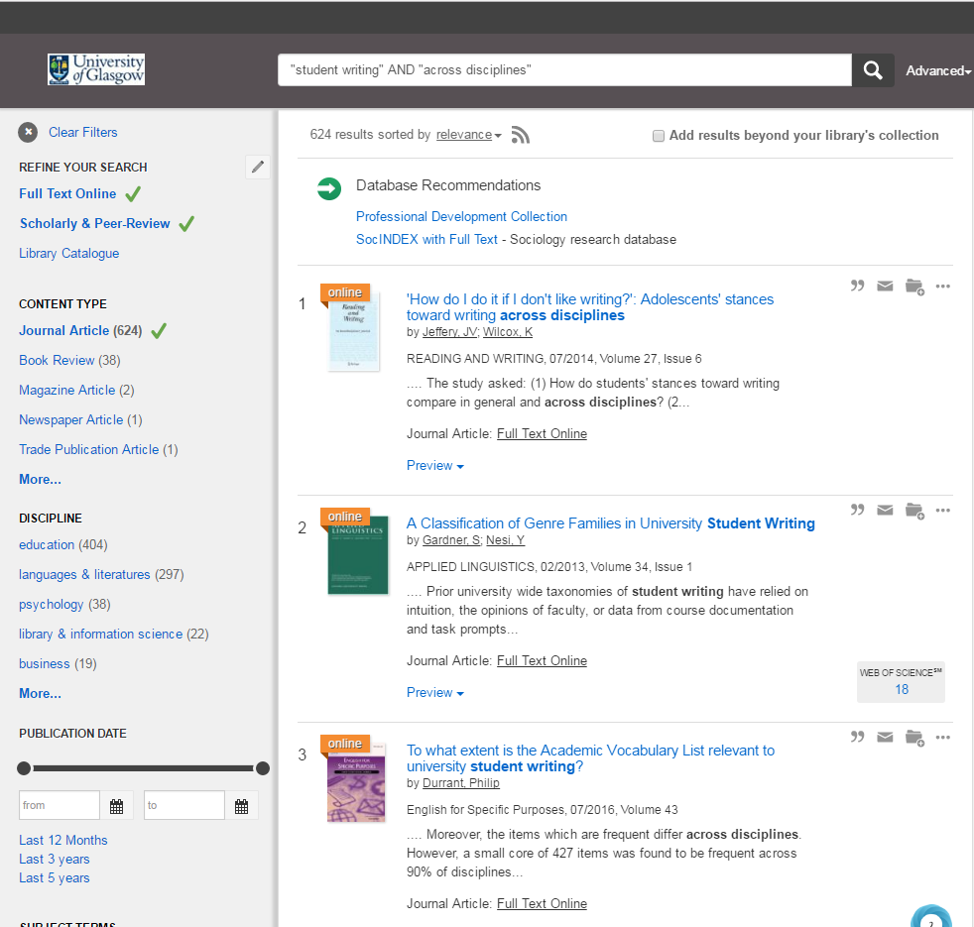
This shows the results screen from the search for “student writing” AND “across disciplines” which I’ve limited to Full Text Online & Scholarly & Peer-Review.
You can further limit by Discipline and /or Publication Date
Specific search: Articles

Slide 7
To access individual journal articles, click on the Full Text Online Link
Specific search: Articles

Slide 8
To recap, you can use
  Specific Search: Articles
to find eJournal articles.
Just remember to refine your results using
  Full Text Online
Specific search: Articles

Slide 9
The second method of searching is to refine the results from a search using Library Search
www.glasgow.ac.uk/library
Finding Articles using Library Search

Slide 10
On the Library homepage enter your search terms in the search box, and click on Search
Using the same search as before – “student writing” AND “across disciplines”
Finding Articles using Library Search

Slide 11
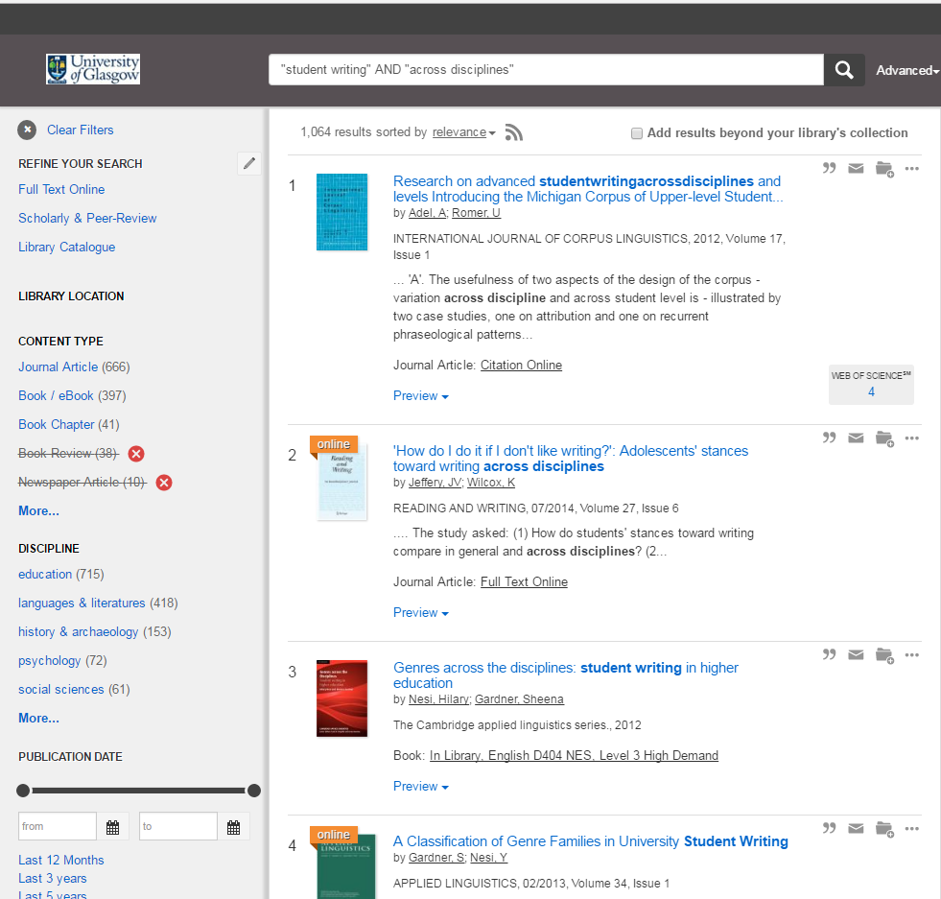
The results displayed are a mix of books, articles, journals, conference reports, book chapters…
Refining your results

Slide 12
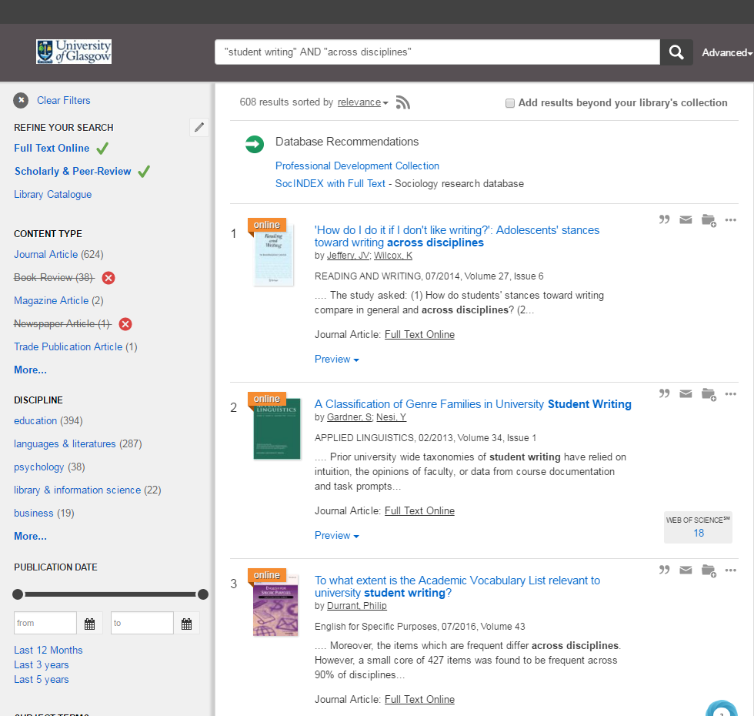
However, if you refine by Full Text Online & Scholarly & Peer Review you only see Journal articles
You can further restrict by Discipline & Publication Date
Refining your results

Slide 13
To access individual journal articles, click on the Full Text Online Link
Finding articles using Library Search

Slide 14
So, that’s two ways to search for, and access eJournal articles:
Use Specific Search: Articles
Refine the results from Library Search
Here are a couple of tips for using eJournal articles
Finding e-Journal articles

Slide 15
When you click on Full Text Online, you will either:
be taken to the eJournal website, or
be taken to a Library webpage which will provide a link to the eJournal website.
You may be prompted to enter your GUID
Once on the eJournal website, you will either:
have direct access to the particular article you want, or
have to navigate through the list of volumes to get to the particular article you want. Look at the details on Articles search carefully to identify the correct year / volume / issue.
Each eJournal provider has its own website, so they all look and work differently. If you are struggling to use the eJournal article, refer to the on screen help guides. Remember:
you can choose to read articles online or to download them (generally as a pdf),
many eJournal providers require that you have a recent version of Adobe Reader installed, this can be downloaded from the Adobe website,
you can access eJournal articles using your pc, laptop, tablet or smartphone.
Tips for using eJournal articles

Slide 16

Library
Knowledge Base
Thank you, this presentation is complete.
Please close this presentation.

