Slide 1

Introduction to Open Access
Research Information Management team
research-openaccess@glasgow.ac.uk
Notes:
Hi, welcome to this introduction to open access. My name is Matt, I’m a member of the Research Information Management team.

Slide 2

What is open access?
Open Access is the principle that a research output should be presented in a form that allows anyone with internet access to search electronically within the text, read it and download it without charge.
The copyright holder of an output can make it open access by applying an open access licence to it.
For example, a journal article or dataset with an open access licence can be accessed by anyone, and
there will be no (or very few*) restrictions on
How people can reuse the item.
*Common restrictions include: the author must be
acknowledged; any derivative work must also be
open access; only non-commercial reuse permitted.
Notes:
Open Access is the principle that a research output should be made available free of charge, with no barrier to access.
The copyright holder of an output can make it open access by applying an open access licence to it.
For example, a journal article or dataset with an open access licence can be accessed and reused by anyone, and there will be no (or very few*) restrictions on how
people can reuse the item.
*Common restrictions include: the author must be acknowledged; any derivative work must also be open access; only non-commercial reuse permitted.

Slide 3
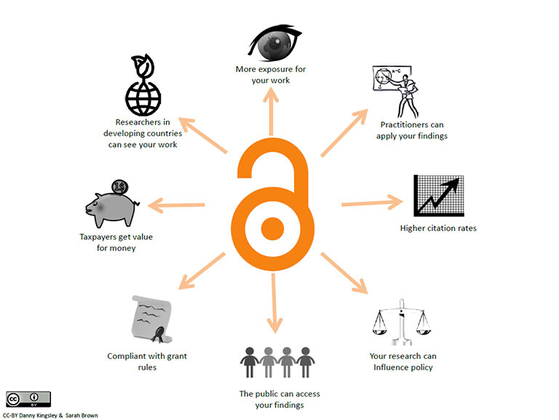
Benefits of being open
+ Integrity
https://casrai.org/credit/
+ Research
Environment
More on OA:
https://www.gla.ac.uk/myglasgow/openaccess/whatisopenaccess/
Notes:
There are lots of benefits to making your work open access:
It means more exposure, and higher citation rates – your open access outputs will be referred to by more people in their own publications.
Your work is available to a wider audience without subscription. This means that people who don’t have access to sources such as University libraries can read your work – this might be researchers in developing countries, practitioners and policy makers, or members of the public.
Funders are also keen on open access because it means more people can see the results of research, which represents better value for money for the taxpayer who often funds much of the research.
You can find more info on the history of Open Access in this video from Foster.

Slide 4
Routes to Open Access
For journal articles and conference papers there are two routes to Open Access:
Gold (paid for)
Article is immediately freely available
Payment of a fee or ‘Article Processing Charge’ (APC)
Green ('free’)
Deposit (usually accepted final version) in online repository
Usually an embargo period to making this visible
University direction - go Green (‘free’) wherever possible
Notes:
There are a few different ways to achieve open access. If you’re making something available yourself (like a dataset or a report or some other grey literature) you can choose to licence it yourself. But if you want something that’s published to be open access, you need to follow the publishers’ open access policy.
Some journals are ‘fully open access’ – everything in the journal is automatically open access. Sometimes this is free, but more often the journal will apply a publication charge to every article, to replace the income they would have received from subscriptions.
Some journals don’t automatically publish articles open access, but they allow authors to deposit the text of the final accepted manuscript in an online repository where it can be made open access after an embargo period of up to two years. These journals can sometimes make articles open access immediately, but apply a processing charge for this.
We call it ‘Gold’ open access when it is paid for, and ‘Green’ when it is free.
The University’s approach is to take the free route wherever it is possible to do so.
Before you submit a manuscript, you need to think about how the fee will be covered if it has to be paid. You can contact us at any time to check if we can cover costs – you don’t need to wait until you’ve had an article accepted.

Slide 5
Notify research-openaccess@glasgow.ac.uk when you have a paper accepted, and we will advise on the appropriate route.
Notes:
So what do you need to do to make sure your articles and conference proceedings are open access? It’s simple – notify us as soon as you have a paper accepted. We will advise you on the best route to open access for your article.

Slide 6
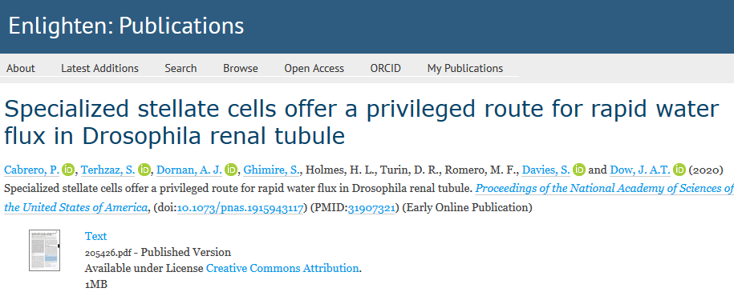
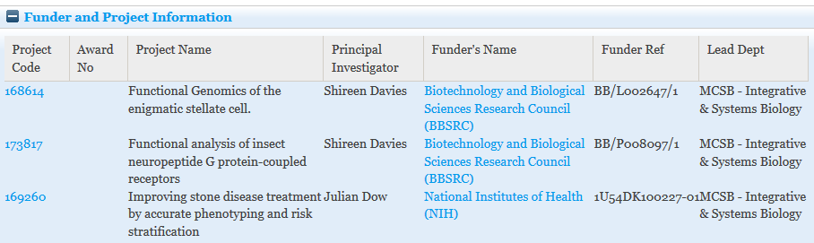
If you notify us, your article will be recorded in Enlighten
Notes:
Once you notify us, we’ll make a record for your publication in Enlighten, our publications repository. If the publisher lets us, we’ll deposit a copy of the accepted manuscript that you provide.

Slide 7
Items in Enlighten with a relevant funder’s reference number acknowledged will be uploaded to Researchfish.
All staff publications will be uploaded to the Performance and Development Review tool.
Notes:
Everything in Enlighten that has a funders’ reference for a grant that requires a return will be uploaded to the Researchfish reporting tool. For staff, we also use Enlighten to populate the publications section of your Performance and Development Review (the form used to discuss achievements and forward planning with your manager).

Slide 8
Open Access requirements:
University, Funders and REF

Slide 9

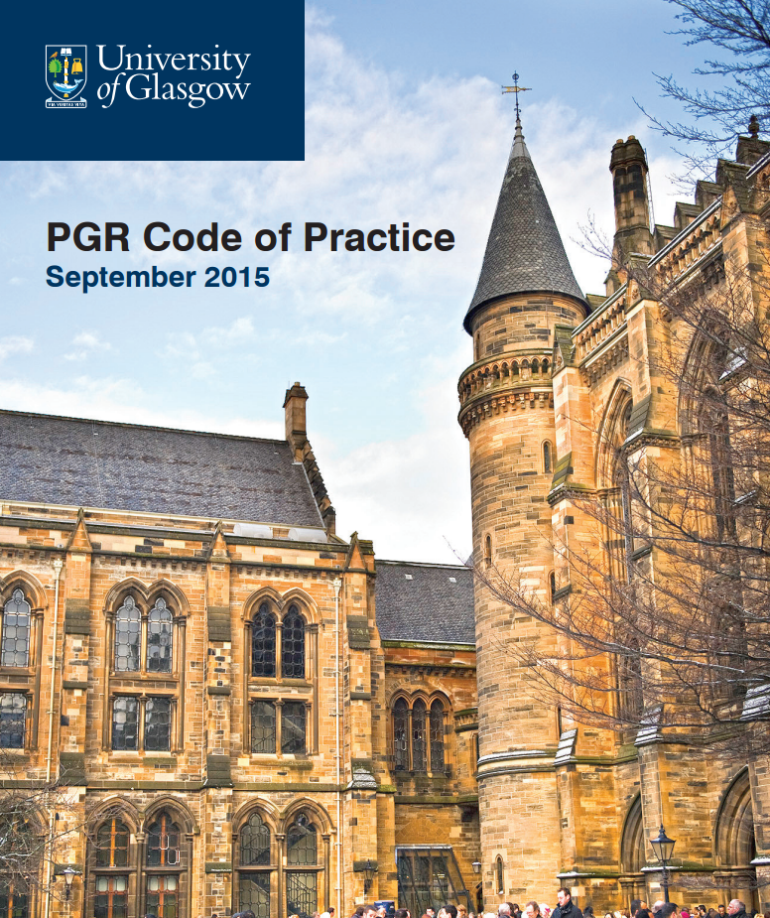
University of Glasgow policies
Outputs should be made open access where possible.
Code of Good Practice in Research https://www.gla.ac.uk/media/media_490311_en.pdf
Postgraduate Research Code of Practice http://www.gla.ac.uk/services/postgraduateresearch/pgrcodeofpractice/
Good Management of Research Data Policy
https://www.gla.ac.uk/media/media_555892_en.pdf
Notes:
There is some good guidance in the University’s policy documents and we recommend that you read them.
University of Glasgow’s approach is that outputs should be made open access wherever possible.
Journal articles and conference proceedings can usually be made open access via the Gold or Green route.
Research Data should be made open access wherever it is possible to do so. Good reasons for restricting access might be that your data contains personal information, or is in copyright, or you need to embargo it for a patent application.

Slide 10
Some funders have open access requirements – consider these before submitting an article

Slide 11
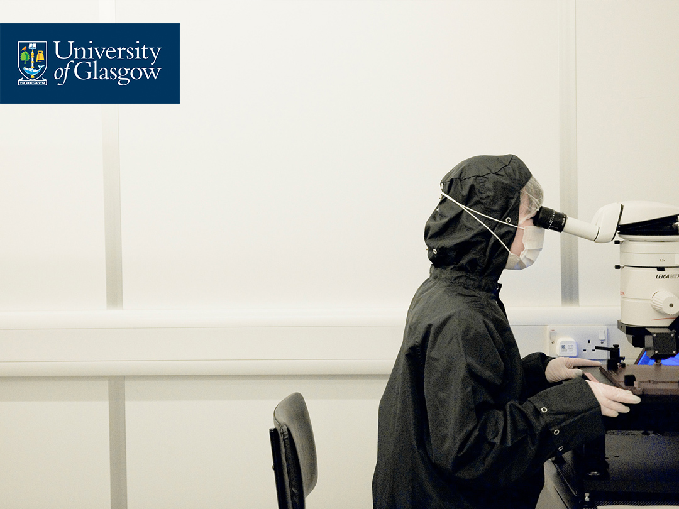
Funder acknowledgement and licensing
All papers should include acknowledgement of the funding that supported the research
Recommended format :
‘This work was supported by XX Funder/Research Council [grant number xxx]'
Notes:
If you received funding for your research, you should always include an acknowledgement of your funding in the correct format. Always include the funders’ reference number in the acknowledgement. If you don’t acknowledge the funder, we may not be able to pay for Gold open access where the paper is eligible for our Open Access funds.

Slide 12

UKRI Funds for Open Access
(Policies will be updated in 2021)
Outputs must be made open access with a maximum embargo of 6 months (STEM) or 12 months (Arts and Social Sciences).
UKRI policy applies to peer-reviewed research articles, non-commissioned reviews, systematic reviews, Cochrane Reviews and conference proceedings acknowledging past or current grants or studentships
Mandatory page charges and supplements will be covered if we are paying for open access,
The UKRI fund is finite. When it runs out, the embargo periods are extended.
Includes NC3Rs
A CC-BY licence is required if we are paying.
MRC/BBSRC outputs must be deposited in PubMed Central.
Notes:
Before you submit an article, make sure that the journal’s open access policy fits with what your funder requires. These policies will be updated in 2021, and we will issue new guidance if anything changes.
Outputs must be made open access with a maximum embargo of 6 months (STEM) or 12 months (Arts and Social Sciences).
UKRI policy applies to peer-reviewed research articles, non-commissioned reviews, systematic reviews, Cochrane Reviews and conference proceedings acknowledging past or current grants or studentships
Mandatory page charges and supplements will be covered if we are paying for open access. We do not pay for optional charges like colour covers.
The UKRI fund is finite. When it runs out, the embargo periods are extended.
Includes NC3Rs (National Centre for the Replacement Refinement & Reduction of Animals in Research)
A CC-BY licence is required if we are paying.
Papers with a biomedical theme must be deposited in PubMed Central. This is usually Medical Research Council, sometimes Biotechnology and Biological Sciences Research Council or other research councils.

Slide 13









Other support for Open Access
Policies vary. Generally apply to peer-reviewed original research and review articles that acknowledge past or current grants or studentships.
A CC-BY licence is usually required if funder pays.
Biomed articles must generally be deposited in PubMed Central
The funders have differing procedures – some provide us with funds, others ask you to apply directly to them
https://www.gla.ac.uk/myglasgow/openaccess/howdoimakemypublicationsopenaccess/otherfundsforopenaccess/
No funds 2021
Notes:
There are several other funders who provide support for open access. Some may seem less relevant to your topic but I will quickly mention them as there is funding to your college from some of these funders and it may be that co-authors are funded by them.
Policies vary but generally apply to peer-reviewed original research and review articles that acknowledge past or current grants or studentships.
A CC-BY licence is usually required if the funder pays.
Biomedical articles must generally be deposited in PubMed Central
The funders have differing procedures – some provide us with funds, others ask us to apply directly to them.
You can find details of the funders’ procedures at the link at the bottom of this slide.
Remember also the University policy is to use the ‘green’ route where available so payment is not always necessary.
Again, check that the journal’s policy matches your funder requirements before submitting your paper. If you’re not sure, email us at research-openaccess@glasgow.ac.uk.

Slide 14
Wellcome Trust
Original Research Articles Submitted from 1st January 2021
Freely available on PubMed Central
CC-BY (exception for ND by application)
Include statement on submission to publisher:
'This research was funded in whole, or in part, by the Wellcome Trust [Grant number]. For the purpose of Open Access, the author has applied a CC-BY public copyright licence to any Author Accepted Manuscript version arising from this submission.'
Fund open access journals or those transforming to open access.
Encouraged to share pre-prints
Require open access for books and book chapters.
Notes:
Wellcome Trust has a new policy which applies to Original Research Articles Submitted from 1st January 2021
This means articles must:
Be freely available on PubMed Central
Have a CC-BY licence (an exception is possible for a non-derivative licence by application)
And the author must include a statement of acknowledgement on submission to publisher:
This allows the author to make the accepted version open access e.g. via the University repository ‘Enlighten’ and Europe PubMed Central even if the publisher does not offer a compliant open access route or funds are not available to pay the publisher.
Wellcome will only fund submissions to fully open access journals or those transforming to open access.
Authors are also encouraged to share pre-prints – early drafts before peer-review.
Require open access for books and book chapters.

Slide 15






Publisher Deals and Discounts
http://www.gla.ac.uk/services/openaccess/howdoimakemypublicationsopenaccess/publisherarrangements/
Notes:
The University has a number of arrangements with different publishers to lessen the cost of open access, and in some cases to get open access for free for all items by UofG authors. These deals are updated quite frequently, so check our Publisher Arrangements page to see whether any apply to you and contact research-openaccess@glasgow.ac.uk if you want to check if your paper can be covered by a deal.

Slide 16
Open Access policies for the Research Excellence Framework (REF)
Notes:
The other main driver of open access is the Research Excellence Framework.

Slide 17
What is REF?
The Research Excellence Framework (REF) is a process of expert review of research outputs across UK universities. The exercise:
Provides accountability for public spending on research,
Provides benchmarking for the quality of outputs
Informs the selective allocation of funding to universities.
For each submission, three distinct elements are assessed: the quality of outputs (e.g. publications, performances, and exhibitions), their impact beyond academia, and the environment that supports research.
Articles and conference proceedings submitted to REF must be open access! https://www.ref.ac.uk/about/what-is-the-ref/
Notes:
The Research Excellence Framework (REF) is a process of expert review of research outputs across UK universities. The exercise:
Provides accountability for public spending on research,
Provides benchmarking for the quality of outputs
Informs the selective allocation of funding to universities.
For each submission, three distinct elements are assessed: the quality of outputs (e.g. publications, performances, and exhibitions), their impact beyond academia, and the environment that supports research.
Articles and conference proceedings submitted to REF must be open access!

Slide 18
REF Open Access Policy
Applies to articles and conference proceedings* accepted for publication from 1st April 2016
The output must have been deposited in a repository as soon after the point of acceptance* as possible, and no later than three months after this date.
Author Accepted manuscript – final agreed text before publisher adds logos and mark-up
We must evidence it is in our repository
It may be a closed deposit
The author is responsible for ensuring that this policy is followed.
There are limited exceptions that might be applied in rare cases.
*final acceptance - all changes made and ready to typeset – not the date that the publisher says they will publish subject to amendments
Notes:
Applies to articles and conference proceedings* accepted for publication from 1st April 2016
The output must have been deposited in a repository as soon after the point of acceptance* as possible, and no later than three months after this date.
Author Accepted manuscript – final agreed text before publisher adds logos and mark-up
We must evidence it is in our repository
It may be a closed deposit
The author is responsible for ensuring that this policy is followed.
There are limited exceptions that might be applied in rare cases.

Slide 19
REF Eligibility –
The Library can help
Outputs must be made open-access.
REF accepts embargo periods:
12 months for Science, Technology and Medicine
24 months for Arts and Social Sciences
MYTHBUSTER - It is not necessary to pay an open access charge to comply with REF open access requirements.
Notes:
Outputs must be made open-access.
REF accepts longer embargo periods than most funders:
12 months for Science, Technology and Medicine
24 months for Arts and Social Sciences
MYTHBUSTER - It is not necessary to pay an open access charge to comply with REF open access requirements.

Slide 20

What do researchers need to do?
When a paper is accepted, make sure it is added to Enlighten:
Notify research-openaccess@glasgow.ac.uk
Include the final accepted manuscript
Include award* numbers on papers
Don’t agree to pay if don’t have ££
Use University email address and affiliation
*The funds available are based on awards to the University
Notes:
So just to summarise what you need to do:
When a paper is accepted, make sure it is added to Enlighten:
Notify research-openaccess@glasgow.ac.uk
Include the final accepted manuscript
Include award* numbers on papers
Don’t agree to pay if don’t have ££
Use University email address and affiliation

Slide 21

What does the Library do?
Check funder requirements
Check the publisher copyright policy
Act as researcher’s memory
Pay from UKRI or Charities Open Access funds if appropriate
Deposit manuscript and release after embargo
Compliance reporting and checking
Notes:
We will check the funder requirements and the publisher’s policy, and advise you on how to proceed. If appropriate, we’ll arrange payment from the funds we hold.
If you’re taking the green route, we’ll deposit the manuscript and make it available after the embargo period expires. We’ll also check compliance and report to funders.

Slide 22

Open Access to
Research Data
Funders and the University also expect data to be made open access where appropriate.
See https://www.gla.ac.uk/myglasgow/datamanagement/ for more info.
Notes:
If you’ve got some research data that you need to make open access, take a look at our research data management pages, where you will find guidance documents and info about training courses.

Slide 23








Other Hints and Tips
/glasgowuniversity
@UofGlasgow
@UofGlasgow
UofGlasgow
Search: University of Glasgow
Notes:
Here are some other hints and tips you might find useful:

Slide 24
Identifying Trusted Journals
Most publishers are reputable.
Beware of those that do not deliver appropriate standards of peer review and service.
These are sometimes known as ‘predatory’ journals.
Use a practical checklist such as https://thinkchecksubmit.org/ to help identify trusted journals
Trusted journals will usually be indexed in a suitable database. See https://www.gla.ac.uk/myglasgow/library/specificsearch/databasesbysubject/
Notes:
You should make sure you can identify whether a journal is trustworthy.
Most publishers are reputable.
Beware of those that do not deliver appropriate standards of peer review and service.
These are sometimes known as ‘predatory’ journals.
Use a practical checklist such as https://thinkchecksubmit.org/ to help identify trusted journals
Trusted journals will usually be indexed in a suitable database.

Slide 25
14 CRediT
Roles
Term | Definition
Conceptualization | Ideas; formulation or evolution of overarching research goals and aims.
Methodology | Development or design of methodology; creation of models.
Software | Programming, software development; designing computer programs; implementation of the computer code and supporting algorithms; testing of existing code components.
Validation | Verification, whether as a part of the activity or separate, of the overall replication/reproducibility of results/experiments and other research outputs.
Formal Analysis | Application of statistical, mathematical, computational, or other formal techniques to analyse or synthesize study data.
Investigation | Conducting a research and investigation process, specifically performing the experiments, or data/evidence collection.
Resources | Provision of study materials, reagents, materials, patients, laboratory samples, animals, instrumentation, computing resources, or other analysis tools.
Data Curation | Management activities to annotate (produce metadata), scrub data and maintain research data (including software code, where it is necessary for interpreting the data itself) for initial use and later re-use.
Writing – Original Draft | Preparation, creation and/or presentation of the published work, specifically writing the initial draft (including substantive translation).
Writing – Review & Editing | Preparation, creation and/or presentation of the published work by those from the original research group, specifically critical review, commentary or revision – including pre- or post-publication stages.
Visualization | Preparation, creation and/or presentation of the published work, specifically visualization/data presentation.
Supervision | Oversight and leadership responsibility for the research activity planning and execution, including mentorship external to the core team.
Project Administration | Management and coordination responsibility for the research activity planning and execution.
Funding Acquisition | Acquisition of the financial support for the project leading to this publication.
https://www.gla.ac.uk/myglasgow/openaccess/howdoimakemypublicationsopenaccess/beforesubmittingyourmanuscript/
Notes:
You should make sure that authors are appropriately credited for the work that they have contributed to an output. The University recommends the Credit taxonomy of authorship. You can find more information on our open access pages.

Slide 26
Thank you
research-openaccess@glasgow.ac.uk
research-datamanagement@glasgow.ac.uk
Credits:
Valerie McCutcheon (Writing – Original Draft)
Matt Mahon (Voiceover, Writing – Review and Editing)
Susan Ashworth and Mary Donaldson (Writing – Review and Editing)
/glasgowuniversity
@UofGlasgow
@UofGlasgow
UofGlasgow
Search: University of Glasgow
Notes:
Thanks for watching. If you’ve got any questions, you can contact us at research-openaccess@glasgow.ac.uk for enquiries about publications, or research-datamanagment@glasgow.ac.uk for enquiries about data.

