Slide 1




Library
Knowledge Base
TEAP -Accessing your Reading List

Slide 2



The Reading List is where you can find the details of the books, book chapters, and journal articles your lecturer expects you to review in preparation for seminars, tutorials and assignments.
Use ReadingLists@Glasgow to make accessing these resources easy.
Your course Moodle should have a link to the course Reading List.
Accessing your course Reading List

Slide 3
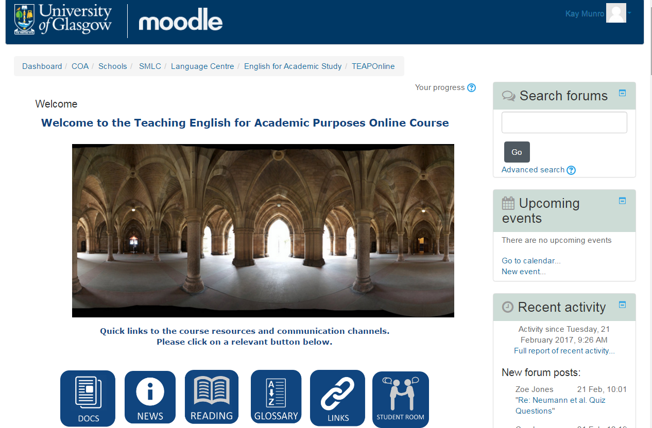

You can access the reading list from the TEAP Moodle – just click on the Reading icon at the top of the page
Accessing your course Reading List

Slide 4
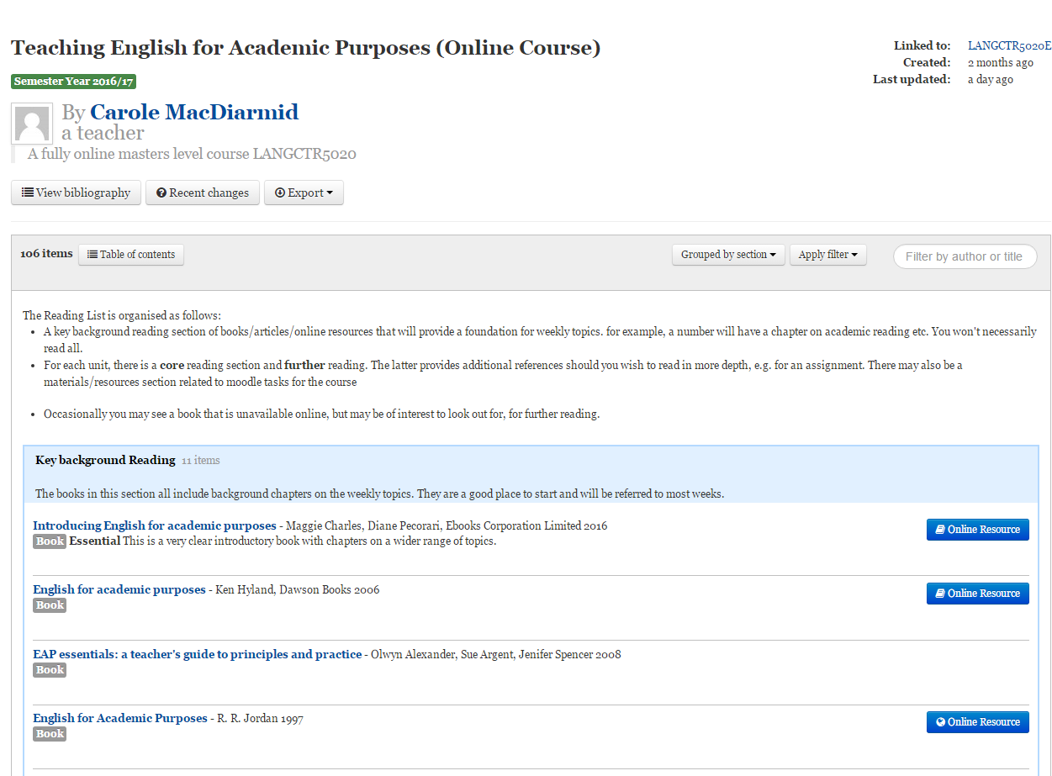
Finding your Reading List

Slide 5
Each lecturer can set up the Reading List as they wish.
It may be arranged by:
week / assignment – everything you need to review for a particular discussion or assignment
literature type – books; journal articles; professional guidance
importance – required reading, suggested reading, for information
Once you have worked out how your Reading List has been arranged, you will be able to move around it quickly.
How the Reading List is arranged

Slide 6
You can navigate around the list by scrolling down or by clicking on the Table of Contents
Using your Reading List

Slide 7
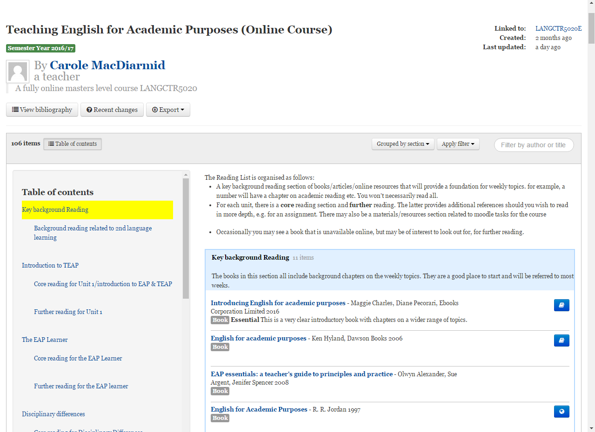
Click on Table of contents to navigate around the list, and find the section you require
Using your Reading List

Slide 8
Click on the online resource button to link directly to ebooks, ejournal articles, digitised readings, and websites
Using your Reading List

Slide 9
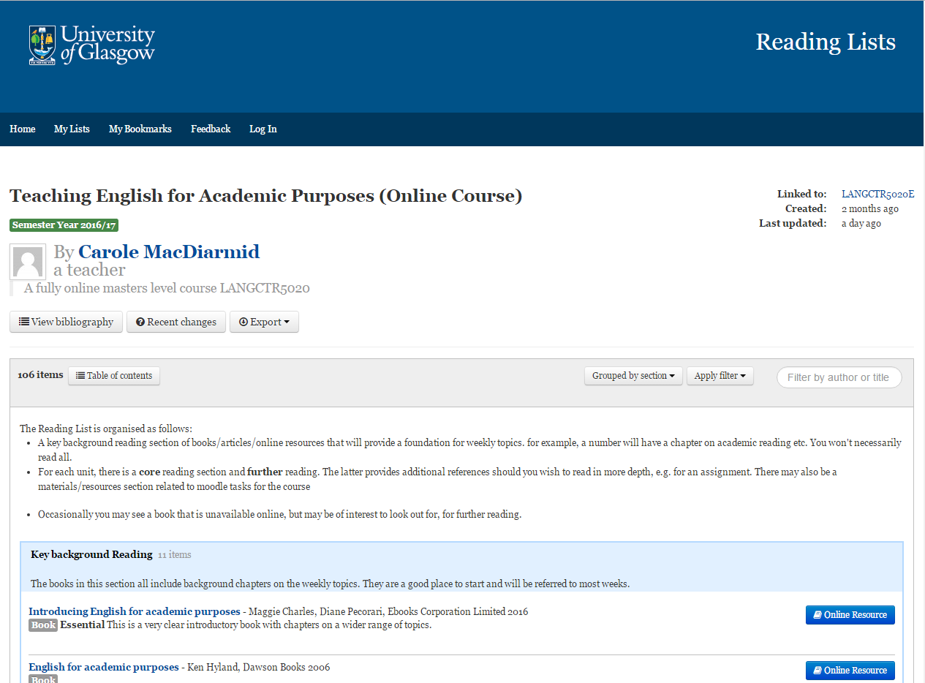
To use all the features of ReadingLists@Glasgow you can Log In – by clicking on the Log In link at the very top of the screen – you will be prompted for your GUID.
Getting more from your Reading List

Slide 10
Use the Read status and Add note features to prioritise your reading, and keep notes on what you have read.
Getting more from your Reading List

Slide 11
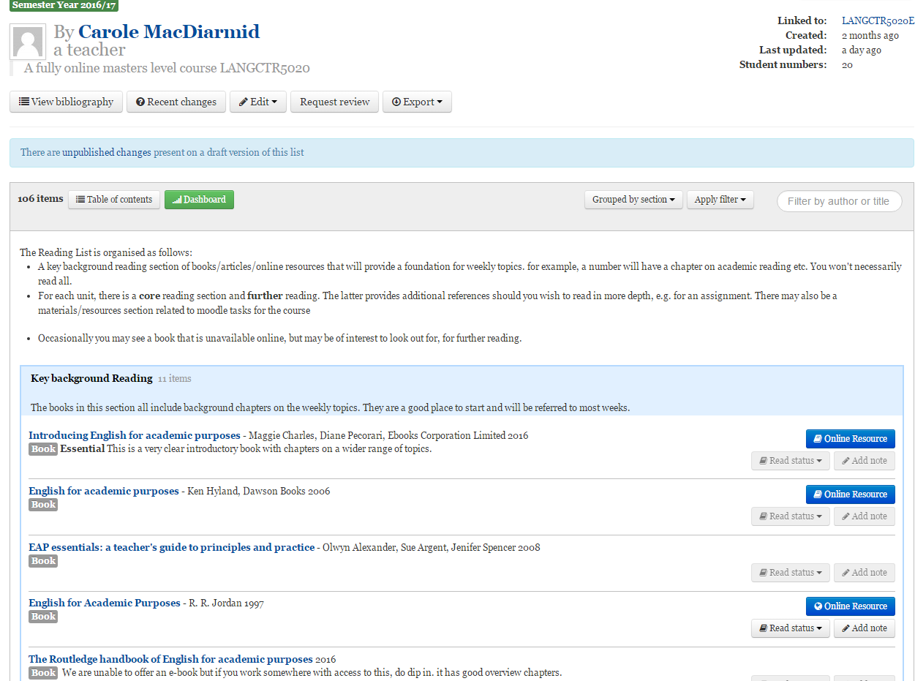
Use the Read status and Add note features to prioritise your reading, and keep notes on what you have read.
Getting more from your Reading List

Slide 12
Use the View bibliography and Export options to help you reference and cite accurately in your assignments
Getting more from your Reading List

Slide 13
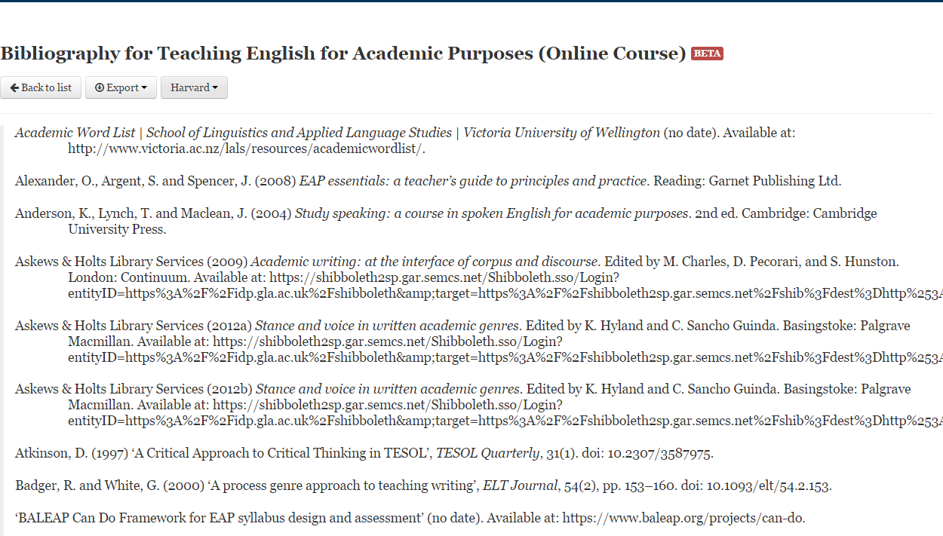
Getting more from your Reading List

Slide 14

Library
Knowledge Base
Thank you, this presentation is complete.
Please close this presentation.

