Slide 1

Getting started with literature searching
Lynn Irvine, College Librarian

Slide 2

Contents
The literature review – how it contributes to planning your literature search/search strategy
How searching works – how records are retrieved with different search techniques
Generating search terms (keywords) - ways to identify relevant search terms
Where to start…Library Search (and how it compares to Google Scholar)
Some search examples – how to create a search string
Useful features of Library Search – value added features to help with evaluating search results and finding related literature (research hacks to find papers)
Locating previous dissertations
Photo by Danielle MacInnes on Unsplash

Slide 3
Approaching research – skills and attitudes
OPEN, FLEXIBLE, METHODICAL, PATIENT and CRITICAL
value intellectual curiosity in developing questions and learning new investigative methods;
recognize that ambiguity can benefit the research process
maintain an open mind and a critical stance;
consider research as open-ended exploration and engagement with information;
persist in the face of search challenges, and know when you have enough information to complete the information task
seek multiple perspectives during information gathering and assessment;
use research tools and indicators of authority to determine the credibility of sources
recognize that authoritative content may be packaged formally or informally and may include sources of all media types
understand the increasingly social nature of the information ecosystem where authorities actively connect with one another and sources develop over time.

Slide 4
The role of the literature review
You may already have an idea of what you want to study and some knowledge of the literature in the research area. The literature review is an important part of a research project, and it will give you the knowledge you need to develop your research question.
The literature review will:
give you an understanding of the research in your subject area and provide the historical context
familiarise you with the language, terminology, themes, theories and arguments
help you identify relevant search terms (keywords)
raise your awareness of research methods
uncover key papers and authors
give you a picture of the current areas and topics of interest
Tip: SAGE Research Methods core database has books, videos, podcasts and case studies all about doing research. Research tools, like the Project Planner and Methods Map help you plan your project and understand terminology and definitions. Library home>Databases>Databases by name You will find lots of useful information on literature reviews.

Slide 5
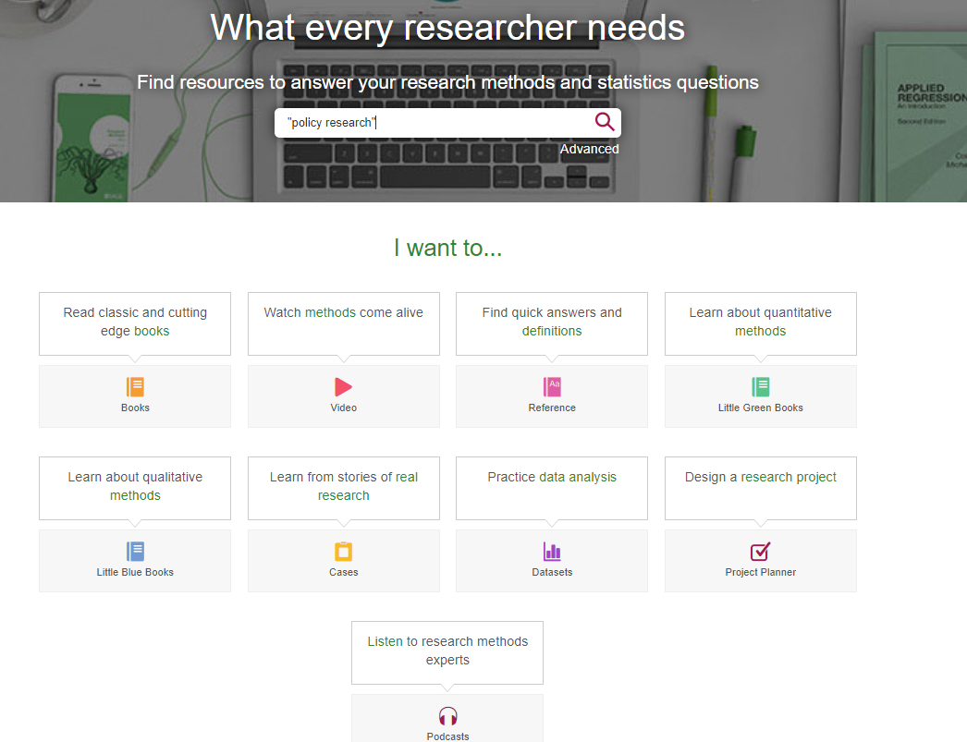
SAGE Research Methods - core
The database has books, case studies, podcasts, videos and useful tools all about research.

Slide 6
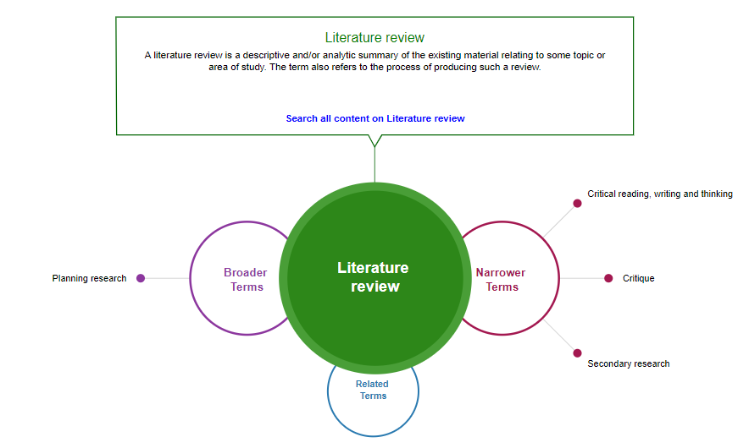
Methods Map
Shows the relationship between research terms and links to relevant content.

Slide 7
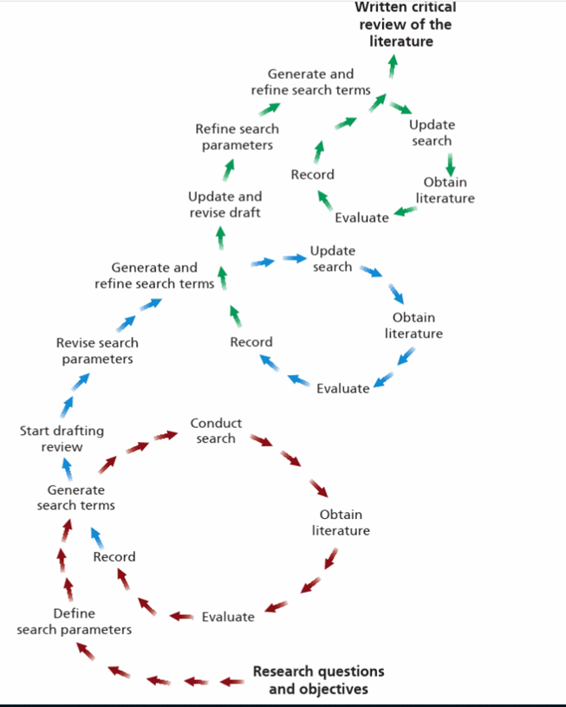
Searching is an iterative process of strategic exploration.
As Saunders (2019) diagram shows, each iteration of the search process is directional and purposive, as your knowledge of the published literature increases.
It starts with your research question and objectives which you must operationalise for searching : decide on the scope of your research; identify key search terms and reflect on types of information required [academic journals, trade journals, data, grey literature etc.]
Choose discovery tools and use search operators (Booleans, phrase, proximity, truncation, wildcards) to run your search.
Assess your search (are search results relevant? Do you need to change the search terms? Use a different discovery tool (search engine or database)?
Evaluate results for relevance; use them to identify more search terms, including key papers and authors. Critically evaluate what you select.
Image taken from Saunders, M.N.K., Lewis, P. & Thornhill, A. 2019, Research methods for business students, Eighth edn, Pearson, Harlow, England

Slide 8
How searching works – keyword matching and ranking
In keyword searching, when you use a search engine (Library Search) or a database, searching works by matching.
Search terms are matched against indexed content, including:
  the full text (including all metadata and the article references)
  Abstract
  Title
  Author-supplied keywords
  Database-supplied keywords
  Subject headings
  Article metadata
You can control how your results are retrieved by using keywords, search operators and field searches.
When you don’t use field searches, a database or search engine will return results based on a ranking algorithm usually on term frequency, inverse term frequency (rarity) and field weighting (title, abstract, keyword and subject fields have higher ranking).

Slide 9
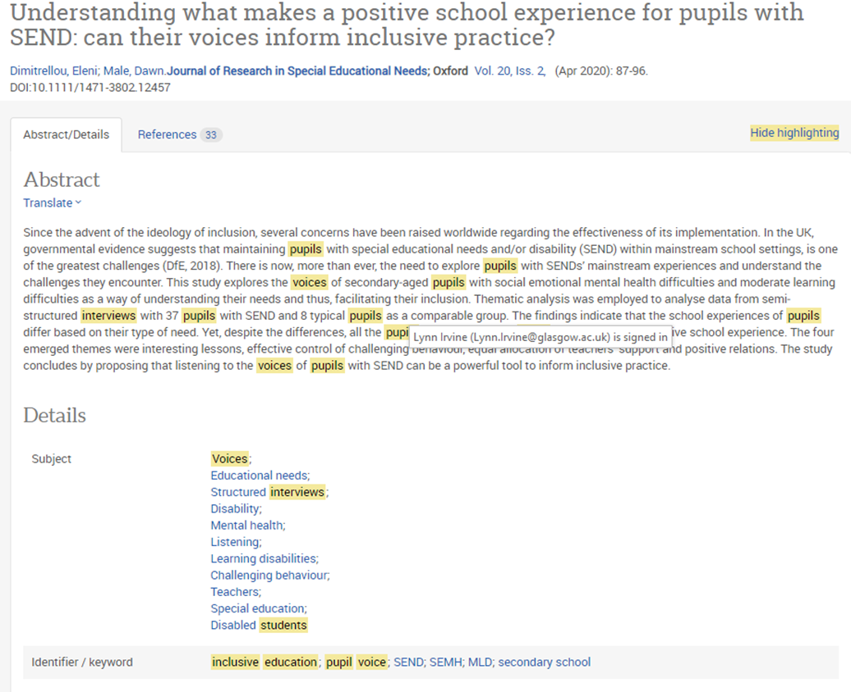
Search result showing matched search terms
In this example from Proquest, search terms are highlighted to contextualise them. This shows the terms being matched in the article abstract, keyword and subject field. This article is at the top of the results list so is ranked highly – both for term frequency and field weighting.
Relevance = term frequency + field weighting.
There is a direct correlation between search results and search terms.

Slide 10
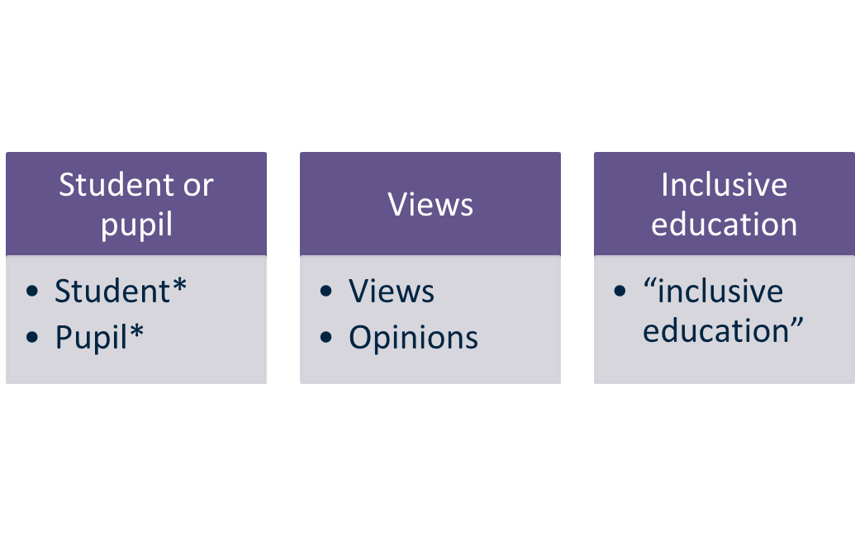
Sample search question and a basic keyword table
An exploration of student and pupil views of inclusive education.

Slide 11

Searching – identifying keywords from existing knowledge
Most searching is done using keywords
Keyword searching is the process of expressing your research question in the form of keywords or subject terms (in a search string or in search fields) and matching these to the literature.
How do you identify relevant keywords?
Start with the key concepts from your initial research proposal and expand these with your knowledge of a subject – key theories, concepts or authors you have come across in your coursework.
In order to maximise the comprehensiveness of your search, you must consider synonyms, antonyms and related terms, variant spellings, discipline-specific language, plurals, variant word endings etc.

Slide 12

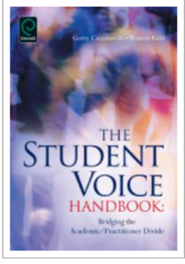
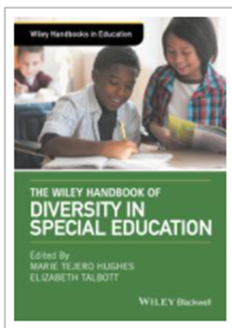
Generate keywords from textbooks, research monographs and handbooks
You might also find it useful to generate keywords from key textbooks or research handbooks. Research Handbooks reflect the current key arguments and theories in a research area. Use the chapter headings, chapter introductions and the index to identify:
Concepts
Theories
Studies
Key authors and experts
Sources of further information
Book records in Library Search often have a summary description of content and chapter headings (for print and ebooks). [Click the Preview link to open this up. ] Open the full text of ebooks to scan chapter headings and the introduction.

Slide 13
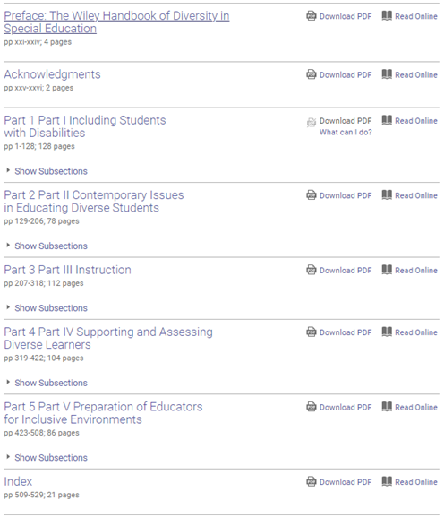
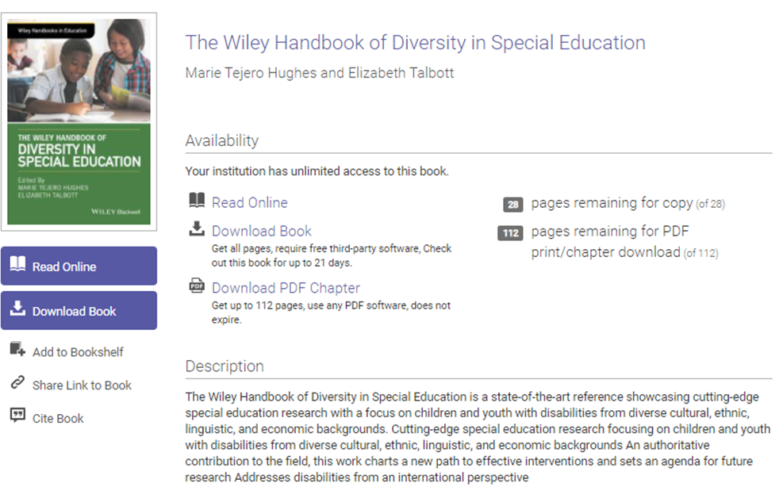
Generate keywords from textbooks, research monographs and handbooks (2)

Slide 14
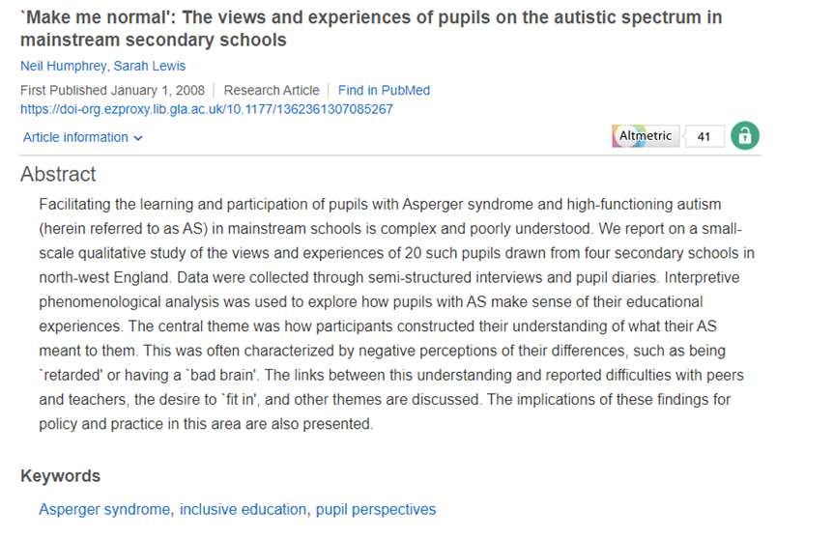
Generate keywords from journal articles – abstracts and author-supplied keywords
You might also find it useful to generate keywords from published journal articles.
You can find keywords from reading the full text of the article but running a few initial searches and using the abstract and author-supplied keywords or subject headings is a good way to quickly generate lists of relevant key terms for searching.
A quick scan read of the introduction can also be useful.
Humphrey, N. and Lewis, S. (2008) ‘`Make me normal’: The views and experiences of pupils on the autistic spectrum in mainstream secondary schools’, Autism, 12(1), pp. 23–46. doi: 10.1177/1362361307085267.

Slide 15
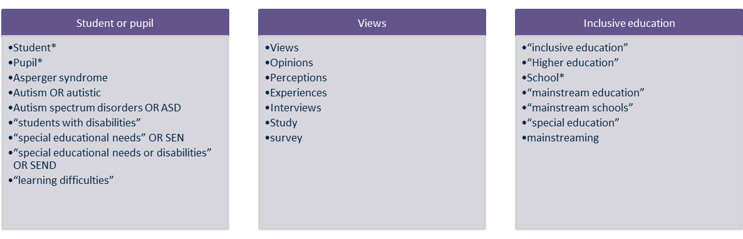
Sample search question and expanded keyword table
An exploration of student and pupil views of inclusive education.

Slide 16
Structuring a search – points to note
When you structure your search:
You may not want to include all concepts in the search. Tailor the search to the specific concept you are researching e.g. you may be doing some research on the concept of inclusive education - what does it mean? Is the term challenged or superseded in the literature? Was there another term used previously? Etc.
Think about where you are searching in a document – are all of your concepts likely to be in the title or abstract? Do you need to search across all of the fields to find relevant literature?
Terminology – use synonyms, variant spellings, discipline-specific language, plurals, variant endings etc.
Consider searching single concepts at a time, then using different combinations to explore your topic

Slide 17
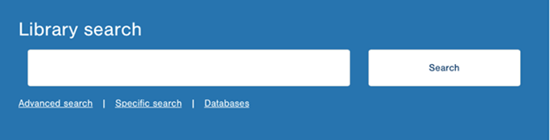
Library Search – full text keyword searches
"inclusive education" AND (student OR pupil) AND voices – 5054 journal articles
"inclusive education" AND (student OR pupil) AND (voices OR views OR opinions OR perceptions) - 14,119 journal articles
("inclusive education" OR "inclusive practice" OR "inclusive pedagogy") AND (student OR pupil) AND (views* OR perception* OR interview*) – 14,930 journal articles
("inclusive education" AND (student OR pupil) AND (views* OR perception* OR interview*) limited to publications from 2015 to current – 6,420 journal articles

Slide 18
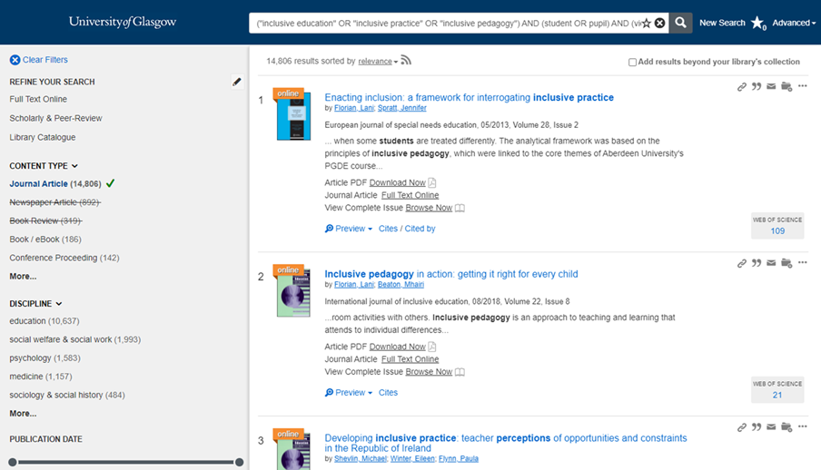
Library Search – filtering your results and linking to the full text
Use the filters on the left to easily focus your search by content type and date for example to journal articles published in the last 5 years.
Click on the Preview link to read the abstract.
Click on Full Text Online to open and read the full text or download the PDF to read offline or to link to the full issue of the journal.

Slide 19
Evaluating search results – skim reading for relevance
Use preview and detailed record screens to help you evaluate search results:
The abstract should help you find out a bit more about the article than you can gather from the title alone. For empirical articles you will usually get a summary of the focus of the research, methodology and conclusions.
  If you are still unsure, open the article and read the introduction and conclusion. If it looks relevant, download or mark for reading later (you can export or email marked/saved search results in Library Search and in all databases)
Look at the journal (source) title – in multidisciplinary databases you will get search results from journals across many subject areas. Journal titles will give you a sense of their scope. You may also start to notice particular journals coming up regularly in results.
Note the date of the article so that you have a sense of how recent or long ago the article was written. This does not mean that older articles are of less value (classic or seminal works are very important) but you should be aware that conclusions or arguments may have been challenged in subsequent research. Look for citing literature to get more recent, related literature.
Use search results to gather more keywords, concepts, cited works or authors that you want to add to your search strategy.

Slide 20
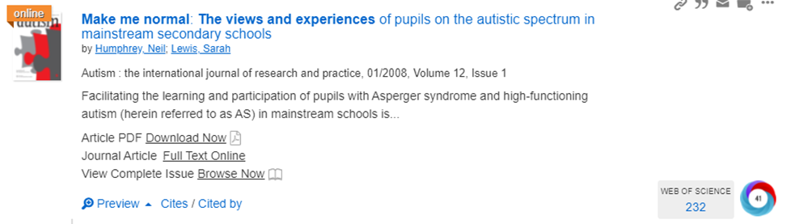
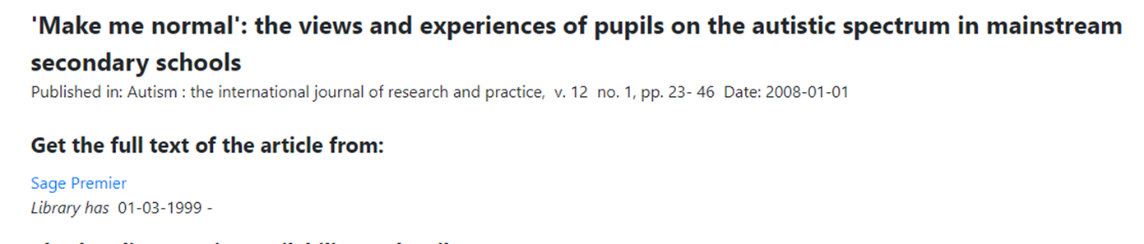
Locating the full text from Library Search
Click on the Full text Online to read the journal online or download the PDF to read offline.
In this example, when you click on the Full text Online link you get an interim screen with a link (see below).
This usually happens when there is more than one source for the full-text e.g., from within a database or from the publisher website. If that happens, you have a choice of which source to use. Click on the hyperlink to link to the full text from your preferred source, or from the source listed if there is only one (as in this example).

Slide 21
Use all of the useful information from your search results
Choose Cites to see all the references used in the article that are indexed on Library Search. This is useful for identifying sources.
The Cited By link lets you list the indexed literature citing this paper. This is a good way to see more recent papers that may be useful for your research.
The Altmetric donut (colourful icon) shows the online attention to the article after it was shared or published, including in blogs, on social media, in news sources and in policy documents.

Slide 22
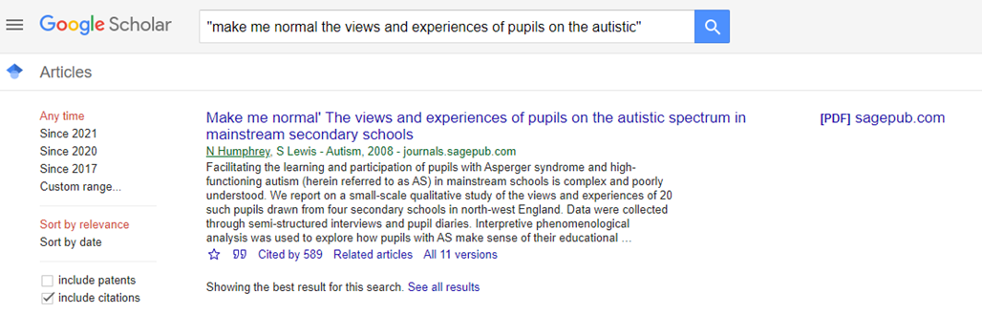
Using Google Scholar for citing literature
Google Scholar is an alternative source for citing literature. Search for the article on Google Scholar.
Choose the Cited by link to see the indexed papers citing the article.
Where there is a lot of citing literature as in this example, use the date option on the left of the results page to see how much the paper continues to be cited. Use that to look at only the most recent papers as appropriate. Selected from the dates offered or state a date range of your choice.
Critically assess the relevance of papers, using the article titles and source titles.

Slide 23

Looking for previous dissertations
Online dissertations
The library has digitized some dissertations which are hosted in a repository. You need to use remote desktop to use the dissertation repository as it is an on-campus service. To find out how to access services using Remote Desktop see the IT information here https://www.gla.ac.uk/myglasgow/anywhere/desktop/
You can then access the dissertation repository here http://endeavour.gla.ac.uk/
You can browse past dissertations by college or school. Please note that these are representative only of the dissertations selected by schools and sent to the library; the repository does not contain all past dissertations.
Print dissertations
You can also search for print dissertation titles, using Library Search https://www.gla.ac.uk/myglasgow/library/ - search for dissertation AND "University of Glasgow" AND business and use the Library Catalogue filter on the left (replace the word business with any other relevant search term). You should see past dissertations in print that are held in the library.

Slide 24

In summary
Be prepared (think about what you are looking for – so you know where to look!)
Be flexible – when you explore you will find things you were not looking for; equally you may occasionally struggle to find anything at all that seems relevant. That is a normal part of research – accept it and make changes - where you look (change discovery tool) – and how you look (change your keywords or subject terms)
Be curious and bold - embrace different search tools
Be prepared to find relevant material in different places
Leave enough time to explore
Be critical and reflective – is the information you find relevant to your question?
Use the information you have and know when to stop. Make full use of the information you have before looking for more.
Don’t forget to take note of where you found information (especially quotes) – you will need this information for your bibliography
Ask for help if you need it
Photo by Kelly Sikkema on Unsplash

Slide 25

Further help and support
The College Library Support Team
https://www.gla.ac.uk/myglasgow/library/help/collegesupport/ can help you to get started finding information and using library resources.
Email them for some help or to book an appointment.
Or use the generic help address library@glasgow.ac.uk and staff will answer your enquiry or refer you to specialist teams who can help.

Slide 26



This presentation is created by Lynn Allardyce Irvine under licence -
CC BY-NC-SA 4.0 Attribution-NonCommercial-ShareAlike 4.0 International
#UofGWorldChangers
@UofGlasgow

