Slide 1

Selecting key discovery tools for research in education
Lynn Irvine, College Librarian

Slide 2

Matching discovery tools to information needs
No single search engine or database indexes all the information sources you are likely to need for a dissertation or research project. You will need to use a variety of search tools to find the types of information you may need to answer your research question.
The presentation will identify key discovery tools for finding the main types of information required in dissertation research.
Textbooks, handbooks and research monographs
Academic and practitioner journal articles
Grey literature, including theses, conference papers and policy documents
Research methods, how-to books, reference works and case studies

Slide 3

Handbooks and research monographs
Research Handbooks
Research handbooks collate essays on current research by experts in their field. These are a useful starting point for your research to help identify current and past research themes, as well as key authors. Use this information search for other works by these authors, or on the key themes. It is also a useful way to get a starting bibliography as they are always well referenced.
Textbooks and research monographs
Textbooks (often edited – therefore with multiple authors) are good for definitions and overviews of a topic so are a very useful starting point. Research monographs, written by single experts in a field are a good way to gain an insight into the history of a subject as well as key arguments and debates. These are well referenced and useful for identifying key authors and seminal works.

Slide 4
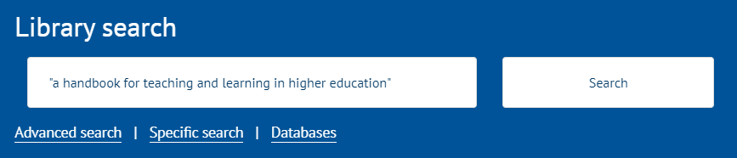
Finding textbooks , handbooks and research monographs
There are thousands of ebooks indexed on Library Search which you can retrieve with any search. These include books from key social science publishers including Wiley, CUP, OUP, Taylor & Francis, Emerald, Elsevier, Springer and Pearson.
It indexes most of what the Library owns or subscribes to. As we buy new books and collections, these are added to the Library Search index.
To find books – use relevant keywords (include the word handbook if you want to find research handbooks on a topic)
The search results will show all the material indexed in Library Search, matching your terms.
Use the books/eBooks filter to see only books.
Use the Full Text Online filter if you want to limit to eBooks.
You can use the Specific search link under the search box and choose books to filter your search results to just books before you search if you want to.

Slide 5
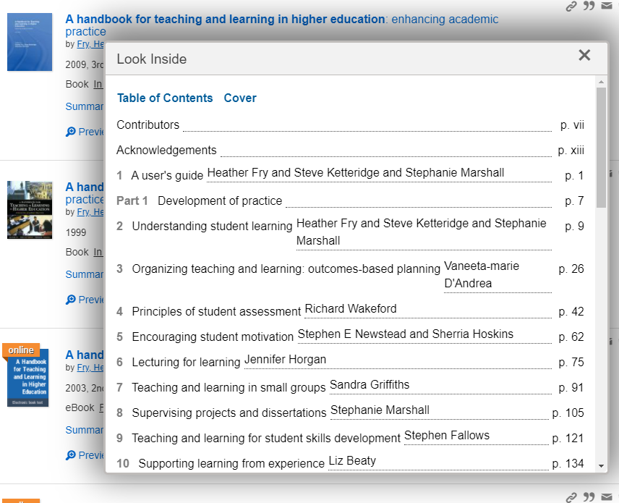
Using the Preview, Summary or Look Inside options for book information
Use any of the links for Preview, Summary or Look Inside to get more information about books. This can provide more about the scope and content and its relevance to your research.
It is of most value for books we have in print as it will save you the trip to the shelves if it is not what you really need.
For eBooks you can open the book on the screen and do a quick scan of the contents pages to asses its relevance.

Slide 6

Journal articles
Journal articles are a principal source of information for dissertations. Journal articles are regularly published and well referenced. They are connected by citations which makes them excellent sources for related papers.
There are different types of academic journal article:
empirical(original research) articles describe and discuss studies and experiments. They normally include survey aims, methodology and conclusions. They are good for finding quantitative and qualitative data.
review articles in the form of a literature review or systematic review, provide a comprehensive summary of research on a particular topic and a perspective on the state of the field and the direction in which it is going. They are well-used and highly cited as they are well-referenced and a rich source of related literature.
theoretical articles, where the author draws on existing research to form a new theory or explores existing theories in new ways. These also have significant reference lists and are a good source of related literature.
Practitioner journal articles
Practitioner journals, sometimes called trade publications, publish articles by professionals working in particular fields. For example, those working in education, which might include teachers, lecturers, managers and policy makers.
These can be useful if you want to explore professional perspectives on key policies, initiatives within specific areas of a profession or high-interest topics. Articles tend to be short and have few references.

Slide 7
Finding journal articles - when to use a search engine and when to use a database
Most research databases index journal literature, including academic and practitioner articles. You can also use search engines like Library Search or Google Scholar (Scholar does not index practitioner articles).
When should you use a database instead of a search engine and what is the difference between them?
Open web search engines are useful for grey literature but not for academic literature. Library Search and Google Scholar are useful for quick searches or initial searches.
For focussed searching when you have a search strategy and a set of keywords, databases are more efficient
​Databases are either multidisciplinary or subject-specific, focusing on outputs common to that subject area (empirical education research, review articles, survey reports or evaluation of education policy documents for example).
Multidisciplinary databases are high-quality, curated databases with value-added features allowing you to search across thousands of journal articles, using features to help you focus your search and to find related literature. They often also include traditional and alternative metrics. SCOPUS and Web of Science are the two main multidisciplinary databases.​
Subject-specific databases are smaller, curated collections useful for systematic searching and targeted research. They often have document types and grey literature not easily found through other search engines or databases. EBSCOhost and Proquest are the two largest database platforms, hosting many databases (77 between them).​
If you are unsure of which database to use –use the databases by subject pages or use the methodology section in published journal articles to see what databases researchers used.​

Slide 8
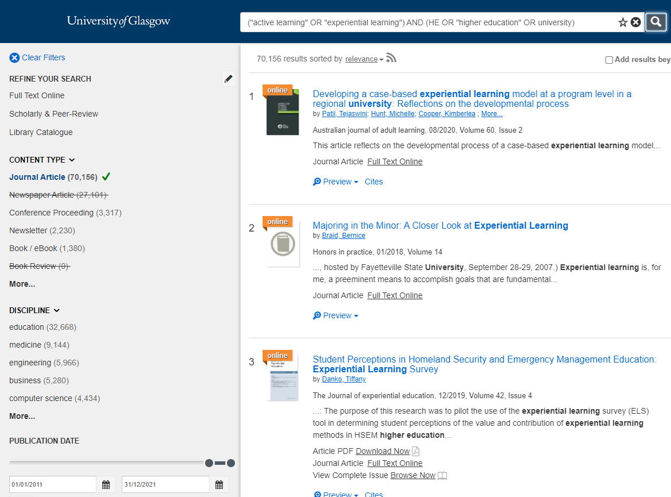
Library Search - searching for journal articles
("active learning" OR "experiential learning") AND (HE OR "higher education" OR university)
You can:
Use the content filter to limit results to journal articles
Use the date filter to limit results to the most recent publications
Choose Preview to read the abstract of the article. This will help you evaluate its relevance to your search.
Download the PDF or link to the article online
Link to the whole journal issue (useful if there is a ‘special issue’ with multiple articles on your topic)
Save the article to a temporary folder (useful if you are exploring an issue and want to do a few searches). The folder icon to the right of the search result is the save button.
Use the Cites link to see article references or the Cited By link to see the citing literature

Slide 9
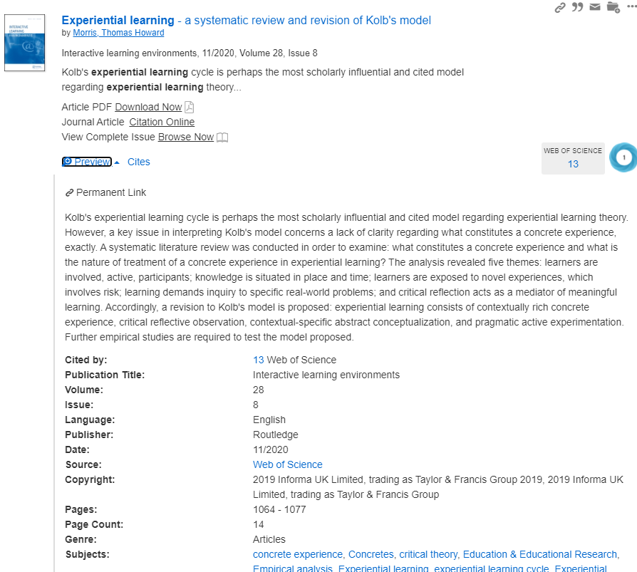
Journal abstracts
Choose Preview to read the journal abstract and bibliographic information about the article, including subject headings.
You can also link out to citing literature on Web of Science. There may also be a Cited By link to citing literature on Library Search.

Slide 10
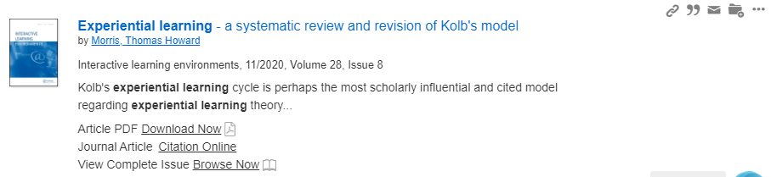
Saved searches and search results icons
There are 4 icons to the right of each search result:
Chain link which creates a stable URL to the search result
Quotation mark which creates a reference of the search result in a style of your choice e.g. Harvard
Envelope which allows you to send the article reference to someone by email
Folder which lets you save the search result to a temporary folder. Saved item folders are red. (Saved items are shown in the folder icon at the top right of the screen.)

Slide 11
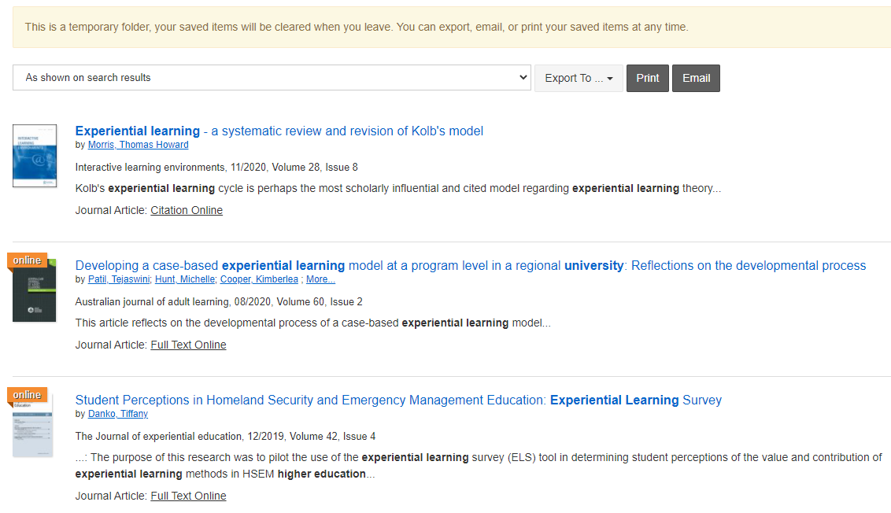
Library Search - saved results page
When you click on the temporary folder, you will see your saved results.
You can email them to yourself (or someone else), export them to reference software (like Endnote), link to the full text or create a quick reference list.
To create a quick reference list, choose the drop down option in the box ‘As shown on search results’. Choose a citation style from the list and your search results will be converted into a short reference list.
N.B. the list will be in the order you added the items to the folder. It is not a fully formatted reference list.

Slide 12
Multidisciplinary databases and platforms for cross-searching
You may need to use a database outside of your main subject area so you may have to look at multiple listings to identify key databases. However, there are multidisciplinary databases which allow you to search multiple subjects , and platforms which allow you to cross-search multiple databases.
The two biggest research platforms are:
EBSCOhost
Proquest Academic
They host many databases across a range of subjects. You can search single databases, selected databases, pre-defined collections, or search all at once. Education databases are available on both platforms.
The two largest multidisciplinary databases are:
SCOPUS
Web of Science (core collection)
Use them for searching, or if you want to find citing literature (i.e. the journals that cite a key paper you have found). These two databases have excellent features to help you connect related articles.

Slide 13
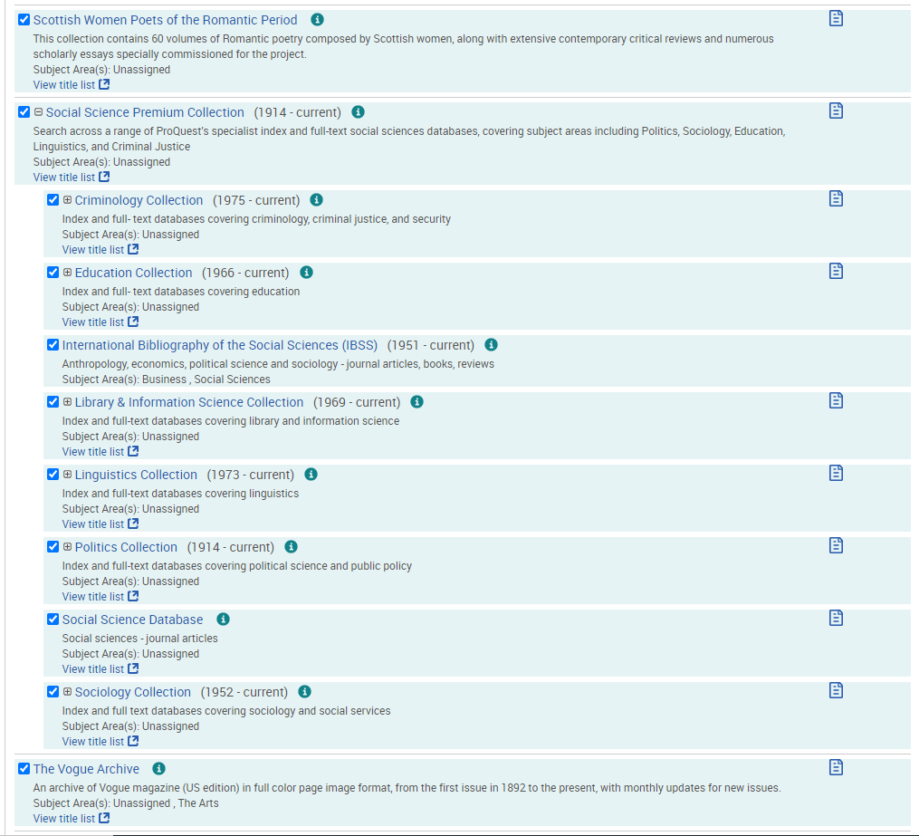
Databases on the Proquest platform
There are multiple databases on the platform. You can select those you want, search across all or do more focussed searching in individual databases.
To see the list of databases, from within any database choose the ‘Change databases’ link or click on the Proquest logo to return to the home page, and choose the Databases link on the toolbar.
You may want to try using the Social Science Premium Collection which has 17 databases you can cross-search
Proquest also hosts several archival newspapers.

Slide 14
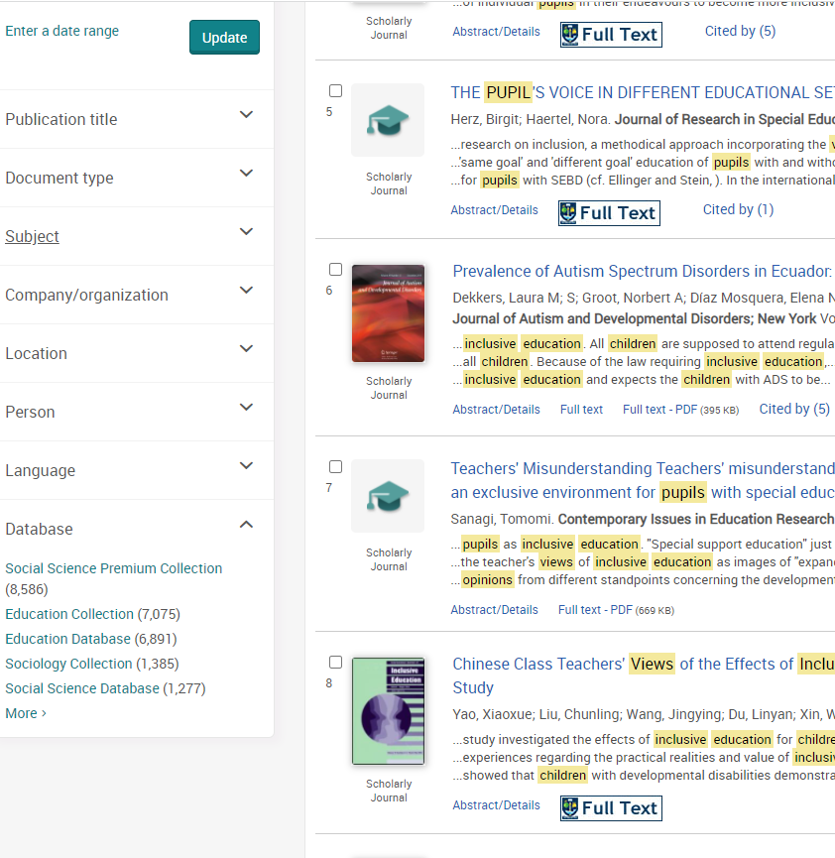
Use the database filter to identify relevant databases
You can use the database filter on Proquest or EBSCOhost to see which databases match most content against your search terms

Slide 15
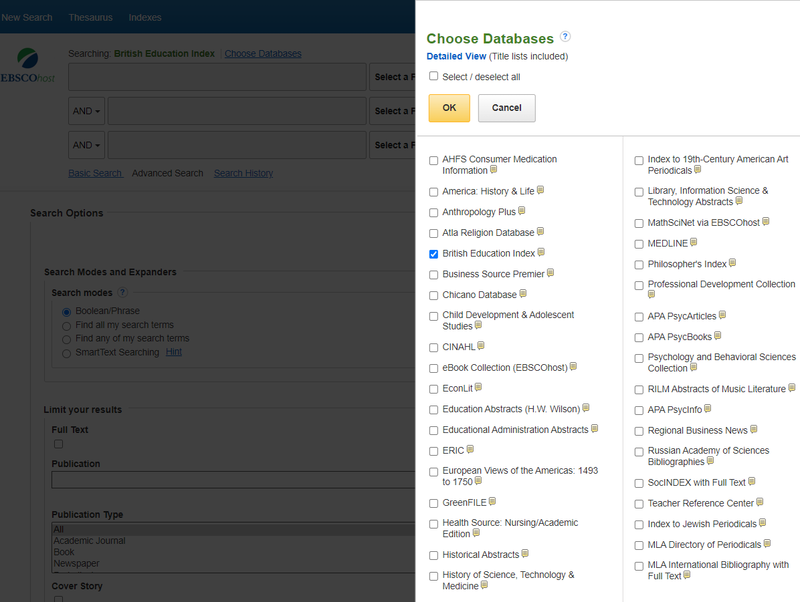
Databases on the EBSCOhost platform
Similar to Proquest, there are multiple databases on the EBSCOhost platform. You can search across all, search specific databases and easily switch between them and re-run your searches.

Slide 16
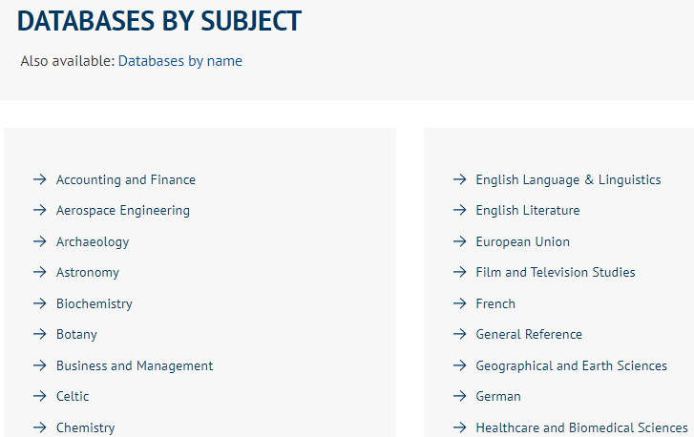
Subject-specific databases
The link for the databases page is on the library home page under the Library Search box. Our databases are listed alphabetically by major subject heading. Choose a heading to see the databases available. The most appropriate will depend on the focus of your research question. Databases are available on and off campus. Most are accessed with your GUID and password.

Slide 17
Key databases for education research
The main education databases are:
ERIC
Professional Development Collection
Education Abstracts
Australian Education Index
British Education Index
And for more general social science or behavioural science/psychology subjects:
SOCIndex
APA PsycInfo

Slide 18

Education databases content – non-journal sources
Book chapters
Conference papers
Survey reports (Research Councils and Research Associations)
Statistics
Government documents (policy documents, statistics and research reports)
Photo by Beatriz Pérez Moya on Unsplash

Slide 19
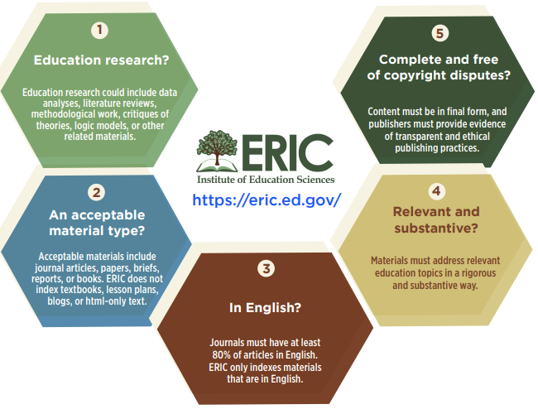
ERIC – selection criteria
ERIC collects and indexes education research materials to enable users to understand and implement education practices, understand and evaluate education policies, and expand knowledge and understanding of education research.

Slide 20
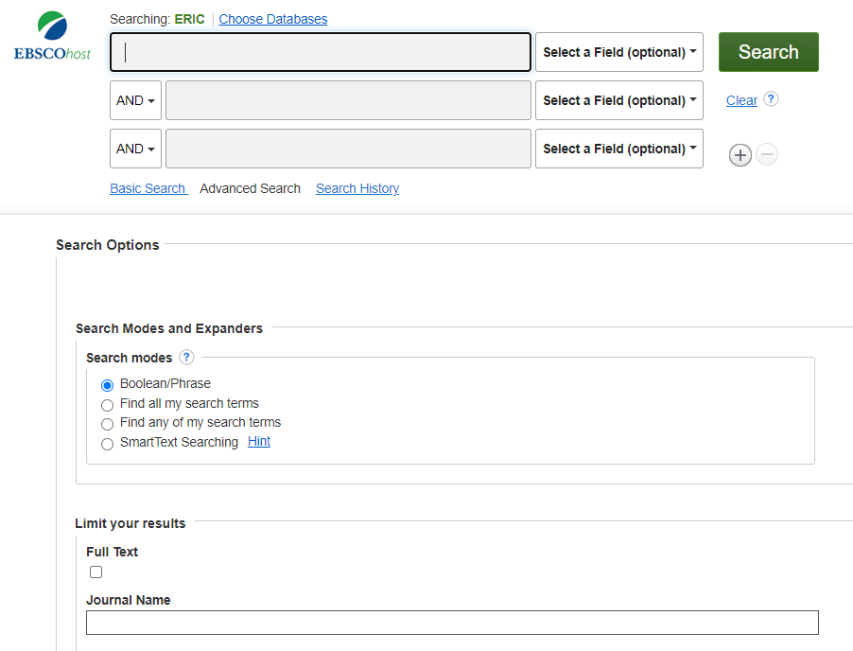
ERIC
ERIC (Education Resources Information Center) is an authoritative database of indexed education literature and resources:
Academic journals (including peer reviewed titles) and books from major international publishers including Sage, Routledge, Taylor & Francis, Wiley-Blackwell, OUP, Springer and university presses
Education magazines
Trade publications (professional titles)
Conference papers
Government departments of education reports, statistics and policy documents (US, UK, Australia
Research Council and Research Association reports
Content coverage from 1907
Subject areas include Higher Education, Adult Education, Teaching, Assessment and Evaluation, Technology…

Slide 21
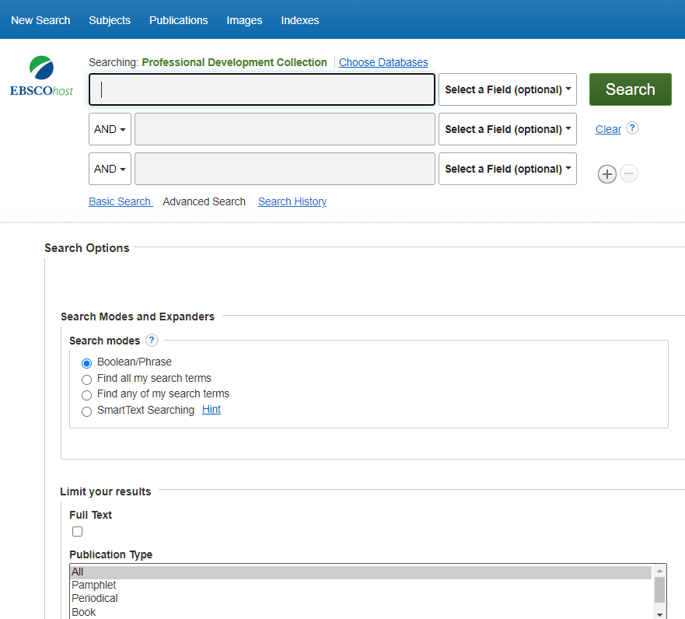
Professional Development Collection
Specialised education database indexing:
Academic journals (including peer reviewed titles) from major international publishers including Sage, Routledge, Taylor & Francis, Wiley-Blackwell, OUP, Springer and university presses
Education magazines
Trade publications (professional titles)
US Dept of Education reports (policy documents, statistics, survey reports)
Australian Council for Educational Research reports (longitudinal and other surveys, statistics)
Subject areas include Higher Education, Adult Education, Teaching, Literacy, Curriculum planning and development, Education Policy, Educational Technology, Psychology, etc.

Slide 22
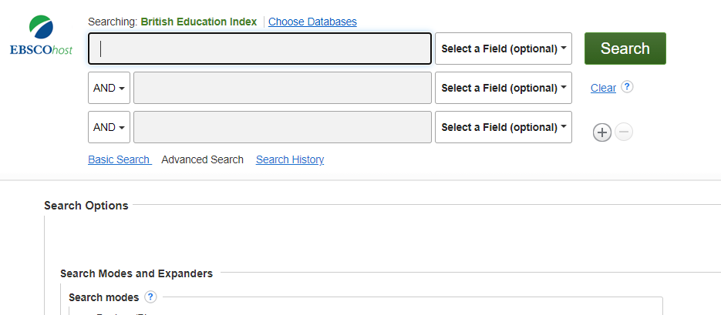
British Education Index
British Education Index (BEI) covers all aspects of educational policy and administration, evaluation and assessment, educational technology and special educational needs.
The database indexes:
Academic journals (published in the UK with some international literature) from SAGE, Routledge, Emerald, OUP, Wiley-Blackwell, CUP
Magazines
Thesaurus with British-specific terminology
Coverage from 1929 to current
Subject coverage includes curriculum development, educational policy, educational technology, multicultural education

Slide 23
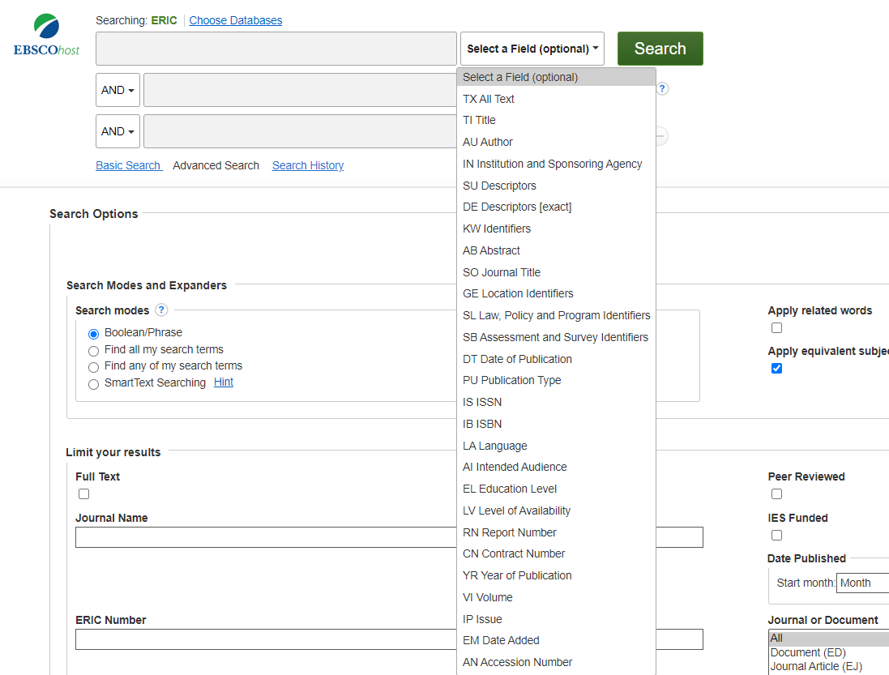
EBSCOhost search screen
The default search screen is the Advanced Search screen which has multiple search boxes (and the option to add more rows as required) allowing for flexibility in how you search
Boolean search operators are embedded to allow combinations of search rows
The default search is to match keywords to whole item records (for example a full text journal article or book chapter) but the advantage of a database is the flexibility to match terms against specific fields in a record. Use the drop-down to see all the fields you can match terms against
Limiters are shown under the search box which allow you to select limiters before you search (Alternatively, these can used after you search from the search results screen)
You can switch databases from the search screen, (and rerun searches if desired)

Slide 24

BoB National – on demand TV and radio content for education
Access 2.5 million broadcasts dating back to the 1970s
Record from over 75 free-to-air channels
Create your own playlists, clips and clip compilations
Search programme transcripts and subtitles
One-click citation for easy academic referencing

Slide 25

Newspapers
The library provides access to thousands of local, national, international broadsheets and daily newspapers.
Includes key European titles and important international titles like , New York Times, Washington Post
The two main databases are Nexis and Gale News (on Gale Reference Complete). We subscribe to current content and digital archives (going back to the seventeenth century).
See the newspapers page for selected titles.
Photo by Mr Cup / Fabien Barral on Unsplash

Slide 26

Searching for journals in the library collection
Choose the Specific search under the main search box on the library home page.
Choose journals.
You will see a search box or an option to browse the library’s ejournal collection.
The search box will look for print and online versions of journals (the library often has print back – older – copies as well as online access to the most recent articles.
The browse option is only for online journals

Slide 27
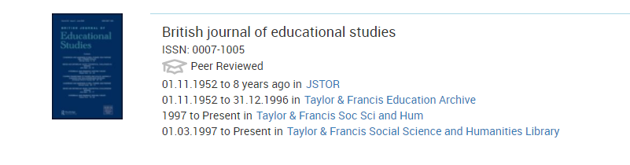
Example of a journal record
The library has access to journals from several sources- for example from database subscriptions or direct from the publisher.
In this example, we have access to journal content for the British Journal of Educational Studies from a variety of sources:
The JSTOR database
The publisher (Taylor & Francis) archive
Current content from the publisher Taylor & Francis
You can access the content from any of these sources. Check the coverage dates which differ across sources.
Click on the hyperlinks to access the journal

Slide 28
Finding grey literature
Grey literature is broadly defined as encompassing documents produced by government, academics, business and industry which are not controlled by commercial publishers.
Government and parliamentary publications, working papers, theses, business and organisation information can all be searched using specialist repositories, going direct to the organisation web site or using a generic search engine.
Some grey literature is indexed in subject-specific databases e.g. policy papers, business reports, speeches and videos.
UK Theses EthOS https://ethos.bl.uk/ is the UK’s national thesis service which aims to maximise the visibility and availability of the UK’s doctoral research theses. It can be useful for the detailed reference lists.
UK Government policy papers https://www.gov.uk/search/policy-papers-and-consultations
House of Commons Library Research briefings – an excellent source of collated analysis and statistics

Slide 29
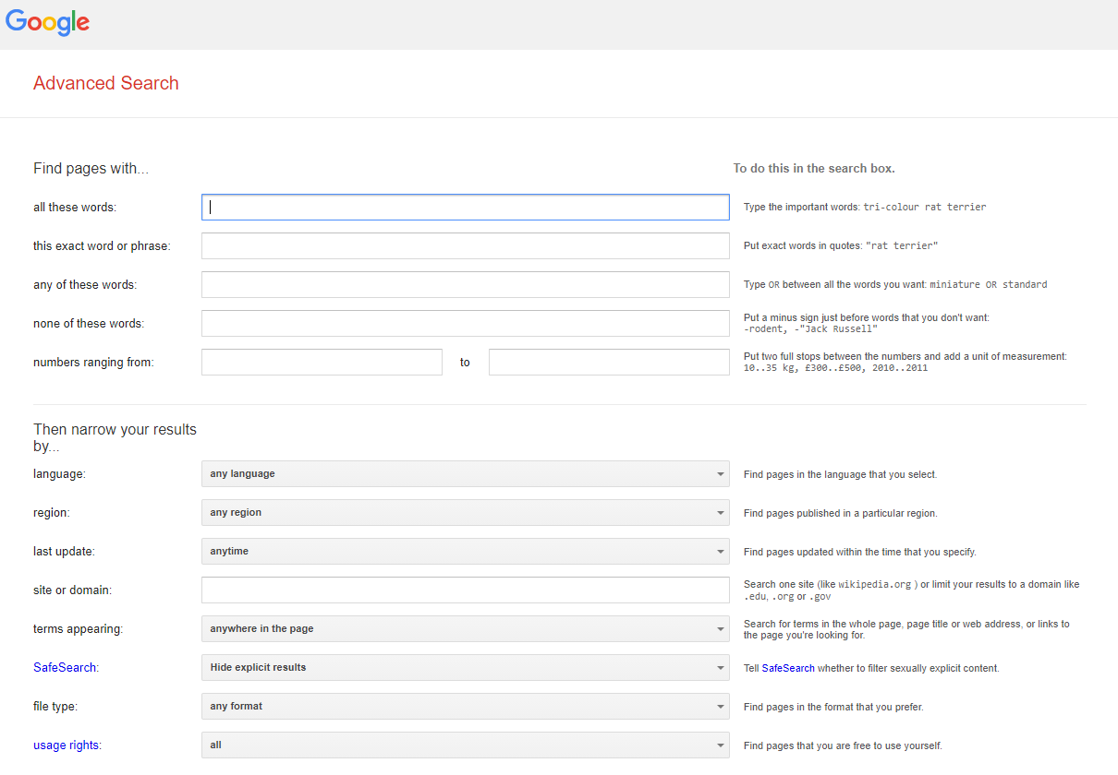
Google - Advanced search tips
Use the Advanced search for more effective and easy searching. (Choose the Settings link on the bottom right of the screen and then Advanced Search). You can use Boolean operators (AND, OR, phrase) and combine these with some very useful limiters.

Slide 30
Google – site and filetype search from the basic search screen
“inclusive education” site:org.uk
To find agencies, organisations and charity web pages on inclusive education.
You can run the same search for any government or organisation if you know the domain e.g., gov.uk; scot.gov; org; ac.uk; edu
“inclusive education” filetype:ppt
Finds PowerPoint presentations on inclusive education.
“inclusive education” filetype:pdf
Is useful for finding reports.

Slide 31
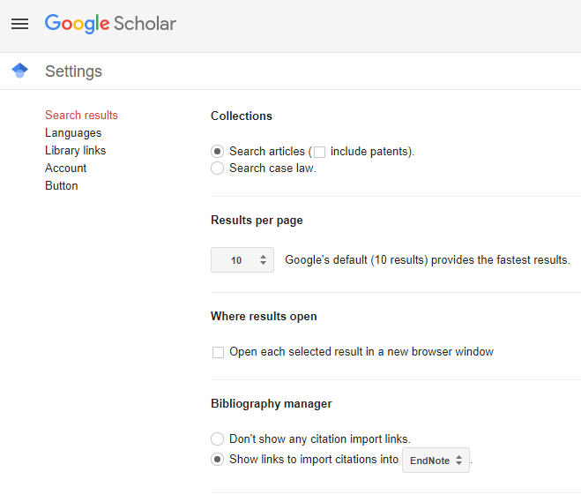
Google Scholar settings
Go to Google Scholar https://scholar.google.com/
Click on the hamburger menu and choose Settings
Choose Library Links
Enter University of Glasgow in the search box
Choose University of Glasgow – Full text from Glasgow
Press Save

Slide 32
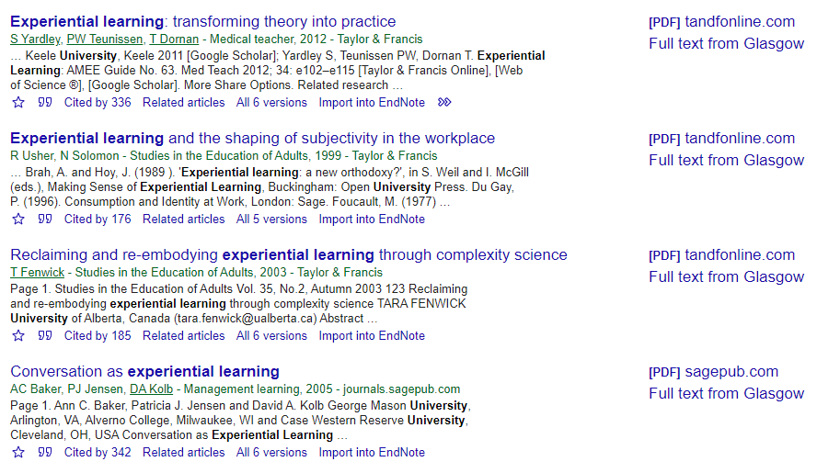
Google Scholar – results showing library access

Slide 33
How to get access to material that the library does not have
Please use the library web pages to find books, journals and information in databases.
If you start from the library pages, you will be prompted for your GUID and password for access to the full text.
Double check our journal holdings and on Library Search, for any material that you are having difficulty accessing in full text.
If we do not have access you can use Article Reach to request journal articles. If the journal is not available via Article Reach, request the item via Inter Library Loan (ILL). For details of the Article Reach and the ILL service, see here https://www.gla.ac.uk/myglasgow/library/help/icantfindwhatimlookingfor/needsomethingthatwedonthave/
Request the purchase of books using the Book Suggestion Form on the library web site https://www.gla.ac.uk/myglasgow/library/contact/forms/booksuggestionform/

Slide 34

EndNote for referencing
Consider using EndNote or another reference management system to help you manage your reference lists and bibliographies
EndNote is already installed on all student computers on campus and is available via remote desktop services
You can download a desktop copy for free to install on your own device and/or register for an account to use Endnote online (via the Web of Science database)
There is information and help guides on our web pages https://www.gla.ac.uk/myglasgow/library/help/endnote/
There are plenty of videos and guidance on the EndNoteTraining YouTube channel https://www.youtube.com/channel/UCdTDZ4RUT9Jl81oRhpEIIxA and the Clarivate pages https://clarivate.libguides.com/endnote_training/home
Photo by Trent Erwin on Unsplash

Slide 35
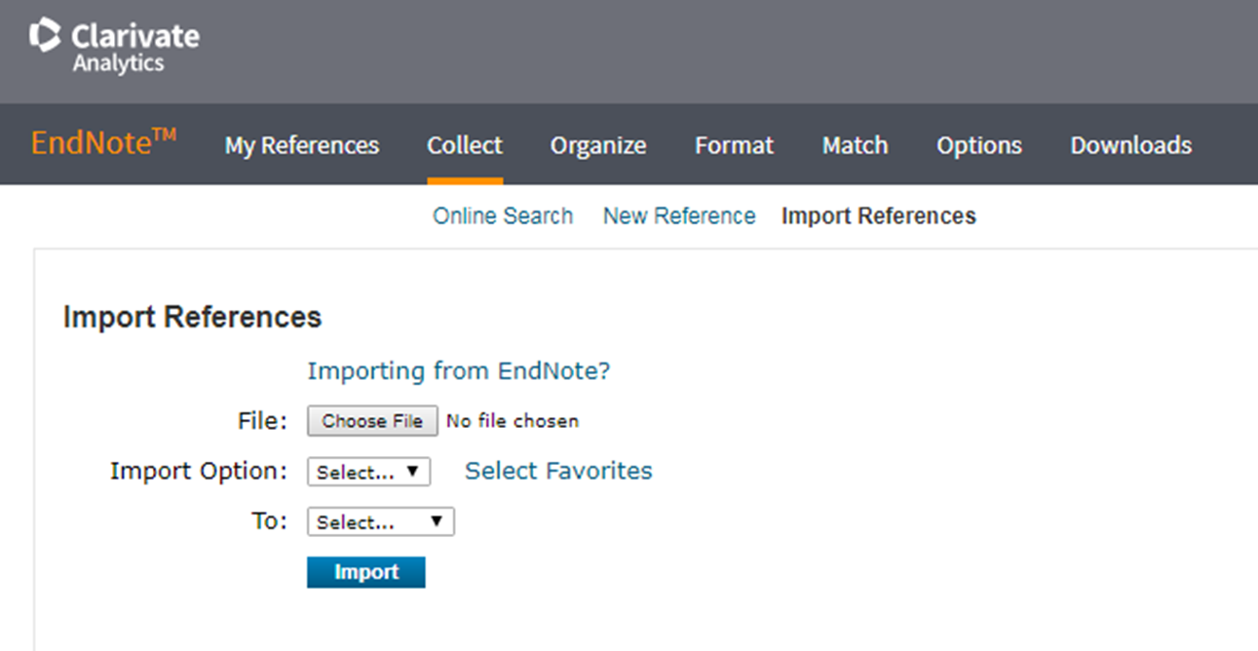
Functions of EndNote
Download citations directly from many library article databases. Methods for saving records vary depending upon the database used.
Use the "Collect" tab to import citations
Use the "Organize" tab to manage your folders and share folders with collaborators.
Use the "Format" tab to generate bibliographies
Download the Cite While You Write plug-in to use your EndNote references in Microsoft Word.

Slide 36


Further help and support
The College Library Support Team
https://www.gla.ac.uk/myglasgow/library/help/collegesupport/ can help you to get started finding information and using library resources.
Email them for some help or to book an appointment.
Or use the generic help address library@glasgow.ac.uk and staff will answer your enquiry or refer you to specialist teams who can help.

Slide 37



This presentation is created by Lynn Allardyce Irvine under licence -
CC BY-NC-SA 4.0 Attribution-NonCommercial-ShareAlike 4.0 International
#UofGWorldChangers
@UofGlasgow

