Slide 1

Effective searching – Boolean, search operators and complementary search techniques
Lynn Irvine, College Librarian

Slide 2
Contents
This guide is intended for students in the College of Social Sciences. It provides information on search principles and guidance on applying techniques within databases across disciplines within the social sciences.
How searching works
Boolean operators
Phrase searching and proximity searching
Truncation and wildcards
Field searching – how to use it
Using controlled vocabulary and database thesauri
Complementary search techniques – citation searching

Slide 3

Searching – matching and ranking
When you search, using a search engine (Library Search) or a database (Business Source Premier, Scopus, IBSS etc.) the process usually works by matching.
Search terms are matched against:
  the full text (including all metadata and the article references)
  Abstract
  Title
  Author-supplied keywords
  Subject field
  Article metadata
You can control how your results are retrieved by using keywords, search operators and field searches. If you do not choose a field (e.g. title or abstract etc.) ,the default is usually a search across all available fields, including the full text.
When you don’t use field searches, a database or search engine will return results based on a ranking algorithm usually on term frequency, inverse term frequency (rarity) and field weighting. Words in the title, abstract, keyword and subject fields have a higher ranking so if your search terms appear there, the search result will be higher up the list.
Photo by NASA on Unsplash

Slide 4
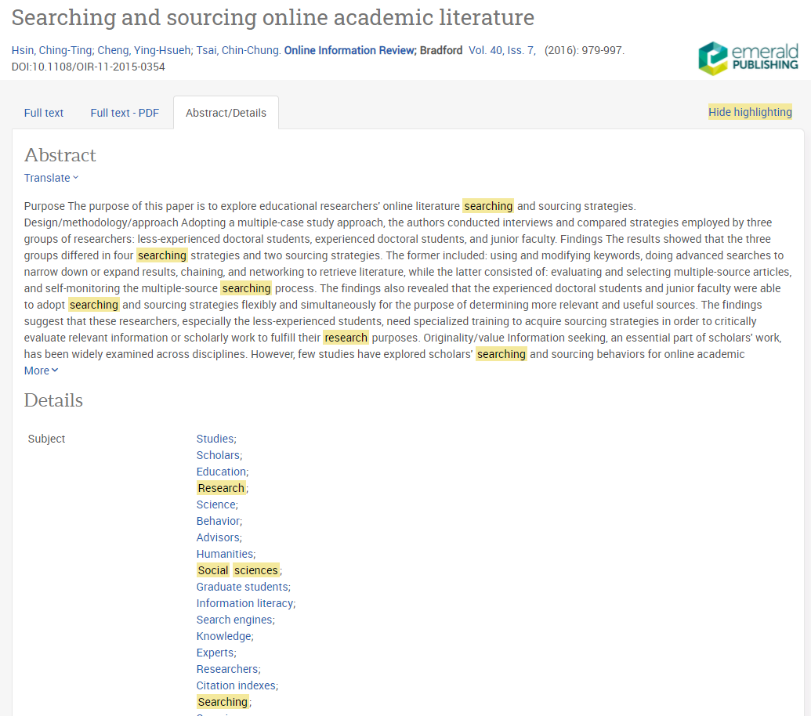
Search result showing matched search terms
In this example from Proquest, search terms are highlighted to contextualise them. This shows search terms being matched in the article abstract, keyword and subject field. This article is near the top of the results list so is ranked highly – both for term frequency and field weighting.
Relevance = term frequency + field weighting.
There is a direct correlation between search results and search terms.

Slide 5
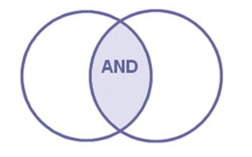
Search operators – Boolean AND
Search operators are used in search engines and databases to combine search terms for more effective searching. Although there are database-specific operators their function is common across discovery tools.
AND
Narrows and focusses a search by limiting results to records with all terms (phrases, authors, keywords, subject terms) Only records with all terms will be retrieved.
It is sometimes called the implicit AND as it is assumed by a search engine when you enter more than one keyword. The more keywords you use, the more focused/narrow the search. It can be represented by and, capital AND, & or a space. Check the database or search tool to see which to use. Capital AND is most commonly used.

Slide 6

Search operators – Boolean OR
OR
Broadens and expands a search by including records with any or all terms. It is very useful for synonyms, antonyms, related terms and alternative spellings. This is useful when you are searching a multidisciplinary database or your research crosses disciplines ( for example, sociology, psychology, management).
It is often called the inclusive OR as it expands your search – to include alternatives. It is most commonly expressed as a capital OR, or small letter or.
e.g., youth OR teenager OR adolescent OR “young person” OR “young adult”

Slide 7
Search operators – truncation and wildcard
Wildcard and truncation are common search operators that you may find useful.
Truncation
Most commonly expressed as an asterisk * is a way to search for all forms of a word. It is usually used at the end of the stem of a word. You can use it simply to search singular and plural forms of a word or for more variations.
e.g. manage* matches:
Manage
Manager
Management
Managerial etc.
Wildcard
Is a bit like truncation but is more often used in the middle of a word – especially for alternative spellings. It is most often expressed as a question mark ? or exclamation mark !
e.g., organi?ation - to search for organisation OR organization

Slide 8

Search operators – phrase searching
"…......."
Enclosing words in speech marks is a way to instruct a database or search engine to retrieve records with these words together and in this order. It is a common operator and is used in almost all discovery tools. It is a way to focus and narrow a search and ensure that results are relevant.
Only use for phrases i.e. those you’d expect to find in the literature e.g. "transformational leadership", “inclusive education", “special educational needs", “peer mentoring" etc. It is useful for finding specific books or journal articles by enclosing the title between quotation marks.
Terms reflecting your research topic/concept are not always expressed as a phrase. Use a proximity operator instead. Use your judgement to decide if you are searching for a phrase or nearby concepts.

Slide 9
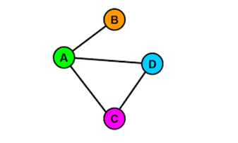
Search operators – proximity or adjacency
Adjacency or proximity operators are ways to retrieve records where terms appear near to one another. They are useful when you are searching across the full text of a document and need to focus your search results. (Other ways to search for words near to one another is to use a field search)
Proximity operators focus your search and work well when a phrase search would be too restrictive or is not appropriate. The most common way to express a proximity operator is with ADJ/n or NEAR/n where n is replaced by a number. In Library Search a proximity operator is expressed as "x x"~n where x is your adjacent terms and n is the number of words between your terms.
"inclusion education"~15 [Library Search]
Inclusion N15 education [in EBSCOhost databases]
Inclusion NEAR/15 education [Web of Science]

Slide 10
Search queries – how to build a search
Brackets and nesting
Use brackets to structure your search – especially where you are searching for related/alternative terms using the OR operator. This is called nesting and is a way to control your search. It overrides any search order in a database. This works best when you are using a single search box (like Library Search or the default basic search screens in some databases).
Examples of nested search queries
(employee* OR worker*) AND (engagement OR motivat*) AND ("business success“ OR growth OR "organisational success")
(inclus* OR mainstream) AND (education OR school) AND “special educational needs”
("case study" OR survey OR interview OR questionnaire OR “focus group”) AND (lectur* OR academic*) AND (views OR perceptions) AND ("student feedback" OR assessment*)
(“information literacy” OR “online searching” OR “information seeking”) AND “social sciences” AND (researcher* OR “graduate student” OR student*)

Slide 11
Using fields for focused searching
Records for content indexed in databases are structured with fields. Fields are sections of the record – most commonly:
Author
Title
Abstract
Assigned keywords
Subject heading
Source or publication title
Full text
Use the Advanced Search screen in databases, to match search terms against specific fields. This is a very effective way to focus a search.
You can combine a search using more than one field – e.g., a keyword in the full text combined with author or a source, to find works on a topic by a particular author, or in a specific journal. Fields have field codes e.g., AB for abstract, SO for source etc.
Basic search screens in databases usually default to either an all-field search or a combination of key fields. In the research databases Scopus and Web of Science the default search includes the article title, abstract and keyword fields.

Slide 12
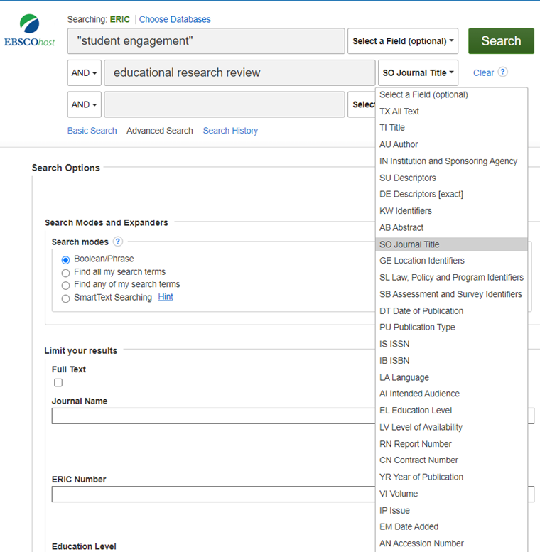
Field search example in the ERIC database.
In this example [taken from the EBSCO database ERIC] , the search is across the full text of articles in the review journal Educational Research Review. This is a journal which publishes reviews and analyses of studies and theoretical papers.
Use the drop down to the right of search boxes to choose the field you want to search. Each field has a code to identify it.
Use any combination or a single search as required. The default search is across all fields.
You may want to use fields when you are finding too many search results, or your search results are not directly relevant.

Slide 13
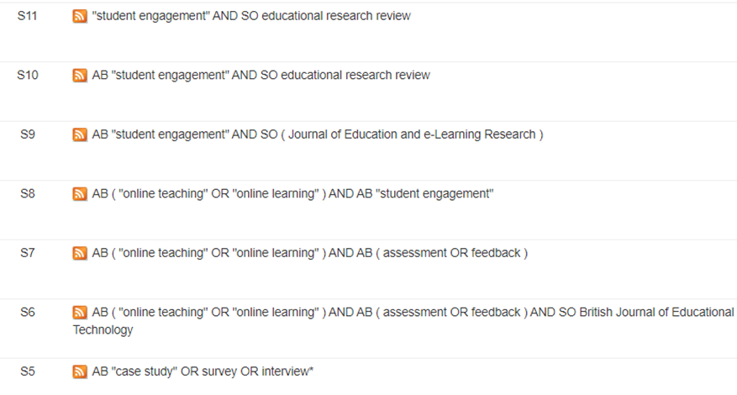
Search history screen showing field codes.
You can see the fields you have used when you look at your searches. In EBSCOhost databases your search history is shown just under the search box.
Each search is given a number to identify and it so that you can combine it with other searches to broaden or focus searches as required.
Search 6 (S6) matches search terms in the abstract of articles in the journal British Journal of Educational Technology.
AB = abstract
SO = publication or source title

Slide 14
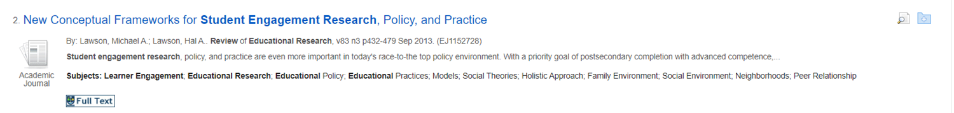
Searching with controlled vocabulary
Another common method of searching is to use subject headings or controlled vocabulary. These are broader than keywords and are applied to indexed published literature – usually in databases.
Subject terms connect related literature on a given topic.
Subject terms can incorporate all related terms (terms and sub-headings).
They are applied to article records by indexers who read the article to identify its main focus.
They are usually hyperlinked to allow you to link to other material with the same subject heading.
They are useful to expand your search beyond your list of keywords whilst ensuring the search is relevant.
Subject terms are in a specific field of a record.
The example below has several subject headings. [Hyperlinks are shown on the detailed record screen. Click on the article title to go to the detailed record screen.] This is taken from a record in the database ERIC.

Slide 15
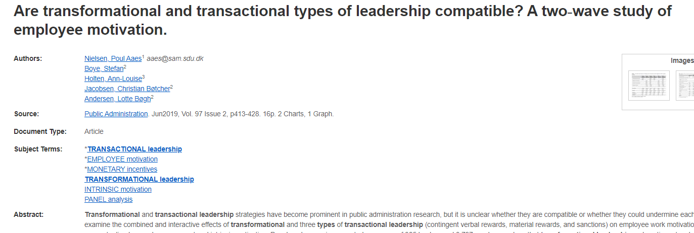
A search result showing subject headings
This example from the Business Source Premier database shows hyperlinked subject headings

Slide 16
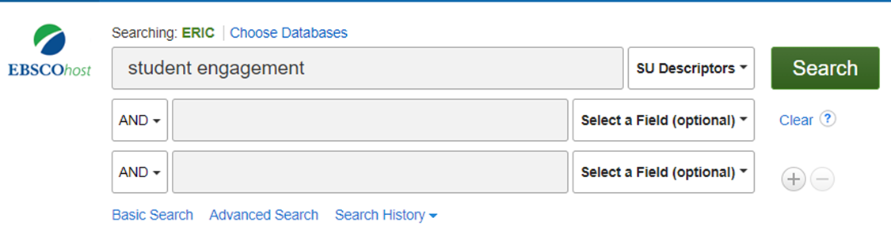
Searching using the subject field
You can choose subject terms from results after you run a search by clicking on highlighted terms. Alternatively, you can either select subject headings from a thesaurus in a database to add to your search, or you can enter terms in the subject field on a search page.
Here is an example of a subject search in the ERIC database using the drop-down option. This will match the words student and engagement against the subject field in a record.

Slide 17
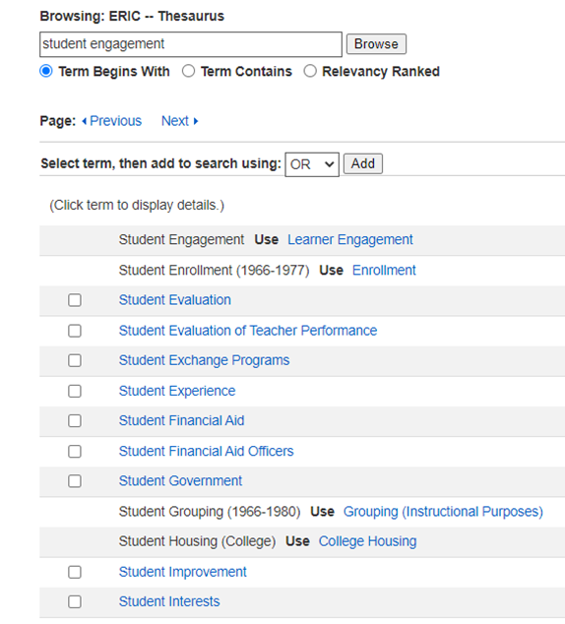
A thesaurus search on the EBSCOhost platform (1)
A Thesaurus search will allow you to choose exact subject headings from an index (authority file).
To do this, choose Thesaurus from the toolbar, and enter your search terms in the Browse box choosing a search option – Term begins With; Term Contains; or Relevancy Ranked.
If your search term matches an entry on the index, it will be shown as a hyperlink, or you may be prompted to use the preferred term.
In this example, choose the heading Learner Engagement.
This is a useful way to search as you can see how the term is contextualized in the index. It is also a useful way to identify related concepts that you may not have thought of.

Slide 18
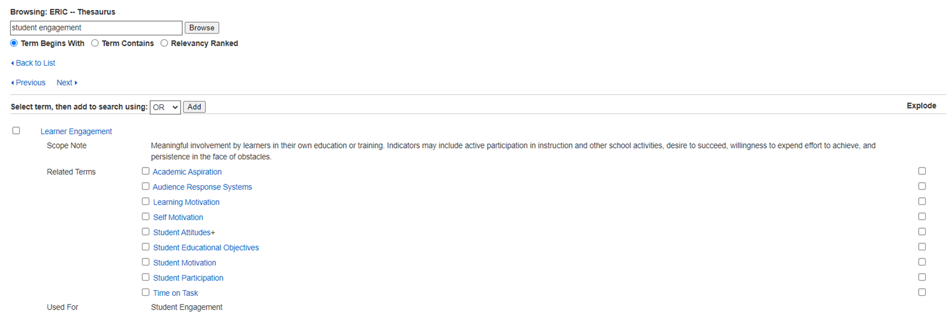
A thesaurus search on the EBSCOhost platform (2)
Having chosen the heading Learner Engagement, you can add this to your search by ticking the box to the left of the term and choosing Add.
However, if you click on the hyperlinked term, you can open another page which shows narrower, broader or related terms and a description of the scope of the term. Use the boxes to the left of each additional term to add these to your search as desired.

Slide 19
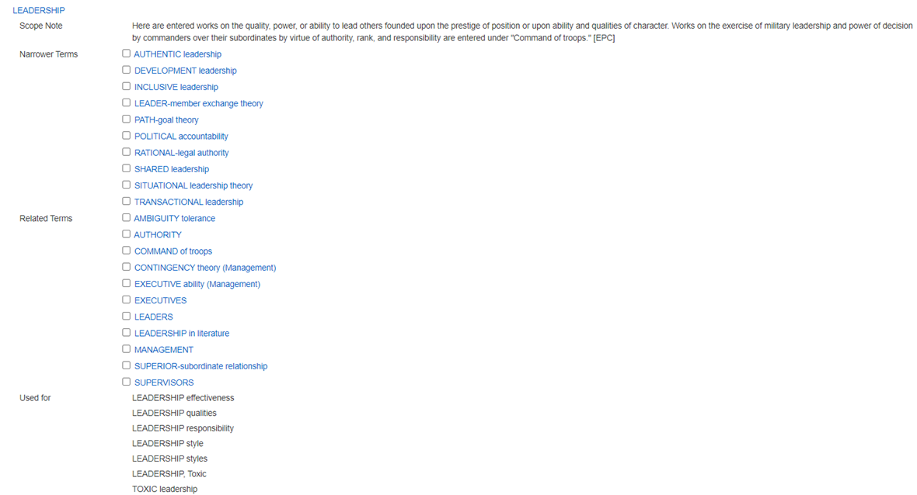
Thesaurus search for the term ‘leadership’ from Business Source Premier
The Scope Note will show how the term is defined in the database. This will help you decide on its relevance to your search.

Slide 20
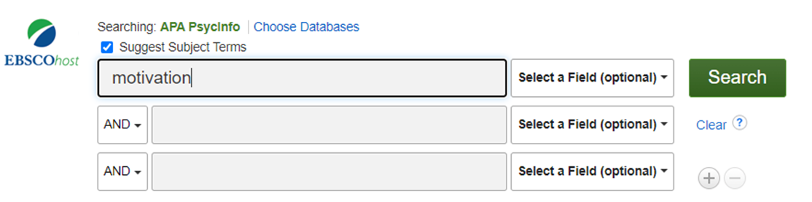
A thesaurus search – APA PyscInfo
In other databases, the thesaurus is automatically selected when you are searching. This is the case in medical, health and psychology databases. Controlled subject headings are important in health and medical fields to ensure consistency, accuracy and reproducibility.
Here is an example from APA PsycInfo. There is an option above the search box in these databases, Suggest Subject Terms which is automatically selected. (You can override this if you want to search using keywords instead.) When you enter a search term, it is matched against the subject thesaurus/index.

Slide 21
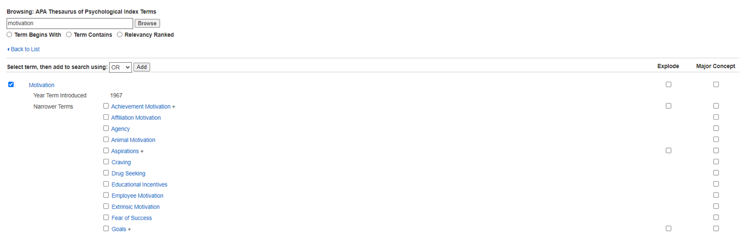
A thesaurus search – APA PSycInfo subject index
When you enter your search term, it is matched against the subject index. You can choose the term you entered, by ticking the box to the left of the term and pressing Add, then Search. This retrieves all records with the term ‘motivation’ in the subject field.
If you click on the hyperlinked term, you can see all the narrower terms beneath it. You can select any that you want to add or choose the Explode options to include them all.

Slide 22
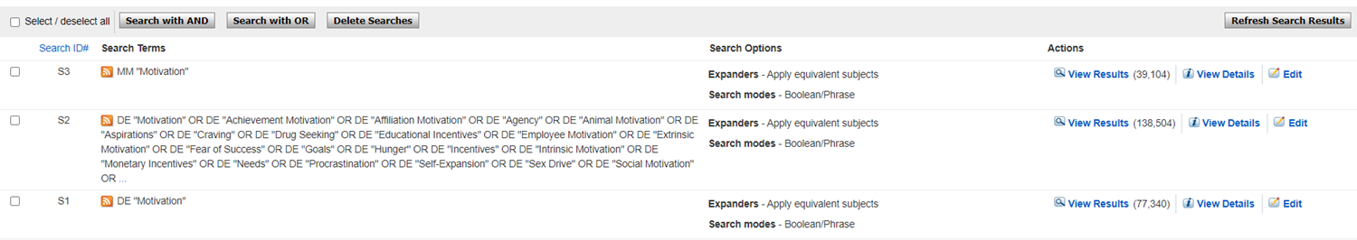
Search history showing thesaurus searches
You can choose the term, by ticking the box to the left and Add, then Search. This retrieves all records with the term ‘motivation’ in the subject field. Subject terms are shown with the prefix DE in the search history.
If you choose Explode, all subheadings are also included in the search (you will see an expanded list of the main term and narrower terms all with the prefix DE, separated by a Boolean OR.
If you choose Major Concept (prefix MM), only records where the term is the major focus of the article will be retrieved.
Here is a screenshot of the three searches and the difference this makes to search results. S1 is an exact thesaurus terms search; S2 is an exploded thesaurus term search and S3 is a thesaurus search using the Major Concept option.

Slide 23
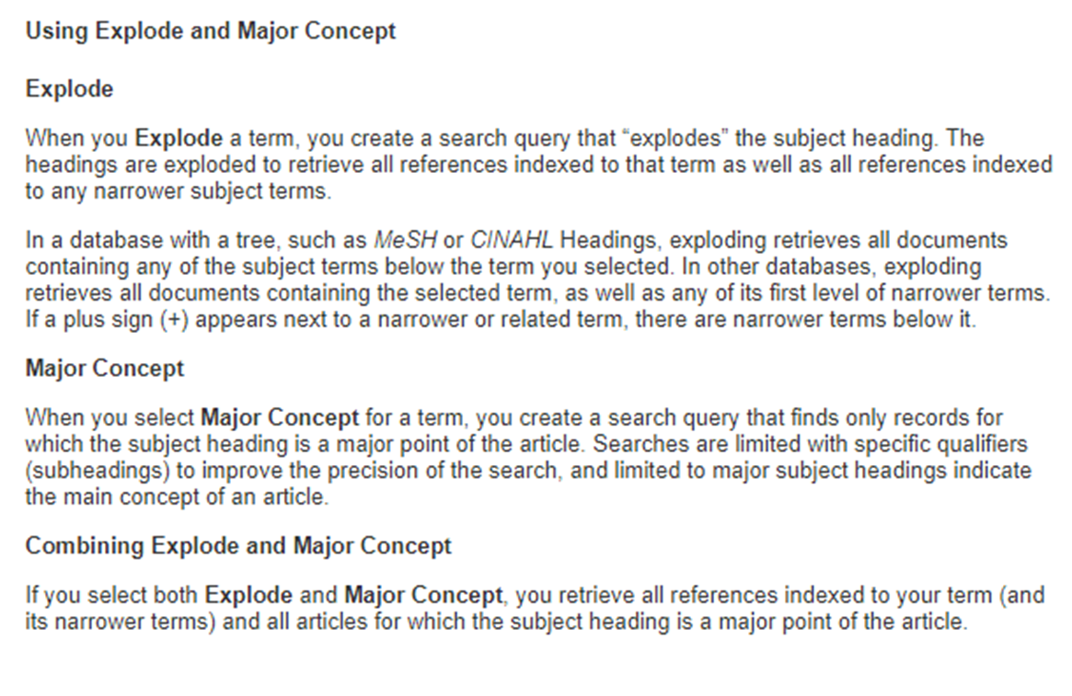
Explode v Major Focus
Here is the explanation of the explode and the major focus options on EBSCO databases.

Slide 24
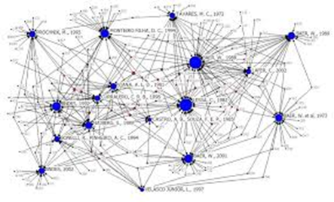
Complementary search methods
You will not search for all the sources of information that you use in your research. A large proportion of what you use may come from information that you discover as you read – from reference lists, from the citing literature, from database recommendations ('similar articles' and 'related searches' prompts) and from recommendations from other people.
Use the information that you find fully to exploit these connections:
Use the reference lists in articles and books that you read to identify key sources of information [where did the author get the statistical data or survey results?]
Use Web of Science or Scopus or Google Scholar or to find the citing literature [what are other authors saying about this paper? Useful for identifying related more up-to-date papers.]
Use advanced features in databases to locate related items – i.e., from the same authors, from papers with the same major subject headings, from papers citing the same sources etc.

Slide 25
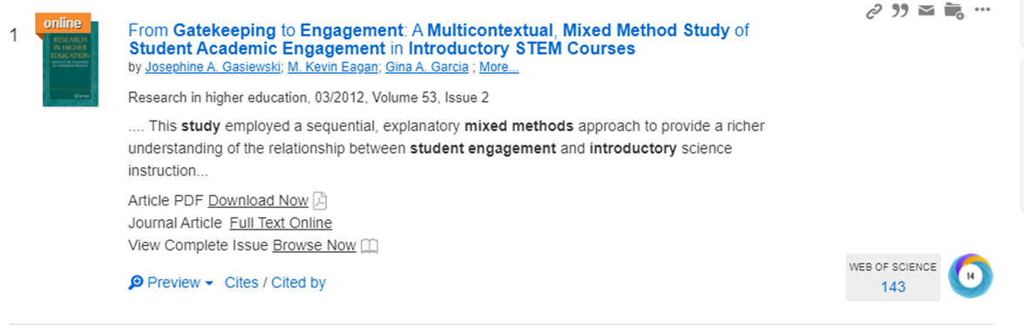
Using citations to find other relevant material
These are forms of finding relevant material from an initial batch of relevant search results. This is a bona fide and effective method of retrieval.
At its simplest, if you find some useful papers for your research, use the reference list to look backwards for relevant papers matching your search criteria. This is called backwards snowballing.
Forward snowballing is when you look at the citing literature (i.e. work that has cited the papers you have found). You can sift the citing literature for other relevant material. Library Search has a Cited by link and a link to citing literature in the Web of Science database ( a high-quality, established multidisciplinary database):

Slide 26
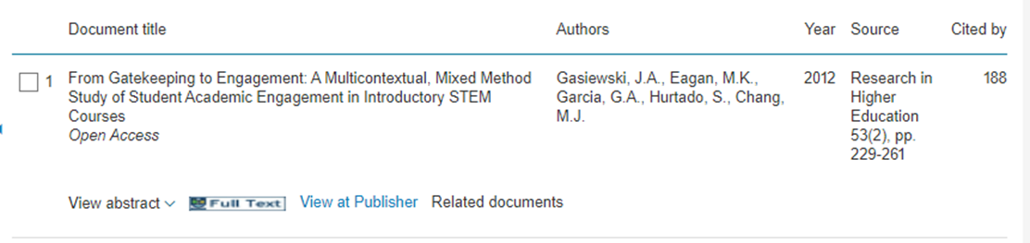
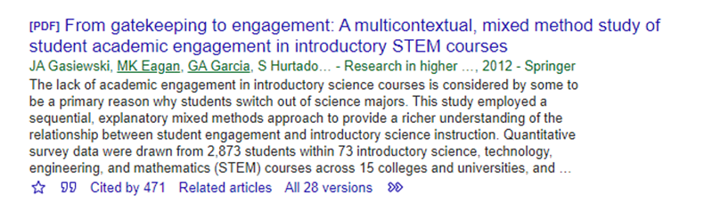
Finding citing literature
As well as Library Search and Web of Science, there are two other major sources of citation data – the Scopus database and Google Scholar. Whichever tool you choose, simply search for the article you want to find the citing literature for and use the ‘cited by’ links.
See screenshots from the Scopus database and Google Scholar below:

Slide 27


Further help and support
The College Library Support Team
https://www.gla.ac.uk/myglasgow/library/help/collegesupport/ can help you to get started finding information and using library resources.
Email them for some help or to book an appointment.
Or use the generic help address library@glasgow.ac.uk and staff will answer your enquiry or refer you to specialist teams who can help.

Slide 28



See other presentations in this toolkit for steps in dissertation research including:
~getting started with literature searching (first steps in the process)
~selecting key discovery tools (databases and search engines)
~finding and using secondary data
~critical appraisal tools for evaluating information sources for relevance and authority
This presentation is created by Lynn Allardyce Irvine under licence
CC BY-NC-SA 4.0 Attribution-NonCommercial-ShareAlike 4.0 International
#UofGWorldChangers
@UofGlasgow

