Slide 1

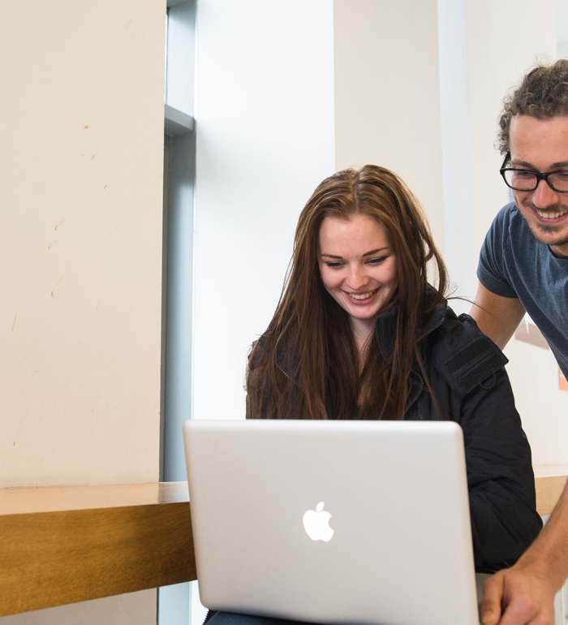



Archives and Special Collections Training
23 Things (you might not know about)
Archives & Special Collections
Julie Gardham, Sarah Hepworth, Clare Paterson, Moira Rankin
This work is made available under a Creative Commons Attribution-Non Commercial 4.0 International License (CC BY-NC 4.0)

Slide 2
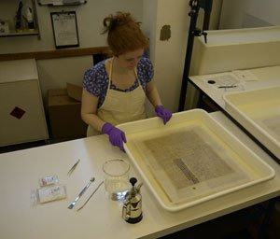
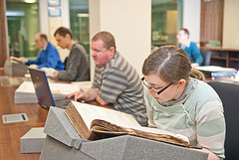
1. Our mission is to:
Manage, deliver and maintain a high quality of collections, information architecture, access, and study space to support the University’s mission to undertake world leading research and to provide an intellectually stimulating learning environment.

Slide 3
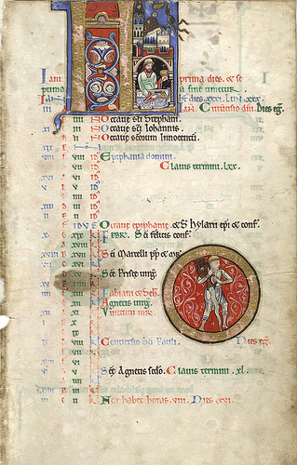
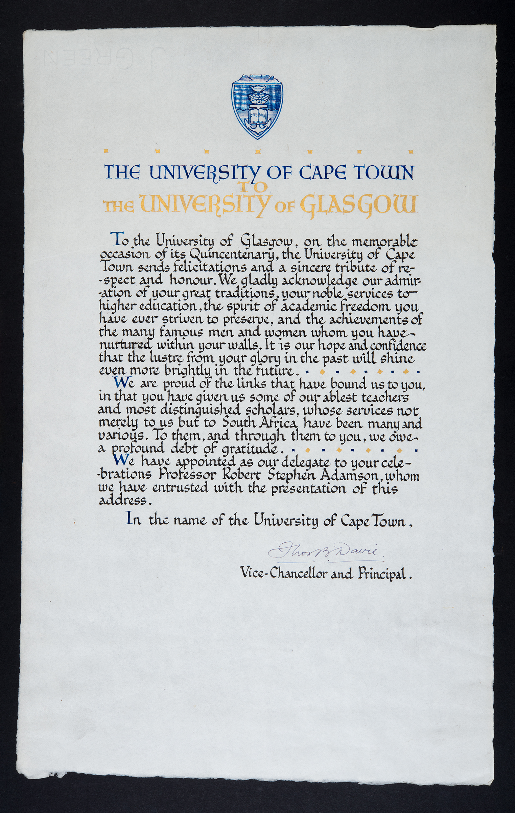
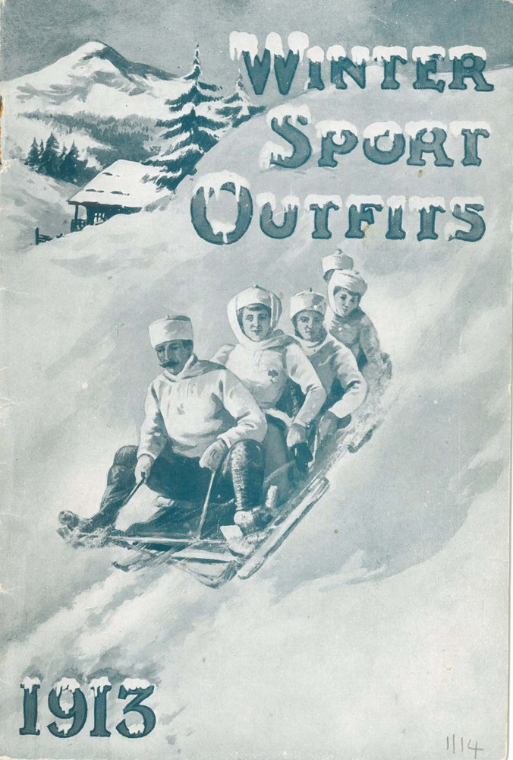
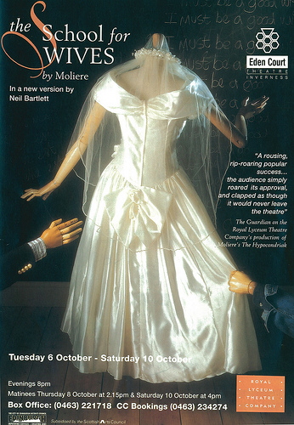
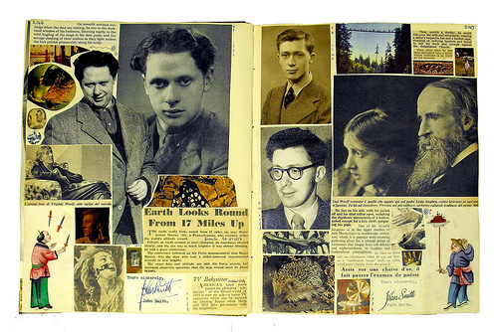
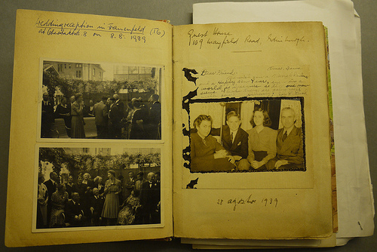
2. We collect materials to support the University’s goals
Not just relating to Glasgow University! Glasgow businesses like House of Fraser
and cultural heritage objects like Edwin Morgan’s
Scrapbooks are collected.
Notes:
3

Slide 4
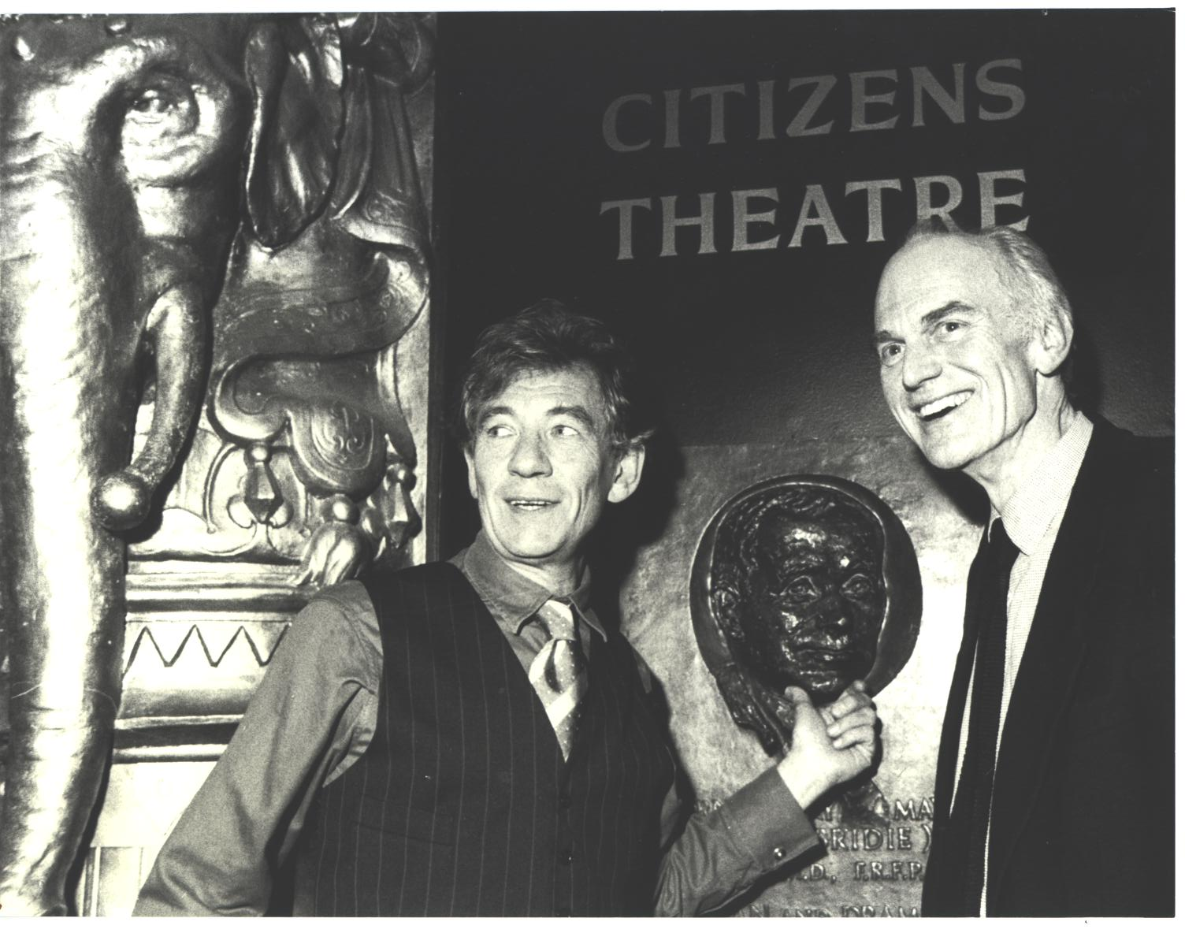
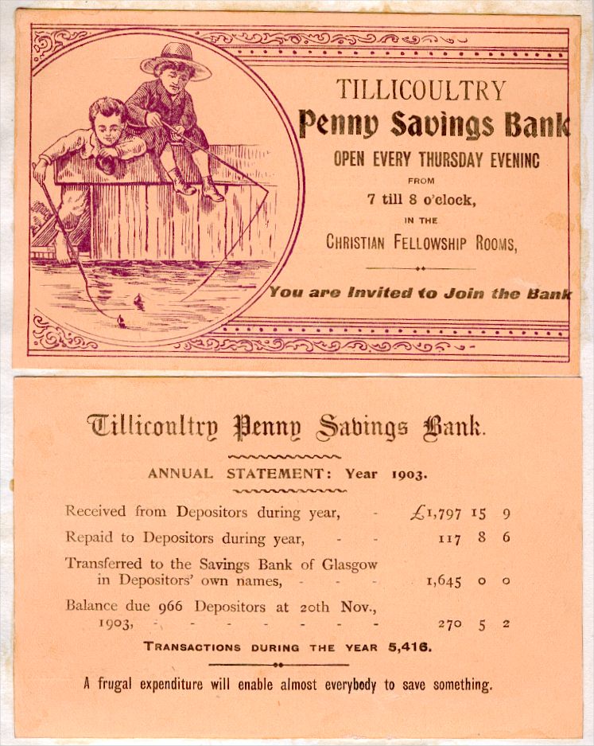
3. Accessioning and de-accessioning never stops
We get offered a lot of content! We decide what to collect based on our mission statement and the potential value of the objects for research and teaching.
Notes:
4

Slide 5
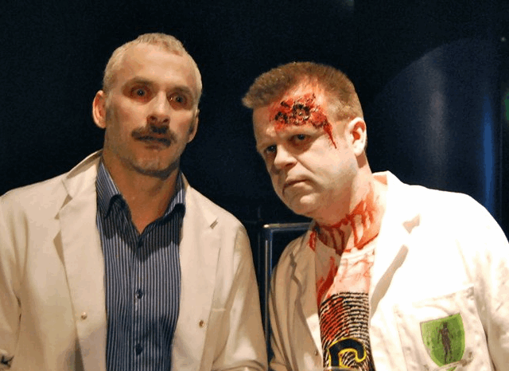
4. Our users are drawn from all Colleges - and beyond
Notes:
5

Slide 6
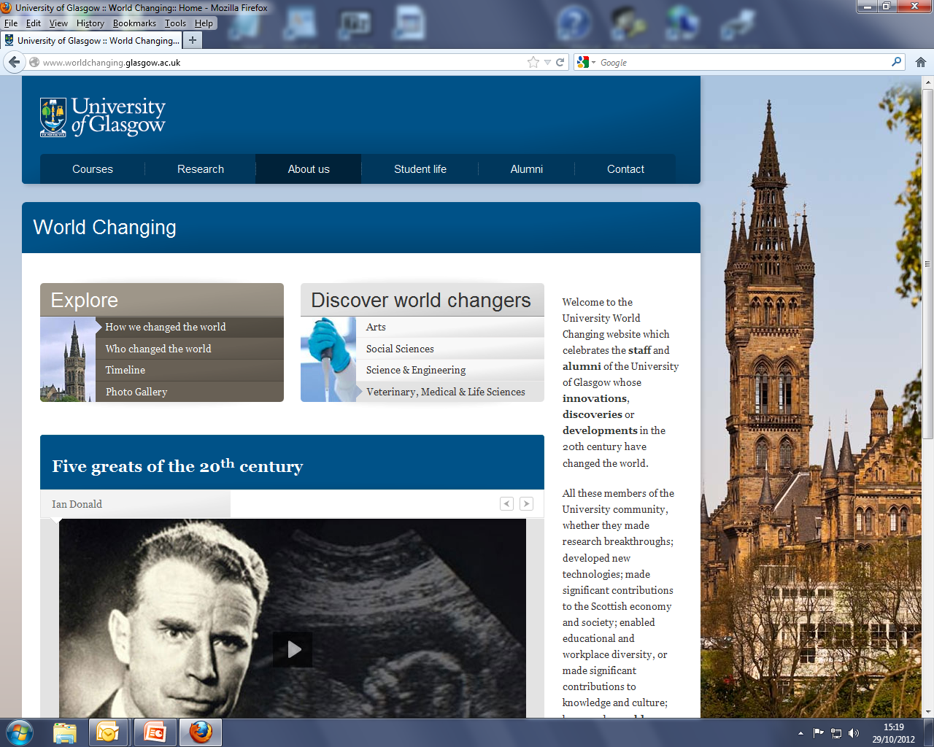
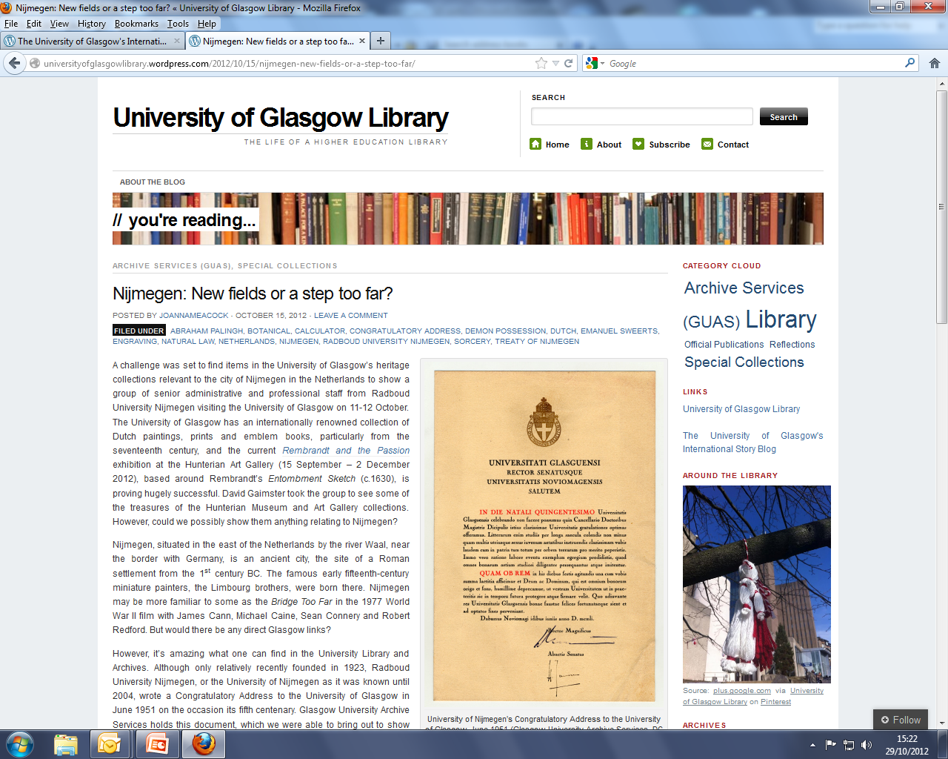
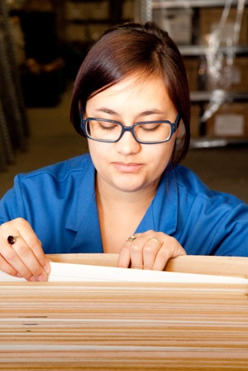
5. We work closely with other University Services
Notes:
6

Slide 7
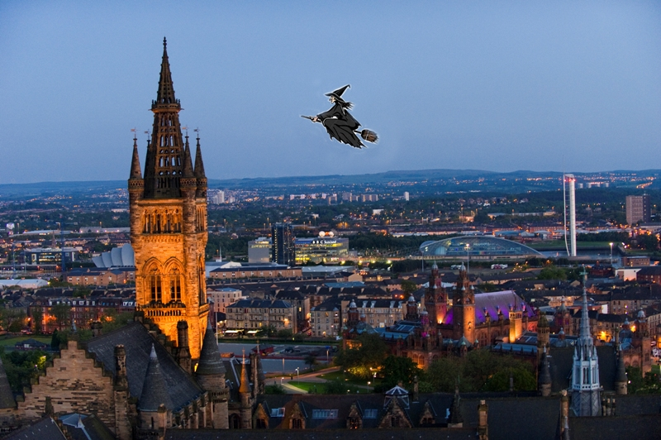
6. We get asked the strangest things
Notes:
7

Slide 8
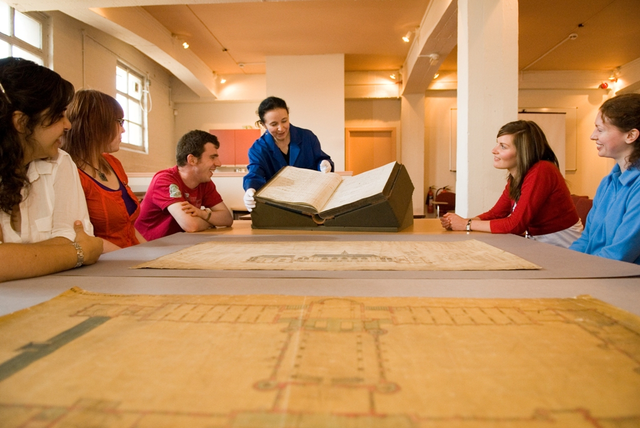
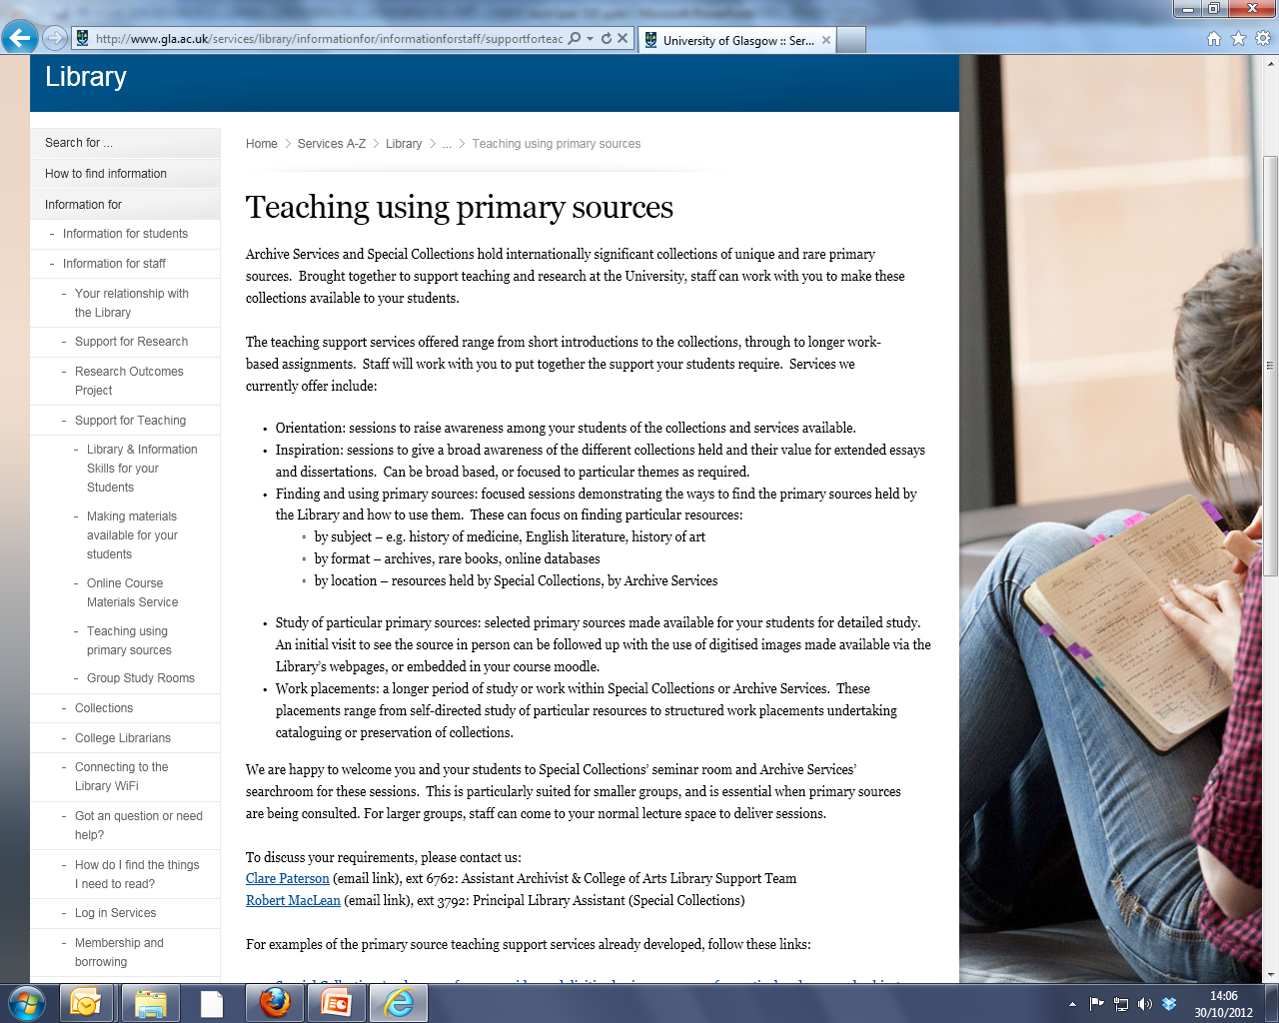
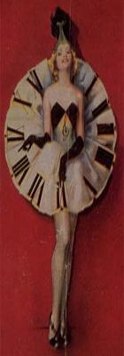
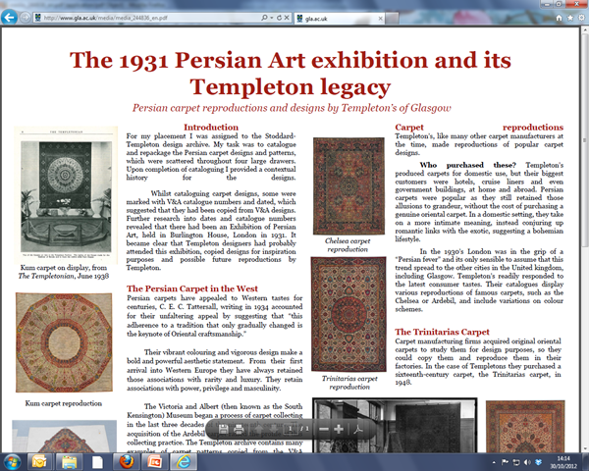
7. We offer a range of teaching support services
Notes:
8

Slide 9
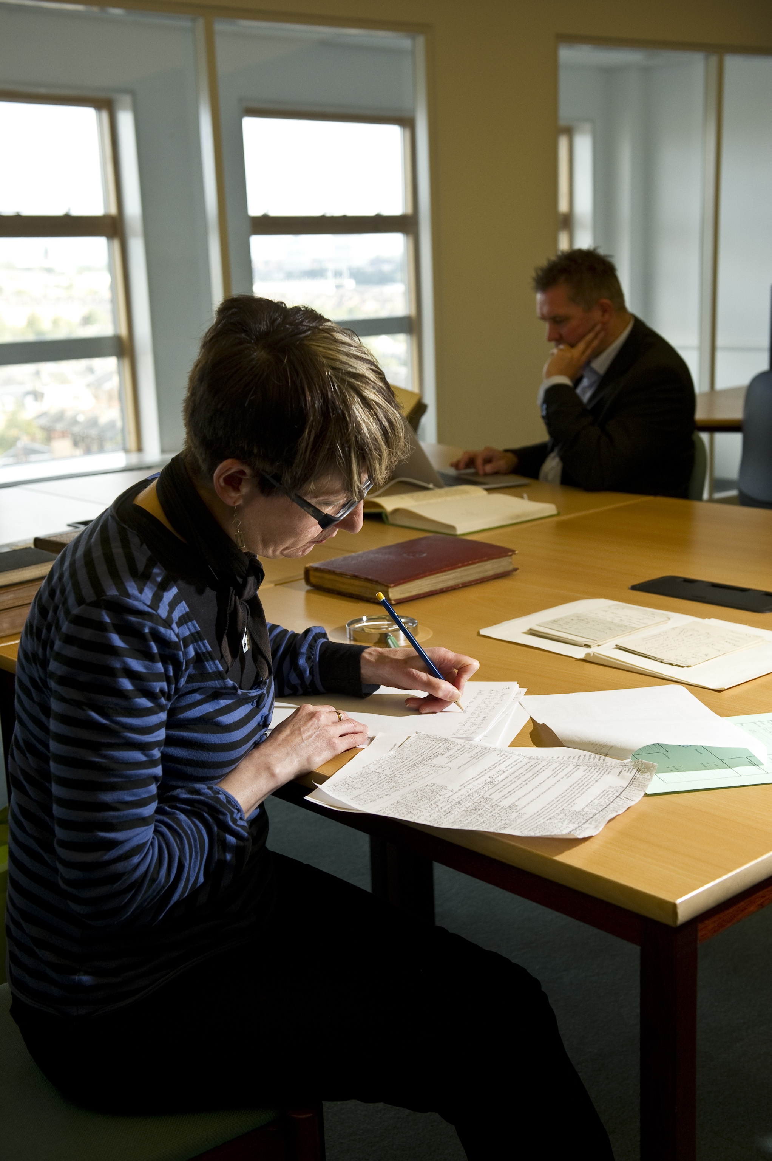
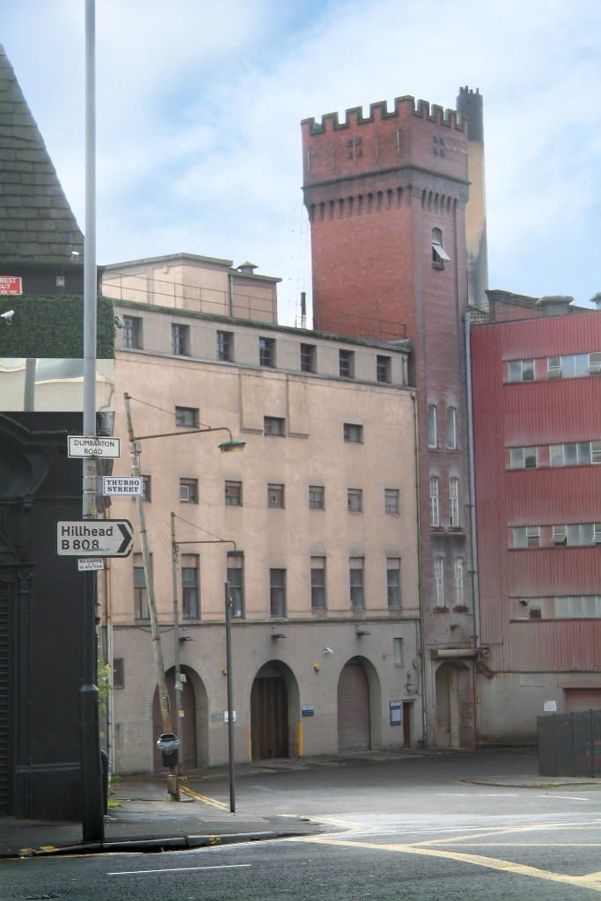
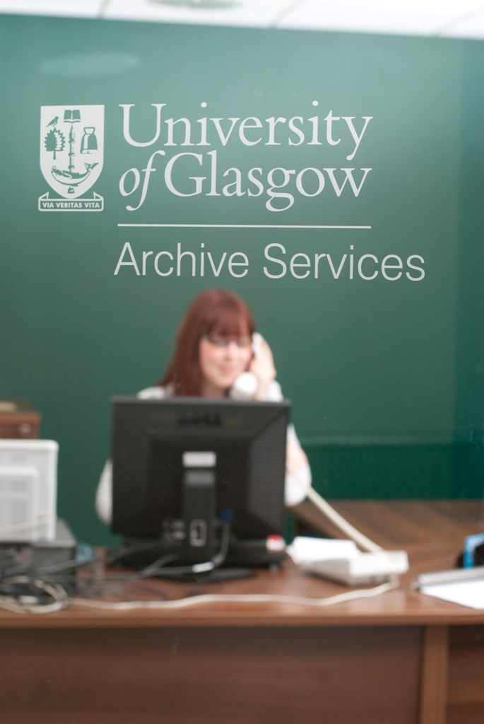
8. Our visitor facilities are world class
Notes:
9

Slide 10
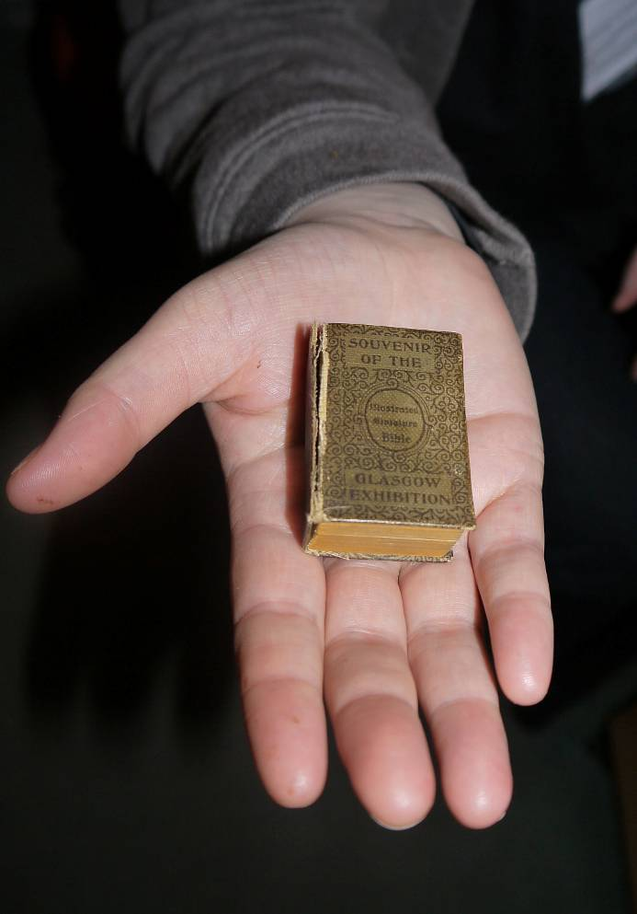
9. We take care of the tiniest things…
An illustrated miniature Bible, printed by David Bryce & Son, Glasgow. Produced for the Glasgow International Exhibition of 1901.
Presented to the Library in 1919 by Col. A Napier.
Measures 4.8 cm x 3.3 cm, and a magnifying glass is needed to read the text.
Sp Coll Dd-1.13
Notes:
10

Slide 11
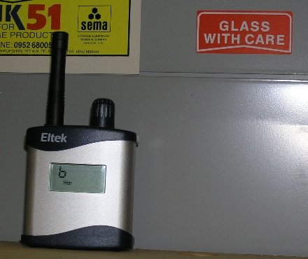
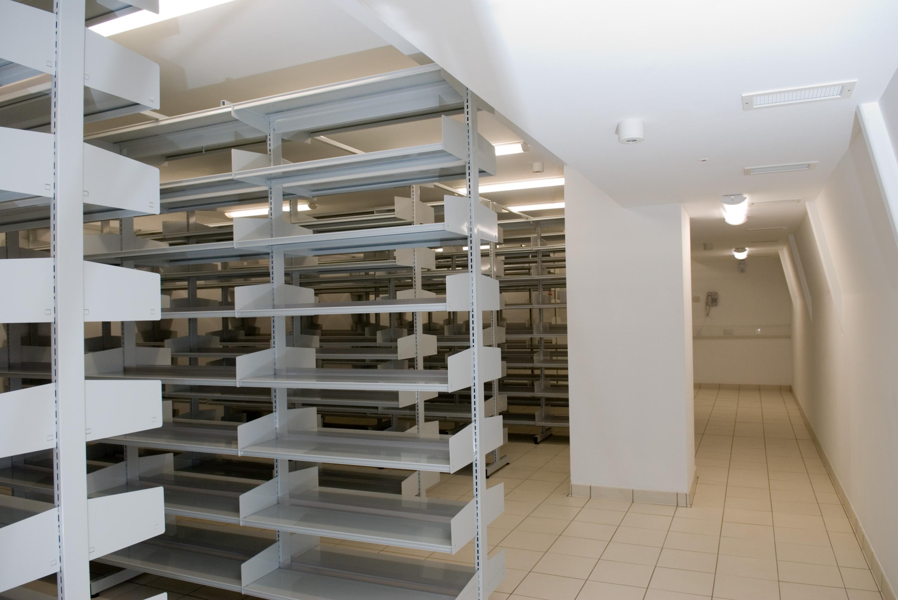
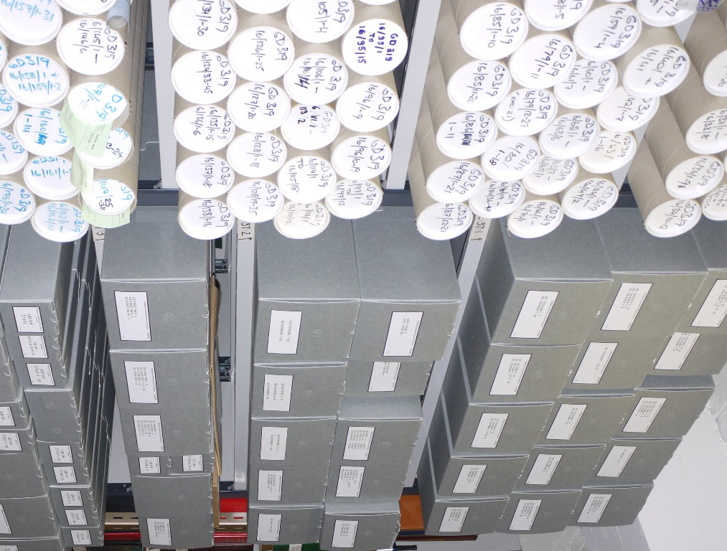
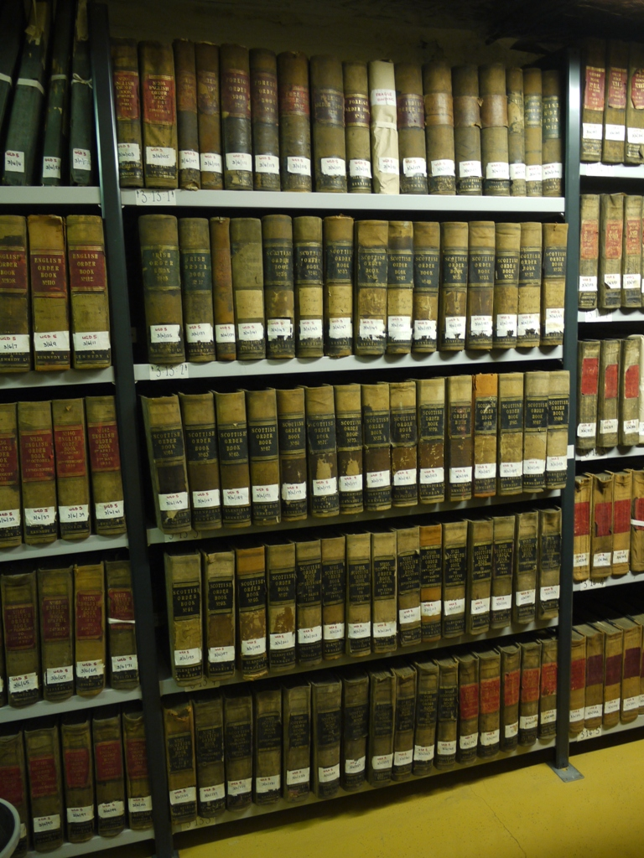
10. … by ensuring we have the right environment
Notes:
11

Slide 12
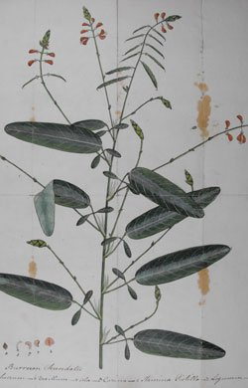
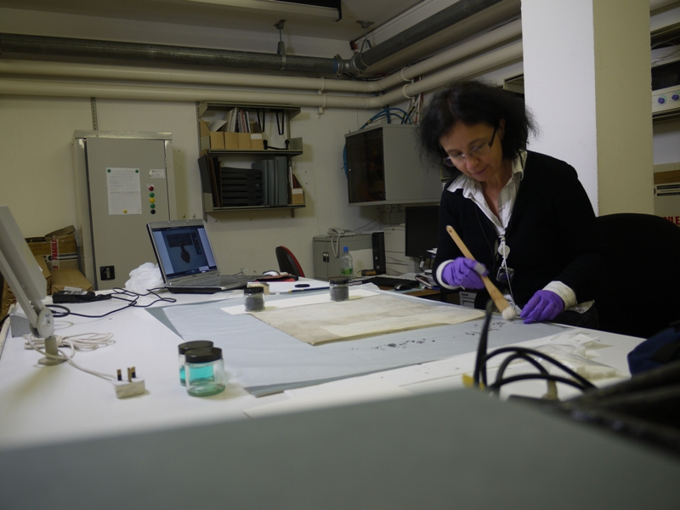
11. … and through conservation work
Notes:
12

Slide 13
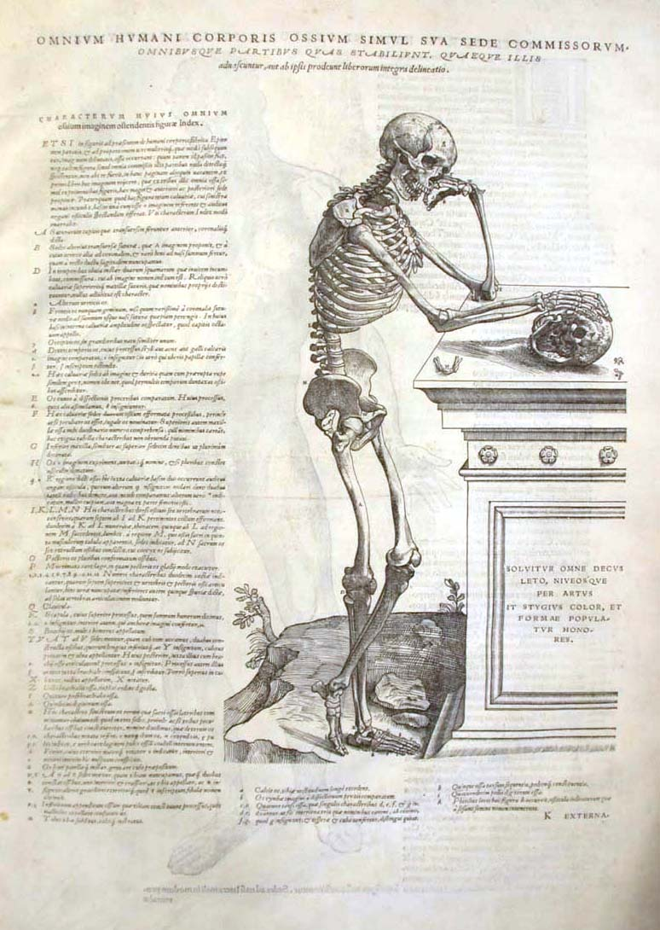
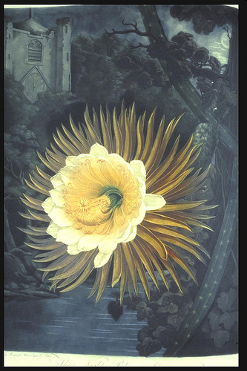
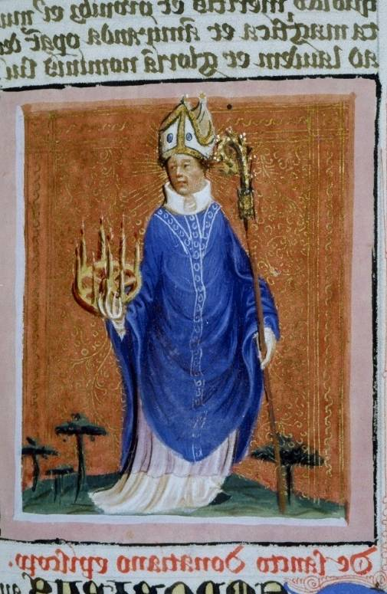
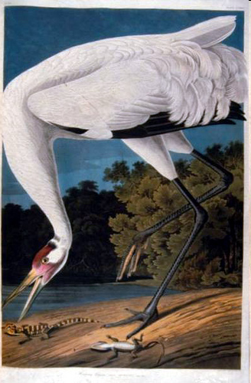
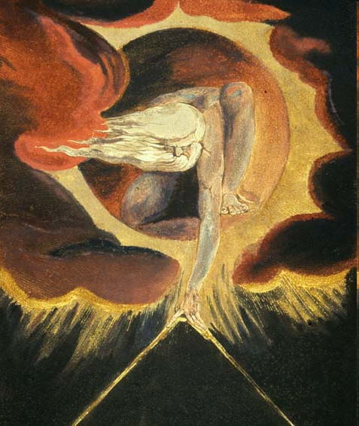
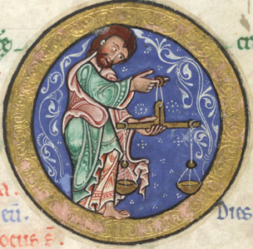
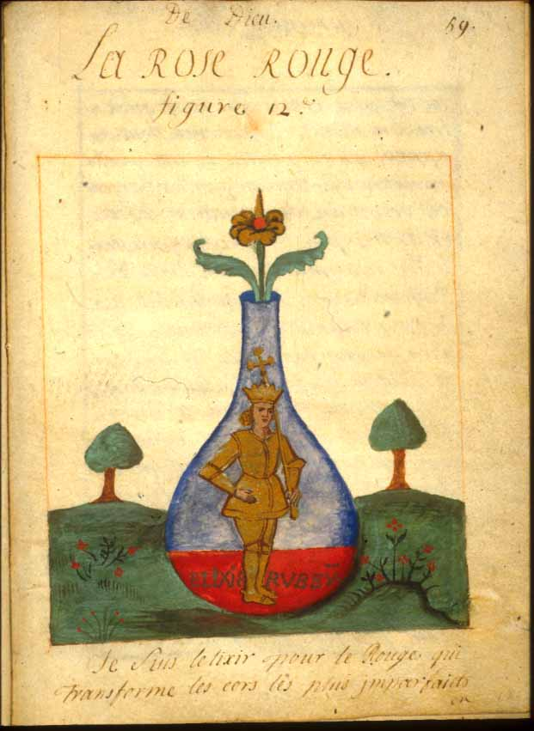
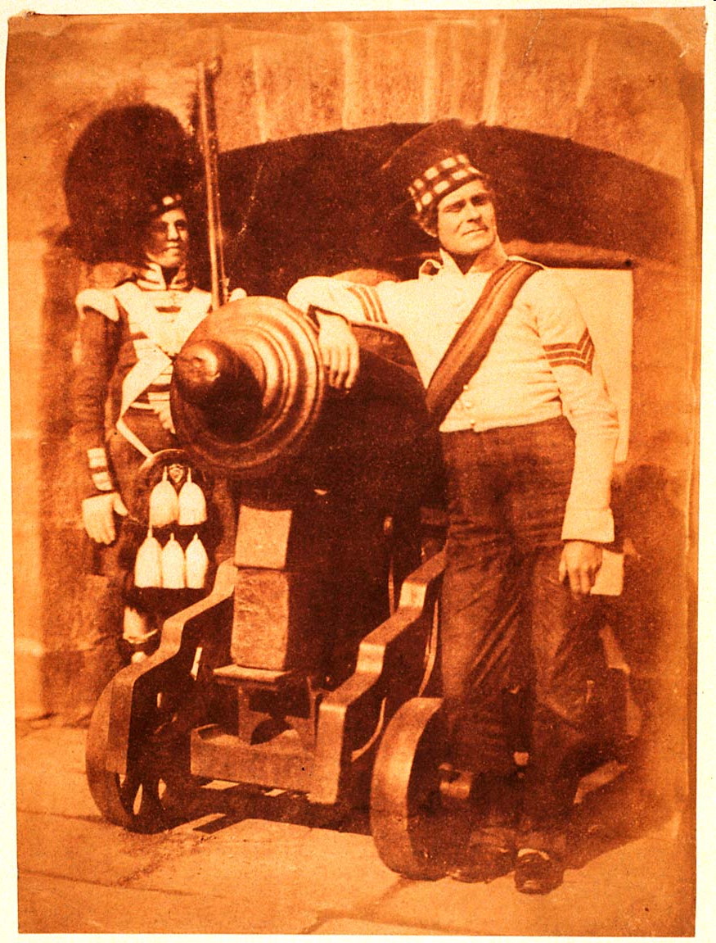
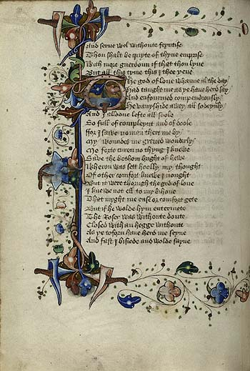
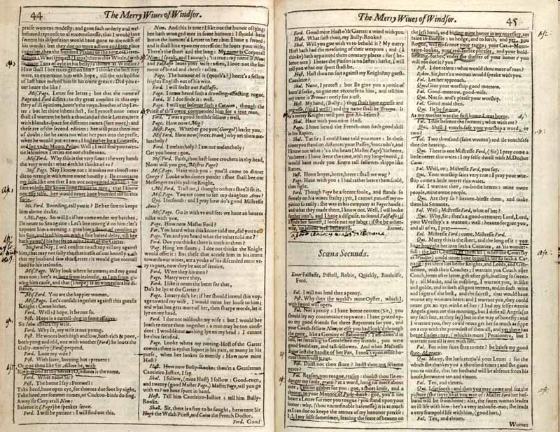
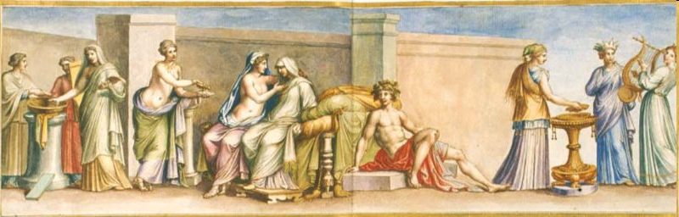
12. It’s all worth a lot …
…so we to take good care of our collections by following international standards
Notes:
13

Slide 14
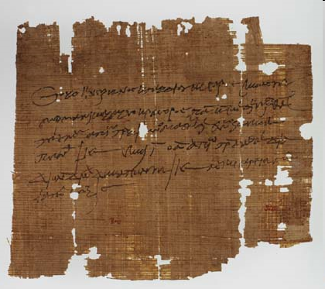
13. We have some very old things
Notes:
14

Slide 15
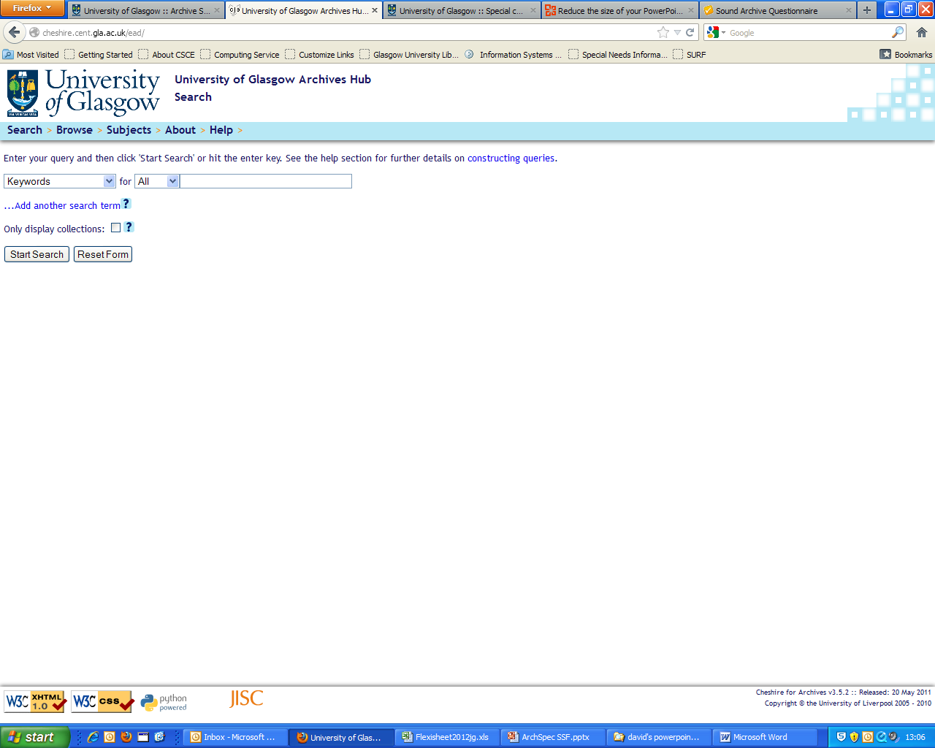
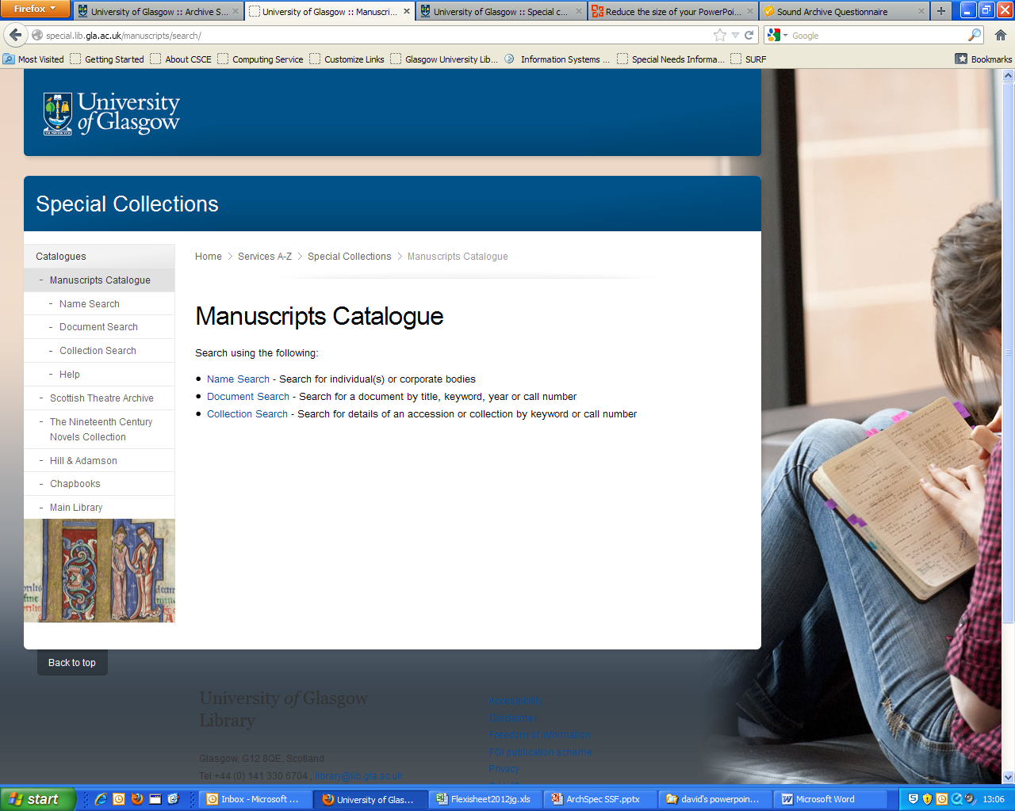
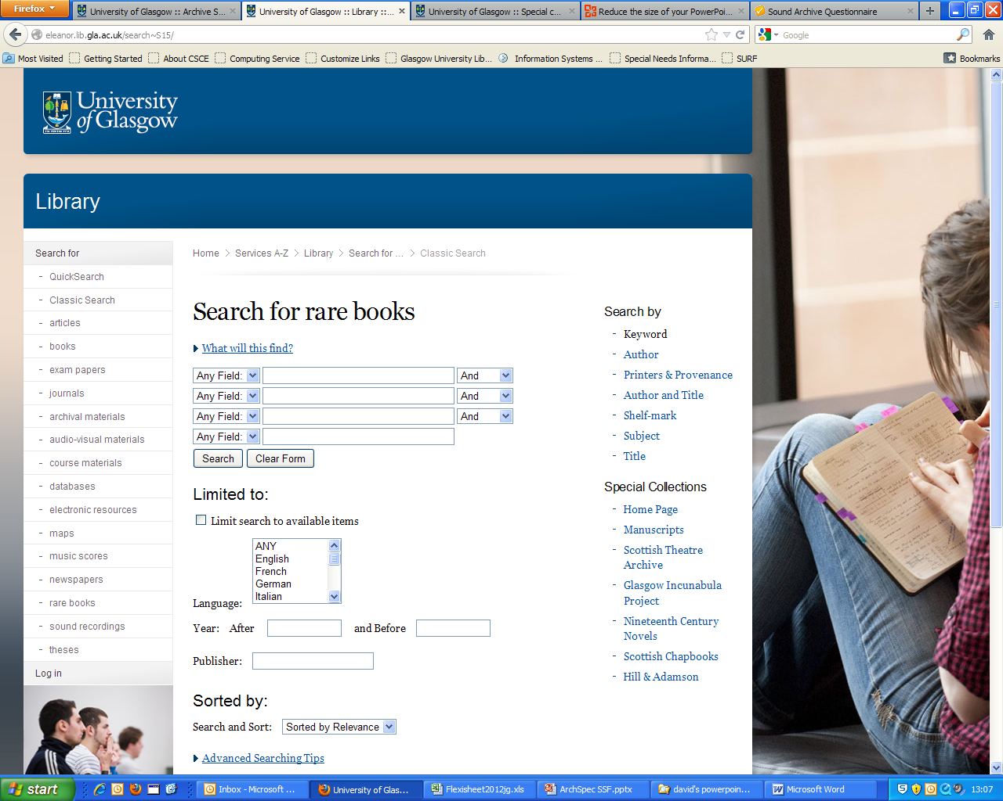
14. We make all this stuff discoverable online
Search archival collections using
https://archiveshub.jisc.ac.uk/
Search for manuscripts using http://special.lib.gla.ac.uk/manuscripts/search/
Search for rare books at
http://eleanor.lib.gla.ac.uk/search~S15/
Notes:
15

Slide 16

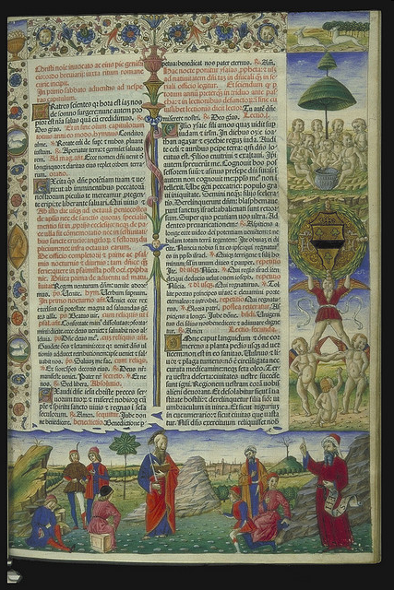

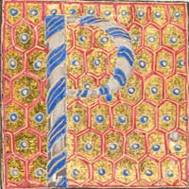
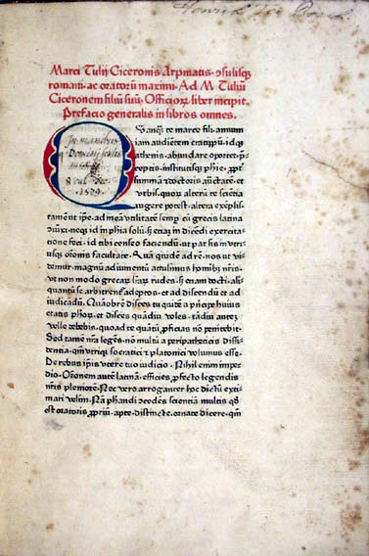
15. We want the world to know about our incunabula
https://www.gla.ac.uk/myglasgow/incunabula/
Notes:
16

Slide 17
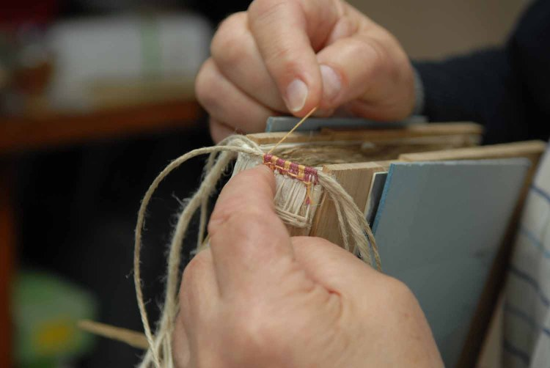
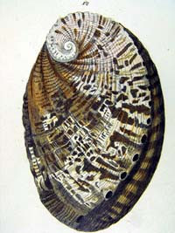




16. We seek funding to support our work – here, there and everywhere
Notes:
17

Slide 18




17. Our collections are in demand by researchers around the globe…
…and we are always working to get more content online. We collaborate with a wide range of externa organisations like the Wellcome Digital Library to digitise content to make it more accessible.
Notes:
18

Slide 19

18. People like to take our stuff home
Notes:
19

Slide 20

19. Managing our images is challenging! We have a lot of content and we work hard to make accessible
Notes:
20

Slide 21


20. We have some very big things
Notes:
21

Slide 22





21. We collaborate with a wide range of partners
Notes:
22

Slide 23


22. Our collections are often loaned for exhibitions
Notes:
23

Slide 24




23. Our collections are a source of inspiration
Notes:
24

Slide 25

Archives and Special Collections
To learn more about ASC, our services and how we can support you, please visit our website: https://www.gla.ac.uk/myglasgow/archivespecialcollections/
@UofGlasgowASC

