Slide 1
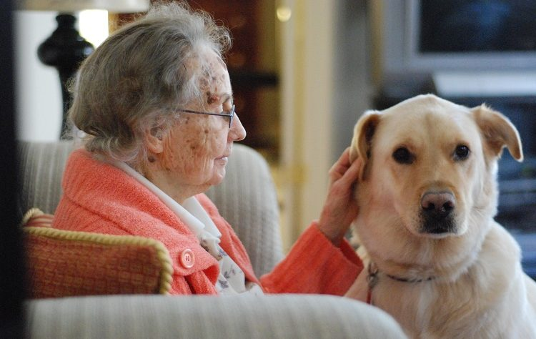
Non-pharmacological Interventions for Improving the Quality of Life of People with Dementia Living in Long-Term Care: A Systematic Review
Abbreviations: LMICs=low- and middle-income countries, ADI= Alzheimer’s Disease International, LTC=long-term care, BPSD=behavioural and psychological symptoms of dementia NPIs=non-pharmacological interventions, QoL=quality of life, PwD= people with dementia, RCTs=randomised control trials
1. Background
3. Results
Globally, the prevalence and incidence of dementia is increasing (ADI, 2019)
Most significant increase expected to come from LMICs (ADI, 2015)
Progressive nature of dementia often leads to increased care (usually LTC) (Mjørud et al., 2017).
No curable or disease modifying treatments (Robinson, 2016)
Limited efficacy and adverse side affects of pharmacological interventions used to treat BPSD (Xiong et al., 2015)
Increased interest in NPIs that aim to improve the QoL of PwD (Berg-Weger and Stewart, 2017).
A need for a systematic review that identifies effective NPIs specifically in LTC
23 included studies
RCTS, cluster-RCTs, and non-RCTs
Various types and severities of dementia
5 main types of NPIs
> Music (n=4) > Cognitive Stimulation (n=5) > Reminiscence (n=3) > Animal-Assisted Interventions (n=5) > Life Storybooks (n=2)
Other NPIs
> Exercise (n=1) > Mindfulness (n=1) > Sensory (n=1) > Creative Storytelling (n=1)
Aims
Fill identified gap in the literature
Identify countries that lack research in this field
Answer the research question
“are NPIs effective in improving the QoL of PwD living in LTC?”
- Inconsistent with other reviews (McDermott et al., 2019), exercise improved QoL
- Mindfulness and life storybooks improved QoL
- Sensory stimulation and creative storytelling did not improve QoL
- Music, Cognitive Stimulation, and Reminiscence Therapies are more beneficial when delivered in a group setting
- Animal-Assisted interventions beneficial when delivered as a group AND individually
2. Methods
3 bibliographic databases were searched
4. Conclusions
Eligibility criteria applied to identify relevant articles
Data extraction template created for this review
Additional researcher reviewed selected articles and data extraction
Risk of bias of each included study was assessed as recommended by the Cochrane Handbook for Systematic Reviews (Higgins et al., 2011)
- The review answered the research question - Certain interventions should be delivered in a group-based setting - Limitations of existing reviews were addressed - Fills the gap in the literature - Results should be considered regarding bias, validity, reliability, and generalisability - Lack of research in LMICs - Future research should involve larger sample sizes and not excluded people with BPSD or comorbidities - Future reviews should limit exclusion criteria - The review can inform health care managers and policy makers in dementia care
References
Alzheimer’s Disease International. (2015). World Alzheimer Report 2015. The Global Impact of Dementia. An Analysis of Prevalence, Incidence, Cost and Trends. London: Alzheimer’s Disease International
Alzheimer’s Disease International. (2019). World Alzheimer Report 2019. Attitudes to Dementia. London: Alzheimer’s Disease International.
Berg-Weger, M., & Stewart, D. B. (2017). Non-Pharmacologic Interventions for Persons with Dementia. Missouri medicine, 114(2), 116–119. Accessed on 13th June 2020 from https://www.ncbi.nlm.nih.gov/pmc/articles/PMC6140014/
Higgins, J. P. T., Savović, J., Page, M. J., Elbers, R. G., & Sterne, J. A. C. (2011). Assessing risk of bias in included studies. In. J. P. T. Higgins, & S. Green (Eds.), Cochrane Handbook for Systematic Reviews of Interventions. Online: The Cochrane Collaboration. Retrieved on 15th July 2020 from https://handbook-5-1.cochrane.org/
McDermott, O., Charlesworth, G., Hogervorst, E., Stoner, C., Moniz-Cook, E., Spector, A., Csipke, E., & Orrell, M. (2019). Psychosocial interventions for people with dementia: a synthesis of systematic reviews. Aging and Mental Health, 23(4), 394-403. DOI: 10.1080/13607863.2017.1423031
Mjørud, M., Røsvik, J., Rokstad, A. M., Kirkevold, M., & Engedal, K. (2014). Variables associated with change in quality of life among persons with dementia in nursing homes: a 10 months follow-up study. PloS one, 9(12), e115248. DOI: 10.1371/journal.pone.0115248
Robinson, R. (2016). Advances in the prevention and treatment of dementia. Prescriber, 27(12), 18-24. DOI: 10.1002/psb.1520
Xiong, G. L., Filshtein, T., Beckett, L. A., & Hinton, L. (2015). Antipsychotic Use in a Diverse Population With Dementia: A Retrospective Review of the National Alzheimer's Coordinating Center Database. The Journal of Neuropsychiatry and Clinical Neurosciences, 27(4), 326–332. DOI: 10.1176/appi.neuropsych.15010020
MEDLINE logo [online image]. Retrieved 3rd September 2020 from https://cahslibrary.health.wa.gov.au/home/databases 02/09/2020
PsycINFO logo [online image]. Retrieved 3rd September 2020 from https://mcw.libguides.com/EBM/search
CINAHL logo [online image]. Retrieved 3rd September 2020 from https://pennbiomedlibrary.blog/2019/09/17/featured-resource-the-nursing-database-aka-cinahl/
Animal Assisted Therapy [online image]. Retrieved 3rd September 2020 from https://geekfishing.net/how-can-animal-assisted-therapy-help/
Reminiscence Therapy [online image]. Retrieved 3rd September 2020 from https://www.evidentlycochrane.net/do-memories-matter-is-reminiscence-over-rated-as-a-therapy-for-people-with-dementia/

