Slide 1
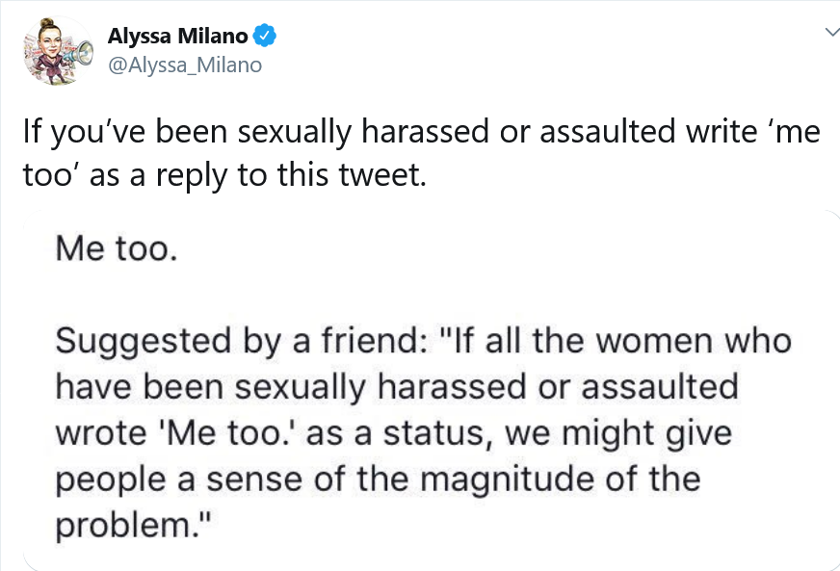
#MeToo Disclosure Decisions and Experiences in the United Kingdom Versus India: A Thematic Analysis College of Medical, Veterinary, and Life Sciences, Institute of Health and Wellbeing, University of Glasgow
1. Background
Sexual trauma (ST) survivors are reluctant to disclose due to stigma (Suarez & Gadalla, 2010), but, since 2017, 85 million have shared online via #MeToo (Sayej, 2017; see Figures 1 and 2).
Studies exploring why and how #MeToo disclosure affected survivors have:
Analysed online posts rather than asked survivors directly (Alaggia & Wang, 2020) or only interviewed North American activists (Strauss Swanson & Szymanski, 2020).
No study has focused on survivors in the United Kingdom (UK) or India who:
Were the most prolific users outwith North America (Fox & Diehm, 2017).
Have nationally disparate disclosure rates (Office of National Statistics – Crime Survey for England and Wales, 2018, 2020; Palermo et al., 2014). Decreased disclosure in India partly stems from an increased endorsement of stigmatising beliefs, e.g. survivors are responsible for ST (Hill & Marshall, 2018), which may have affected disclosure decisions and experiences.
Rationale:
Understanding why survivors disclosed may help create environments welcoming speech.
Learning about experiences may help determine needs.
Comparing accounts from the UK and India may clarify if needs vary contextually.
2. Aims
To understand and compare #MeToo disclosure decisions and experiences with UK-based and India-based survivors by answering four research questions:
What did survivors hope for through disclosure?
What inspired disclosure?
How was #MeToo participation experienced?
How, if at all, did disclosure decisions and experiences differ cross-nationally?
Figure 1 (Left) American Actress Alyssa Milano’s Twitter Post Prompting #MeToo Disclosures (Milano, 2017)
Figure 2 (Right)
Alyssa Milano (Sorensen, 2011)
3. Methods
Approach: Qualitative
Recruitment: Convenience sampling, social media advertisements
Participants: 27 survivors who disclosed using #MeToo or #MeTooIndia (regional variation)
16 UK-based (All Female [F], aged 16-55)
11 India-based (10 x F, 1 x Male [M], aged 16-45)
Data Collection: Online qualitative survey
Data Analysis: Thematic analysis (Braun & Clarke, 2006)
4. Results
One overarching theme, four themes, and two-sub-themes were identified (see Figure 3). The overarching theme indicates that all themes described endeavours for or experiences of change.
Theme 1 - Disclosure Begets Disclosure: Participants disclosed because others did, but aspirations and inspirations varied.
Sub-Theme 1 - Roaring in Numbers Too Big to Ignore:
Both countries:
Participants disclosed to raise awareness about ST: “to bring up the pervasive issue of sexual harassment and violence against women that is often ignored, minimised, or spun into a victim-blaming narrative” (P.19, India, F, aged 26-35).
Participants felt compelled to strengthen #MeToo by supporting other survivors: “I felt empowered. I felt like there are SO many of us survivors. We’re like an army… I wasn’t just stating it on a random day. It was part of a culture shift” (P.2, UK, F, aged 26-35).
Sub-Theme 2 - I Hear Your Roar – Now Let Me Try: UK:
Participants disclosed to liberate themselves from secrecy: “I have kept this to myself for a long time, and I was made comfortable and confident to do it as the numbers increased” (P.8, UK, F, aged 46-55).
Disclosure was enabled by positive discourse: “me too really changed my perspective, and it really opened my eyes to the fact it wasn’t my fault” (P.3, UK, F, aged 16-25).
Theme 2 - Building and Breaking Bonds:
Disclosure influenced relationships with others.
UK:
Participants felt accepted through survivor connections: “Just seeing so many people also using #MeToo and being a part of that, I just felt seen and heard” (P.2, UK, F, aged 26-35).
Both countries:
Some received negative responses:
India: Lack of secrecy displeased relatives: “It made my family unhappy as they were afraid that it would affect my chances of finding a good husband” (P.18, India, F, aged 16-25).
UK: Disbelief and abandonment was described: “A lot of people such as family and close friends walked away because they didn’t believe me” (P.25, UK, F, aged 16-25).
Figure 3
Thematic Map. Note. Solid lines = Hierarchical relationships between overarching theme and themes or a theme and its sub-themes. Dashed lines = Lateral relationships between themes and sub-themes of a different theme.
5. Conclusions
Aspirations:
In both countries, participants disclosed politically.
UK-based participants also disclosed therapeutically, extending similar results (Alaggia & Wang, 2020) by highlighting possible geographical differences in aspirations.
Inspirations:
In both countries, other survivors inspired disclosure (e.g. through the desire to show solidarity).
For UK-based participants, positive discourse catalysed therapeutic disclosures. As research suggests that the Indian media framed #MeToo less positively compared with Western countries (Starkey et al., 2019), India-based participants may have felt less able to disclose therapeutically.
Experiences:
In both countries, participants received negative reactions, but these differed cross-nationally.
UK-based participants felt less alone through survivor connections.
In both countries, disclosure facilitated positive self-transformation and increased ST-processing. However, #MeToo exposure sometimes increased distress. These observations extend Strauss Swanson and Szymanski’s (2020) comparable results to non-activists outwith North America.
Implications:
Public, positive ST-related discussion should increase in India and continue in the UK.
Interventions tackling problematic community beliefs must be context-sensitive.
Online survivor support groups might facilitate speech and meet therapeutic needs.
Future research should assess whether distress induced by heightened ST coverage translated to increased demand for mental health services.
Theme 3 - Rising Unafraid:
Disclosure promoted positive self-changes.
Both countries:
Some felt more powerful: “Being able to share it gave strength” (P.27, India, F, aged 26-35).
Adaptive behavioural changes were made: “It… helped me get more help and become who I needed to be” (P.25, UK, F, aged 16-25).
Theme 4 - Trauma: Painful, Processed, Powerful:
Disclosure influenced relationships with trauma.
Both countries:
#MeToo sometimes triggered distressing memories: “I was reminded of my traumatic experiences almost every day. It haunts every day since” (P.17, UK, F, aged 26-35).
For others, disclosure increased sense-making: “It started me on a long journey of deconstruction” (P.22, India, M, aged 26-35).
Some felt able to assign value to ST: “It generated a conversation amongst people I know, which I think was important” (P.19, India, F, aged 26-35).
References
Alaggia, R., & Wang, S. (2020). “I never told anyone until the #metoo movement”: What can we learn from sexual abuse and sexual assault disclosures made through social media? Child Abuse and Neglect, 103, 104312. https://doi.org/10.1016/j.chiabu.2019.104312
Braun, V., & Clarke, V. (2006). Using thematic analysis in psychology. Qualitative Research in Psychology, 3(2), 77–101. https://doi.org/10.1191/1478088706qp063oa
Fox, K., & Diehm, J. (2017, November 9). #MeToo’s global moment: The anatomy of a viral campaign. CNN. https://edition.cnn.com/2017/11/09/world/metoo-hashtag-global-movement/index.html
Hill, S., & Marshall, T. C. (2018). Beliefs about sexual assault in India and Britain are explained by attitudes toward women and hostile sexism. Sex Roles, 79, 421–430. https://doi.org/10.1007/s11199-017-0880-6
Milano, A. [@Alyssa_Milano]. (2017, October 15). If you've been sexually harassed or assaulted write 'me too' as a reply to this tweet [Tweet]. Twitter. https://twitter.com/Alyssa_Milano/status/919659438700670976
Office for National Statistics - Crime Survey for England and Wales. (2018). Table 22: Who victims aged 16 to 59 told about rape or assault by penetration (including attempts) experienced since age 16, by sex of victim, year ending March 2017 CSEW [Table]. https://www.ons.gov.uk/peoplepopulationandcommunity/crimeandjustice/datasets/sexualoffencesappendixtables
Office for National Statistics - Crime Survey for England and Wales. (2020). Table 20: Who adults who experienced sexual abuse before the age of 16 told about the abuse or who found out, by type of sexual abuse, year ending March 2019 CSEW [Table]. https://www.ons.gov.uk/peoplepopulationandcommunity/crimeandjustice/datasets/childsexualabuseappendixtables
Palermo, T., Bleck, J., & Peterman, A. (2014). Tip of the iceberg: Reporting and gender-based violence in developing countries. American Journal of Epidemiology, 179(5), 602–612. https://doi.org/10.1093/aje/kwt295
Reddit logo [Image]. (2017). Imgur. https://i.imgur.com/ws2kAA0.png.
Sayej, N. (2017, December 1). Alyssa Milano on the #MeToo Movement: “We’re not going to stand for it any more.” The Guardian. https://www.theguardian.com/culture/2017/dec/01/alyssa-milano-mee-too-sexual-harassment-abuse
Sorensen, T. (2011). Alyssa Milano 2011 [Image]. Wikimedia. https://commons.wikimedia.org/wiki/File:Alyssa_Milano_2011.jpg
Starkey, J. C., Koerber, A., Sternadori, M., & Pitchford, B. (2019). #MeToo goes global: Media framing of silence breakers in four national settings. Journal of Communication Inquiry, 43(4), 437–461. https://doi.org/10.1177/0196859919865254
Strauss Swanson, C., & Szymanski, D. M. (2020). From pain to power: An exploration of activism, the #MeToo Movement, and healing from sexual assault trauma. Journal of Counseling Psychology. Advance online publication. https://doi.org/10.1037/cou0000429
Suarez, E., & Gadalla, T. M. (2010). Stop blaming the victim: A meta-analysis on rape myths. Journal of Interpersonal Violence, 25(11), 2010–2035. https://doi.org/10.1177/0886260509354503
UofG MVLS [@UofGMVLS]. (2020). UofG MVLS logo [Image]. Twitter. https://twitter.com/uofgmvls

