Slide 1
Searching and reporting for systematic reviews: Class 3
Dr Paul Cannon
College Librarian Medical, Veterinary & Life Sciences
paul.cannon@glasgow.ac.uk
Photo by rawpixel on Unsplash
This work is licensed under a Creative Commons Attribution 4.0 International License

Slide 2
Learning outcomes
By the end of this class, you will be able to:
Search trial repositories and grey literature resources
Conduct reference and citation analysis
Utilise tools to speed up the search process
Export searches for reporting purposes

Slide 3
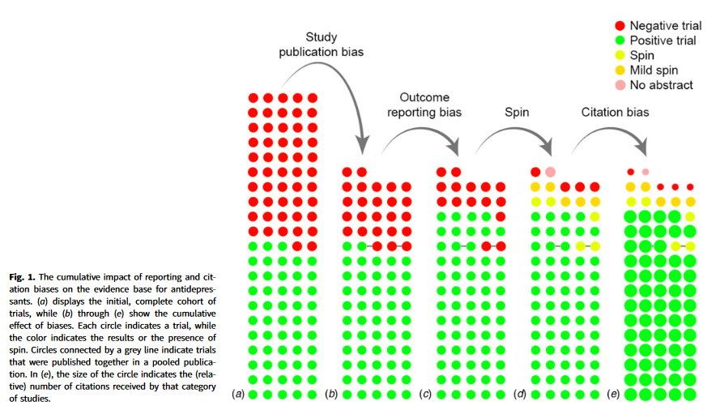
The importance of trial registers
From: De Vries, Y., Roest, A., De Jonge, P., Cuijpers, P., Munafò, M., & Bastiaansen, J. (2018). The cumulative effect of reporting and citation biases on the apparent efficacy of treatments: The case of depression. Psychological Medicine, 48(15), 2453-2455. doi:10.1017/S0033291718001873

Slide 4
Any questions?
Feel free to unmute yourself or type into the chat box.

Slide 5
Grey literature and other information sources
Conference abstracts
Covered in Scopus, Web of Science Core Collection, and PapersFirst and ProceedingsFirst
Official publications
Government, NGOs, charities, professional bodies, guidelines, etc.
Dissertations and theses
ProQuest Dissertations and Theses
Handsearching
Reference lists of other reviews and citations
See Scopus, Web of Science Core Collection, and Google Scholar for references and citations

Slide 6
Recording grey literature searches

Slide 7
Any questions?
Feel free to unmute yourself or type into the chat box.

Slide 8
Systematic review tools
PubReMiner
https://hgserver2.amc.nl/cgi-bin/miner/miner2.cgi
Textmines PubMed, generating frequency tables of data fields
Polyglot from Systematic Review Accelerator
https://sr-accelerator.com/#/polyglot
Translates a search for different interfaces
Litsearchr
An R package for “quasi-automatic search strategy development for systematic reviews” https://elizagrames.github.io/litsearchr/

Slide 9
Reference management and software
Using EndNote to manage references in systematic reviews
https://edshare.gla.ac.uk/1293/
SR toolbox
http://www.systematicreviewtools.com/

Slide 10
Any questions?
Feel free to unmute yourself or type into the chat box.

Slide 11
Reporting search methods
SECTION/TOPIC | ITEM # | CHECKLIST ITEM
INFORMATION SOURCES AND METHODS
Database name | 1 | Name each individual database searched, stating the platform for each.
Multi-database searching | 2 | If databases were searched simultaneously on a single platform, state the name of the platform, listing all of the databases searched.
Study registries | 3 | List any study registries searched.
Online resources and browsing | 4 | Describe any online or print source purposefully searched or browsed (e.g., tables of contents, print conference proceedings, web sites), and how this was done.
Citation searching | 5 | Indicate whether cited references or citing references were examined, and describe any methods used for locating cited/citing references (e.g., browsing reference lists, using a citation index, setting up email alerts for references citing included studies).
Contacts | 6 | Indicate whether additional studies or data were sought by contacting authors, experts, manufacturers, or others.
Other methods | 7 | Describe any additional information sources or search methods used.
SEARCH STRATEGIES
Full search strategies | 8 | Include the search strategies for each database and information source, copied and pasted exactly as run.
Limits and restrictions | 9 | Specify that no limits were used, or describe any limits or restrictions applied to a search (e.g., date or time period, language, study design) and provide justification for their use.
Search filters | 10 | Indicate whether published search filters were used (as originally designed or modified), and if so, cite the filter(s) used.
Prior work | 11 | Indicate when search strategies from other literature reviews were adapted or reused for a substantive part or all of the search, citing the previous review(s).
Updates | 12 | Report the methods used to update the search(es) (e.g., rerunning searches, email alerts).
Dates of searches | 13 | For each search strategy, provide the date when the last search occurred.
PEER REVIEW
Peer review | 14 | Describe any search peer review process.
MANAGING RECORDS
Total records | 15 | Document the total number of records identified from each database and other information sources.
Deduplication | 16 | Describe the processes and any software used to deduplicate records from multiple database searches and other information sources.
Rethlefsen, M.L., Kirtley, S., Waffenschmidt, S. et al. PRISMA-S: an extension to the PRISMA Statement for Reporting Literature Searches in Systematic Reviews. Syst Rev 10, 39 (2021). https://doi.org/10.1186/s13643-020-01542-z
See also https://prisma-statement.org/Extensions/Searching

Slide 12
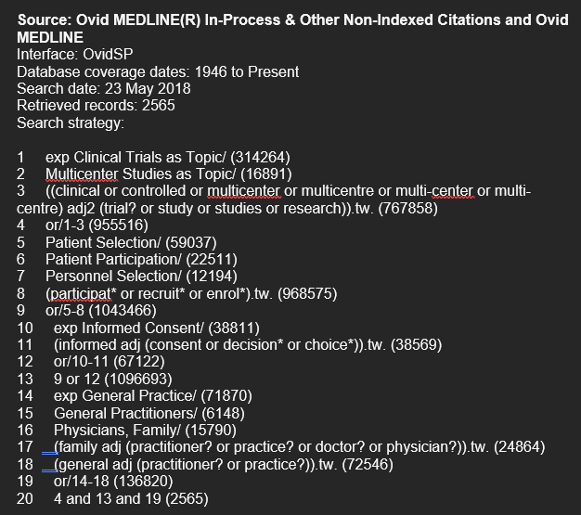
Reporting search strategy example
See section 7 of the SR guide for a template https://edshare.gla.ac.uk/444/
Moffat, K.R., Shi, W., Cannon, P. et al. Factors associated with recruitment to randomised controlled trials in general practice: a systematic mixed studies review. Trials 24, 90 (2023). https://doi.org/10.1186/s13063-022-06865-x

Slide 13
Any final questions?
Feel free to unmute yourself or type into the chat box.

Slide 14
Support for your reviews
Systematic and scoping review resources: https://edshare.gla.ac.uk/451/
Research students and staff
email: paul.cannon@glasgow.ac.uk
Book an appointment at: https://www.gla.ac.uk/myglasgow/library/help/collegelibrarians/mvls/
Undergraduate and Taught postgraduate students
College Library Support Team
email: library-college-support@glasgow.ac.uk
book an appointment at https://www.gla.ac.uk/myglasgow/library/help/collegesupport/

