Slide 1
Searching and reporting for systematic reviews: Class 2
Dr Paul Cannon
College Librarian Medical, Veterinary & Life Sciences
paul.cannon@glasgow.ac.uk
Photo by rawpixel on Unsplash
This work is licensed under a Creative Commons Attribution 4.0 International License

Slide 2
Learning outcomes
By the end of this class, you will be able to:
Develop a search consisting of text words and subject headings in different databases and interfaces
Save searches in different interfaces

Slide 3
Using a question formulation framework to develop a search strategy
“In people with dementia, what are the benefits and limitations of video consultation over telephone consultation?
Framework element | Question element
Population / patient | Dementia
Intervention / indicator | Video consultation
Comparator / control | Telephone consultation
Outcome | Benefits and limitations

Slide 4
Don't reinvent the wheel
"Given the difficulty defining upstream interventions, a multistranded search method²⁸ will be employed, with each strand representing an intervention of interest. [...] The dental and oral health elements of the search will be adapted from the strategies employed by Waldron et al²⁹ and Arora et al.³⁰ The sugar tax strand of the search will use the strategies of Pfinder et al³¹ and the equity-focused strand will use the strategies of Prady et al.³²"
Dawson ER, Stennett M, Daly B, et al. Upstream interventions to promote oral health and reduce socioeconomic oral health inequalities: a scoping review protocol
BMJ Open 2022;12:e059441. doi: 10.1136/bmjopen-2021-059441

Slide 5
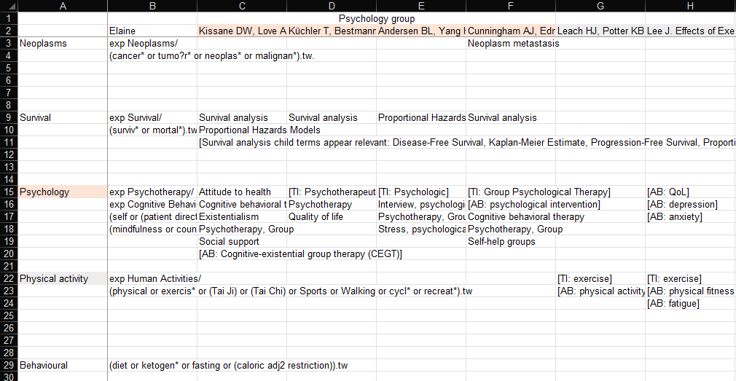
Vocabulary in existing literature

Slide 6
Exercise 1
Look for search strategies and vocabulary using:
The Cochrane Library: https://www.cochranelibrary.com/advanced-search
Campbell Collaboration: https://www.campbellcollaboration.org/better-evidence.html
Scopus: https://www.scopus.com/
Web of Science Core Collection: https://www-webofscience-com.ezproxy.lib.gla.ac.uk/wos/woscc/basic-search
PubReMiner: https://hgserver2.amc.nl/cgi-bin/miner/miner2.cgi
Note the strategies:
Either copy the strategies in a Word document or keep the results open in a new tab – we’ll use these later

Slide 7
Boolean logic
OR: increases sensitivity
use for different synonyms, spelling variants and acronyms, i.e. diet or eat or feed
AND: increases specificity
use to group different concepts that must be mentioned with the search results, i.e. Population AND Intervention AND Comparator
NOT: exclude unwanted terms
in most circumstances, never use NOT; you may lose important references

Slide 8
Search syntax
Proximity: more sensitive than phrase searching
use to find words near each other, i.e., “mental health” adj3 (personnel or professionals or staff)
NOTE: the proximity syntax varies in each database, and is not supported in others
Truncation: different word endings (or sometime beginnings)
use for different word formulation i.e., toxic* will retrieve toxic, toxicity, toxicology…
Wildcards: spelling variations
use for British and American spelling amongst other uses i.e., colo?r will retrieve color and colour
NOTE: the wildcard syntax varies in each database, and is not supported in others
Combining syntax:
cognitive adj1 “behavio?r* therap*”

Slide 9
Comprehensiveness of vocabulary
Cognitive behaviour therapy--clinical applications.
Contemporary Cognitive Behavior Therapy: A Review of Theory, History, and Evidence.
Historical perspective and future directions in Cognitive Behavioral Therapy for insomnia and behavioral sleep medicine.
Cognitive-behavioral treatment of the paraphilias.
Cognitive behavioral control of arthritis pain.
Behavioral and cognitive-behavioral approaches to chronic pain: recent advances and future directions.
Cognitive therapy for anxiety disorders.
Cognitive Training in the Elderly: Bottlenecks and New Avenues.
Influence of adjuvant mindfulness-based cognitive therapy (MBCT) on symptoms of post-traumatic stress disorder (PTSD) in veterans - results from a randomized control study.
Effects of an Internet-based cognitive behavioral therapy (iCBT) program in Manga format on improving subthreshold depressive symptoms among healthy workers: a randomized controlled trial.

Slide 10
Cognitive behaviour therapy
OR
Cognitive behavior therapy
OR
Cognitive behavioral therapy
OR
Cognitive behavioral therapies
OR
Cognitive-behavioral treatment
OR
Cognitive behavioral control
OR
Cognitive-behavioral approaches
OR
Cognitive therapy
OR
Cognitive training
OR
Mindfulness-based cognitive therapy
OR
ICBT
OR
MBCT
OR
CBT

Slide 11
Cognitive behaviour therapy OR Cognitive behavior therapy OR Cognitive behavioral therapy OR Cognitive behavioral therapies OR Cognitive-behavioral treatment OR Cognitive behavioral control OR Cognitive-behavioral approaches OR Cognitive therapy OR Cognitive training OR Mindfulness-based cognitive therapy OR ICBT OR MBCT OR CBT

Slide 12
((Cognitive adj2 (therap* OR treatment* OR control OR approach* OR training)) OR ICBT OR MBCT OR CBT)

Slide 13
Exercise 2
Start developing your search strategies:
Using your results from earlier, note the concepts used by authors for each element of your question formulation framework
Can you develop these into a search using Boolean logic and syntax?
Use the syntax crib sheet to help: https://edshare.gla.ac.uk/280/

Slide 14
Any questions?
Feel free to unmute yourself or type into the chat box.

Slide 15
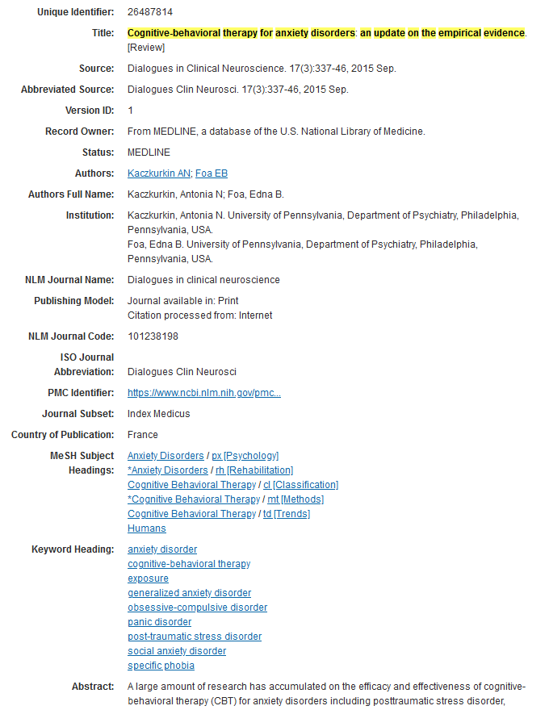

Slide 16
Any questions?
Feel free to unmute yourself or type into the chat box.

Slide 17
Subject headings
Treatment
Cognitive behavior therapy
Acceptance and commitment therapy
Cognitive processing therapy
Prolonged exposure therapy
PsycINFO
Behavior treatment
Cognitive behavioral therapy
Acceptance and commitment therapy
Cognitive restructuring
Mindfulness
Medline
Cognitive therapy
Cognitive behavioral therapy
Cognitive behavioral stress management
Cognitive processing therapy
Cognitive restructuring
Dialectical behavior therapy
Mindfulness-based stress reduction
Embase

Slide 18
Worked example: Embase and PsycINFO
Databases (and Interfaces)
Embase (OvidSP)
PsycINFO (EBSCOhost)

Slide 19
Precision vs sensitivity
Precise
Sensitive
[Title or abstract] Cognitive behaviour therapy OR Cognitive behavior therapy OR Cognitive behavioral therapy OR Cognitive behavioral therapies OR Cognitive behavioral treatment OR Cognitive behavioral control OR Cognitive behavioral approaches OR Cognitive therapy OR Cognitive training OR Mindfulness based cognitive therapy OR ICBT OR MBCT OR CBT
[Subject heading] Cognitive behavior therapy
[Title/abstract] ((Cognitive adj2 (therap* OR treatment* OR control OR approach* OR training)) OR ICBT OR MBCT OR CBT)
[Subject heading] exp Cognitive behavior therapy
[Title or abstract] Cognitive behaviour therapy OR Cognitive behavior therapy OR Cognitive behavioral therapies OR Cognitive behavioral therapies OR CBT

Slide 20
Any final questions?
Feel free to unmute yourself or type into the chat box.

Slide 21
Support for your reviews
Systematic and scoping review resources: https://edshare.gla.ac.uk/451/
Research students and staff
email: paul.cannon@glasgow.ac.uk
Book an appointment at: https://www.gla.ac.uk/myglasgow/library/help/collegelibrarians/mvls/
Undergraduate and Taught postgraduate students
College Library Support Team
email: library-college-support@glasgow.ac.uk
book an appointment at https://www.gla.ac.uk/myglasgow/library/help/collegesupport/

