Slide 1

Tips for identifying relevant databases
Lynn Allardyce Irvine, College Librarian

Slide 2

Contents
If you are not sure which database to use for your search, you can use a subject guide, or ask for help. Not all databases index the same content. There will always be some overlap between databases as well as unique content. It is almost always the case that you will need to use a variety of search tools for your research/project. Here are a few quick tips on how to select an appropriate database for your search.
When to use a search engine and when to use a database
Multidisciplinary databases and platforms for cross-searching
‘Best fit’ journals and ‘best fit’ journal articles
Indexing information on journal web pages
Journal information on databases
Identifying relevant databases from published review articles
Using a database filter on cross-searching platforms
Photo by Sebastian Herrmann on Unsplash

Slide 3

Finding journal articles - when to use a search engine and when to use a database
Most research databases index journal literature, including academic and practitioner articles. You can also use search engines like Library Search or Google Scholar (Scholar does not index practitioner articles).
When should you use a database instead of a search engine?
Library Search and Google Scholar are useful for quick searches or initial searches. e.g., if you are looking for a specific article, want to get a sense of the volume of published literature or want to generate a list of keywords to use in searches.
For focussed searching when you have a search strategy and a set of keywords, databases are more efficient. The have curated subject content and smaller indexes. You can find relevant information more quickly.
Photo by Erol Ahmed on Unsplash

Slide 4

Types of database
Databases are either multidisciplinary or subject-specific, focusing on outputs common to that subject area (empirical research, review articles, case studies, industry reports, survey reports, working papers, financial information, country demographics, news sources for example). Content is assessed for quality and relevance.
Multidisciplinary databases are high-quality, curated databases with value-added features allowing you to search across thousands of source documents, using features to help you focus your search and to find related literature. They include traditional and alternative metrics (i.e., information on who has cited, commented on or shared a document). SCOPUS and Web of Science are the two main multidisciplinary databases.​
Subject-specific databases are smaller, curated collections useful for systematic searching and targeted research. They often have document types and grey literature not easily found through other search engines or databases. EBSCOhost and Proquest are the two largest database platforms, hosting many databases.
Image by Photo by Erol Ahmed on Unsplash

Slide 5

Use the subject listings on the library website
The library purchases subscriptions to multidisciplinary and subject-specific databases to support research
These are listed on the library website by broad subject area and alphabetically by the name of the database
Subject listings might be shown as key and all databases. Key databases are recognised as the most significant databases for a specific subject area.
You may have to use databases across subject areas for your research question
Databases by subject
Alphabetical list of databases

Slide 6
Multidisciplinary databases and platforms for cross-searching
You may need to use a database outside of your main subject area so you may have to look at multiple listings to identify key databases. However, there are multidisciplinary databases which allow you to search multiple subjects , and platforms which allow you to cross-search multiple databases.
The two biggest research platforms are:
EBSCOhost
Proquest Academic
They host many databases across a range of subjects. You can search single databases, selected databases, pre-defined collections, or search all at once.
The two largest multidisciplinary databases are:
SCOPUS
Web of Science (core collection)
Use them for searching, or if you want to find citing literature (i.e. the journals that cite a key paper you have found). These two databases have excellent features to help you connect related articles.

Slide 7

‘Best fit’ journals and ‘best fit’ journal articles
Check where the ‘best fit’ journals are indexed – either on the journal web page, or check the publications listed in databases to see if the journal is indexed
A ‘best fit’ journal is one that publishes articles in your research area. You may notice that it appears regularly on search results
A ‘best fit’ journal article is an authoritative article that closely matches your research question or topic. Check which journal the article is published in and use the journal web site to find out where the journal is indexed, or check the publications indexes in key databases to see if the journal is included
Photo by Sharon McCutcheon on Unsplash

Slide 8

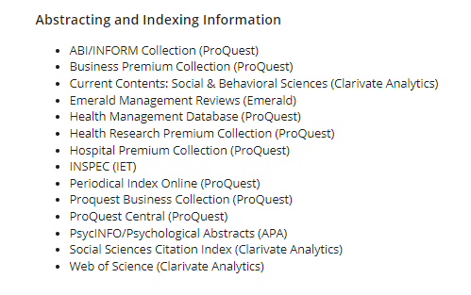
‘best fit’ journals – journal web pages
For example, perhaps articles published in the Human Resource Management Journal, (a 4* ranked journal on the Academic Journal Guide ) published by Wiley Blackwell regularly features on your search results
Go to the journal web page – the ‘about’ or overview information for the journal provides a list of databases where the journal is indexed.

Slide 9
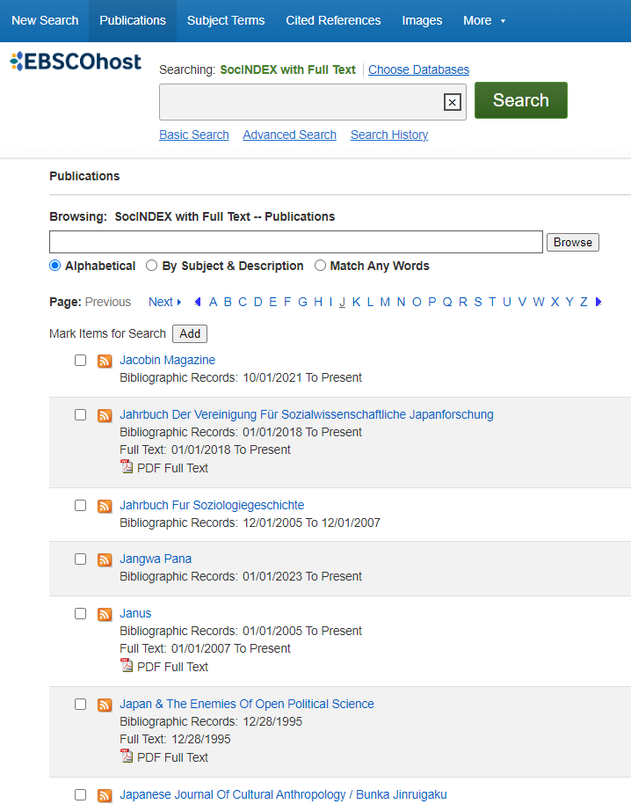
‘Best fit’ journals – journal information on databases
Databases index journals and other material in accordance with their scope and inclusion criteria.
You can usually search or browse the publications and other sources indexed in a database. This is a common feature in databases.
Here is an example from the SocINDEX database. Choose the ‘Publications’ link on the top toolbar and search or browse.

Slide 10
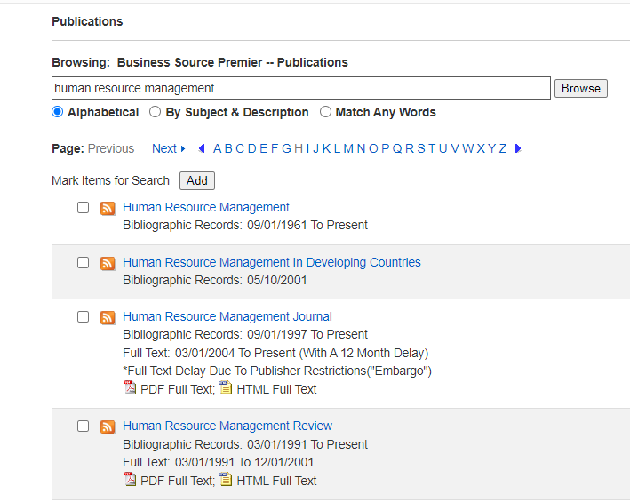
Publication search/browse on Business Source Premier
The default setting is browse alphabetically, but you can search for titles. Information about each title shows the coverage dates and if the content is bibliographic only or available in full-text

Slide 11
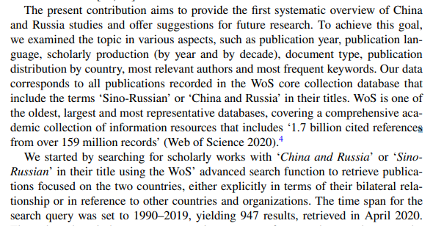
Tips for identifying appropriate databases – from published literature
Look in the methodology section of relevant articles to see which discovery tools the authors used. Review articles (literature reviews or systematic reviews) or theoretical articles using modelling and data are more likely to list the databases and other discovery tools they used.
An example is this article which aims to systematically review the literature on China and Russia studies. The authors share information on their choice of database.
Papageorgiou, M. M., & Vieira, A. (2022). Mapping the literature on china and russia in IR and area studies: A bibliometric analysis (1990–2019). Journal of Chinese Political Science, 27(1), 155-181. doi:https://doi.org/10.1007/s11366-021-09768-x

Slide 12
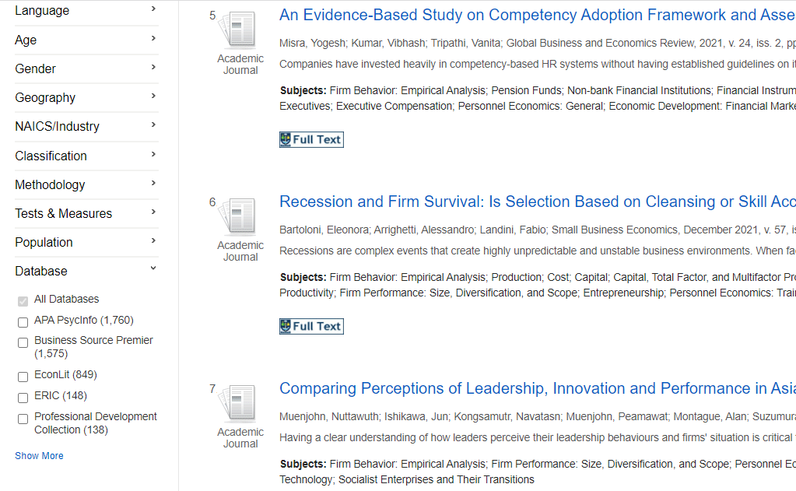
Use the database filter on database platforms
Cross search all databases on a platform like EBSCOhost or Proquest and use the database filter to judge which databases have most content matching your search terms
Here is an example of a search on EBSCOhost
The database filter shows the databases with the number of results matching your search terms. They are shown with the highest number of results at the top.
This can help you identify some useful database(s) for your search
Note here that although this is a business research question about the correlation between leadership and business success, there are results from psychology and education databases as well as business databases.

Slide 13


And if you are still not sure, ask!
The College Library Support Team
https://www.gla.ac.uk/myglasgow/library/help/collegesupport/ can help you. Email them for some help or to book an appointment.
Or use the generic help address library@glasgow.ac.uk and staff will answer your enquiry or refer you to specialist teams who can help.
PGR and staff should contact your College Librarian

Slide 14



This presentation is created by Lynn Allardyce Irvine under licence -
CC BY-NC-SA 4.0 Attribution-NonCommercial-ShareAlike 4.0 International
#UofGWorldChangers
@UofGlasgow

