Slide 1

Multifaceted, tailored approaches to belonging for Postgraduate Online Students in Higher Education
Jenny Crow, PhD student / Digital Education Team Manager (MVLS)

Slide 2
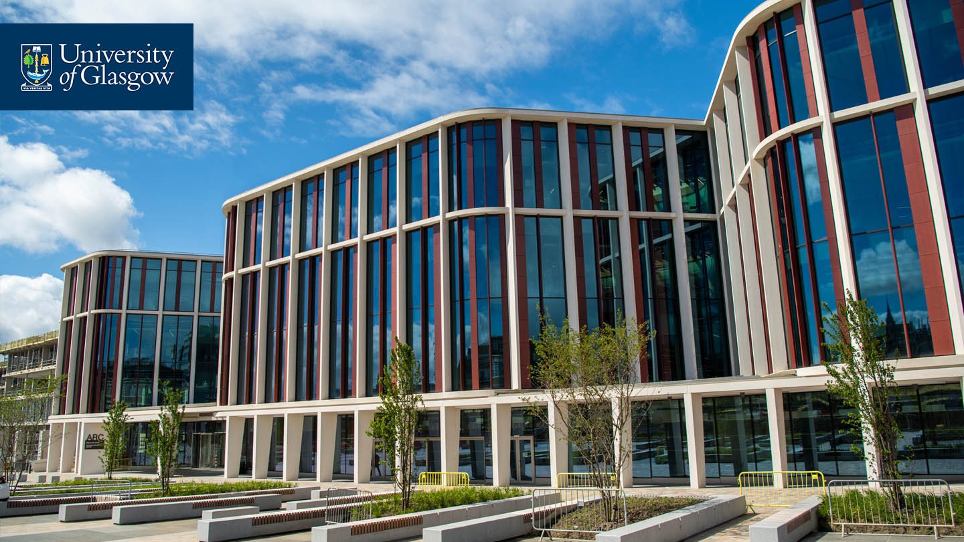
Background / methods
Background
28 online interviews
Approx 30 mins each
Phenomenography
Population

Slide 3
Setting the scene
Student identity, multiple responsibilities
“Like I said, since I'm distance, sometimes I forget that I'm in a programme. So I tend to kind of... I would say throughout the week I just do my work and then during the weekend I'm like, "Oh my gosh, I have to do I have to do the class." So sometimes I trick myself into thinking that I don't have nothing to do, but I have something. And like there's sometimes emails that they send and I want to participate, but then I forget about it because I don't check really my Outlook as much, and then I try to respond, but then the deadline has already passed.”
Connection with physical campus
“I still feel the distance, even though there shouldn't be a distance, between the two places. Sometimes, yeah, I think because some of the students are in Glasgow and they can be more physically connected to the university”.
More sense of belonging to cohort
“I feel quite belonged to University of Glasgow, but not to the fullest satisfaction... I think the maximum interaction I've had is with my department and my lecturers or teachers. So, that's where I feel more belong to… So, I feel still an outsider when I visited it [University of Glasgow campus]... I feel more connected virtually, somehow, within the team, when we speak or discuss or have live sessions”

Slide 4
Staff presence
“there's quite a big difference in the modules in terms of how they're run…So the two differences, one of them is the course tutor of that particular module. So I've had two modules where the course tutor has been extremely present. It's been very interactive. And as a result of that, it's been actually great fun. And I've had two modules where in one of them, the course tutor was completely absent... So that the course tutor made a huge difference to how I perceived a course to be…. when we had the very interactive course tutor, the students themselves were also more interactive” “my first semester, it was purely online. I did not have, and there was no live session, no interaction. There was no feedback on the forum, nothing that was. And it was my first course, so it made me feel... In fact, I felt like I wasn't getting value for what I paid for.” “the course I'm doing right now, the lecturers absolutely come back every week giving a bit of a summary, but sometimes you never hear anything at all when you're like... Not a, "Why am I doing it?" You're doing it for your own learning, but is anyone seeing it? If I'm putting something really, really wrong or down the wrong path is anybody telling me.” “Really well connected. So in particular, [the programme leader], who's the course leader on the MSc. It's a bit of a strange course because it's run across several departments…. It can feel a bit like a collection of courses. And if there's nobody to sort of pull it together into one curriculum, I think that it would be easy to get lost. But [programme leader] is really good at being a visible point of contact.” “I'm not very connected [to staff], …I tried to email them and they don't really reply. Like, I've been waiting for reply for a month now, and three months with the other lecturer. So, quite a long time.”

Slide 5
Factors impacting staff presence
“I can't think of any examples of anything that would make me feel less connected. I think they [staff] make a good effort really to kind of try and involve people and particularly the group discussions on the chat” “I think for us as students, I think you have to be proactive, if you wanted to ask something or you have to send that email or you have to get in contact because it wasn't going to be the other way around. So that I suppose that you had to make the connection, I think, I felt more so.” “I think just engaging regularly, offering to do stuff, whether it's Zoom calls rather than just recorded stuff. Probably showing a bit more of a human side to them [staff] as well. Actually like making jokes about whatever, their personal lives when they're posting. It takes away that kind of tension of that formality, I guess. So it opens you up a little bit to them” “Not particularly [connected to staff], but I guess that's partly me, as well. I've not found that I've needed to contact them very often, because I guess that's testament to how clear everything is. So, apart from seeing them in the Zoom tutorial type things, I wouldn't say particularly connected, really…” “with this course, the [course name], they have different lecturers every week. So you're seeing a lot of staff members. So it's not like you can kind of create a rapport with just one…But it's nice to see how many people are actually in [MSc programme] at Glasgow Uni, and getting to know their names anyway. So I think that maybe because we're not doing one-to-ones, you don't feel quite so connected to them, but when they make the effort on the discussion forum, it makes a difference”

Slide 6
Relationship with peers
“Why that changed was because we had a task of doing a presentation. A group presentation. And so, that kind of involved us. That pushed us to interact a lot more with the classmates, form a group, have more conversations just in general. How are you coping? How are you feeling about the topic?” “I've been grouped once in three courses. It's been useful, but again, the people I'm with are all professionals, so we're very much transactional in the sense, "Oh, this is the assessment. We've got to it," then after that, "Thanks, goodbye." “I feel completely supported [by peers]. I think it's better now in the second year than it was in the first year, because we got know each other a little more. So whenever I post the question in the WhatsApp group, they help me and reply quite quickly… I felt less alone.…I think it's good that we have this WhatsApp group.” “I think having the initial video introductions so you know who everybody is and the regular Zoom meetings with your classmates, just to sort of see your classmates' faces and get a bit of a feel for who they are, what their interests are, I think that really helps actually because I think, particularly when you're doing something part time, to keep that momentum up, it's really good to just have someone else who's in the same position to chat about it to…feel like you're all in it together … you're not alone with that stress” “Well, I don't talk to them at all [peers], so... It's not by anyone's fault at all, but yeah, I don't feel supported by them at all. But again, it's no one to blame. Everyone is busy, so it's okay…”

Slide 7
Factors impacting relationship with peers
“you'll have some students in some classes, and you might start to make some connections, relationship, but then they might not be in your next class, and I think that's due to the programme structure” “Moodle doesn't really give an interactive session between the students, because you have to first message someone personally before you actually start a conversation and people are not very comfortable just writing certain things on the forum and that's quite understandable” “I think feedback of any sort, by students or tutors. That actually it's nice if your voice gets heard and people don't have to agree with you at all, but it's nice that actually at least people take the opportunity to kind of criticise or compliment or whatever. And I think that, for me, increases my sense of belonging.” “I try to take participation in the weekly forums as much as I can. And because we have... So, we have a group of my own class on a WhatsApp, where we have voluntarily participated. Or if you want to share any bits and pieces, any information, papers to read, good tips for the students and stuff. So, we kind of pass on to each other. So, that's how we support one another.”

Slide 8
Conversation
“I suppose the discussion forum online as well is another one of those. I think possibly that's been a little bit sporadic, I suppose. There's been some units where we've utilised the forum a lot more than others. So I think going forward, if that could be encouraged a little bit more, that might help… Possibly like a students-only area on the forum might be good. So sort of taking it out of WhatsApp, …somewhere that they can go and discuss a little bit more” “Definitely, more of those Zoom [online tutorials]…. the previous five week course we had, we didn't have any at all. You feel like here's the learning material, just get on with it, and it is nice to touch base. Even if you haven't got a specific question about it, it's just nice to know that you're on the right tracks, or even just to have a meetup just to say hi would be nice.” “Not anything specific [activities that make feel more connected to staff]. It's just the nature of the course, because we're doing lots of discussions or forums online. And we do lots of chatting through the course, and also there's been WhatsApp groups for the different courses “The discussion forum just isn't quite the same [as live sessions] and people learn the best I think sometimes when they can bounce off each other. And I don't think that is necessarily always represented in the forums” “I know I'm raving about the discussion forum. Sometimes I do lack maybe input on the discussion forum. I sometimes do just post my answers to something and then just kind of leave it. I don't go through everybody's posts and comment on everybody's questions.”

Slide 9
Factors impacting conversation
“I find it really easier to communicate while I speak, rather than while I type. Maybe it's because English is not my first language” “especially some of the online Zoom meetings we've had and the kind of presentations that people had to give. Definitely you see people, you see their expressions and can have discussions that I think that helps in a sense of belonging” “I think sometimes the live lectures, if you can't attend them because obviously it's an online part-time course, then you're just watching a recording and you're watching everybody else comment and you weren't there. But obviously that's not really the fault of the lecturers for you not being able to make the time. So I think just the live lectures but obviously they are recorded, so I can watch them.” “I think it would be okay if we had some more activities together, but again, bearing in mind that I know our year just has the guys in the UK, one in Bahamas, one here. So we've got those time zones. If you've got them further flung to the east, it's going to be really difficult to get everyone together. And, that's the nature of the beast, I guess. And, we know what that is going in, so that's fine.” “when I have looked at participant lists and it's like... What there are 30 or more people in any kind of discussion. You might have maybe five or six people that are posting, they post once, they don't seem to... People don't answer back. I'm not sure it does so and it seems to be the first week or two people are kind of gung ho and then well it kind of falls off.”

Slide 10
Flexibility / inclusive design
“watch them back whenever you like and keep repeating certain parts of it.” “What really was helpful for me is the fact that I could download them.” “increase the speed to 1.5 or 1.75, so I can get through the lecture quickly” “I love the online lectures. I love the way they're set out. I think they're really clever actually, because you can just dip in and out. You can do it in your own time …I can organise my full week ahead.” “I think completely [accessible], because we have the transcriptions and different formats of the same lectures. Yeah….I think it [sense of belonging] impacts it in a good way.” “I don't think it's negatively impacted my sense of belonging, but one thing I do think, there's loads of different platforms” “No, it is very, very inclusive, from what I've seen, there are other students from every corner of the globe. Even in the group work so far, I've had the chance to sort of speak and engage with a couple of them. So, obviously, it's very interesting and it opens up the door to learning about obviously their lifestyle, culture, and things like that. So, it is a very inclusive course, and even the group work, which we've had to carry out has sort of shown me that, you know, because it's given me the chance to work with people from everywhere, really.

Slide 11
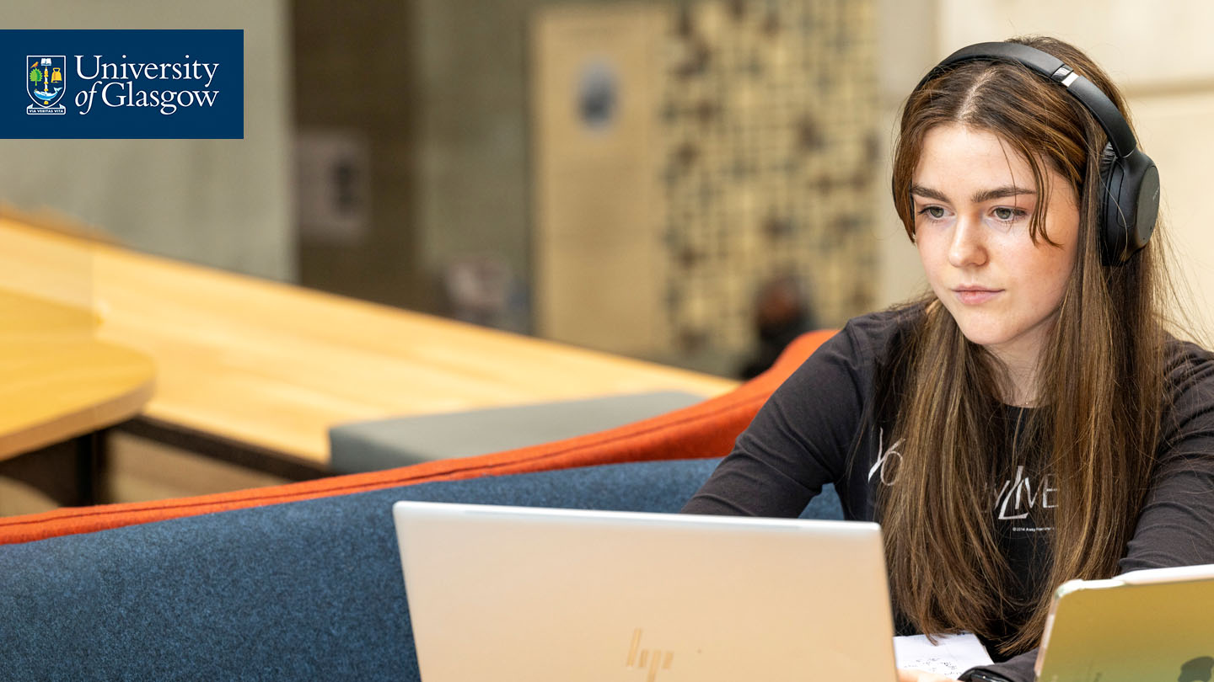
Lessons learned
Introductions (videos) staff & students
Live sessions
Group work
Replying to student interactions
Creating a community all voices are valid
Students feeding into course evaluation
Being considerate of time zone and work / life balance for students
Spaces for students to connect with peers
Alternative formats / flexible content

Slide 12

Implementing / future plans
Virtual coffee sessions (dissertation)
Dissemination with internal colleagues
Worksheet / interviews
Writing up PhD

Slide 13




Thanks and questions jenny.crow@glasgow.ac.uk
LinkedIn: jenny-crow-77581a16
Blue Sky: @jenncrow.bsky.social
PhD supervisors: Prof Keith Smyth, Dr Vicki Dale, Prof Jo-Anne Murray & Dr Michelle Bellingham​
#UofGWorldChangers
@UofGlasgow

