Slide 1

Developing Rigour and Validity in Literature Searches
Please download the course exercise worksheet from https://edshare.gla.ac.uk/id/
document/8136

Slide 2



Developing Rigour and Validity in Literature Searches at Doctoral Level
Dr Paul Cannon
College Librarian Medical, Veterinary & Life Sciences
paul.cannon@glasgow.ac.uk
Photo by rawpixel on Unsplash
This work is licensed under a Creative Commons Attribution 4.0 International License

Slide 3
Learning outcomes
By the end of the workshop, you should…
Understand the various literature review methods available and their limitations
Be able to structure a search strategy for effective literature searching
Utilise advanced search techniques to find relevant information in your research field
Use basic text mining techniques to improve the specificity or sensitivity of searches
Use data to identify prominent journals, papers and authors within your field

Slide 4
Getting started and familiarisation
Enlighten Publications: the University’s research repository
Enlighten Theses: research degree repository
Enlighten Research Data: research data repository
EthOS: UK doctoral theses
Proquest Dissertations and Theses: Global theses
University of Glasgow Library: your collections and archives
Library Hub Discover: Search the collections of most UK and Irish libraries

Slide 5
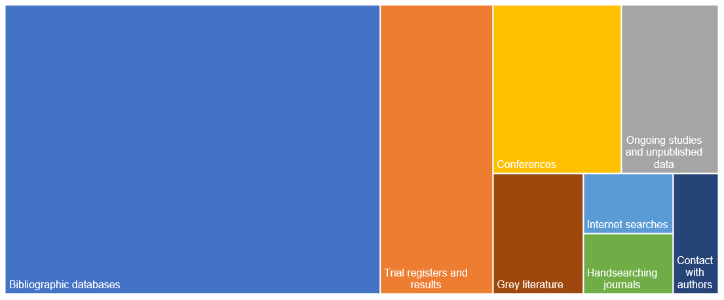
Where to find data

Slide 6
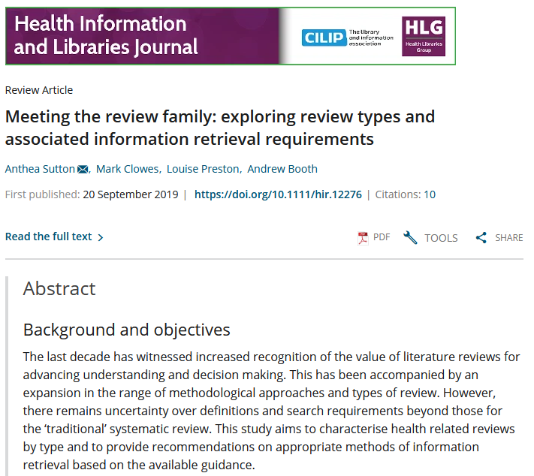
What type of literature review am I doing?
https://doi.org/10.1111/hir.12276

Slide 7
Any questions?

Slide 8
Question formulation frameworks
PICO Used for: Evidence-based medicine https://dx.doi.org/10.7326/ACPJC-1995-123-3-A12 | SPICE Used for: Evaluating projects or interventions https://dx.doi.org/10.1108/07378830610692127 | SPIDER Used for: Qualitative or mixed methods https://dx.doi.org/10.1177/1049732312452938 | ECLIPSE Used for: Evaluating services https://dx.doi.org/10.1046/j.1471-1842.2002.00378.x
Population / patient | Setting | Sample | Expectation
Intervention / indicator | Perspective / population | Phenomenon of Interest | Client group
Comparator / control | Intervention | Design | Location
Outcome | Comparison | Evaluation | Impact
 | Evaluation | Research methodology / method | Professionals
 |  |  | SErvice
See Supplementary Material 1 of Booth A, Noyes J, Flemming K, et al. Formulating questions to explore complex interventions within qualitative evidence synthesis. BMJ Global Health 2019;4:e001107: https://dx.doi.org/10.1136/bmjgh-2018-001107 for an exhaustive list of question formulation frameworks.

Slide 9
What are the most effective chemical repellents to deter arthropod vectors?
PICO Used for: Evidence-based medicine https://dx.doi.org/10.7326/ACPJC-1995-123-3-A12 | SPICE Used for: Evaluating projects or interventions https://dx.doi.org/10.1108/07378830610692127 | SPIDER Used for: Qualitative or mixed methods https://dx.doi.org/10.1177/1049732312452938 | ECLIPSE Used for: Evaluating services https://dx.doi.org/10.1046/j.1471-1842.2002.00378.x
Population / patient | Setting | Sample | Expectation
Intervention / indicator | Perspective / population | Phenomenon of Interest | Client group
Comparator / control | Intervention | Design | Location
Outcome | Comparison | Evaluation | Impact
 | Evaluation | Research methodology / method | Professionals
 |  |  | SErvice

Slide 10
Exercise one: PICO
Worksheet at https://edshare.gla.ac.uk/id/document/8136
Framework element | Concept
Population / patient | adult cat
Population / patient | chronic kidney disease
Intervention / indicator | Wet maintenance diet
Comparator / control | dry maintenance diet
Outcome | lower disease risk
Search strategy
(cat OR cats OR feline*)
AND
(chronic renal failure OR chronic renal disease OR chronic renal insufficiency OR chronic kidney insufficiency OR chronic kidney failure OR chronic kidney disease OR CKD)
AND
(diet* OR food* OR feed)

Slide 11
Any questions?

Slide 12
Exercise two: “AI” exploration
AI “discovery tools” have revolutionised how we retrieve information… or have they?
What do you think?
Various AI discovery tools – not recommendations! – https://www.gla.ac.uk/myglasgow/library/ai/

Slide 13
Current research on AI for literature searching
AI-designed searches can be run in PubMed but, they
Either have low sensitivity (= miss relevant studies) or low precision (= higher screening workload) or both
Need to be heavily revised to be fit for purpose: requires expertise
May be useful as a starting point for search strategy development, but not as unique/unaudited method
Slide data amended from: https://www.cochrane.org/events/how-can-ai-based-automation-tools-assist-systematic-searching
Adam GP, DeYoung J, Paul A, Saldanha IJ, Balk EM, Trikalinos TA, et al. Literature search sandbox: a large language model that generates search queries for systematic reviews. JAMIA Open. 2024;7(3). https://doi.org/10.1093/jamiaopen/ooae098
Staudinger M, Kusa W, Piroi F, Lipani A, Hanbury A, editors. A Reproducibility and Generalizability Study of Large Language Models for Query Generation. 2024. https://arxiv.org/abs/2411.14914
Shuai Wang, H. S., Bevan Koopman, Guido Zuccon (2023). "Can ChatGPT Write a Good Boolean Query for Systematic Review Literature Search?" https://arxiv.org/abs/2302.03495
Lieberum J-L, Töws M, Metzendorf M-I, Heilmeyer F, Siemens W, Haverkamp C, et al. Large language models for conducting systematic reviews: on the rise, but not yet ready for use – a scoping review. 2024. https://www.medrxiv.org/content/10.1101/2024.12.19.24319326v1

Slide 14
Any questions?

Slide 15
Don't reinvent the wheel
"Given the difficulty defining upstream interventions, a multistranded search method²⁸ will be employed, with each strand representing an intervention of interest. [...] The dental and oral health elements of the search will be adapted from the strategies employed by Waldron et al²⁹ and Arora et al.³⁰ The sugar tax strand of the search will use the strategies of Pfinder et al³¹ and the equity-focused strand will use the strategies of Prady et al.³²"
Dawson ER, Stennett M, Daly B, et al. Upstream interventions to promote oral health and reduce socioeconomic oral health inequalities: a scoping review protocol
BMJ Open 2022;12:e059441. doi: 10.1136/bmjopen-2021-059441

Slide 16
Advanced search techniques
OR: increases sensitivity
  use for different synonyms, spelling variants and acronyms i.e., diet or eat or feed
AND: increases specificity
  use to group different concepts that must be mentioned with the search results i.e., Population AND Intervention AND Comparator
NOT: exclude unwanted terms
  in most circumstances, never use NOT; you may lose important references

Slide 17
Advanced search techniques
Truncation: different word endings (or sometime beginnings)
  use for different word formulation i.e., toxic* will retrieve toxic, toxicity, toxicology…
Wildcards: spelling variations
  use for British and American spelling amongst other uses i.e., colo?r will retrieve color and colour
    NOTE: the wildcard syntax varies in each database, and is not supported in others
Phrase searching: “cognitive behavioural therapy”
  use for very specific phrases

Slide 18
Advanced search techniques
Proximity: more sensitive than phrase searching
  use to find words near each other, e.g.,
  (cognitive N1 (therapy or training))
  cognitive ______ therapy
  cognitive ______ training
  cognitive therapy
  cognitive training
  (and also the reverse of the above e.g., therapy ______ cognitive, etc.)
NOTE: the proximity syntax varies in each database, and is not supported in others

Slide 19
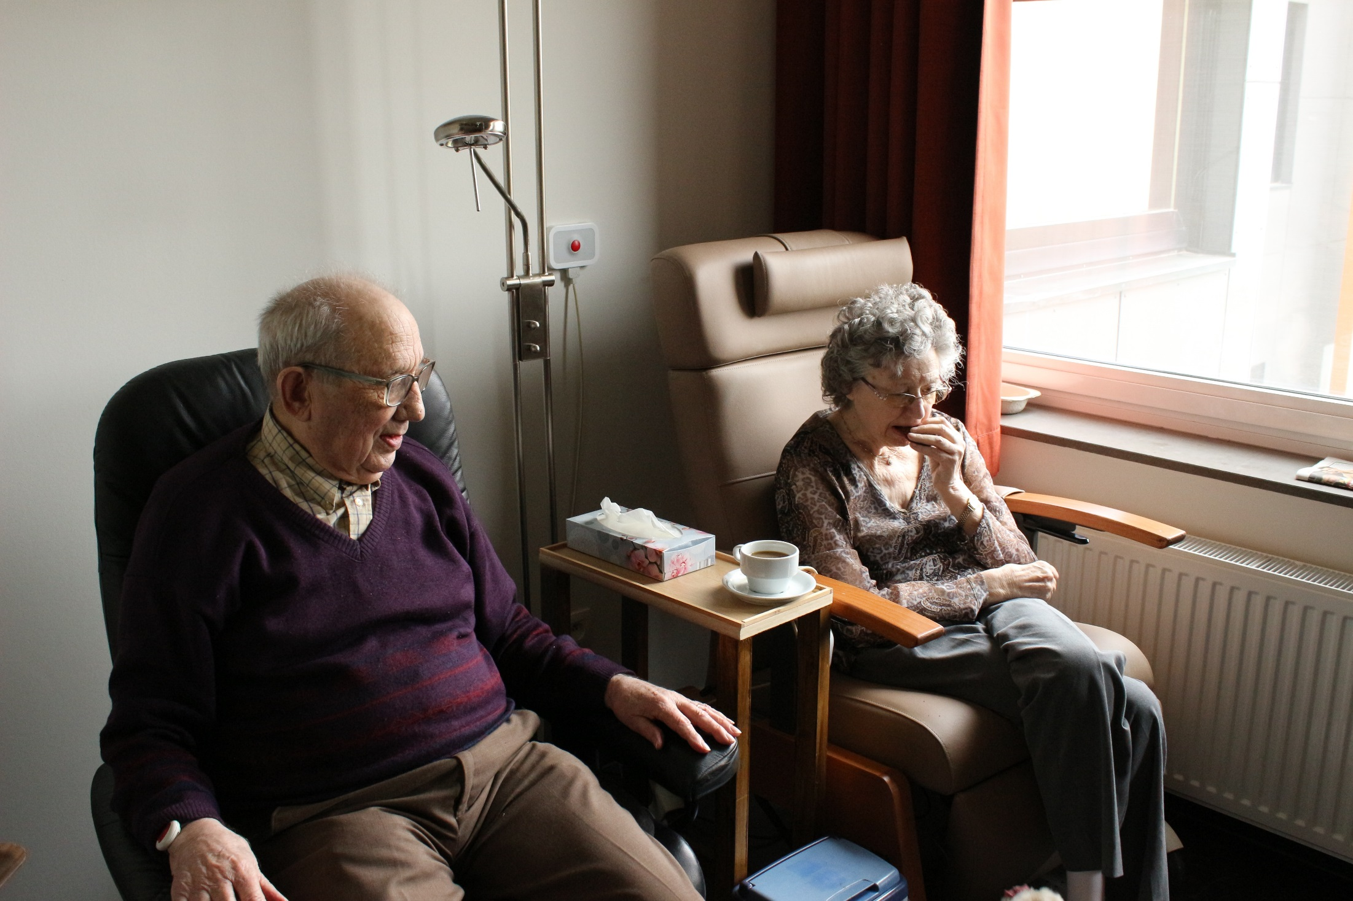
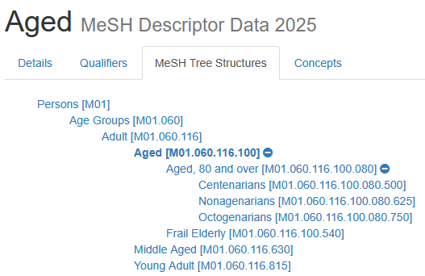
How would you describe the age of these people?
Photo by Elien Dumon on Unsplash

Slide 20
Any questions?

Slide 21
Exercise three: text mining to develop a search strategy
Worksheet at https://edshare.gla.ac.uk/id/document/8136
What insights can we learn from the number of articles published per year?
Frequency of articles published per year variable, but relatively stable. This is a small field of research and that will affect the approach to my search
Where might you chose to read, or publish in, on this topic?
Antimicrobial Agents and Chemotherapy
What authors might you follow or seek out their work?
Be careful with author names – these may not be unique persons and may simply share a surname and initial(s)
Are there any particular keywords or MeSH headings you would incorporate into a search strategy as a result of this search?
Look out for F0XDI6ZL63; this is the Unique Ingredient Identifier. Always search for the drug name, trade name, registry number and UNII

Slide 22
Text mining
PubMed PubReMiner: text mines PubMed
MeSH on Demand: identifies MeSH headings and articles from PubMed
The National Centre for Text Mining
Previously identified literature

Slide 23
Exercises
Worksheet at https://edshare.gla.ac.uk/id/document/8136
Exercise four and five: hands-on searching
Embase: key database for all MVLS subjects
BIOSIS Previous: useful for biomedical life sciences
Exercise six: citation searching
The BIOSIS platform, Web of Science, is useful for citation searching and analysis (Scopus is another alternative, and is a larger database)

Slide 24

Decorative image
Photo by Mishal Ibrahim on Unsplash

Slide 25

Support for your reviews
Workshop slides: https://edshare.gla.ac.uk/352
Inter-library loans: https://www.gla.ac.uk/myglasgow/library/interlibraryloans/
Literature search and review in MVLS: https://edshare.gla.ac.uk/78/
Systematic and scoping review resources: https://sway.cloud.microsoft/w8GFGP6RUhf8CjW1?ref=Link
Cochrane Interactive Learning: https://eleanor.lib.gla.ac.uk/search~S6?/.b4103063/.b4103063/1%2C1%2C1%2CB/eresourcee1004127~b4103063
Video guides to searching library databases: https://edshare.gla.ac.uk/278
Book an appointment to see me: https://www.gla.ac.uk/myglasgow/library/bookanappointment/cl/mvls/ or email paul.cannon@glasgow.ac.uk
  only after reviewing the self-help material, please!

Slide 26
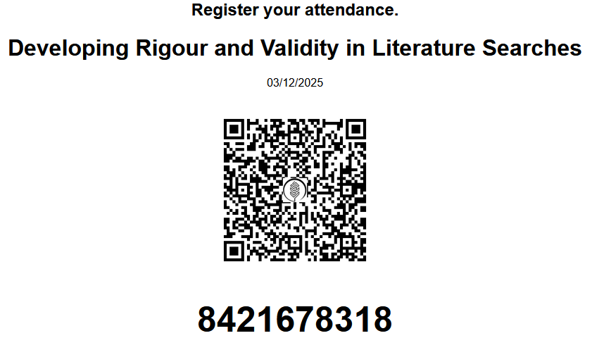
To register your attendance, scan the QR code with your mobile device. Alternatively visit the web portal https://glasgow.inkpath.co.uk/ and press "Complete" to use the numeric code.

