Slide 1



Student perspectives on belonging: human connections enabled by technology
Jenny Crow – PhD student / Digital Education Team Manager (MVLS)
Notes:
10mins

Slide 2

Background / methods
Background
28 online interviews
Approx 30 mins each
Phenomenography
Population

Slide 3
Staff presence
“I liked the induction videos that we all had to do, just like explaining who was who, that was really nice. I like that when you have lectures that people the tutors do a little induction about themselves as well, so that you kind of get to know them, […] but when you find someone, like a lecturer that's got the same similar interest to you, then you get even more keen to get going on that one, so that's really... You feel more drawn to that person, I guess. So, it's nice to know what they're area of interest is. I'm nosy, and also I do like to know what they like, if they do that little bit of personal stuff as well, it's quite nice. Just makes it feel a bit more friendly, a bit more personal” [INT02] “I'm not very connected [to staff], …I tried to email them and they don't really reply. Like, I've been waiting for reply for a month now, and three months with the other lecturer. So, quite a long time.” [INT15] “Yeah, I think belonging, when it's an online course, there is a lot of ... the staff do play a big role in that because they set the precedent for how welcome you feel, how connected you feel to them. […] I would see that their attitude and accessibility definitely helps you feel that you belong more. And they also play a role in encouraging students to engage with each other, which is a huge part of feeling that you belong to a class or you belong to a cohort of people.” [INT31]
Notes:
Inclusion, scaffolding, getting to know, response times.

Slide 4
Peer support
“With the students, we actually started forming like a WhatsApp group every semester and that was always very good, because if we weren't sure about something, we could ask it and it was…it was nice to connect on a personal level of like, "Oh, I'm really busy with work, I'm finding it really difficult maybe to get through this semester or through this week, or someone was sick." So, you give them a little bit of sympathy. So, I think that was always quite nice to feel connected in that way. And I know it was outside the university, but at the same time, I think the fact that it was kind of like outside university, it was maybe going with our colleagues for, I don't know, to the pub or something” [INT21] “I feel completely supported [by peers]. I think it's better now in the second year than it was in the first year, because we got know each other a little more. So whenever I post the question in the WhatsApp group, they help me and reply quite quickly. […] I felt less alone.” [INT15] “The group Zoom meetings probably, obviously, help you feel like part of team. So that face-to-face time is really important….It's nice when we show up for presentations, or interviews, or components of the course that we don't have to show up for. But people show up to show support for other students.” [INT27]
Notes:
Shared experience, getting to know one another, facial connections, receiving support, student spaces

Slide 5
Activities that created human connection
“the online Zoom meetings we've had and the kind of presentations that people had to give. Definitely you see people, you see their expressions and can have discussions that I think that helps in a sense of belonging” [INT01] “when we have courses that there's no interaction with the person at all, it just feels like while communicating with a computer bot, which is very, I mean, it definitely negatively impacted on my sense of belonging” [INT18] “Because of the group work, which we've had to carry out throughout the whole year, I've actually remained in contact with a few of the students that I've worked with. So, particularly two of them, which I've been working with since the beginning of the year, and we do exchange emails almost every day. So, there is a certain sense of support from the other students, but it's very limited to students that I've worked with.” [INT08] “I think feedback of any sort, by students or tutors. That actually it's nice if your voice gets heard and people don't have to agree with you at all, but it's nice that actually at least people take the opportunity to kind of criticise or compliment or whatever. And I think that, for me, increases my sense of belonging. If you do your weekly task and you don't get any comments then that you think, "Well, am I writing rubbish or is it because people are just not interested?" So that can be quite deadly” [INT01]
Notes:
Synch, active learning, group work, feedback / scaffolding

Slide 6
Barriers to participation
“you're trying to squeeze this into a full-time job and all the other things that life throws at you, sometimes your effort could be more, but you just don't have any time” [INT07] “And then the other thing about the technology it's... And it's not the technology, I suppose, but just the time zone difference and we can't do anything about that. So, I mean, sometimes there have been things that, and I guess this may not... Sometimes there have been the instructor will say, "Oh, there's this presentation at this time." And it's always... And lots of times it's maybe 10 o'clock in the morning for you guys. Well, that's like four o'clock in the morning for me, at least.” [INT03] “So in our first class, it was in [course name], there was one student that's like, "Let's do a WhatsApp group." So we all had a WhatsApp group and we supported each other. We said, "Oh, where can we find this?" And somebody would like send a link…I like that I can put up a question and somebody will answer. And since everybody's in a different time zone, we would have somebody from who's awake, who reply to you randomly at 2:00 AM or something like that. So it felt good, it really felt good.” [INT12]

Slide 7
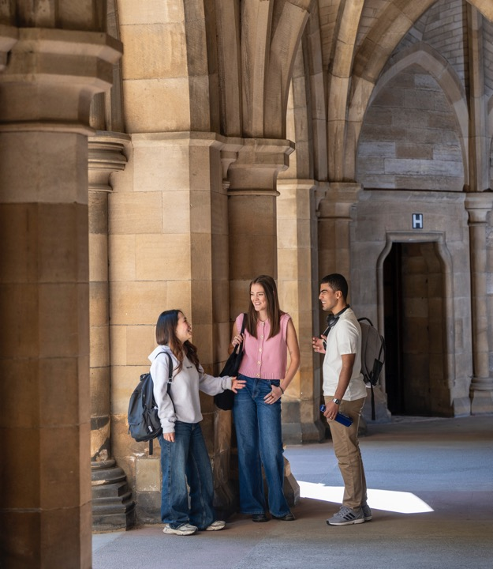
Lessons learned
Introductions (videos) staff & students
Live sessions
Group work
Replying to student interactions
Creating a community all voices valid
Students feeding into course evaluation
Being considerate of time zone and work / life balance for students
Spaces for students: peer connection
Alternative formats / flexible content

Slide 8
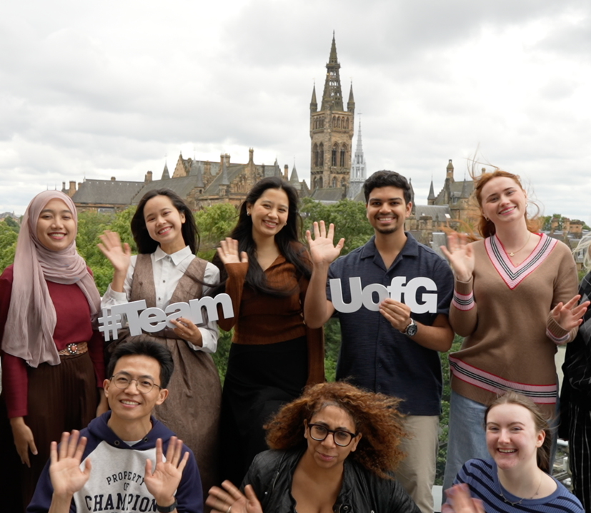
Thanks & questions
Jenny Crow: PhD student &
Digital Education Team Manager (MVLS)
Jenny.crow@glasgow.ac.uk
LinkedIn: jenny-crow-77581a16
PhD supervisors:
Prof Keith Smyth, Dr Vicki Dale, Prof Jo-Anne Murray & Dr Michelle Bellingham​

