Slide 1



Student perspectives on belonging: human connections enabled by technology
Jenny Crow – PhD student / Digital Education Team Manager (MVLS) – jenny.crow@glasgow.ac.uk
Notes:
10mins

Slide 2

Background / methods
Background
28 online interviews
Approx 30 mins each
Phenomenography
Population

Slide 3

Phenomenography
“study of the limited number of qualitatively different ways in which various phenomena […] are experienced, conceptualized, understood, perceived, and apprehended”.
Marton (1994, p.4424)
Constructivism and interpretivism
Cousin (2008, p.192), Stenfors-Hayes et al. (2013)

Slide 4

Belonging
“students’ perceived social support on campus, a feeling or sensation of connectedness, and the experience of mattering […] accepted, respected, valued by, […] faculty, staff and peers.”
Strayhorn (2018, p.4)
Examples of factors impacting belonging:
Ethnicity (Strayhorn, 2012)
Disability (Rovai, 2001)
Gender (DiGiacomo et al., 2023)
Postgraduate students (Moore et al., 2025)
Notes:
Sense of belonging statement university of Edinburgh https://www.ed.ac.uk/students/academic-life/community-and-belonging from 2024

Slide 5
Question: What ways do you try to encourage belonging with your students?

Slide 6
How students manage their engagement
“you're trying to squeeze this into a full-time job and all the other things that life throws at you, sometimes your effort could be more, but you just don't have any time” [INT07] “And then the other thing about the technology it's... And it's not the technology, I suppose, but just the time zone difference and we can't do anything about that. So, I mean, sometimes there have been things that, and I guess this may not... Sometimes there have been the instructor will say, "Oh, there's this presentation at this time." And it's always... And lots of times it's maybe 10 o'clock in the morning for you guys. Well, that's like four o'clock in the morning for me, at least.” [INT03] “So in our first class, it was in [course name], there was one student that's like, "Let's do a WhatsApp group." So we all had a WhatsApp group and we supported each other. We said, "Oh, where can we find this?" And somebody would like send a link…I like that I can put up a question and somebody will answer. And since everybody's in a different time zone, we would have somebody from who's awake, who reply to you randomly at 2:00 AM or something like that. So it felt good, it really felt good.” [INT12]

Slide 7
Staff presence at key stages of the course
“[…] I think even with induction, if you have more FaceTime, or on-the-phone discussion, and if they could maybe just point out exactly what to do, I think that would make it a little easier.” [INT25] “[…] the staff do play a big role in that because they set the precedent for how welcome you feel, how connected you feel to them. […] Yeah, I would see that their attitude and accessibility definitely helps you feel that you belong more. [INT31] “I think completely [inclusive of different voices] […] Well, for example, when we have live lessons, I think the teachers, the lecturers don't make any difference between people and their beliefs. So, for example, I'm from [a country outside the UK], and I know I have an accent, but they don't judge me for that, for example […]” [On how does this impact the participant’s sense of belonging] “Very much. Yeah, in a good way.” [INT15]
Notes:
Inclusion, scaffolding, getting to know, response times.

Slide 8
Differing staff presence
“I think just engaging regularly, offering to do stuff, whether it's Zoom calls rather than just recorded stuff. Probably showing a bit more of a human side to them [staff] as well. Actually like making jokes about whatever, their personal lives when they're posting. It takes away that kind of tension of that formality, I guess. So it opens you up a little bit to them.” [INT11] “[…] there's quite a big difference in the modules in terms of how they're run. […] So the two differences, one of them is the course tutor of that particular module. So I've had two modules where the course tutor has been extremely present. It's been very interactive. And as a result of that, it's been actually great fun. […] when we had the very interactive course tutor, the students themselves were also more interactive”. [INT01] “[…] sometimes you never hear anything at all when you're like... Not a, "Why am I doing it?" You're doing it for your own learning, but is anyone seeing it? If I'm putting something really, really wrong or down the wrong path is anybody telling me.” [INT13]
Notes:
Inclusion, scaffolding, getting to know, response times.

Slide 9
Building connections with staff and peers
“Disconnected, I suppose, in a sense that I couldn't put my hand in my heart and say, yeah, a hundred percent I felt belonged in that respect. It's not until those moments of actually seeing someone's face. And I'm not talking about Moodle where you write an email or feedback, which is again written, but I think having a little bit more sort of FaceTime, even through technology, would've increased a sense of belonging.” [INT29] [On experience at start of the programme] “It was good. […] once I got accepted and the induction started, it was then transferred to the student support team, who phoned me within the first couple of weeks and made sure I was doing okay.” [INT17] “I think they [staff] make a good effort really to kind of try and involve people and particularly the group discussions on the chat. […] with the messaging boards, they try and encourage discussion between people as well as just people answering questions on their own. So you're interacting with other members who are other students who are also doing the course and trying to foster kind of good relations between students. I can't think of any examples of negative experiences with regards to belonging.” [INT26] “Not as connected as I should be, I feel. Year one, no problem. Year two, I'm struggling to get answers to emails. I'm struggling to get quite everything answered basically. There seems to be huge delays in the programme.” [INT04]
Notes:
Sych over email and feedback human connection. Live conversation. Transitions to post grad but also ODL.
Staff involvement, forgotten about students?

Slide 10
Question: What ways are you present in your courses?

Slide 11
Methods of encouraging peer support / Peer support
“[…] I think having the initial video introductions so you know who everybody is and the regular Zoom meetings with your classmates, just to sort of see your classmates' faces and get a bit of a feel for who they are, what their interests are, I think that really helps actually because I think, particularly when you're doing something part time, to keep that momentum up, it's really good to just have someone else who's in the same position to chat about it to […] feel like you're all in it together […] you're not alone with that stress” [INT05] “The group Zoom meetings probably, obviously, help you feel like part of team. So that face-to-face time is really important. […] It's nice when we show up for presentations, or interviews, or components of the course that we don't have to show up for. But people show up to show support for other students.” [INT27] “With the students, we actually started forming like a WhatsApp group every semester and that was always very good, because if we weren't sure about something, we could ask it and it was... […] it was nice to connect on a personal level of like, "Oh, I'm really busy with work, I'm finding it really difficult maybe to get through this semester or through this week, or someone was sick." So, you give them a little bit of sympathy. So I think that was always quite nice to feel connected in that way.” [INT21]

Slide 12
System affordances / Flexibility of content
“I don't think it's negatively impacted my sense of belonging, but one thing I do think, there's loads of different platforms. So I don't know if we're on Teams or if we're on Moodle or we're on Zoom.” [INT04] “So, Moodle, actually, I know that sounds like a really weird thing to say, I've never used Moodle before this course. But as soon as you log on and you see University of Glasgow, you do feel like that you are part of it and it's super easy to use.” [INT02] “[…] I know that the material is sort of given in lots of different formats. So I think even if somebody did have an additional need, there's no reason that we would know about it or notice, you know, because I think, as I say, the format of the material, it is given in so many different formats that it is really accessible. […] Well, I suppose positively [impacts on sense of belonging].” [INT05] “I think it's actually pretty cool because for example, I can go on a trip, just take my tablet and be doing school in the airport, anywhere. […] I think it's kind of revolutionary honestly, because I was looking for just online master's degrees from everywhere […] It helps people who work achieve their goals because sometimes you have to leave everything just to do a master's abroad.” [INT12]

Slide 13
Conversation enablers and barriers
“[…] technology that allows for synchronous communication. So specifically we've used Zoom, we've used Teams, we've used any of those technologies that allow us to have interactive discussions or... So that would be the number one [for belonging], which I'm pretty sure that that would be number one for most people.” [INT06] “I think there are people from lots of different countries and lots of different backgrounds and lots of different ethnicities. I'm sure different sexualities and things that hasn't come up on the programme. And it feels like everybody's voice is given equal value, particularly by the tutors. They respond to everybody equally, I think, and encourage participation from everybody. […] I mean, I guess I like to belong to a place that is inclusive.” [INT26] “I would say some belonging, but not too much. […] A few [live sessions] I wasn't able to attend because of the time constraints. I mean, that's the main issue with me, is that the time difference is a huge problem. Many times there were some tutorials which for me which I attended at 2:00 in the morning my time, but they really become very inconvenient, especially if someone is working, and then you have to get up and start work at 6:00.” [INT25]
Notes:
Time zone more challenge the great the time zone difference
Aychn did overcome barrier of time zone, whatsapp groups…but not 100% due to live questions, 2nd language, being in the same place at same time. Assessment questions sometimes needed live support.

Slide 14
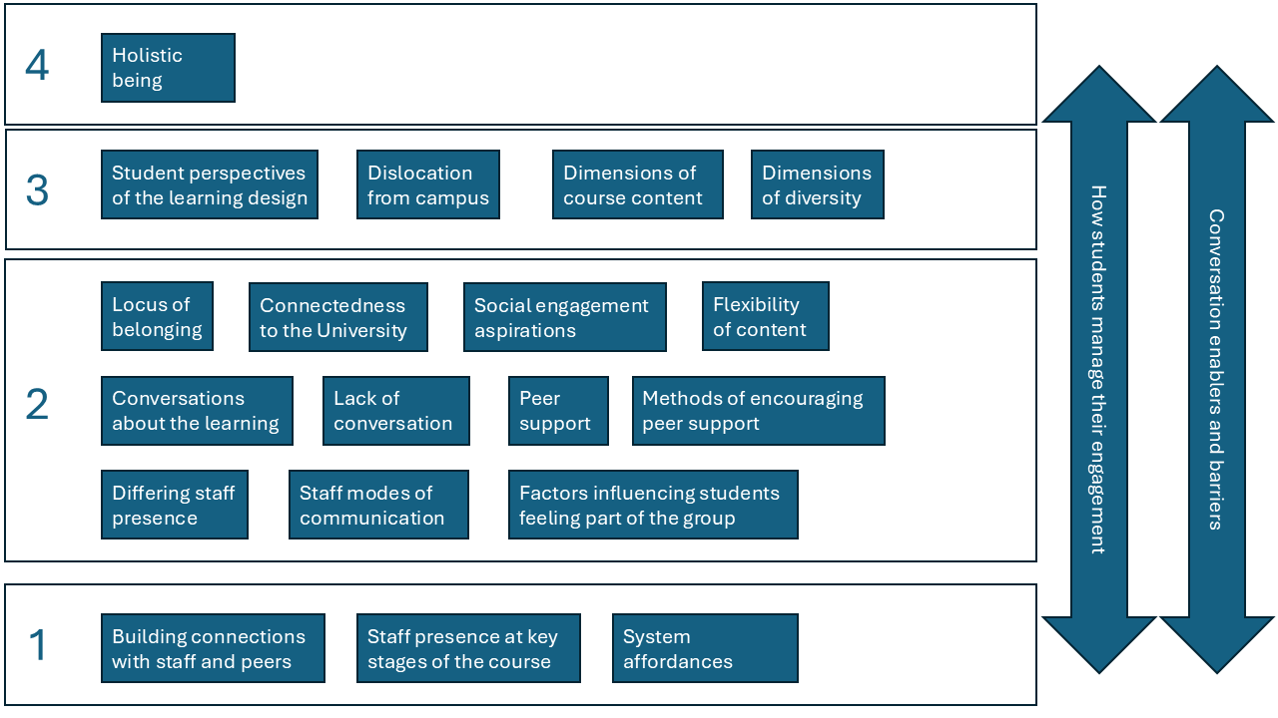
Outcome Space

Slide 15
Outcome space - Student
Factors that can Lead to ODL students having a High Sense of Belonging | Factors that can Lead to ODL Students having a Moderate Sense of Belonging | Factors that can Lead to ODL Students having a Low Sense of Belonging
Fully participates in live sessions Has autonomy in their learning experience Proactive leader in their peers’ learning experience Seeks to have conversations about the subject matter area Desires to make connections and get to know staff and peers Feels supported by staff Has connection with one or more members of staff Active participant in the overall institutional community Feels belonging to their cohort Feels belonging to the overall institution Is adaptable to imperfect conditions for learning | Participates in peers’ learning experience Infrequently participates or limited participation in live sessions Feels supported by staff Feels a limited connection with staff Feels some belonging to their cohort Infrequent participant in the overall institutional community | Does not attend the live sessions Does not participate in peers’ learning experience Has limited autonomy in their learning experience In-frequently participates in the learning experience Is not adaptable to imperfect conditions for learning Does not feel confident in sharing their perspectives as part of the learning Does not feel belonging to their cohort Does not have connection with any staff Feels limited support from staff Does not feel connected to the institution Does not participate in the overall institutional community

Slide 16
Outcome Space - Staff
Factors that can Lead to Staff Creating a High Level of Belonging with their ODL Students | Factors that can Lead to Staff Creating a Moderate Level of Belonging with their ODL Students | Factors that can Lead to Staff Creating a Lower Level of Belonging with their ODL Students
Gets to know and is known by the online students Proactively leads the student learning experience Builds community on the programme Provides regular opportunities for online students to meet staff and peers for discussion Provides active learning opportunities Is considerate about time zones Provides consistent support for students during their online studies Provides a visible point of contact for students with an oversight to all the courses in a programme Provides regular opportunities for the online students to engage with the wider university | Provides limited opportunities to get to know the students or is known by the online students Is inconsistently present in the student learning experience Infrequently provides opportunities for online students to meet staff and peers for discussion Provides inconsistent support for students during their online studies | Is not known by the online students Does not encourage the students to participate in the learning experience Is not present in the student learning experience Does not provide opportunities for online students to meet staff and peers for discussion Does not consider time zones Gives greater priority to the on-campus student learning experience Does not provide opportunities for the online students to engage with the wider university

Slide 17
Outcome Space - Institution
Factors that can Lead to Institutions Creating a High Level of Belonging with their ODL students | Factors that can Lead to Institutions Creating a Moderate Level of Belonging with their ODL students | Factors that can Lead to Institutions Creating a Lower Level of Belonging with their ODL Students
Offers flexible online support that can adapt around the online students’ other commitments and geographical location Provides systems that support synchronous and asynchronous communication Provides the online students with regular opportunities to be part of extracurricular activities Provides processes and systems that are accessible, easy to navigate and intuitive Streamlines information so that information is tailored to the online students Seeks to connect online students with the University brand and values Encourages student feedback processes Provides content platforms that allow content to be consumed in different flexible ways | Infrequently offers online support that is not adaptable around the online students’ other commitments and geographical location Provides processes and systems that are somewhat accessible, somewhat easy to navigate and are somewhat intuitive Provides online extracurricular activities Communicates about the University brand and values Provides student feedback processes Provides content platform(s) that enable content to be consumed in a limited amount of ways | Does not offer online support to students Provides processes and systems that are not accessible, difficult to navigate and are not intuitive Does not provide systems that support synchronous and asynchronous communication Does not share about university brand and values Does not provide online extracurricular activities All students receive the same information from the university at all times Does not provide student feedback processes Provides a content platform that enables content to be consumed in one fixed format

Slide 18

Lessons learned
Introductions (videos) staff & students
Live sessions
Group work
Replying to student interactions
Creating a community all voices valid
Students feeding into course evaluation
Being considerate of time zone and work / life balance for students
Spaces for students: peer connection
Alternative formats / flexible content

Slide 19
Question: Is there anything you are going to put into practice?
Have you got any additional top tips for encouraging belonging?

Slide 20
References
Cousin, G. (2008). Strategies for researching learning in higher education: an introduction to contemporary methods and approaches. Routledge.
DiGiacomo, D. K., Usher, E. L., Han, J., Abney, J. M., Cole, A. E., & Patterson, J. T. (2023). The benefits of belonging: Students’ perceptions of their online learning experiences. Distance Education, 44(1), 24-39. https://doi.org/10.1080/01587919.2022.2155615
Marton, F. (1994). Phenomenography. In T. Husén & T. N. Postlethwaite (Eds.), The International encyclopedia of education (2nd ed., Vol. 8, pp. 4424-4429). Pergamon ; New York : Elsevier Science.
Moore, A., Barreto, A., Bridi, L., Dunn, Z. S., Taylor, V., & Vanni, A. (2025). How Online Learning Environments During COVID-19 Impacted University Students’ Sense of Belonging: A Qualitative Analysis. The journal of educators online, 22(1). https://doi.org/10.9743/JEO.2025.22.1.16
Rovai, A. P. (2001). Building classroom community at a distance: A case study. Educational Technology Research and Development, 49(4), 33-48. https://doi.org/10.1007/BF02504946
Stenfors-Hayes, T., Hult, H., & Dahlgren, M. A. (2013). A phenomenographic approach to research in medical education. Medical Education, 47(3), 261-270. https://doi.org/10.1111/medu.12101
Strayhorn, T. L. (2012). College students' sense of belonging: a key to educational success for all students. Routledge.
Strayhorn, T. L. (2018). College Students' Sense of Belonging [paperback]. Routledge.

Slide 21
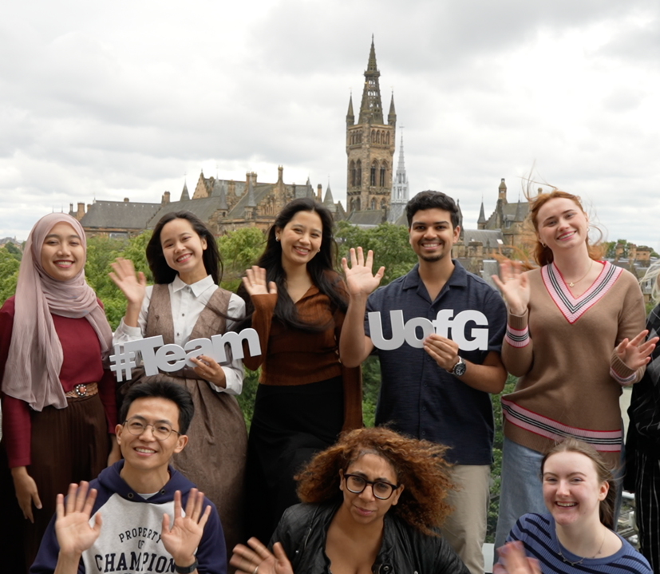
Thanks & questions
Jenny Crow: PhD student &
Digital Education Team Manager (MVLS)
Jenny.crow@glasgow.ac.uk
LinkedIn: jenny-crow-77581a16
PhD supervisors:
Prof Keith Smyth, Dr Vicki Dale, Prof Jo-Anne Murray & Dr Michelle Bellingham​

