Slide 1

Sources of secondary data for Social Sciences and guides to secondary data analysis

Slide 2
Secondary data sources and analysis
The slidedeck includes:
Sources on doing secondary data analysis – case studies, videos and practice datasets
Ethical considerations when using secondary data
Guides on getting started using data from the UK Data Service
Major national databanks and key open-source data
Specialist collections of data (subscriptions available from the University of Glasgow) including data on countries, demographics, companies (including financials), consumers, markets and industries.
Sources of data from published literature

Slide 3
What is secondary data?
Secondary data is often defined in contrast to primary data. It is most easily defined as data collected by someone else for a particular purpose. Secondary data analysis is the reuse of research data for purposes other than that for which it was originally collected, or as the UK Data Service captures it ‘asking new questions of old data’
Who collects data and makes it available?
Official agencies (governments, EU), international organisations or cooperatives (OECD, WHO, World Bank, IMF, WTO,UN, ILO, NATO etc.), market research agencies, individual researchers, companies who create or aggregate (and sell) data for research or commercial purposes…
Asking yourself this question helps you to start to think about where to look for the data you need.

Slide 4
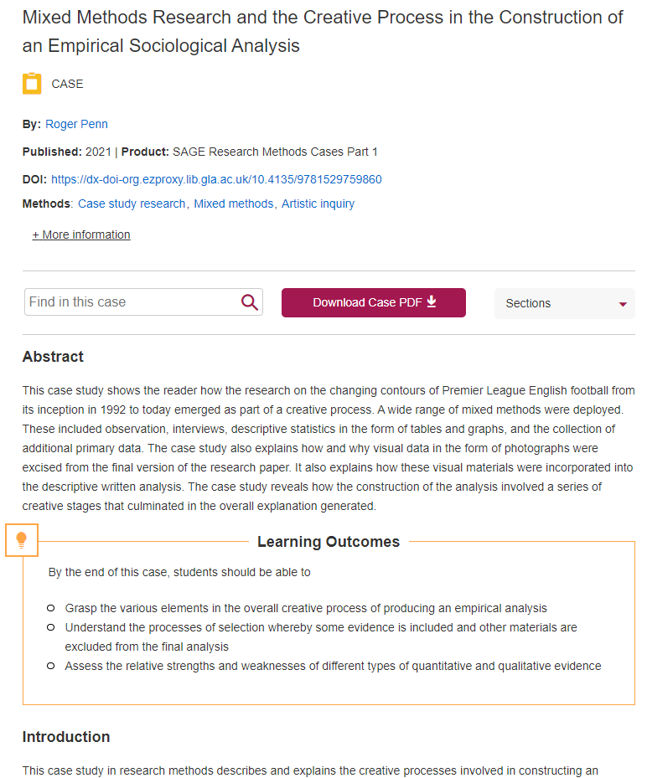
SAGE Research Methods – information on using data
Search on SAGE Research Methods database for "secondary data" to explore:
definitions in encyclopedia and reference works;
discussion in books and journal articles
watch videos and read case studies from researchers on how they use(d) secondary data, what datasets they used, lessons learned and tips for other researchers
TIP: Use the Content Filter when you run a search to look at different types of source (e.g. video, case study etc.)

Slide 5
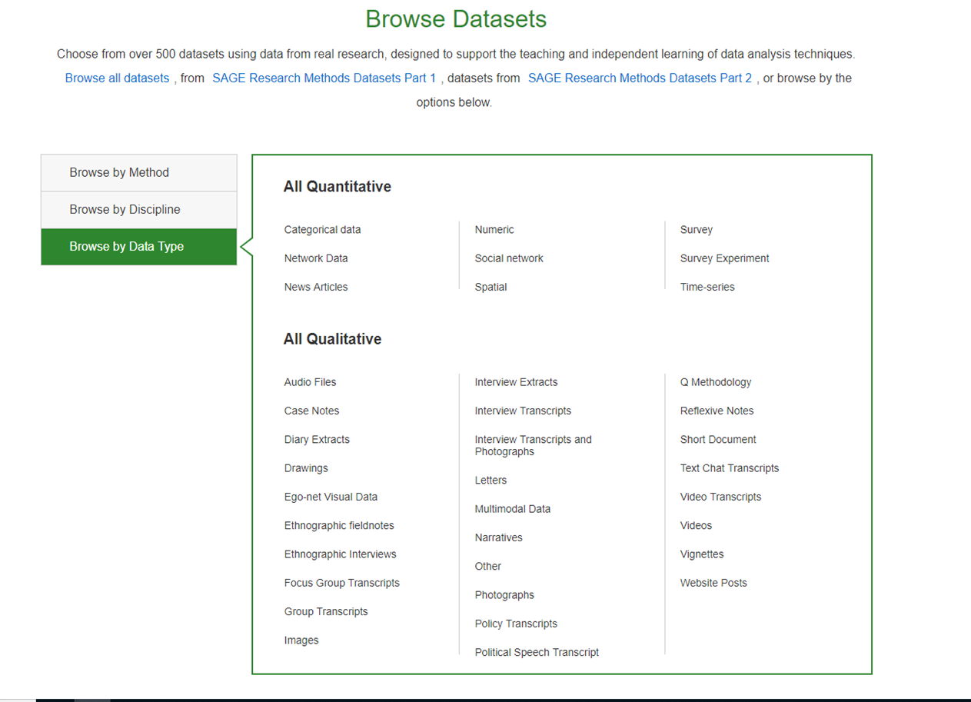
SAGE Research Methods - datasets
SAGE Datasets provides guidance and sample datasets to help you practice using secondary data.
You can browse by:
Method (survey research, SSPS, transcription ...)
Discipline (business and management, health, sociology…)
Data type (categories of quantitative and qualitative data)

Slide 6
Ethical practices when using secondary data
There are important ethical considerations in all data collection and use.
Data repositories often host open data as well as safeguarded or sensitive data which may only be available on request and after ethical approval. Information on what data is open and what is restricted is usually very clear and guidelines are provided. This guide refers students to data sources that are available to use for assignments and dissertations and which may require minimum registration.
Registration and agreeing to the access conditions are part of your ethical responsibility in secondary analysis.
Conditions may include what to do with any data you have downloaded for your project (data destruction)
Cite the data you use

Slide 7
Citing data and following guidance from the College of Social Sciences
Data is a source of information, and you must cite it as you would any other source.
Data repositories will provide citation guidance for their datasets. See the UK Data Service pages for information.
For your research project, you must follow the guidance of your school or the College of Social Sciences.
The College has created webpage guides on research ethics which you may want to refer to:
https://www.gla.ac.uk/colleges/socialsciences/students/ethics/

Slide 8

Key sources of open data
The next few slides will provide information on sources for the types of data you may require for your research.
Major qualitative and quantitative datasets(longitudinal surveys, census data etc.)
Country data – demographics, trade, economic development, education, industry, SDGs, health
Business data – macroeconomic and financial market data; company information
Social surveys – attitudes, well-being, justice, inequality, citizen engagement
Image by Chaitawat Pawapoowadon from Pixabay

Slide 9

UK Data Service
The principal source of open social research data is the UK Data Service. The data is provided to support research in the UK and includes large quantitative and qualitative datasets.
Some of the data is fully open – requiring no authentication or registration. However, as a University of Glasgow student, you can login with your UofG credentials and register to download any non-commercial data (i.e. data for study or dissertations). Registration is quick, easy and free.
There are three levels of data in the service – open data, safeguarded data and controlled data. As a Masters or undergraduate student, you are advised to use open and safeguarded data only. Information on how to download and order data.
You can also browse collections by theme (crime, economics, labour, politics, poverty etc.) or by data type (surveys, longitudinal studies, international microdata, qualitative/mixed methods etc.)
Photo by NASA on Unsplash

Slide 10

Using data - UK Data Service guidance for student dissertations and research
They provide comprehensive guidance on using data for dissertations or projects. This is collected on their Student guide to the UK Data Service
Tutorials on using survey data
  Introduction to survey data – a self-paced tutorial on using survey data – how to find it and how to create tables and graphs.
  Introduction to longitudinal data – self-paced tutorial on key features and issues using longitudinal data and how to analyse it
  Introduction to aggregate data – self-paced tutorial on aggregated data – how to find it and use it
Qualitative data and secondary analysis
What is UK Census data and how do you use it?
Photo by Anne Nygård on Unsplash

Slide 11
UK Data Service – other providers
Ready-made statistics
Details of websites that contain either ready-made statistics or information you may find useful about a particular area.
International data
Data available from the websites of major international organisations, a comprehensive list of national statistics institutes and region specific information and data resource websites.
Qualitative data
International data archives holding or seeking to acquire qualitative data in their collections.
Data archives
Social science data archives across the world. You can search for data using their online catalogues.
Open data
Open data is becoming increasingly available throughout the world, released by governments as part of the transparency agenda.
Question banks
There are a growing number of online tools allowing users to search for questions used on major national and cross-national surveys, both for research purposes and reuse of those questions.

Slide 12
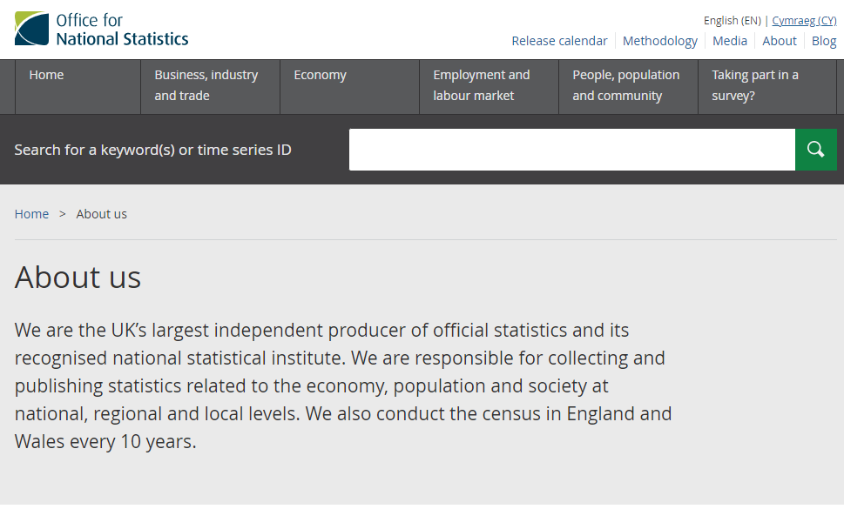
Office for National Statistics (ONS)
ONS main responsibilities is collecting, analysing and disseminating statistics about the UK's economy, society and population.

Slide 13
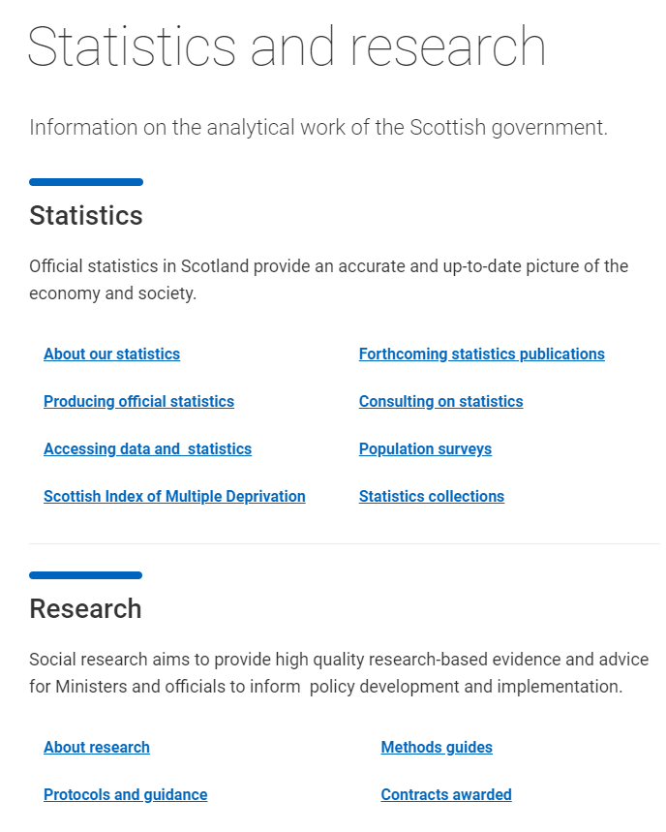
Scottish government statistics and research
Accurate, current statistics on the Scottish economy and society and high-quality social research. Use filters to browse categories of statistics or search for specific datasets.

Slide 14
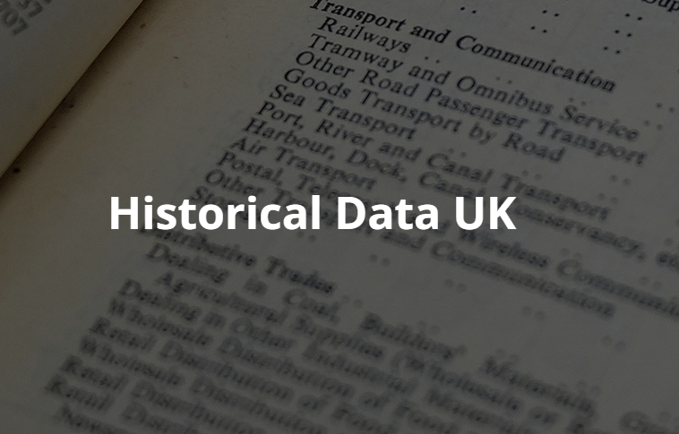
Historical data UK
A repository of data developed by the Bank of England, Economic Statistics Centre of Excellence (ESCOE) and the ONS.
Focus is macroeconomic and financial market data. Includes key official statistical publications produced since the 19th Century up to 2010.
Includes:
Headline macro data
National accounts; financial accounts and balance sheets
Industry and supply
Population and employment; households and housing
Capital and productivity
Fiscal data
Financial markets; money, banking and credit
And more….
https://www.escoe.ac.uk/research/historical-data/

Slide 15
UN Data
UNdata is a web-based data service for the global user community.
Users can search and download a variety of statistical resources compiled by the United Nations (UN) statistical system and other international agencies. ​
The numerous databases or tables collectively known as "datamarts" contain over 60 million data points and cover a wide range of statistical themes including agriculture, crime, communication, development assistance, education, energy, environment, finance, gender, health, labour market, manufacturing, national accounts, population and migration, science and technology, tourism, transport and trade.​
Statistics are available at granular level e.g. women’s share of the labour force, or part-time employment rates by country worldwide…

Slide 16
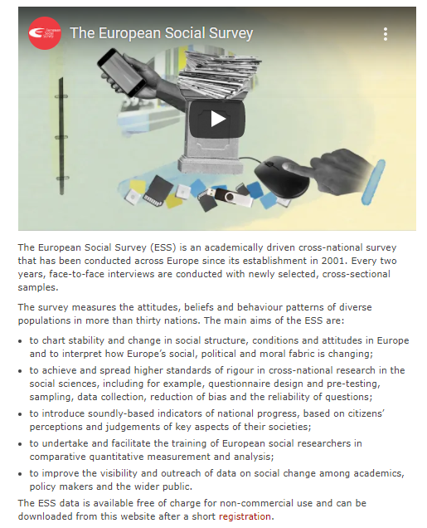
European Social Survey
The ESS data is available free of charge for non-commercial use and can be downloaded after registration.​

Slide 17
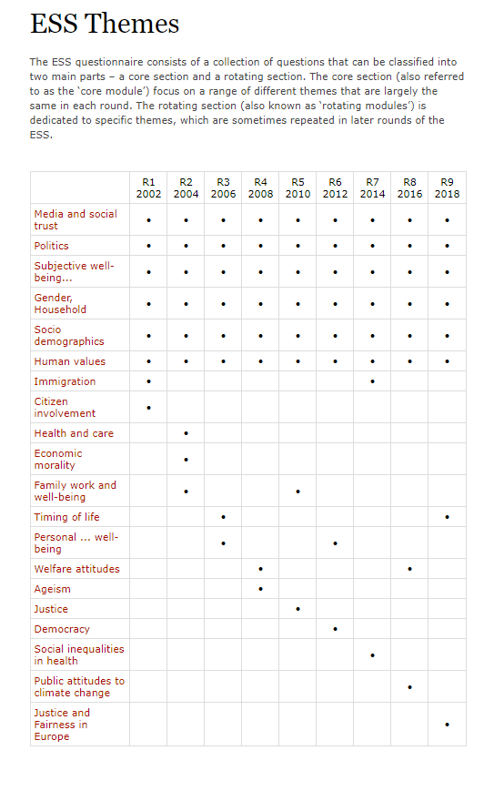
European Social Survey - data
Data is arranged by module/theme with links to the accompanying datasets. Data on some key themes has been collected since the start of the survey.

Slide 18
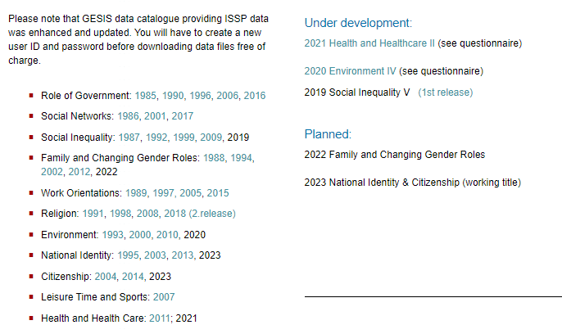
International Social Survey Programme
ISSP https://issp.org/ is a cross-national collaboration programme of annual surveys on diverse topics relevant to social sciences, undertaken by participating nations – Australia, Germany, Great Britain and the US.
For example, you can access questionnaires for each country ​as well as overviews of the survey, background documents and datasets.

Slide 19
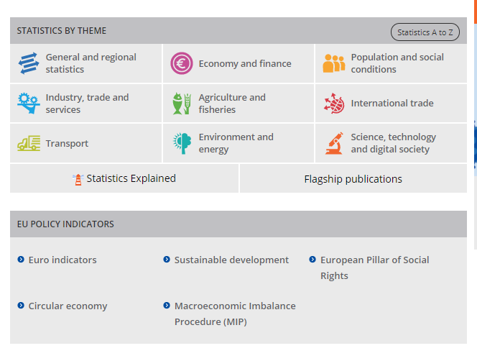
EUROSTAT
Eurostat is the statistical office of the European Union and the principal source of European statistical data. The data is open and freely available to access and use.
The data is comprehensive and wide ranging. You can export data and create your own datasets
There are guides, videos and online tools to help you get started, explaining what data is available, how to quickly search for the data you need and how to use the data extraction tools.​ See the statistics4beginners resource for help understanding statistics.

Slide 20
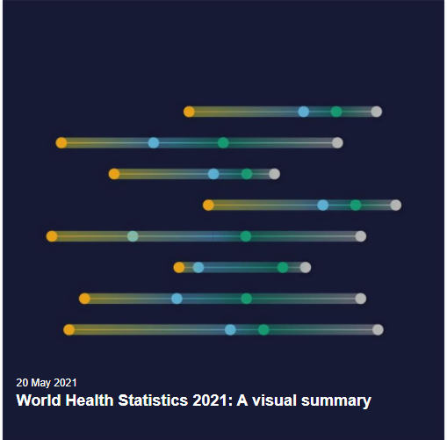
WHO data platform
Global health datasets and collections:
  Global health estimates (causes of death and disability globally by region, country, age, sex and income group)
  Health Sustainable Development Goals (SDGs) tracking progress towards health and well-being for all ages
  Mortality database (visualizations of mortality by country, year, age, sex and cause of death
  Global Health Observatory (data repository for all 194 member states with over 1000 health indicators)
  …plus reports and analysis

Slide 21
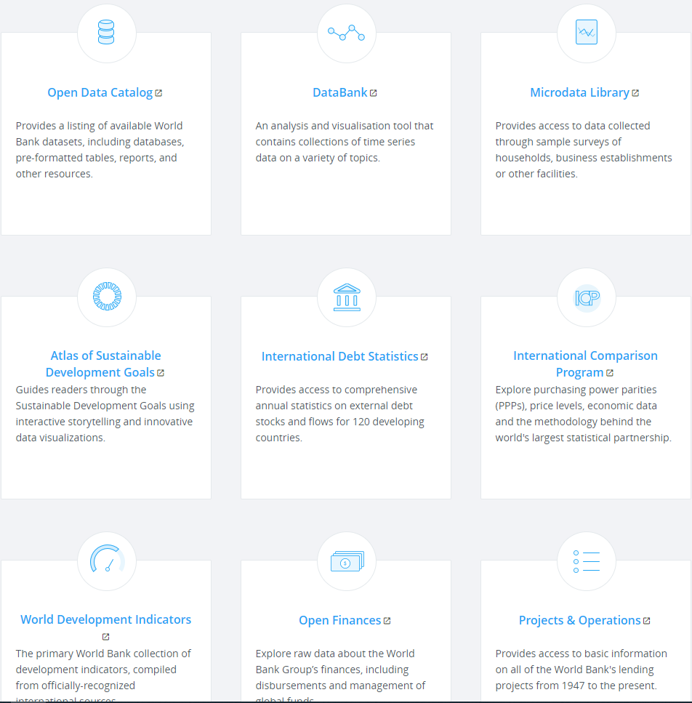
World Bank open data
Global economic data on countries worldwide, free to use with minimal restrictions . Browse by country or economic development indicator or use the Databank, an online data analysis and visualisation tool.​
Indicators include social protection and labor, gender, poverty, social development etc.

Slide 22

Sources of data – key open data – Urban Big Data Centre (UBDC)
The UBDC is based at the University of Glasgow and promotes the use of big data and innovative research methods to improve social, economic and environmental well-being in cities.
Like other data repositories there is open data (which anyone can access) and safeguarded data which requires approval. Open access urban-related data includes commercial data, governmental data, transportation data and social media data.
To access, on the toolbar choose Data > Data Collections > Open Data Catalogue. Search or browse the datasets.
You do not need to register to use the open data, but UBDC ask that you email ubdc@glasgow.ac.uk to say what data you have used so that they can understand how and what data is used for.

Slide 23

consumer research data centre (CRDC)
The CRDC is funded by the ESRC and works with consumer organisations to make their data available to researchers.
They host open data and safeguarded data. You must register first to access the open data. Registration is quick and easy. Fully open data, suitable for student research projects is available here.
Browse or search the datasets by choosing Research from the toolbar. N.B. you can limit all results to Open data using the filter on the left.​
​

Slide 24
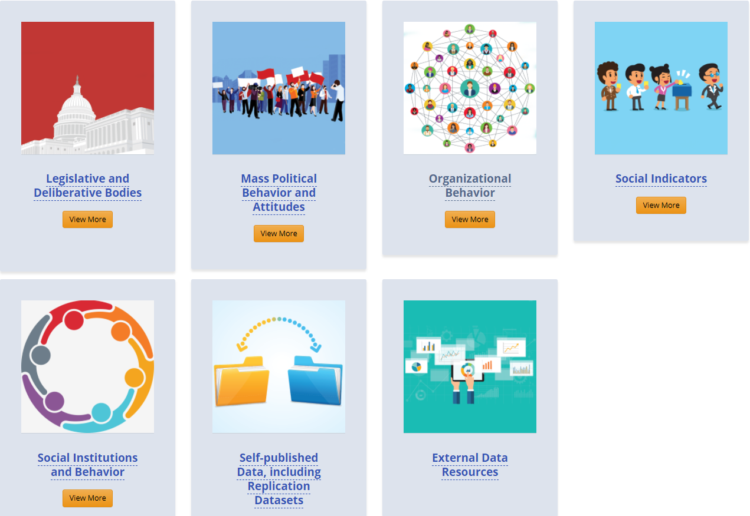
Subscription databases – ICPSR
ICPSR is a consortium of universities and research organizations which supports data analysis through training and hosting datasets. ICPSR maintains a data archive of more than 250,000 files of research in the social and behavioral sciences. Log in with your GUID and register to use and download data.​
Most of the data is free to use to members (some is openly available to non-members). There is some resricted data which requires specific conditions for access. ​
See the ICPSR YouTube Channel for useful videos on working with data.​

Slide 25
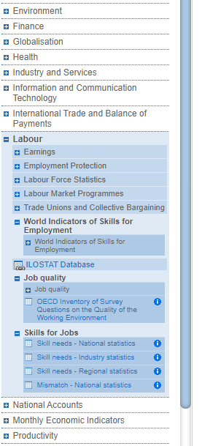
OECD iLibrary and OECD Data Explorer
Books, papers and statistics of the OECD covering Agriculture & Food, Development, Economics, Education, Employment, Energy, Environment, Finance and Investment, Governance, Industry and Services, Nuclear Energy, Science and Technology, Social Issues / Migration / Health, Taxation, Trade, Transport, Urban, Rural and Regional Development. Log in with your GUID and password and register to make full use of the data and reports.​
As a University of Glasgow student, you may use the information and data on the OECD services for academic purposes.​
OECD iLIbrary user guide.​

Slide 26
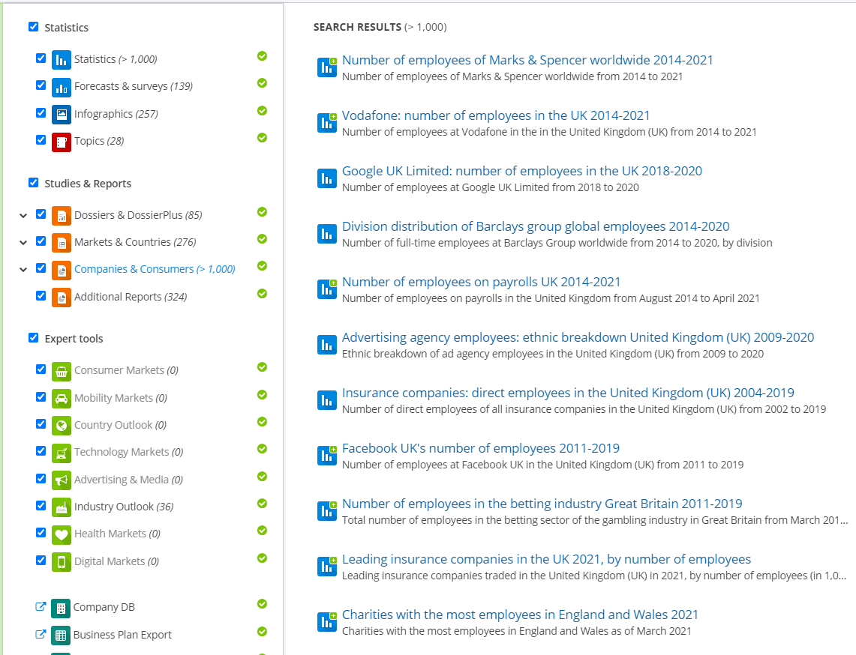
Subscription databases – Consumer, industry and markets data - Statista
​Statista- statistics and reports on markets, industries, brands and companies, consumers, countries, politics and societies worldwide.
Data is provided via subscription and is available on/off campus via GUID for UofG staff and students.

Slide 27
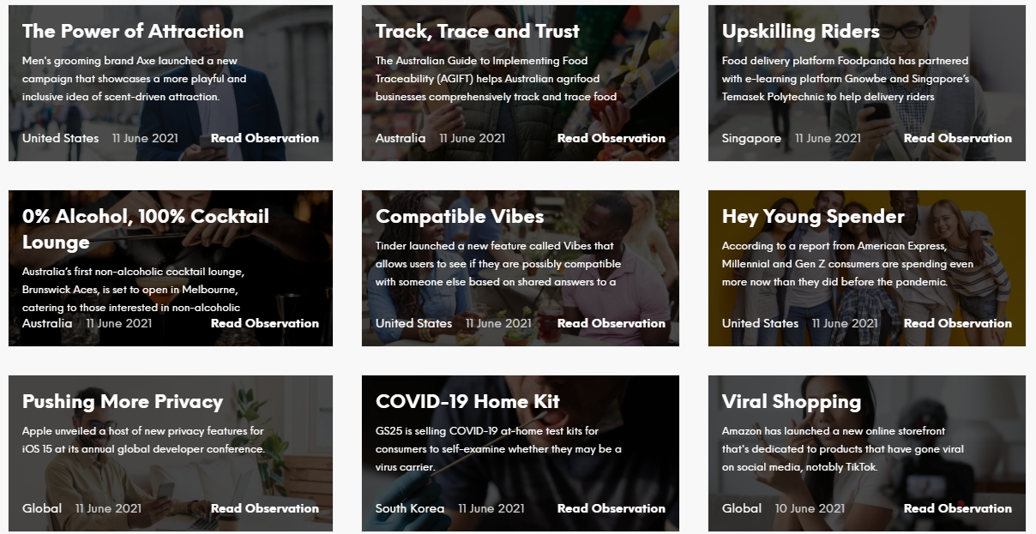
Subscription databases – consumer and market information – Mintel Academic
Market Research database of consumer research. Reports include quantitative and qualitative research data.
Reports include market, consumer, brand, company and data sources
The Library subscribes to UK – brands, food, lifestyles, clothing and footwear, e-commerce, travel; China – retail intelligence; Europe – retail intelligence.​

Slide 28
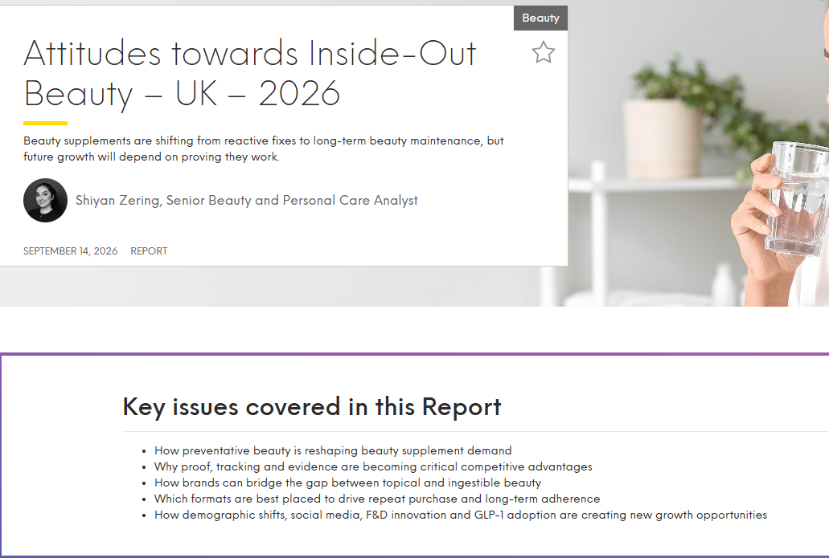
Mintel Academic – example of a report (Attitudes towards inside-Out Beauty 2026)
Reports include market, consumer and brands data with analysis of existing markets, trends and forecasts. Reports include all underlying research datasets downloadable in Excel.

Slide 29
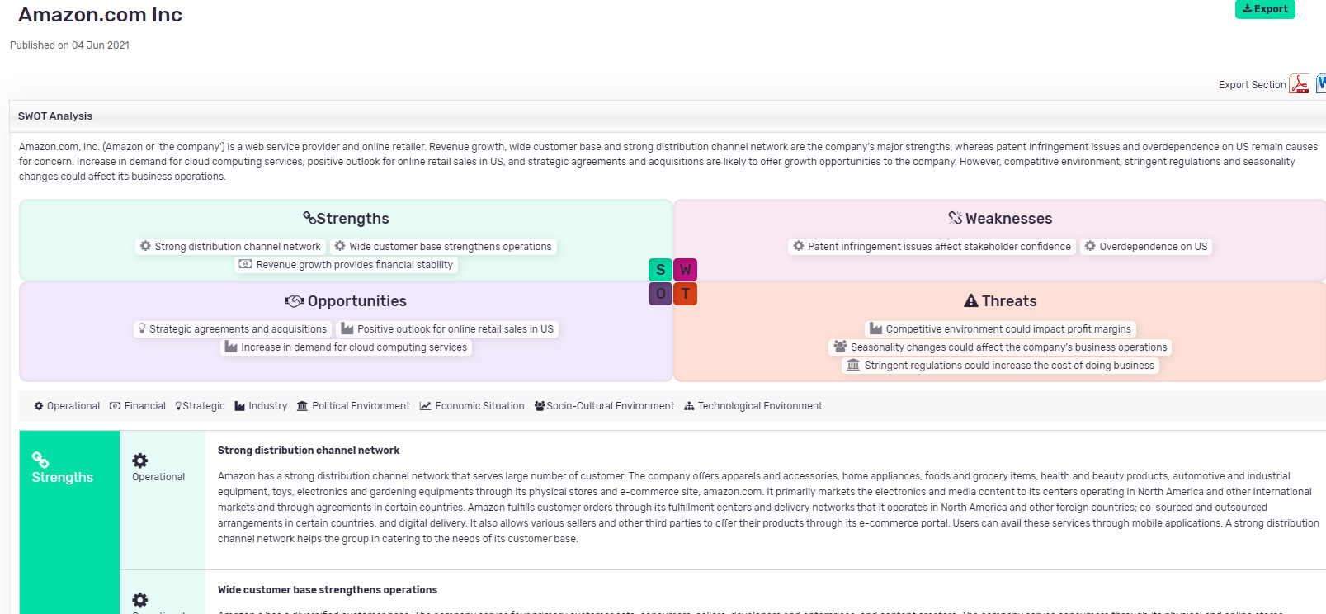
Marketline Advantage
Company – profiles (attributes and financials), case studies and pre-defined lists of companies by category (e.g. by sales and revenue)
Country – macroeconomic data including demographics, labour market, fiscal and monetary environment and country snapshots
City – statistics, profiles and chartbooks
Industry – profiles, case studies, chartbooks, statistics, data, consumer data analytics

Slide 30
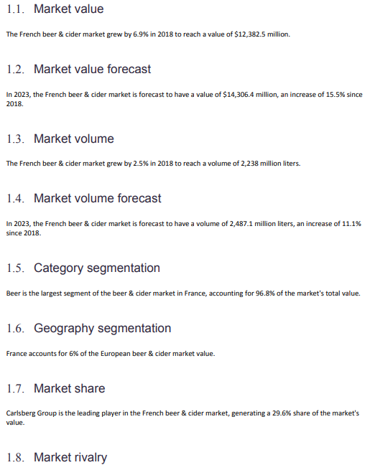
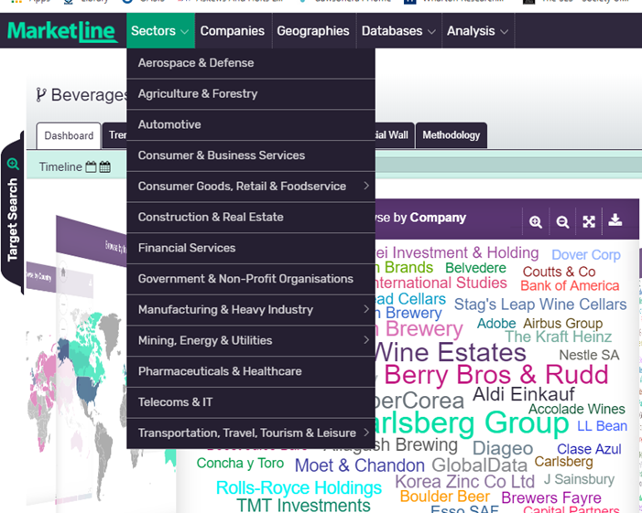
Marketline Advantage – Industry sector analysis e.g. Sectors>Consumer Goods>Alcoholic Beverages>Beer and Cider

Slide 31
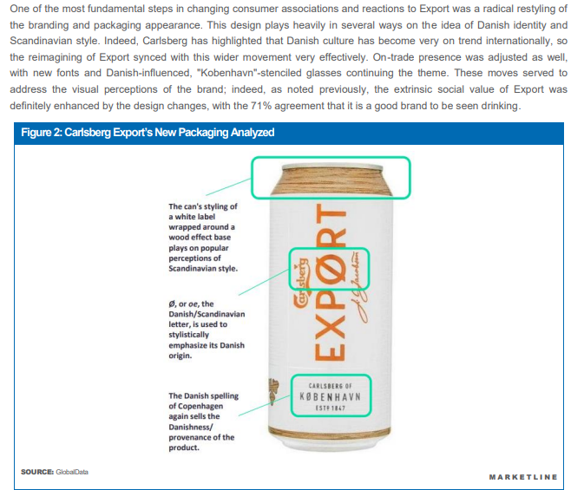
Marketline Advantage – Industry analysis - detail
Example of case study for Carlsberg who rebranded to capture the millennial market.
The company wanted to boost sales to this demographic in the UK market whom they recognised as being more discerning, valuing quality and premium craft beers.
Sectors>Consumer goods>Alcoholic beverages>Beer>Case studies.

Slide 32
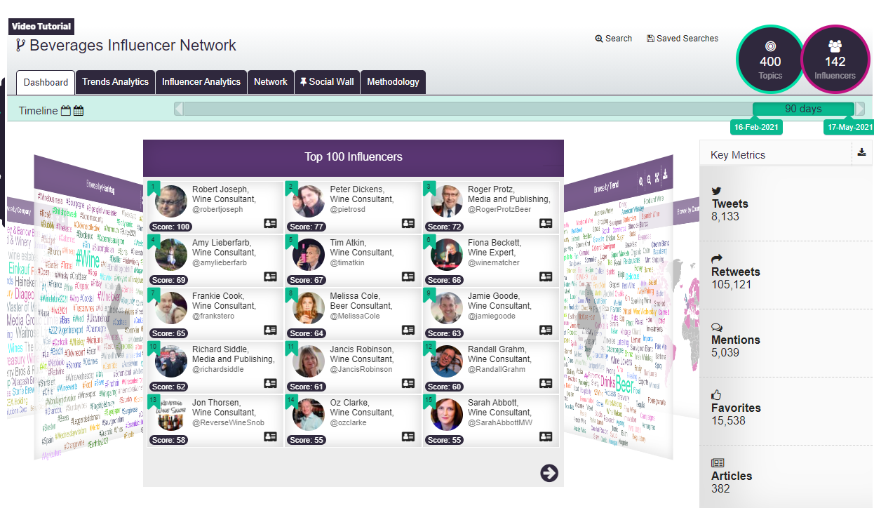
Marketline Advantage – Influencers in the beverages market

Slide 33
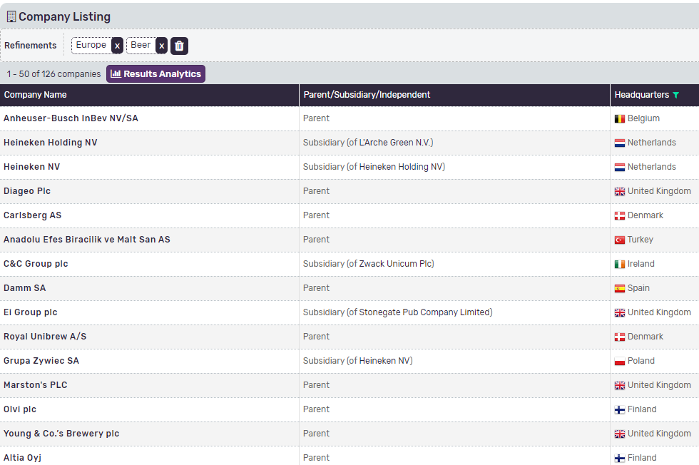
Marketline Advantage – company data
You can search for specific companies or list them by category.

Slide 34
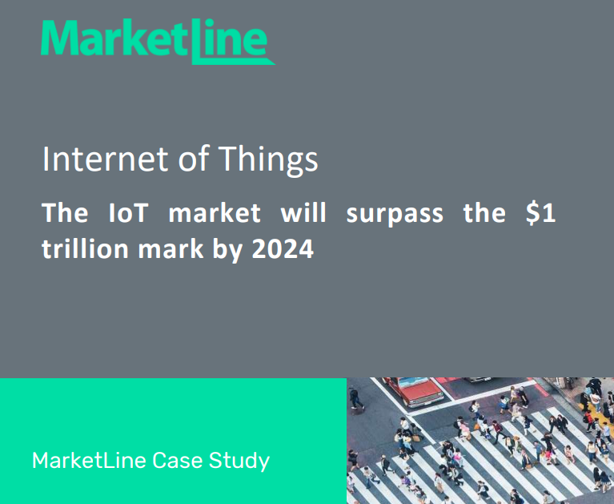
Marketline Advantage – theme reports
These give key trends in markets, specific consumer sectors and major legislative or societal priorities (e.g. Green New Deal, regulation of tech giants etc.)

Slide 35
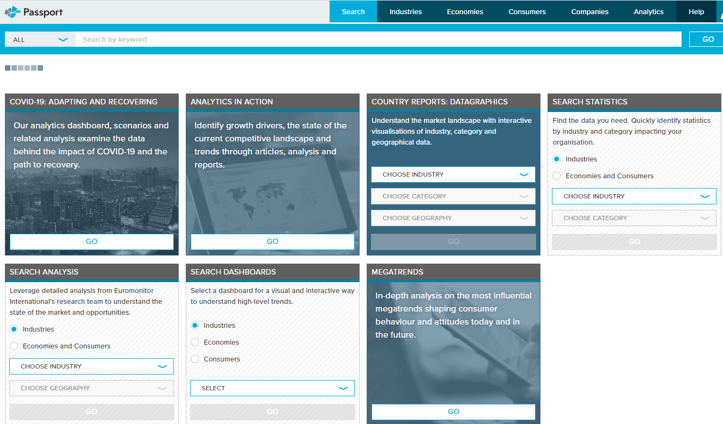
Passport (Euromonitor) – Business Dynamics
Choose Economies from the top toolbar, then Business Dynamics to see statistics, country reports, expert analysis and rank data:

Slide 36
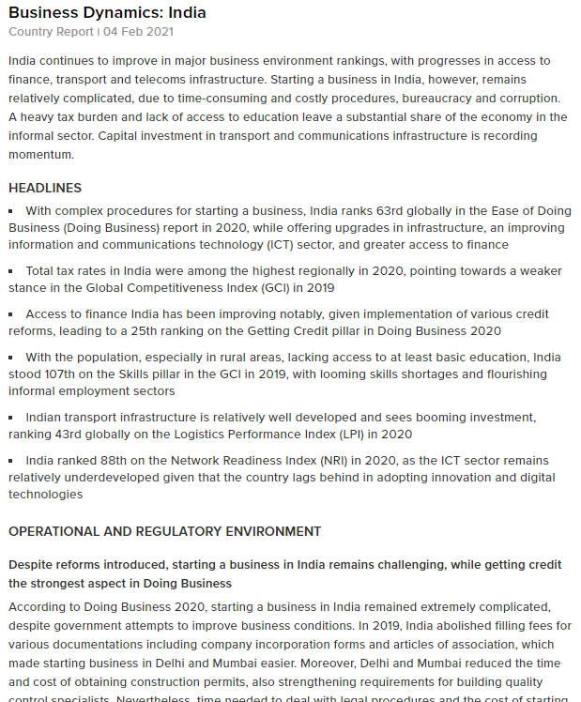
Country reports (Passport Euromonitor)
Analysis and statistics on:
Operational and regulatory environment
Financing and investment
Skills and labour
Transport and infrastructure
Digitalisation and innovation
Operational and legal environment

Slide 37
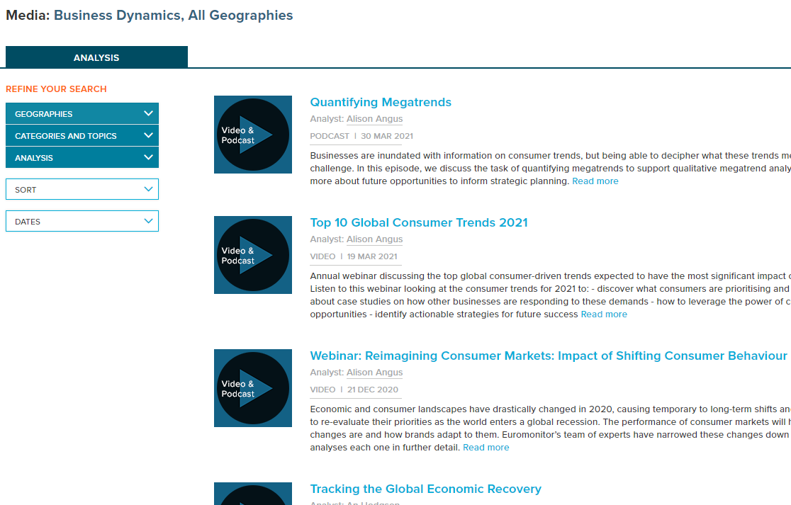
Expert analysis on Business Dynamics (Passport Euromonitor)
Videos and podcasts on:
Megatrends
Economic and consumer trends
Sustainability etc.
Filter by geography, topics and date.

Slide 38
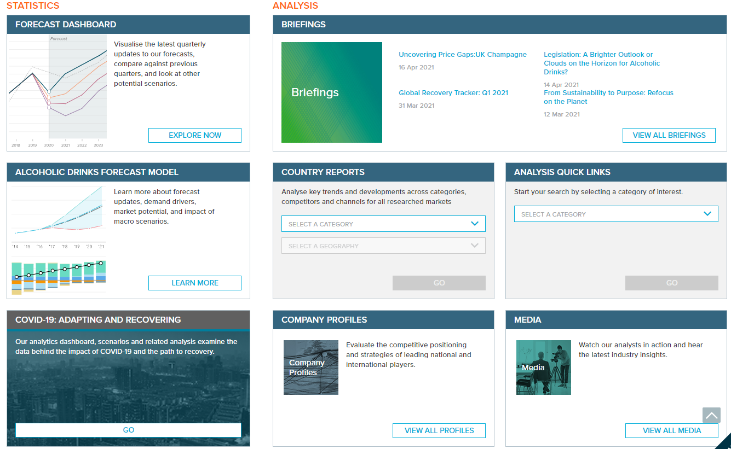
Passport (Euromonitor) – industry overviews and forecasts
Choose Industries from the top toolbar and select from the list to see statistical forecasts, analysis, company profiles, and latest research.

Slide 39
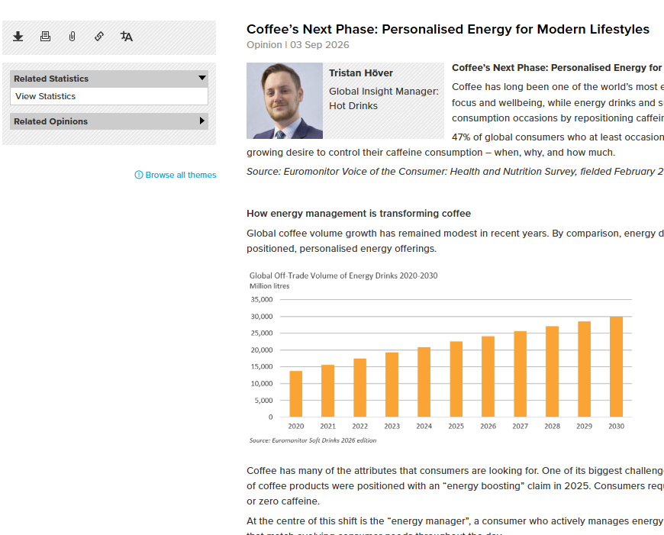
Passport - Example of an industry expert opinion/report
Includes links to other key reports and any relevant statistics.

Slide 40
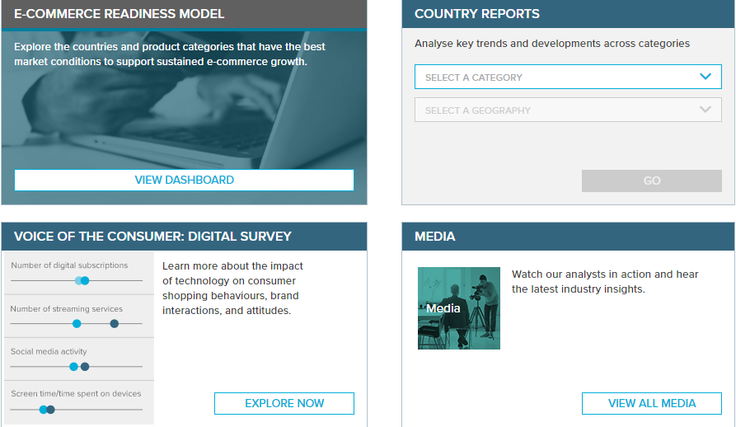
Passport – consumer data
Categories of data include statistics, analysts briefings, country reports, analyst podcasts and videos, survey data and ranking data.
Categories include:
Digital consumer – helps identify which markets are most attractive for digital commerce.
Households – global household data
Income and expenditure – consumer expenditure, population by social class, wealth index
Lifestyles – consumer habits, preferences and attitudes
Population – data by age, by location, births and deaths, migration, segmentation by generation

Slide 41
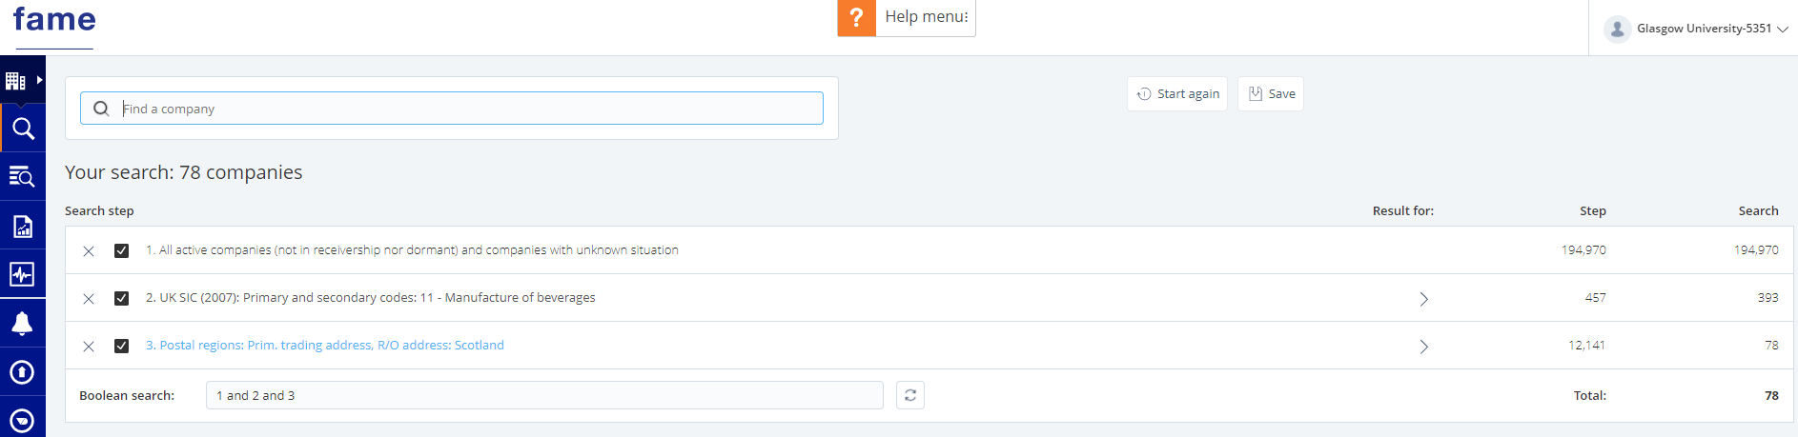
FAME (UK) and Orbis (Europe)
Use these to generate lists of companies in specific industries, and to look in detail at individual companies.

Slide 42
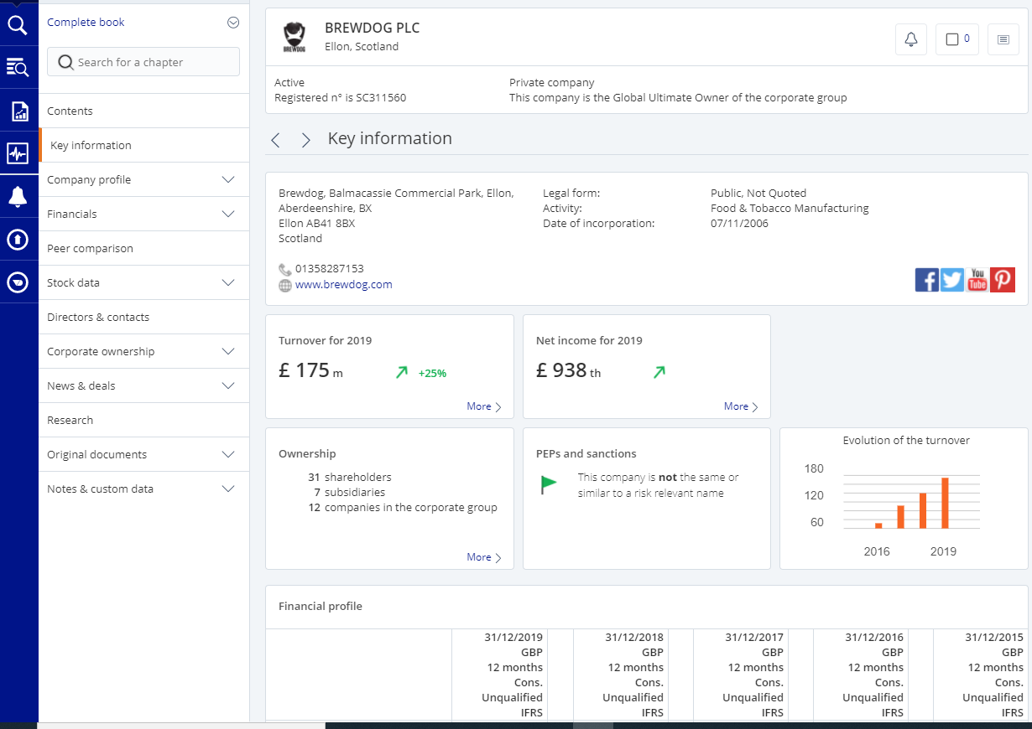
FAME (UK) – company report for Brewdog PLC

Slide 43
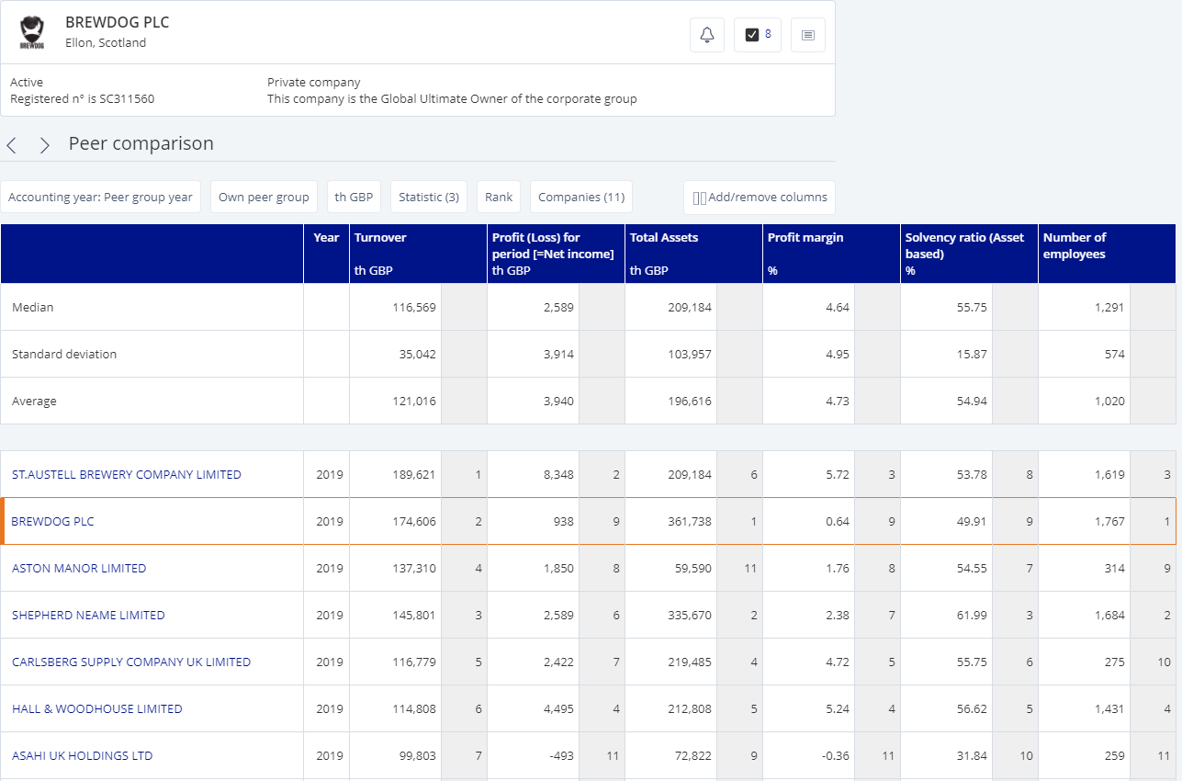
FAME (UK) – peer comparison

Slide 44
Subscription databases – LSEG Workspace and LSEG Datastream
Datastream provides access to company data on equities, equity indices, fixed income securities and associated indices, commodities, derivatives, company fundamentals from Worldscope, economics, interest rates and exchange rates.
Through Datastream you can access data from the following time periods:
Economic: 1950s onwards
Financial Markets data (equities, bonds, etc.): 1960s onwards
Company accounts: 1980s onwards
Company fundamentals - the LSEG Workspace database contains more than ten years of historic data of financial statements of quoted companies.
Global multi-asset pricing data
Analysis and commentary from Reuters business news
I/B/E/S estimates
See the entries on the Library databases pages for access information.

Slide 45

FT.com
FT.com provides access to the full online newspaper as well as in- depth analysis on the global economy, markets and industries. Read analysis from expert columnists, watch short videos and listen to regular columns as podcasts.
Country information – understand the economic, political and social forces shaping world business and filter to countries of interest.
Company and industry – company news, industry trends, financials and M&A activity for companies worldwide.
Emerging markets – breaking news on capital markets, commodities, equities, fund management and trading. See developing trends in emerging economies.
Topics and special reports – Each article is tagged with a topic so you can explore all related articles. In addition to topics, there are special reports published each month offering deep-dive information on industries and world regions

Slide 46

Sources of data – datasets in repositories
Institutional repositories
Shared repositories
Most universities support open research and have repositories for their researchers to deposit research data. Not all data is openly available, and some datasets may require ethical approval before you can access them. Each dataset will have clear guidance on access and reuse. ​
Enlighten: Research Data is the University of Glasgow's data repository. You can search by keyword or browse by author or school/college. ​
figshare – Social Science research and data collection
figshare is a repository where users can make all of their research outputs available in a citable, shareable and discoverable manner. It has many item types, including datasets of raw research data.

Slide 47
Sources of data – datasets from published literature – open access and systematic reviews
Open access datasets​
Publishers are starting to make datasets available with published journal articles. There is a requirement now for open access journal articles to include data as well as the finished article. For more recent open access publications, you should now be able to access the underlying data. Look for this on publisher pages when you are looking at an article. ​
​
The Campbell Collaboration promotes positive social and economic change through the production and use of systematic reviews and other evidence synthesis for evidence-based policy and practice.​
​
Systematic reviews collate and synthesise evidence using specific methods. Published reviews include a meta-analysis of study data. This can be a useful source of published data. Read more about systematic reviews here https://campbellcollaboration.org/​
​
All published reviews are accessible from the Campbell Systematic Reviews Journal ​

Slide 48
Some general advice
Allow enough time to get the data you need
The dataset you find may not have data in the form that you need it, so you are likely to have to fully explore it to extract the data you need​
You may need to use two or more sets of data to answer a question.
The data you want may not exist
There are large surveys that provide rich sets of data e.g. British Household Panel Survey (now Understanding Society) , British Social Attitudes, Labour Force Survey. Take some time to explore these major surveys to identify any kinds of information that you can use from them. See the Key Data in the UKDS to identify these and use the data guides for these surveys to identify what information they contain.​ Every major dataset has a description, FAQs and a list of studies that have used the datasets.
Use case studies to see what datasets researchers have used effectively in their projects​
Use the UK Data Service 'getting started' guides as some of these are applicable to all data use, not just the UKDS datasets​
Check the registration requirements, any restrictions and terms and conditions of use. These are normally clear on sites and resources.​
Cite the data that you use ​

Slide 49
Working with statistics and data
You might find this glossary of statistical terms useful https://www.statista.com/statistics-glossary//
You will also find some useful books and videos on the Sage Research Methods platform.
Books
  Coolidge, F.L. 2021, Statistics: a gentle introduction, Fourth edn, SAGE Publications, Inc, Los Angeles, CA. https://gla.on.worldcat.org/oclc/1274668117
  Rumsey, D., & Safari, an O’Reilly Media Company. (2019). Statistics Essentials For Dummies (1st edition). For Dummies. https://gla.on.worldcat.org/oclc/1118988994
Video tutorials
  Access the Sage Data Visualisation database
  Choose video/tutorials from the filter menu to see short 5-minute tutorials on working with charts and maps and using tools for data visualisations

Slide 50

Further help and support
The College Library Support Team
https://www.gla.ac.uk/myglasgow/library/help/collegesupport/ can help you to get started finding information and using library resources.
Email them for some help or to book an appointment.
Or use the generic help address library@glasgow.ac.uk and staff will answer your enquiry or refer you to specialist teams who can help.

Slide 51




This presentation is created by Lynn Allardyce Irvine under licence -
CC BY-NC-SA 4.0 Attribution-NonCommercial-ShareAlike 4.0 International
#UofGWorldChangers
@UofGlasgow

