Slide 1

Dissertation: getting started with literature searching

Slide 2

Contents
The literature review – how it contributes to planning your literature search/search strategy
How searching works – search and retrieval
Generating search terms (keywords)
Where to start…
Useful features of Library Search – value added features to help with evaluating search results
Locating previous dissertations
Photo by Danielle MacInnes on Unsplash

Slide 3
Searching is a form of strategic exploration
maintain an open mind and a critical stance
consider research as open-ended exploration and engagement with information
use research tools and indicators of authority to determine the credibility of sources
recognize that authoritative content may be packaged formally or informally and may include sources of all media types
understand the increasingly social nature of the information ecosystem where authorities actively connect with one another and sources develop over time.
persist in the face of search challenges, and know when you have enough information to complete the information task
seek multiple perspectives during information gathering and assessment;
Be flexible, methodical, patient and critical

Slide 4
The role of the literature review
The literature review is an important part of a research project, and it will give you useful knowledge to develop your research question.
The literature review will:
give you an understanding of the research in your subject area and provide the historical context
familiarise you with the language, terminology, themes, theories and arguments
help you identify relevant search terms (keywords)
raise your awareness of research methods used in your subject/field
uncover key papers and authors
give you a picture of the current areas and topics of interest
Tip: SAGE Research Methods core database has books, videos, podcasts and case studies all about doing research. You will find lots of useful information on literature reviews and other key stages of a research project.

Slide 5
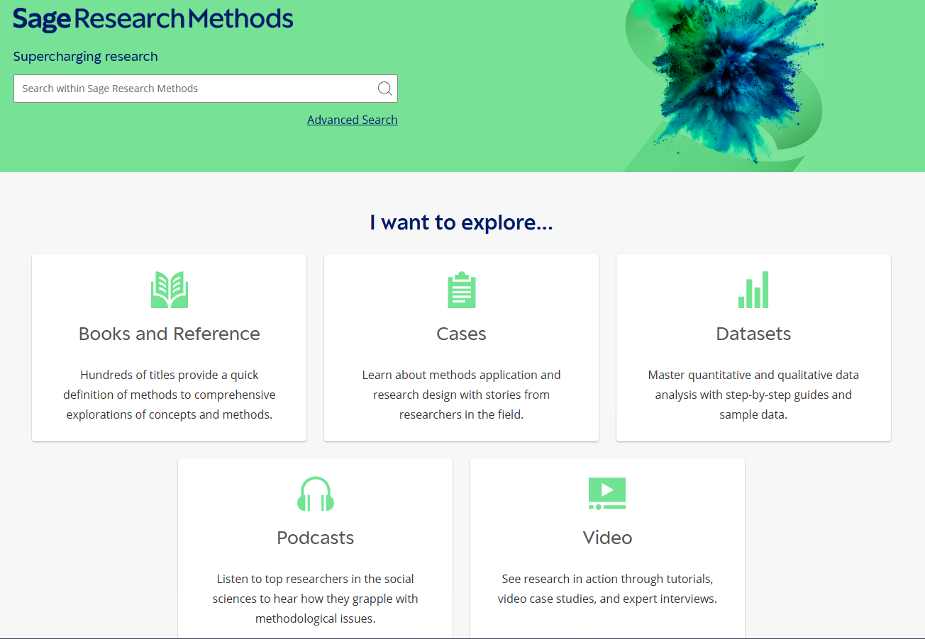
SAGE Research Methods - core
The database has books, case studies, podcasts, videos and useful tools all about research.

Slide 6
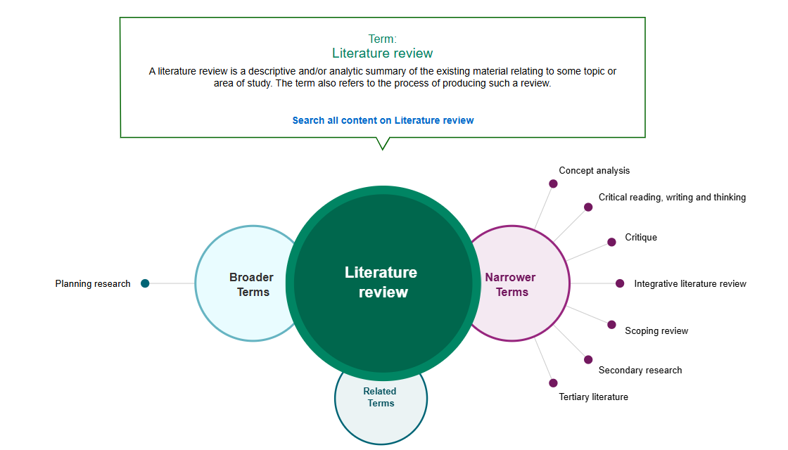
Methods Map
Shows the relationship between research terms and links to relevant content. Click on the hyperlink to see all content on that topic

Slide 7
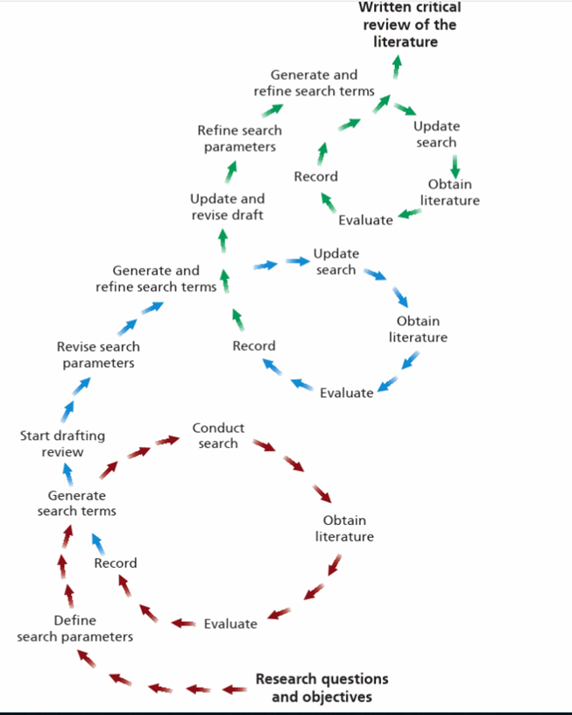
Searching is a process of strategic exploration
As Saunders (2019) diagram shows, each iteration of the search process is directional and purposive, as your knowledge of the published literature increases.
It starts with your research question and objectives which you must translate for searching : decide on the scope of your research; identify key search terms and reflect on types of information required [academic journals, trade journals, data, grey literature etc.]
Choose discovery tools and use search operators - Booleans, phrase, proximity, truncation, wildcards - to run your search.
Assess your search - are search results relevant? Do you need to change the search terms? Use a different discovery tool (search engine or database?
Evaluate results for relevance; use them to identify more search terms, including key papers and authors. Critically evaluate what you select.
Image taken from Saunders, M.N.K., Lewis, P. & Thornhill, A. 2019, Research methods for business students, Eighth edn, Pearson, Harlow, England

Slide 8
How search and retrieval works
In keyword searching, when you use a search engine or a database, searching works by matching.
Search terms are matched against indexed content. The most common search fields are:
  Author
  Title
  Abstract
  Author-supplied keywords
  Database-supplied keywords
  Subject headings
You can control how your results are retrieved by using keywords, search operators and fields.
Databases and search engine return results based on a ranking algorithm usually on term frequency, inverse term frequency (rarity) and field weighting. Title, abstract and subject fields have higher weighting so search terms in these fields rank results highly.

Slide 9
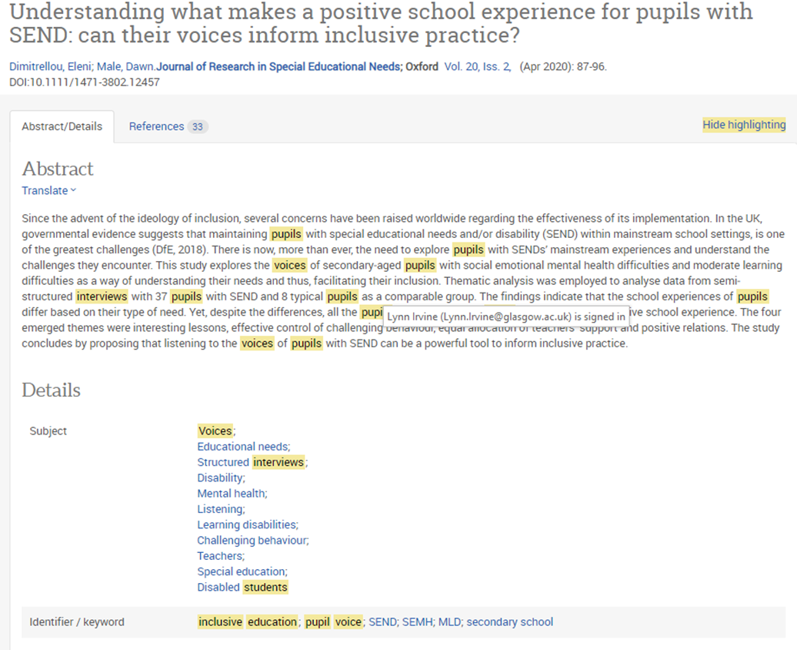
Search result showing matched search terms
In this example from Proquest, search terms are highlighted to contextualise them. This shows the terms being matched in the article abstract, keyword and subject field. This article is at the top of the results list so is ranked highly.
Relevance = term frequency + field weighting.

Slide 10

First step - what do you want to know?
An exploration of the relationship between transformational leadership, employee engagement and organisational performance.
Photo by Kind and Curious on Unsplash

Slide 11
Initial keyword table (based on concepts from your question)
An exploration of the relationship between transformational leadership, employee engagement and organisational performance.
leadership
Leader*
employee
Employee*
engagement
Engage*
Organisation behaviours
[leadership] behaviours
Transformational
Worker*
Organisation*
Success
Organi?ation

Slide 12
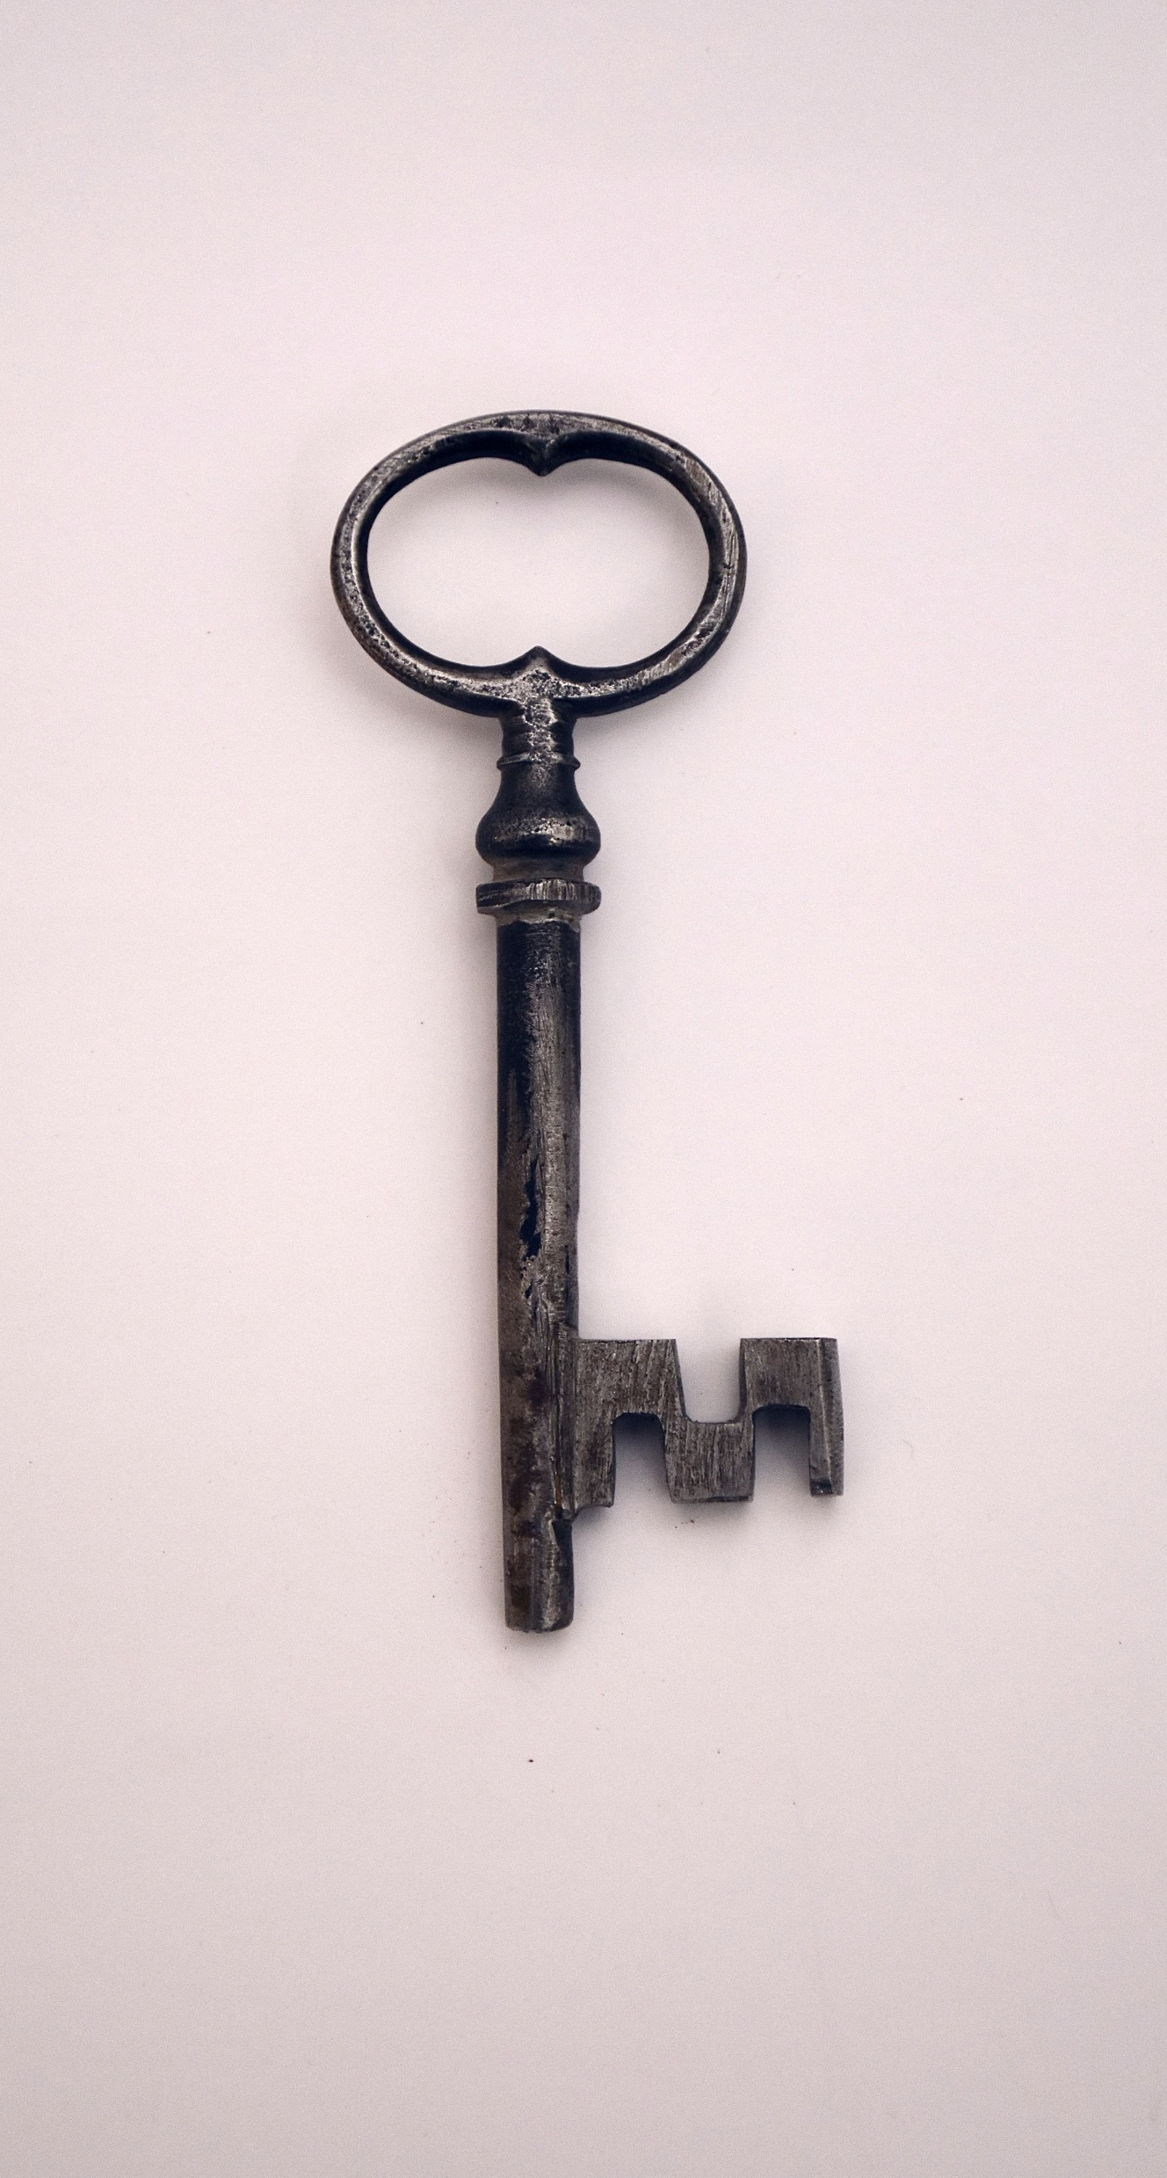
Identifying keywords from existing knowledge
Most searching is done using keywords.
Keyword searching is the process of expressing your research question or information need as keywords or search terms in a search query and matching these to the literature.
How do you identify relevant keywords?
Start with the key concepts from your initial research proposal and expand these with your existing knowledge of a subject.
Keywords may include key theories or theorists, concepts or authors you have identified in previous research or reading.
Reflect on what you already know (known knowns) and what you want to know (known unknowns) and list terms relevant to your research.
In order to maximise the comprehensiveness (sensitivity) of your search, you must consider synonyms and related terms, variant spellings, discipline-specific language, plurals, variant word endings etc.
Photo by Everyday basics on Unsplash

Slide 13
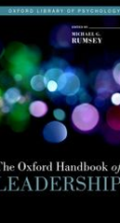
Identifying keywords from textbooks, research monographs and handbooks
You might also find it useful to generate keywords from key textbooks or research handbooks. Research Handbooks reflect the current key arguments and theories in a research area. Use the chapter headings, chapter introductions and the index to identify:
Background to research on the topic
Research trends – key concepts and theories (state of the art)
Important studies
Notable authors/experts
Sources of further information
Book records in Library Search often have a summary description of content and chapter headings for textbooks and research monographs. [Click the Preview link to open this up. ] Open the full text of ebooks to scan chapter headings and the introduction.

Slide 14
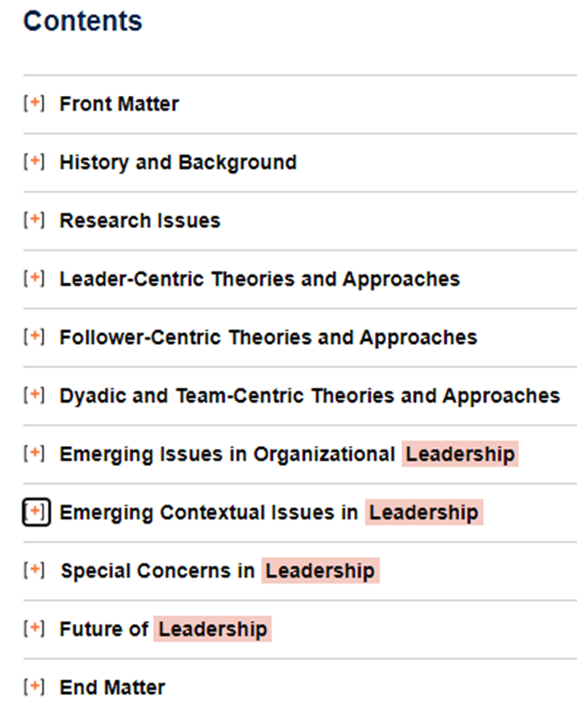
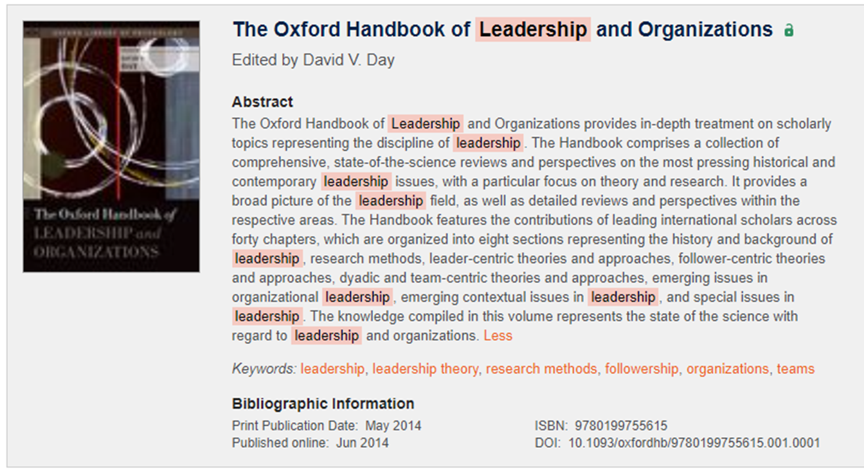
Oxford handbooks – example content page and abstract

Slide 15
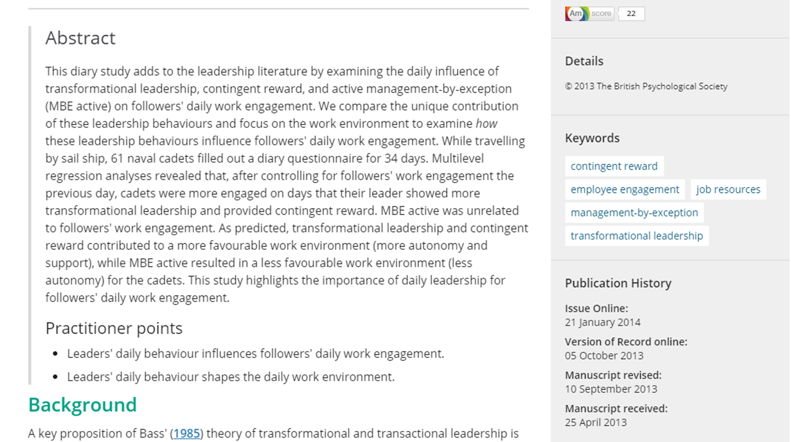
Generate keywords from journal articles – abstracts and author-supplied keywords
You might also find it useful to generate keywords from published journal articles. You can find keywords from reading the full text of the article but running a few initial searches and using the abstract and author-supplied keywords or subject headings is a good way to quickly generate lists of relevant key terms for searching. A quick scan read of the introduction can also be useful.
Breevaart, K., Bakker, A., Hetland, J., Demerouti, E., Olsen, O.K. & Espevik, R. 2014, "Daily transactional and transformational leadership and daily employee engagement", Journal of occupational and organizational psychology, vol. 87, no. 1, pp. 138-157.

Slide 16
Expanded keyword table
An exploration of the relationship between transformational leadership, employee engagement and organisational performance.
leadership
Leader*
employee
Employee*
engagement
Engage*
Intrinsic motivation
Organisation behaviours
[leadership] behaviours
Transformational
Transactional
Inspirational
Charismatic
Worker*
Workforce
Motivat*
Empower*
Inspired
Organisation*
Change
Development
Culture
Success
Extrinsic motivation
creativity
Innovation
Influential
Influence
Organi?ation

Slide 17
Structuring a search – points to consider
When you structure your search:
You may not want to include all concepts in the search. Tailor the search to the specific concept you are researching e.g. you may be doing some research on the concept of inclusive education - what does it mean? Is the term challenged or superseded in the literature? Was there another term used previously?.
Think about where you are searching in a document – are all of your concepts likely to be in the title or abstract? Do you need to search across all of the fields to find relevant literature?
Terminology – use synonyms, variant spellings, discipline-specific language, plurals, variant endings etc.
Consider searching single concepts at a time, then using different combinations to explore your topic

Slide 18
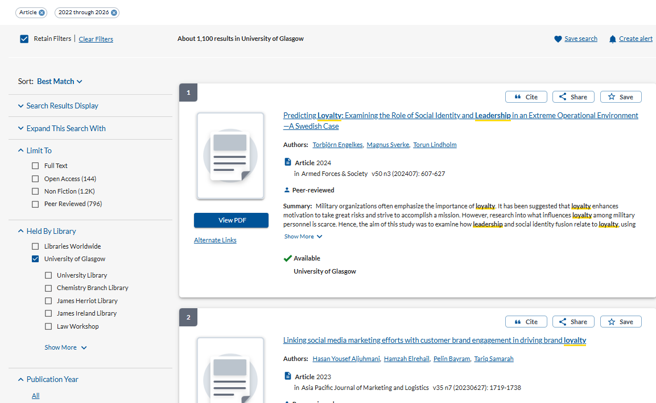
Library Search – filtering your results and linking to the full text
Use the filters on the left to easily focus your search – in this example to journal articles published in the last 5 years.
Click Show More to read the full abstract.
Click on View PDF or Alternate Links to read the full text online or download the PDF

Slide 19
Evaluating search results – skim reading for relevance
Use preview and detailed record screens to help you evaluate search results:
The abstract should help you find out a bit more about the article than you can gather from the title alone. For empirical articles you will usually get a summary of the focus of the research, methodology and conclusions.
  If you are still unsure, open the article and read the introduction and conclusion. If it looks relevant, download or mark for reading later (you can export or email marked/saved search results in Library Search and in all databases)
Look at the journal (source) title – in multidisciplinary databases you will get search results from journals across many subject areas. Journal titles will give you a sense of their scope. You may also start to notice particular journals coming up regularly in results.
Note the date of the article so that you have a sense of how recent or long ago the article was written. This does not mean that older articles are of less value (classic or seminal works are very important) but you should be aware that conclusions or arguments may have been challenged in subsequent research. Look for citing literature to get more recent, related literature.
Use search results to gather more keywords, concepts, cited works or authors that you want to add to your search strategy.

Slide 20
Use all of the useful information from your search results
Capture ideas, theories or significant reports from journal abstracts
Note key authors for further exploration of their work
Use the article references to link to/read any key works used in the article
Check for any citing literature – papers that cite the article you are reading. This will lead you to more current, potentially relevant literature
Look out for key journals that appear regularly in search results. Set up alerts for new issues of these journals. You can do this via journal websites and some databases

Slide 21

Looking for previous dissertations
The library has digitized some dissertations which are hosted in a repository. You need to use remote desktop to use the dissertation repository as it is an on-campus service. To find out how to access services using Remote Desktop see the IT information here https://www.gla.ac.uk/myglasgow/anywhere/desktop/
You can then access the dissertation repository here http://endeavour.gla.ac.uk/
You can browse past dissertations by college or school. Please note that these are representative only of the dissertations selected by schools and sent to the library; the repository does not contain all past dissertations.
Ask your department or school if they have any previous dissertations that you can read

Slide 22

In summary
Be prepared (think about what you are looking for – so you know where to look!)
Be flexible – when you explore you will find things you were not looking for; equally you may occasionally struggle to find anything at all that seems relevant. That is a normal part of research – accept it and make changes - where you look (change discovery tool) – and how you look (change your keywords or subject terms)
Be curious and bold - use different search tools
Leave enough time to explore
Be critical– is the information you find relevant to your question? If it isn’t – don’t use it
Use the information you have and know when to stop. Make full use of the information you have before looking for more.
Don’t forget to take note of where you found information (especially quotes) – you will need this information for your bibliography
Ask for help if you need it
Photo by Kelly Sikkema on Unsplash

Slide 23

Further help and support
The College Library Support Team
https://www.gla.ac.uk/myglasgow/library/help/collegesupport/ can help you to get started finding information and using library resources.
Email them for some help or to book an appointment.
Or use the generic help address library@glasgow.ac.uk and staff will answer your enquiry or refer you to specialist teams who can help.

Slide 24




This presentation is created by University of Glasgow College Librarian under licence -
CC BY-NC-SA 4.0 Attribution-NonCommercial-ShareAlike 4.0 International
#UofGWorldChangers
@UofGlasgow

